Slide 1
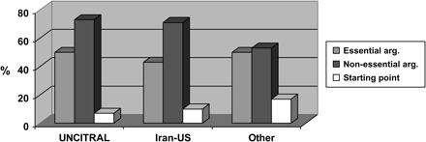
Figure 1. Case law as interpretive argument.
Notes:
Figure 1. Case law as interpretive argument.
Unless provided in the caption above, the following copyright applies to the content of this slide: The European Journal of International Law Vol. 19 no. 2 © EJIL 2008; all rights reserved

Slide 2
Figure 2. Interpretive issues clarified through references to case law.
Notes:
Figure 2. Interpretive issues clarified through references to case law.
Unless provided in the caption above, the following copyright applies to the content of this slide: The European Journal of International Law Vol. 19 no. 2 © EJIL 2008; all rights reserved

Slide 3
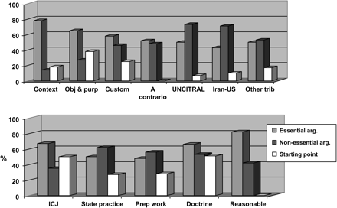
Figure 3. Use of interpretive arguments by ICSID tribunals.
Notes:
Figure 3. Use of interpretive arguments by ICSID tribunals.
Unless provided in the caption above, the following copyright applies to the content of this slide: The European Journal of International Law Vol. 19 no. 2 © EJIL 2008; all rights reserved

