Slide 1
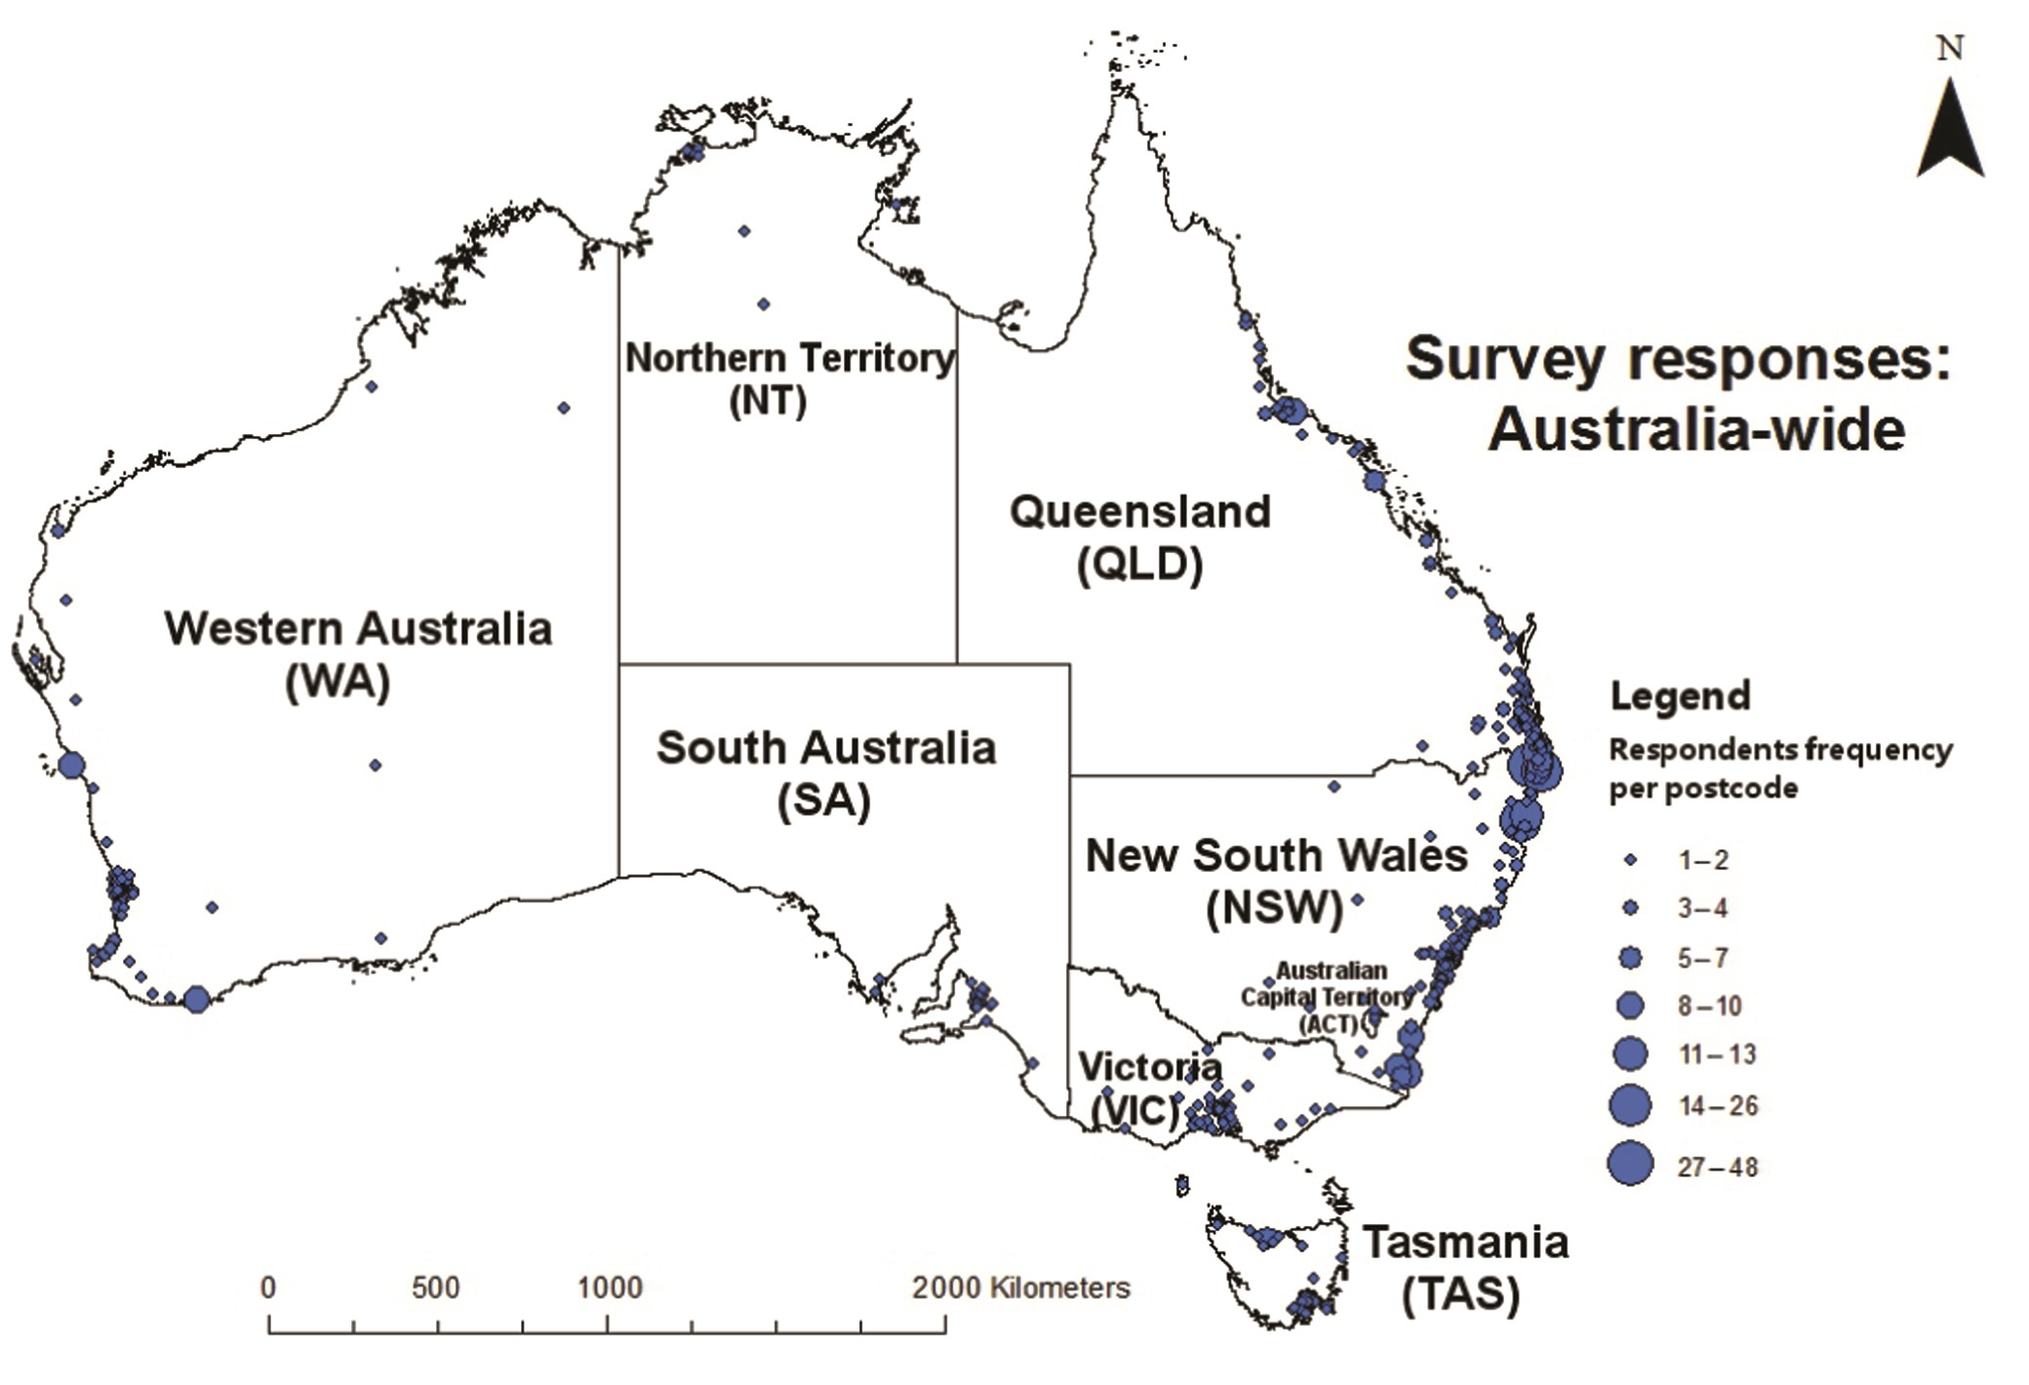
Figure 1. The locations of the survey responses.
Notes:
Figure 1. The locations of the survey responses.
Unless provided in the caption above, the following copyright applies to the content of this slide: © The Author(s) 2016. Published by Oxford University Press on behalf of the American Institute of Biological Sciences. All rights reserved. For permissions, please e-mail: journals.permissions@oup.com.

Slide 2
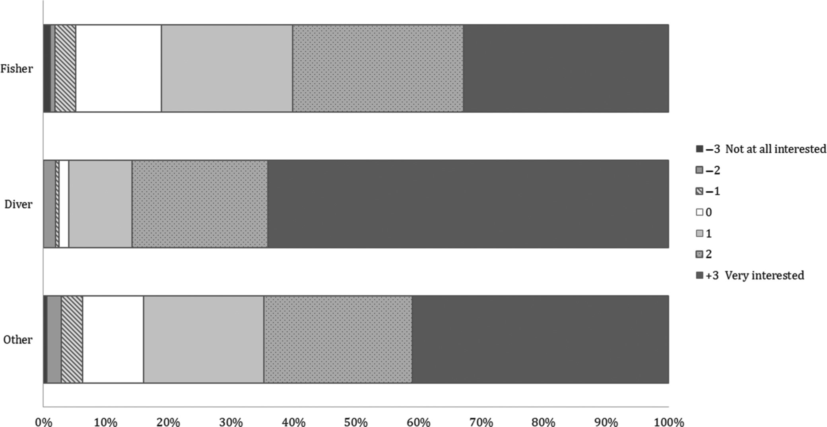
Figure 2. Interest in assisting marine research by activity group.
Notes:
Figure 2. Interest in assisting marine research by activity group.
Unless provided in the caption above, the following copyright applies to the content of this slide: © The Author(s) 2016. Published by Oxford University Press on behalf of the American Institute of Biological Sciences. All rights reserved. For permissions, please e-mail: journals.permissions@oup.com.

