Slide 1
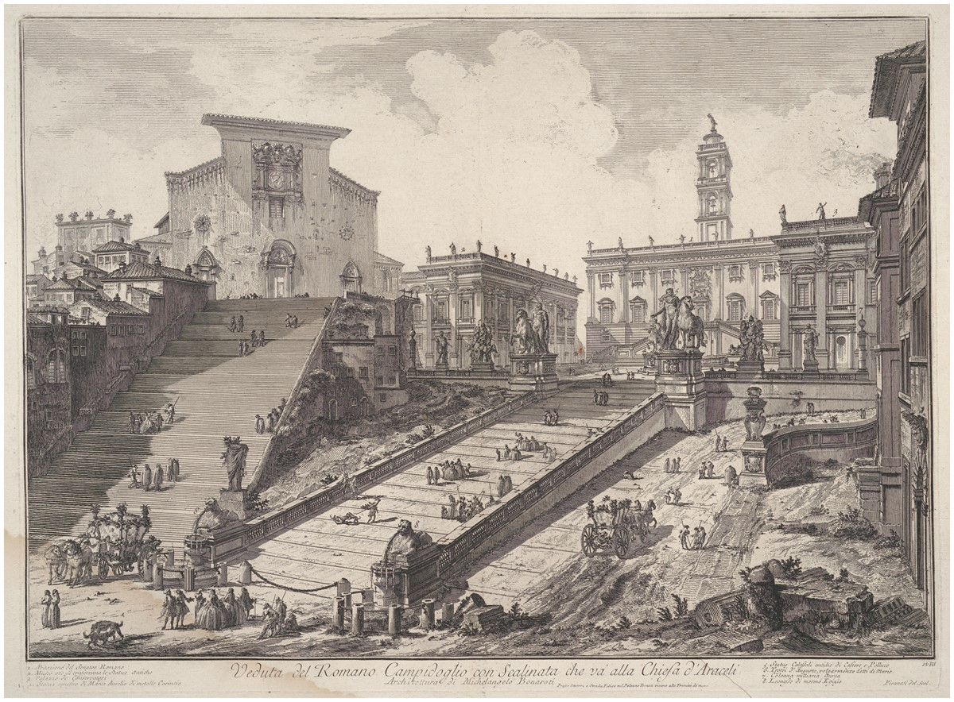
The Capitoline hill, centre of civic government in Rome, was the focus of the judicial work of the Capitoline ...
Notes:
The Capitoline hill, centre of civic government in Rome, was the focus of the judicial work of the Capitoline notaries and the site of their archive. Open Access Image from the Davison Art Centre, Wesleyan University, Middletown, Connecticut.
Unless provided in the caption above, the following copyright applies to the content of this slide: © The Past and Present Society

