Slide 1
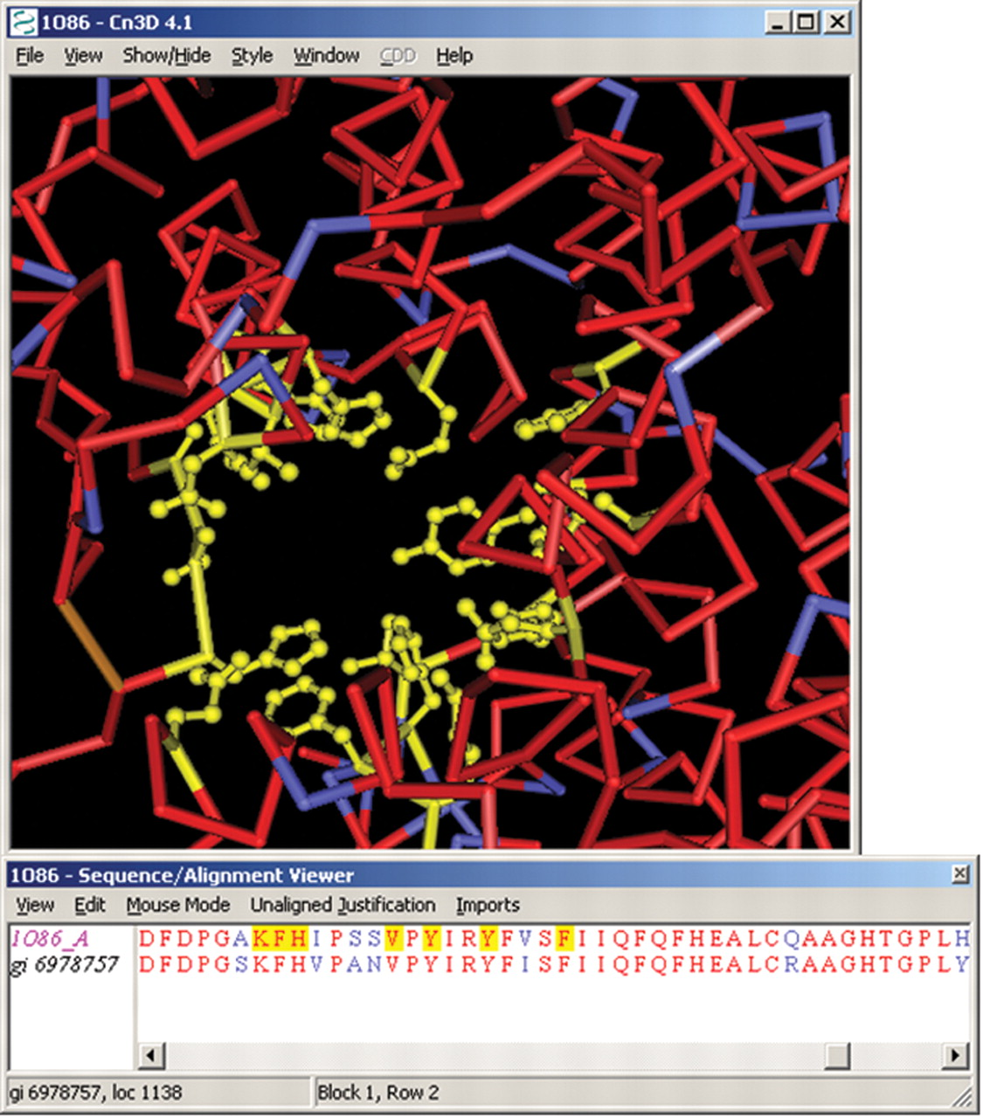
Figure 3 A Cn3D view of the query sequence from Figure 2 aligned to chain A of the related structure 1O86 (PDB code). ...
Notes:
Figure 3 A Cn3D view of the query sequence from Figure 2 aligned to chain A of the related structure 1O86 (PDB code). Residues in aligned regions are displayed in upper case letters with identical residue pairs rendered in red color. Residues within a 5 A contact radius of the bound drug lisinopril are highlighted in the 3D structure view and automatically mapped onto the aligned residues shown in the sequence alignment window. Side chains of these residues are displayed selectively and rendered as ball-and-stick models.
Unless provided in the caption above, the following copyright applies to the content of this slide: © 2006 The Author(s)This is an Open Access article distributed under the terms of the Creative Commons Attribution Non-Commercial License (http://creativecommons.org/licenses/by-nc/2.0/uk/) which permits unrestricted non-commercial use, distribution, and reproduction in any medium, provided the original work is properly cited.

Slide 2
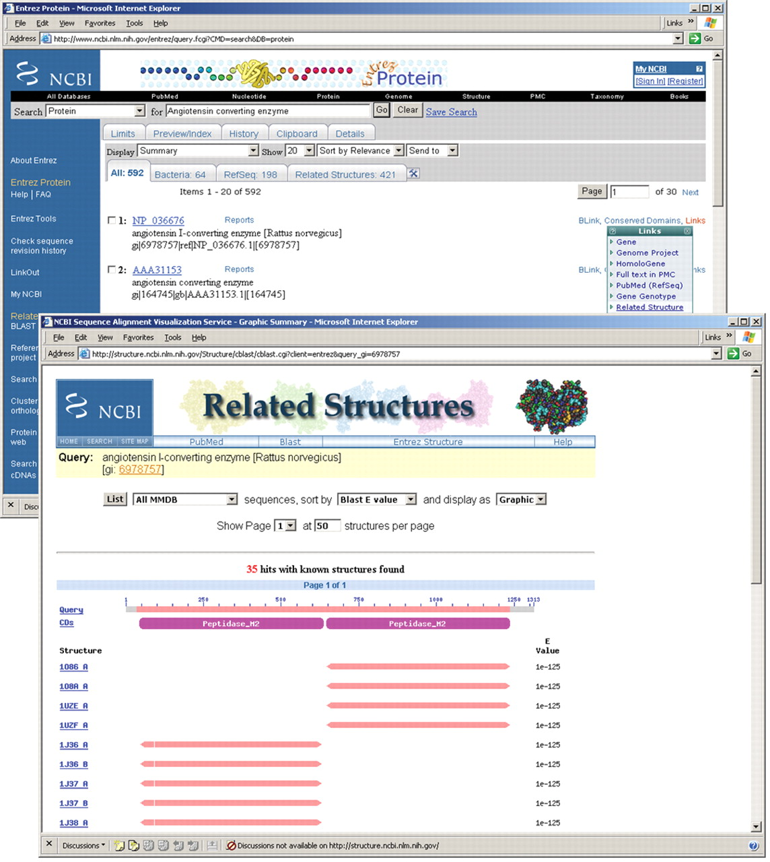
Figure 2 A screen shot of the ‘Related Structure’ summary along with Entrez's document summary for protein NP_036676. ...
Notes:
Figure 2 A screen shot of the ‘Related Structure’ summary along with Entrez's document summary for protein NP_036676. Clicking on the ‘Related Structure’ option from the ‘Links’ pull-down menu launches the summary view.
Unless provided in the caption above, the following copyright applies to the content of this slide: © 2006 The Author(s)This is an Open Access article distributed under the terms of the Creative Commons Attribution Non-Commercial License (http://creativecommons.org/licenses/by-nc/2.0/uk/) which permits unrestricted non-commercial use, distribution, and reproduction in any medium, provided the original work is properly cited.

Slide 3
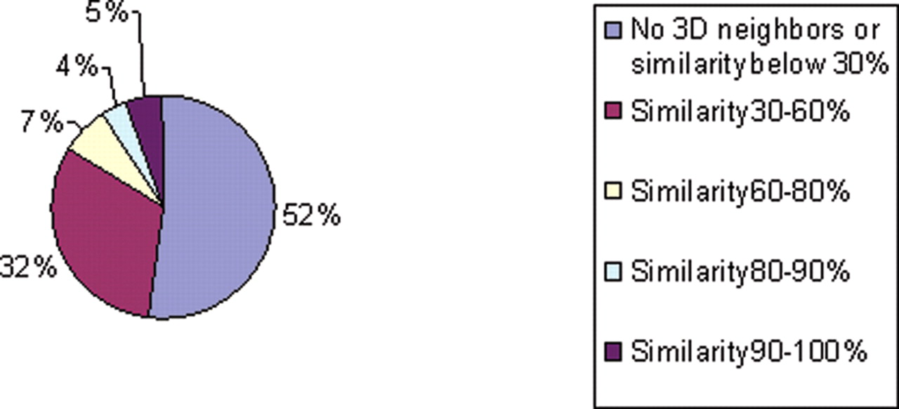
Figure 1 Non-identical protein sequences in Entrez have been classified into groups linked to related structures, at ...
Notes:
Figure 1 Non-identical protein sequences in Entrez have been classified into groups linked to related structures, at various levels of sequence similarity. Sequence identity is calculated from the BLAST alignments, and here only those neighbor relationships are listed that produce an aligned footprint of 50 residues or more. The analysis also excludes protein sequences which have been directly obtained from MMDB. Forty-eight percent of sequences in Entrez protein have at least one structure neighbor with an extensive alignment footprint and at least 30% identical residues.
Unless provided in the caption above, the following copyright applies to the content of this slide: © 2006 The Author(s)This is an Open Access article distributed under the terms of the Creative Commons Attribution Non-Commercial License (http://creativecommons.org/licenses/by-nc/2.0/uk/) which permits unrestricted non-commercial use, distribution, and reproduction in any medium, provided the original work is properly cited.

