Slide 1
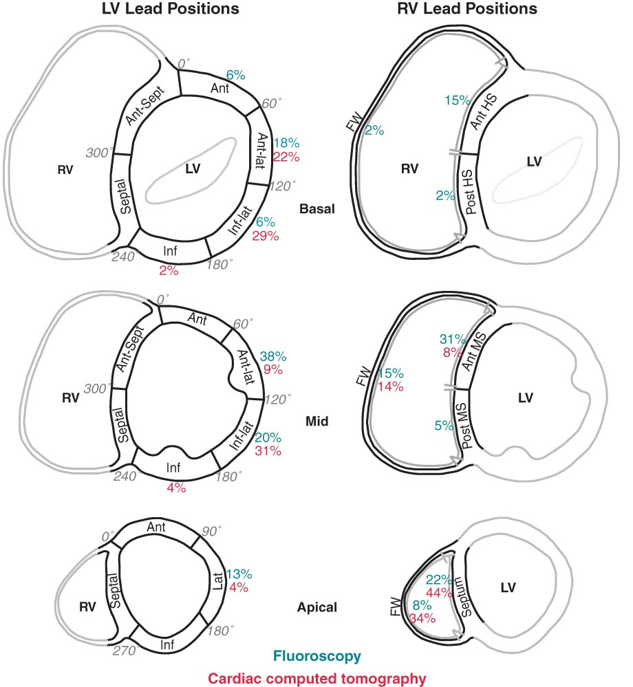
Figure 1 The standardized LV 16-segment model (left) and simplistic RV segmentation (right) used for evaluation of ...
Notes:
Figure 1 The standardized LV 16-segment model (left) and simplistic RV segmentation (right) used for evaluation of pacing lead positions. The distribution of LV and RV lead positions assessed by fluoroscopy (blue) and cardiac CT (red) is shown. Ant, anterior; Ant-lat, anterolateral; Ant-Sept, anteroseptal; FW, free wall; HS, high septum; Inf, inferior; Inf-lat, inferolateral; Lat, lateral; MS, mid septum; Post, posterior.
Unless provided in the caption above, the following copyright applies to the content of this slide: Published on behalf of the European Society of Cardiology. All rights reserved. © The Author 2014. For permissions please email: journals.permissions@oup.com.

Slide 2
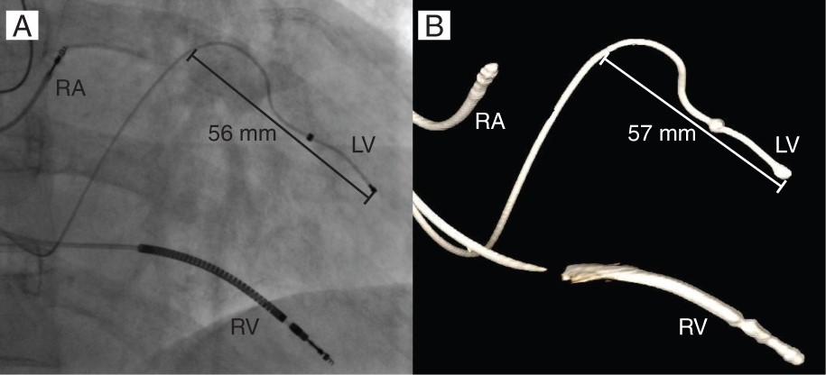
Figure 2 Evaluation of LV lead displacement during follow-up. The difference in perpendicular distance from the lead ...
Notes:
Figure 2 Evaluation of LV lead displacement during follow-up. The difference in perpendicular distance from the lead tip to the lead in the coronary sinus was measured in the procedural fluoroscopy (A) and in the 6 months follow-up cardiac CT (B) using the same RAO projection. RA, right atrial lead; LV, left ventricular lead; RV, right ventricular lead.
Unless provided in the caption above, the following copyright applies to the content of this slide: Published on behalf of the European Society of Cardiology. All rights reserved. © The Author 2014. For permissions please email: journals.permissions@oup.com.

Slide 3
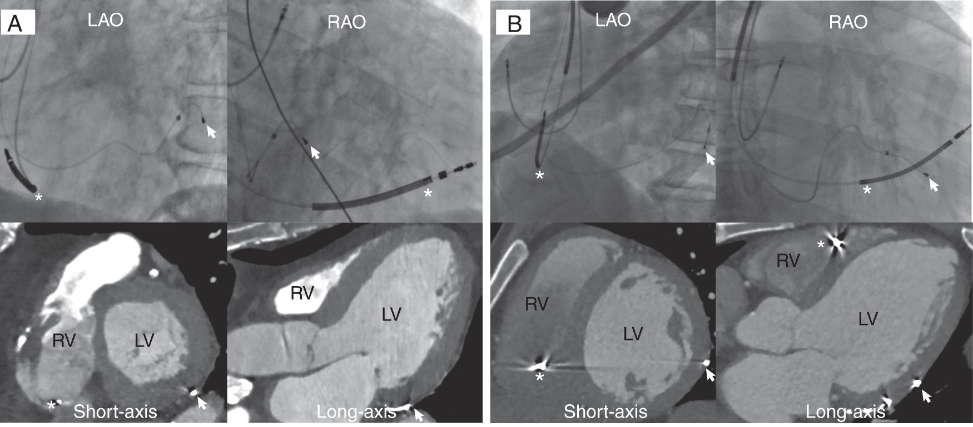
Figure 3 Examples of both disagreement (A) and agreement (B) between fluoroscopy (top) and cardiac CT (bottom) on the ...
Notes:
Figure 3 Examples of both disagreement (A) and agreement (B) between fluoroscopy (top) and cardiac CT (bottom) on the LV lead tip position (arrow). (A) Fluoroscopy showing a lateral LV lead position in the basal portion of the LV. Cardiac CT reveals a LV lead position in the posterior basal segment. (B) Fluoroscopy and cardiac CT are both showing a posterior mid-LV LV lead position. *right ventricular (RV) lead; LAO, left anterior oblique; RAO, right anterior oblique.
Unless provided in the caption above, the following copyright applies to the content of this slide: Published on behalf of the European Society of Cardiology. All rights reserved. © The Author 2014. For permissions please email: journals.permissions@oup.com.

Slide 4
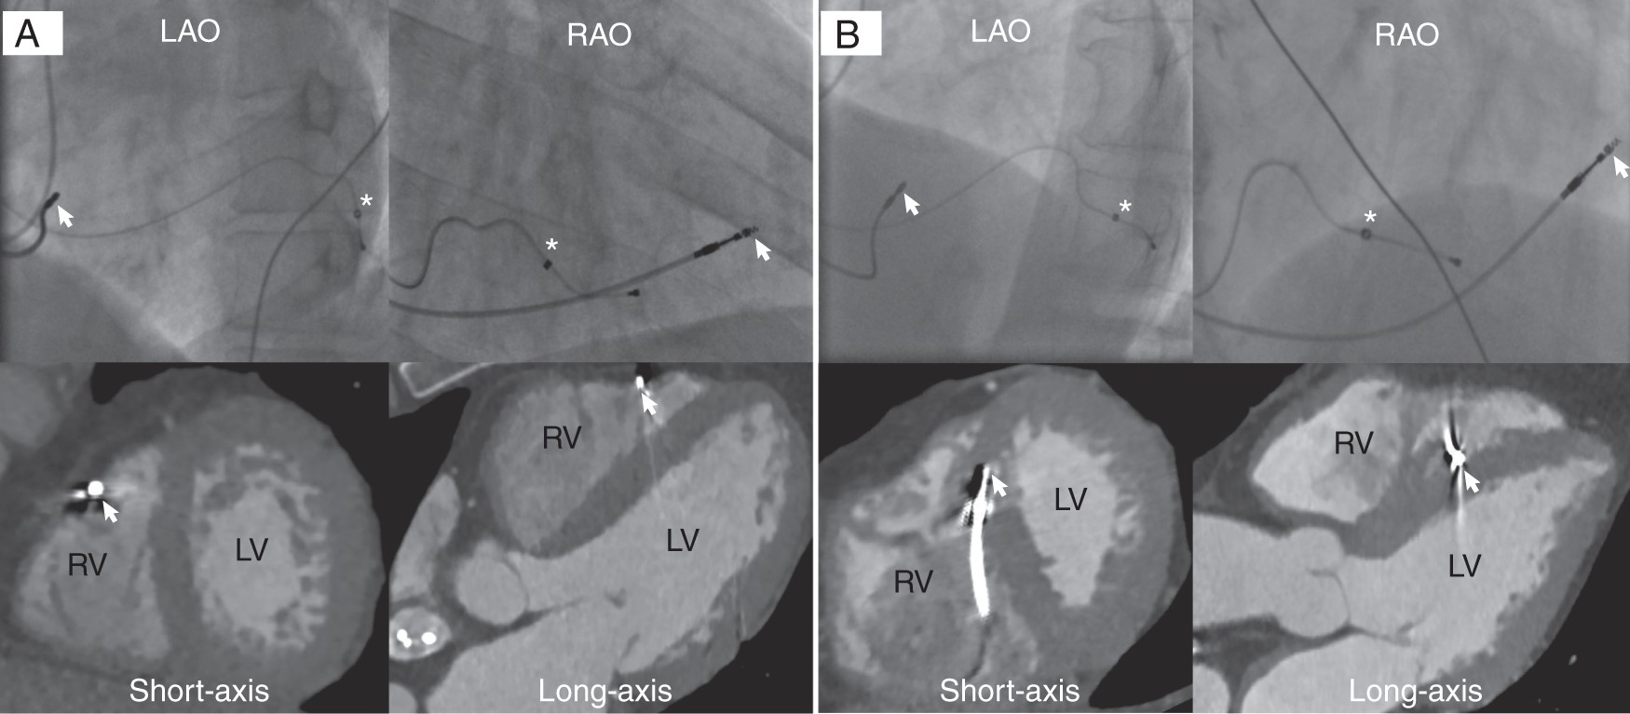
Figure 4 Examples of both disagreement (A) and agreement (B) between fluoroscopy (top) and cardiac CT (bottom) on RV ...
Notes:
Figure 4 Examples of both disagreement (A) and agreement (B) between fluoroscopy (top) and cardiac CT (bottom) on RV lead position (arrow). (A) Fluoroscopy showing an anterior mid-septal RV lead position. However, cardiac CT demonstrates a RV lead position on the apical free wall. (B) Fluoroscopy and cardiac CT are both showing an anterior mid-septal RV lead position. *LV lead; LAO, left anterior oblique; RAO, right anterior oblique.
Unless provided in the caption above, the following copyright applies to the content of this slide: Published on behalf of the European Society of Cardiology. All rights reserved. © The Author 2014. For permissions please email: journals.permissions@oup.com.

Slide 5
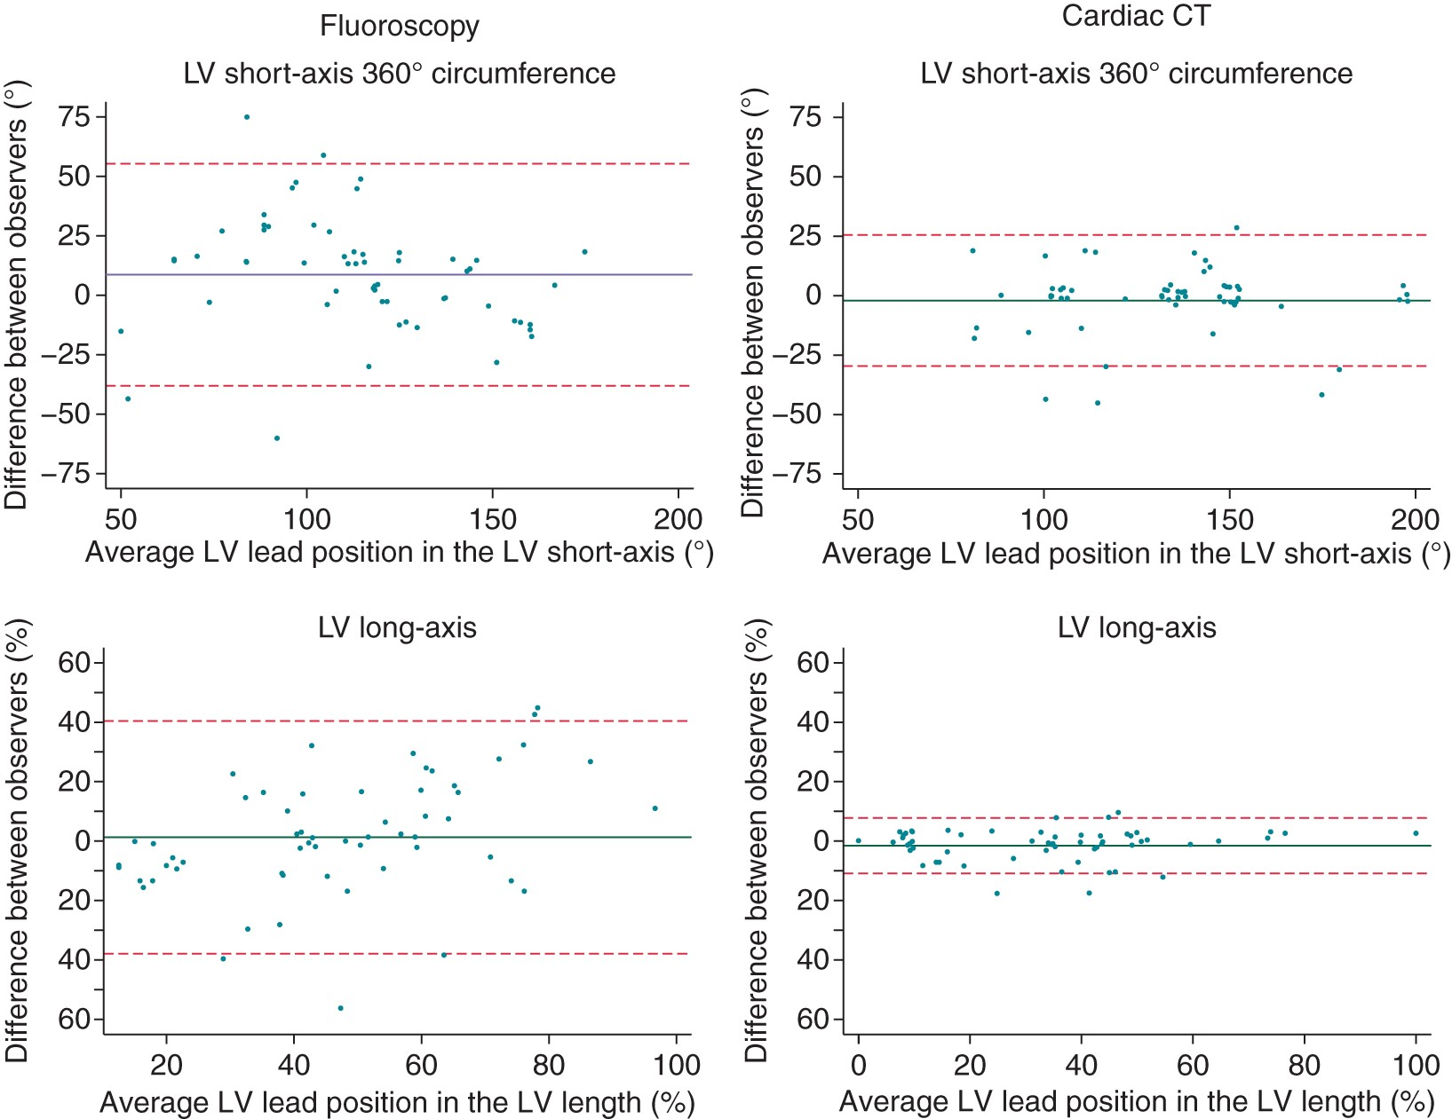
Figure 5 Bland–Altman plots comparing the interobserver agreement of fluoroscopy (left) and cardiac CT (right) when ...
Notes:
Figure 5 Bland–Altman plots comparing the interobserver agreement of fluoroscopy (left) and cardiac CT (right) when evaluating the LV lead position in the LV short-axis circumference (top) and long-axis (bottom). Cardiac CT had the narrowest limits of agreement (dotted lines).
Unless provided in the caption above, the following copyright applies to the content of this slide: Published on behalf of the European Society of Cardiology. All rights reserved. © The Author 2014. For permissions please email: journals.permissions@oup.com.

