Slide 1
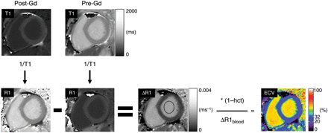
Figure 1 A flow chart describing the process of generating a composite quantitative extracellular volume fraction ...
Notes:
Figure 1 A flow chart describing the process of generating a composite quantitative extracellular volume fraction (ECV) image of a mid-ventricular short-axis slice through the left ventricle. The top row shows two quantitative T1 maps generated from Modified Look-Locker Inversion-recovery images acquired 15 min after (Post-Gd) and before (Pre-Gd) administration of a gadolinium (Gd)-based extracellular contrast agent. Both T1 maps are displayed with the same grey scale. The reciprocal of each pixel value is taken to generate R1 maps (bottom-left two images labelled R1). The Pre-Gd R1 map pixel values are subtracted from the Post-Gd R1 map to generate a ΔR1 map. The R1 maps and the ΔR1 map are all displayed with the same grey scale. In the ΔR1 map, the ΔR1 value of the left ventricular blood pool is measured in a region of interest (black oval). The ΔR1 map pixel values are then multiplied by one minus the haematocrit (hct) and divided by the mean of ΔR1 value of the blood pool (ΔR1blood) in order to get the composite extracellular volume fraction image, ranging in values between 0 and 100%. See Supplementary Data for details regarding the theoretical background behind the operations.
Unless provided in the caption above, the following copyright applies to the content of this slide: Published by Oxford University Press 2012

Slide 2
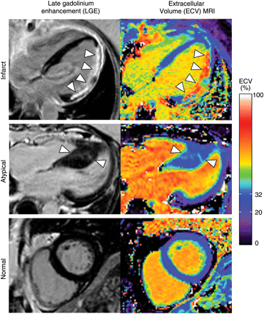
Figure 2 Late gadolinium enhancement (left) and quantitative extracellular volume fraction images (right) in a patient ...
Notes:
Figure 2 Late gadolinium enhancement (left) and quantitative extracellular volume fraction images (right) in a patient with prior myocardial infarction (Infarct) in the lateral wall (arrowheads), a patient with hypertrophic cardiomyopathy associated with atypical enhancement (Atypical) in the septum (arrowheads), and a patient with normal late gadolinium enhancement findings (Normal). Differences in extracellular volume fraction in the blood pool are attributable to differences in haematocrit. In the patient with a lateral infarct, most of the septum appears normal except a small patch of late gadolinium enhancement in the basal septum. The colour scale ranges from 0 to 100% extracellular volume. The normal range (mean ± 2 SD) of ‘normal appearing’ myocardium in our normal population is indicated in the colour scale (20–32%).
Unless provided in the caption above, the following copyright applies to the content of this slide: Published by Oxford University Press 2012

Slide 3
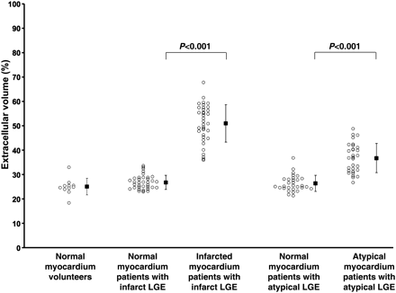
Figure 3 Extracellular volume fraction of infarcted myocardium (Infarct LGE) and regions of Atypical LGE were ...
Notes:
Figure 3 Extracellular volume fraction of infarcted myocardium (Infarct LGE) and regions of Atypical LGE were significantly higher than ‘normal appearing’ myocardium.
Unless provided in the caption above, the following copyright applies to the content of this slide: Published by Oxford University Press 2012

Slide 4
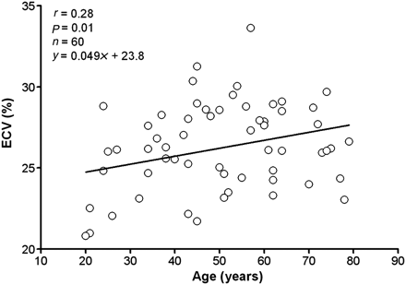
Figure 4 Extracellular volume fraction of myocardium increases as a function of age. Directionally, these findings are ...
Notes:
Figure 4 Extracellular volume fraction of myocardium increases as a function of age. Directionally, these findings are consistent with an age-related increase in diffuse fibrosis.
Unless provided in the caption above, the following copyright applies to the content of this slide: Published by Oxford University Press 2012

Slide 5
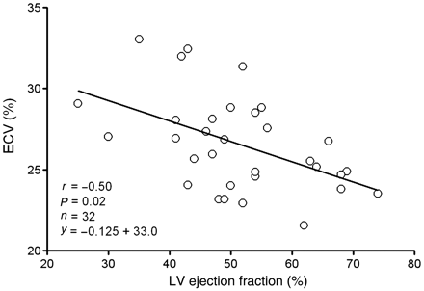
Figure 5 Extracellular volume fraction of ‘normal appearing’ myocardium is inversely related to ejection fraction in ...
Notes:
Figure 5 Extracellular volume fraction of ‘normal appearing’ myocardium is inversely related to ejection fraction in patients with myocardial infarction. These findings are consistent with adverse post-infarct remodelling in myocardium remote from infarction.
Unless provided in the caption above, the following copyright applies to the content of this slide: Published by Oxford University Press 2012

Slide 6
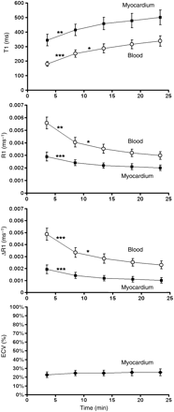
Figure 6 The relationship between T1, R1, ΔR1, and extracellular volume fraction of normal myocardium (black squares) ...
Notes:
Figure 6 The relationship between T1, R1, ΔR1, and extracellular volume fraction of normal myocardium (black squares) and blood (white circles) over time after contrast injection in healthy volunteers (n = 11). R1 is equal to 1/T1. ΔR1 is the difference between post-contrast and pre-contrast R1. ΔR1 is proportional to contrast agent concentration. Extracellular volume fraction is the extracellular volume fraction and is defined as the ratio of ΔR1 of the myocardium to ΔR1 of the blood, multiplied by one minus haematocrit. See Methods and Supplementary Data for details. Extracellular volume fraction effectively remains constant over the time period after contrast injection, indicating that the relationship between contrast agent concentration in the myocardium and in the blood is in a dynamic equilibrium. Extracellular volume fraction measurement in normal myocardium inherently compensates for renal clearance and is thus not dependent on imaging time after contrast injection. Statistical differences by analysis of variance with Bonferroni correction are denoted according to the convention: ***P < 0.001, **P < 0.01, and *P < 0.05.
Unless provided in the caption above, the following copyright applies to the content of this slide: Published by Oxford University Press 2012

