Slide 1
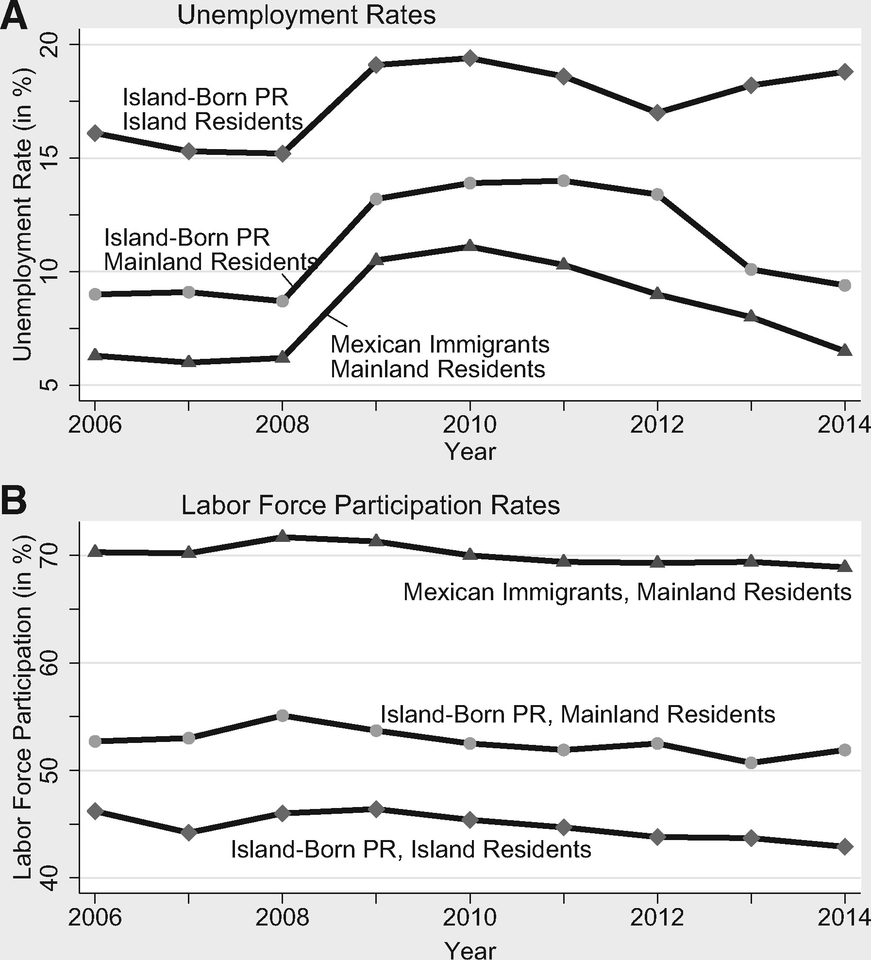
Figure 1. Unemployment and labor force participation rates of island-born Puerto Ricans and Mexican immigrants: ...
Notes:
Figure 1. Unemployment and labor force participation rates of island-born Puerto Ricans and Mexican immigrants: 2006–14. Source: Authors’ estimates using the 2006–14 ACS and PRCS in the IPUMS. Notes: Hispanic ethnicity is determined by self-identification. In the case of Mexican immigrants, only those who were born in Mexico are included. The unemployment rates are estimated for workers in the labor force ages 16 and above. The labor force participation rates are estimated for individuals ages 16 and above.
Unless provided in the caption above, the following copyright applies to the content of this slide: © The Authors 2016. Published by Oxford University Press. All rights reserved. For Permissions, please email: journals.permissions@oup.com

Slide 2
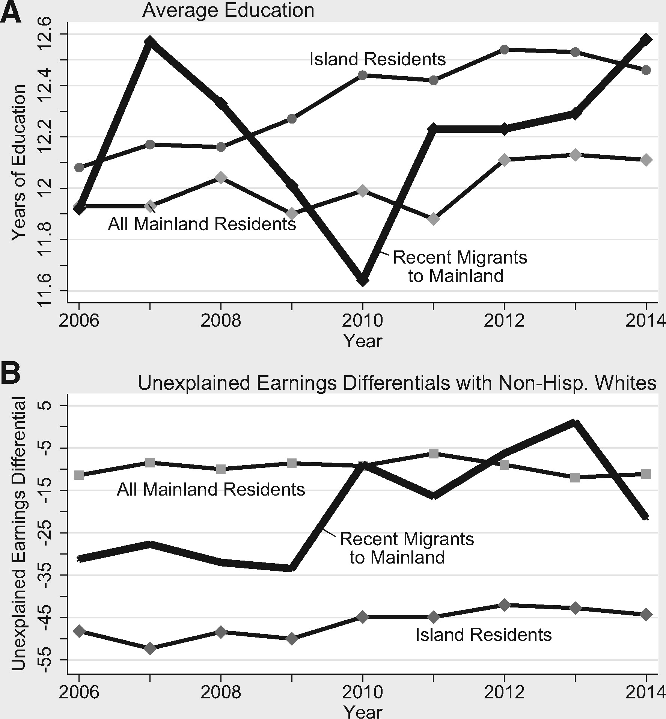
Figure 2. Average education levels and unexplained earnings differentials of island-born Puerto Ricans in the synthetic ...
Notes:
Figure 2. Average education levels and unexplained earnings differentials of island-born Puerto Ricans in the synthetic cohort, by birthplace and residence: 2006–14. Source: Authors’ estimates using the 2006–14 ACS and PRCS in the IPUMS. Notes: This synthetic cohort includes island-born Puerto Ricans who were ages 25–59 in 2006 (ages 33–67 in 2014). ‘Recent Migrants to Mainland’ include Puerto Ricans who moved from the island to the mainland within the past year.
Unless provided in the caption above, the following copyright applies to the content of this slide: © The Authors 2016. Published by Oxford University Press. All rights reserved. For Permissions, please email: journals.permissions@oup.com

