Slide 1
Figure 1 Study design.
Notes:
Figure 1 Study design.
Unless provided in the caption above, the following copyright applies to the content of this slide: © The Author (2011). Published by Oxford University Press on behalf of the Guarantors of Brain. All rights reserved. For Permissions, please email: journals.permissions@oup.com

Slide 2
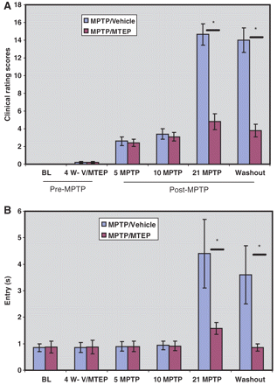
Figure 2 Histograms illustrating the progressive increase of (A) Parkinsonism rating scores and (B) food picking ...
Notes:
Figure 2 Histograms illustrating the progressive increase of (A) Parkinsonism rating scores and (B) food picking ‘entry’ time (i.e. the time between entering the apparatus and retrieval of a food object) in MPTP-treated monkeys (mean ± SD). Four weeks of vehicle (V) or MTEP (10 mg/kg) treatment (4 W-V/MTEP) did not alter behaviour. Significant motor impairments were observed in MPTP/vehicle-treated monkeys after 21 weekly MPTP injections, in the vehicle-treated group (‘21 MPTP’) and were maintained throughout the rest of the study period. *P < 0.001 for differences between the vehicle and MTEP-treated animals. No significant difference was found between control and MPTP/MTEP- treated monkeys. BL = baseline.
Unless provided in the caption above, the following copyright applies to the content of this slide: © The Author (2011). Published by Oxford University Press on behalf of the Guarantors of Brain. All rights reserved. For Permissions, please email: journals.permissions@oup.com

Slide 3
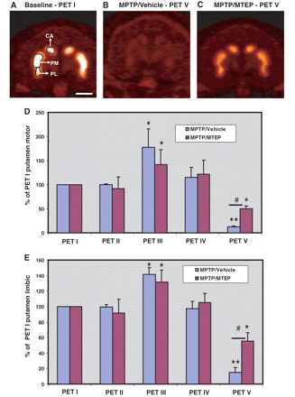
Figure 3 Representative post-commissural coronal in vivo¹⁸F-FECNT PET images. (A) Baseline, (B) ...
Notes:
Figure 3 Representative post-commissural coronal in vivo18F-FECNT PET images. (A) Baseline, (B) MPTP/vehicle, (C) MPTP/MTEP-treated monkeys. (D, E) Bar graphs showing the percentages of striatocerebellar 18F-FECNT uptake ratios (means ± SD) for the motor putamen (D) and the limbic putamen (E), obtained from the five different PET scans collected throughout the study. **P < 0.001; *P < 0.05 for differences between control, MPTP/vehicle- and MPTP/MTEP-treated animals. #P < 0.05 for differences between vehicle- and MTEP-treated animals. CA = associative caudate nucleus; PM = motor putamen; PL = limbic putamen. Scale bar = 10 mm (A–C).
Unless provided in the caption above, the following copyright applies to the content of this slide: © The Author (2011). Published by Oxford University Press on behalf of the Guarantors of Brain. All rights reserved. For Permissions, please email: journals.permissions@oup.com

Slide 4
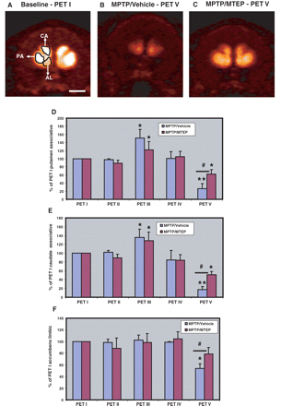
Figure 4 Representative pre-commissural coronal planes of in-vivo¹⁸F-FECNT PET images. (A) Baseline, (B) ...
Notes:
Figure 4 Representative pre-commissural coronal planes of in-vivo18F-FECNT PET images. (A) Baseline, (B) MPTP/vehicle, (C) MPTP/MTEP-treated monkeys. (D–F) Bar graphs showing the percentages of striatocerebellar 18F-FECNT uptake ratios (means ± SD) for the pre-commissural putamen (D), caudate nucleus (E) and the nucleus accumbens (F) obtained from the five PET scans throughout the study. **P < 0.001; *P < 0.05 for differences from control, MPTP/vehicle-, MPTP/MTEP-treated animals. #P < 0.05 for differences between the vehicle and MTEP-treated animals. No significant difference was found in the nucleus accumbens between control and MPTP/MTEP-treated monkeys. AL = limbic nucleus accumbens; CA = associative caudate nucleus; PA = associative putamen. Scale bar = 10 mm (A–C).
Unless provided in the caption above, the following copyright applies to the content of this slide: © The Author (2011). Published by Oxford University Press on behalf of the Guarantors of Brain. All rights reserved. For Permissions, please email: journals.permissions@oup.com

Slide 5
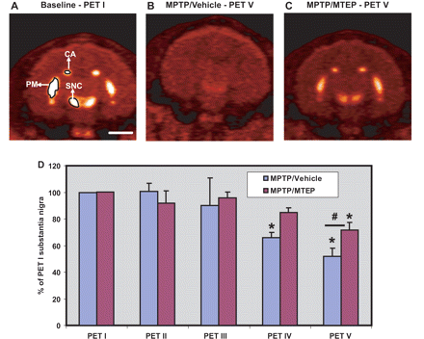
Figure 5 Representative midbrain coronal in-vivo¹⁸F-FECNT PET images. (A) Baseline, (B) MPTP/vehicle, (C) ...
Notes:
Figure 5 Representative midbrain coronal in-vivo18F-FECNT PET images. (A) Baseline, (B) MPTP/vehicle, (C) MPTP/MTEP-treated monkeys. (D) Bar graph showing the percentage of nigrocerebellar 18F-FECNT uptake ratios (means ± SD) for the substantia nigra pars compacta obtained from the five PET scans throughout the study. *P < 0.05 for differences from control, MPTP/vehicle, MPTP/MTEP-treated animals. #P < 0.05 for differences between the vehicle and MTEP-treated animals. CA = associative caudate nucleus; PM = motor putamen; SNC = substantia nigra pars compacta. Scale bar = 10 mm (A–C).
Unless provided in the caption above, the following copyright applies to the content of this slide: © The Author (2011). Published by Oxford University Press on behalf of the Guarantors of Brain. All rights reserved. For Permissions, please email: journals.permissions@oup.com

Slide 6
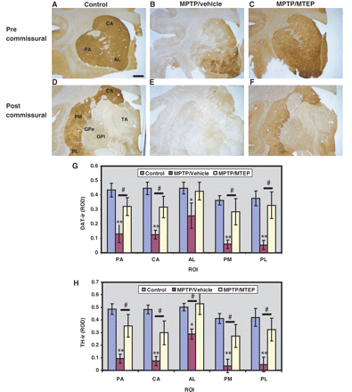
Figure 6 Representative coronal sections of pre-commissural (A–C) and post-commissural (D–F) striatum showing dopamine ...
Notes:
Figure 6 Representative coronal sections of pre-commissural (A–C) and post-commissural (D–F) striatum showing dopamine transporter (DAT) immunoreactivity in Controls, MPTP/vehicle and MPTP/MTEP-treated monkeys. (G–H) Densitometry analysis of control, MPTP/vehicle and MPTP/MTEP-treated monkeys. *P < 0.001 and **P < 0.05 for differences between control and MPTP/vehicle-treated monkeys. #P < 0.05 for differences between the vehicle and MTEP-treated animals. No significant difference was found between control and MPTP/MTEP-treated monkeys. AL = limbic nucleus accumbens; CA = associative caudate nucleus; GPe = external pallidal segment; GPi = internal pallidal segment; PA = associative putamen; PL = limbic putamen; PM = motor putamen; ROD = relative optical density; ROI = region of interest; TA = thalamus; TH-ir = thyrosine hydroxylase immunoreactivity. Scale bar = 5 mm (A–F).
Unless provided in the caption above, the following copyright applies to the content of this slide: © The Author (2011). Published by Oxford University Press on behalf of the Guarantors of Brain. All rights reserved. For Permissions, please email: journals.permissions@oup.com

Slide 7
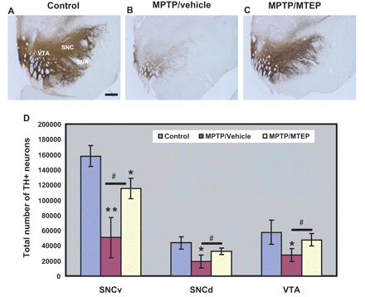
Figure 7 Photomicrographs showing tyrosine hydroxylase labelling in the mesencephalon. (A) Control, (B) MPTP/vehicle, ...
Notes:
Figure 7 Photomicrographs showing tyrosine hydroxylase labelling in the mesencephalon. (A) Control, (B) MPTP/vehicle, (C) MPTP/MTEP-treated monkeys. (D) Stereological estimate of the total number of tyrosine hydroxylase-positive (TH+) neurons (means ± SD) in the ventral substantia nigra pars compacta, dorsal substantia nigra pars compacta and ventral tegmental area regions of control, MPTP/vehicle and MPTP/MTEP-treated monkeys. *P < 0.001; **P < 0.05 for differences between control, MPTP/vehicle and MPTP/MTEP-treated animals by using one-way ANOVA with Tukey’s post hoc test. There was no significant difference found in the dorsal substantia nigra pars compacta and ventral tegmental area between control and MPTP/MTEP-treated monkeys. SNCd = dorsal substantia nigra compacta; SNCv = ventral substantia nigra compacta; SNR = substantia nigra pars reticulata; VTA = ventral tegmental area. Scale bar = 5 mm (A–C).
Unless provided in the caption above, the following copyright applies to the content of this slide: © The Author (2011). Published by Oxford University Press on behalf of the Guarantors of Brain. All rights reserved. For Permissions, please email: journals.permissions@oup.com

Slide 8
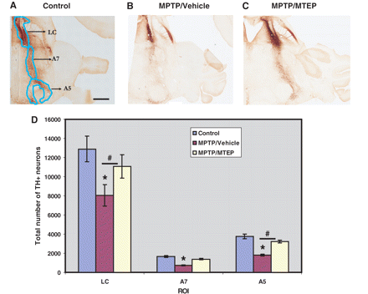
Figure 8 Tyrosine hydroxylase labelling in noradrenergic cells groups. (A) Control, (B) MPTP/vehicle, (C) ...
Notes:
Figure 8 Tyrosine hydroxylase labelling in noradrenergic cells groups. (A) Control, (B) MPTP/vehicle, (C) MPTP/MTEP-treated monkeys. (D) Stereological estimate of the total number of tyrosine hydroxylase-positive (TH+) neurons (means ± SD) in locus coeruleus, A5 and A7 regions of control, MPTP/vehicle and MPTP/MTEP-treated monkeys, representing noradrenergic neurons. *P < 0.05 for differences between control, MPTP/vehicle- and MPTP/MTEP-treated animals. #P < 0.05 for differences between the vehicle and MTEP-treated animals. LC = locus coeruleus; A5 and A7 = catecholaminergic areas A5 and A7; ROI = region of interest. Scale bar = 5 mm (A–C).
Unless provided in the caption above, the following copyright applies to the content of this slide: © The Author (2011). Published by Oxford University Press on behalf of the Guarantors of Brain. All rights reserved. For Permissions, please email: journals.permissions@oup.com

