Slide 1
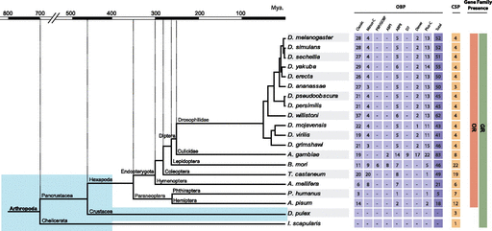
FIG. 1.— Accepted tree topology for the Arthropoda species surveyed. Blue shadowed boxes depict an aquatic ...
Notes:
FIG. 1.— Accepted tree topology for the Arthropoda species surveyed. Blue shadowed boxes depict an aquatic environment. Divergence times are given in millions of years (Tamura et al. 2004; Hedges et al. 2006). Right: number of members of the OBP and CSP gene families classified into subfamilies and the presence of the OR and GR gene families.
Unless provided in the caption above, the following copyright applies to the content of this slide: © The Author(s) 2011. Published by Oxford University Press on behalf of the Society for Molecular Biology and Evolution.This is an Open Access article distributed under the terms of the Creative Commons Attribution Non-Commercial License (http://creativecommons.org/licenses/by-nc/2.5), which permits unrestricted non-commercial use, distribution, and reproduction in any medium, provided the original work is properly cited.

Slide 2
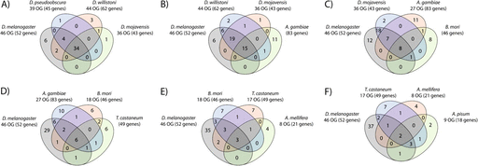
FIG. 2.— OBP orthologous groups shared across species. Venn diagrams indicate the inferred number of groups of ...
Notes:
FIG. 2.— OBP orthologous groups shared across species. Venn diagrams indicate the inferred number of groups of orthologous genes (OG) shared among different insect species. (A) Drosophila, (B) Diptera, (C) Diptera and Lepidoptera, (D) Diptera, Lepidoptera, and Coleoptera, (E) Endopterygota, and (F) Hexapoda.
Unless provided in the caption above, the following copyright applies to the content of this slide: © The Author(s) 2011. Published by Oxford University Press on behalf of the Society for Molecular Biology and Evolution.This is an Open Access article distributed under the terms of the Creative Commons Attribution Non-Commercial License (http://creativecommons.org/licenses/by-nc/2.5), which permits unrestricted non-commercial use, distribution, and reproduction in any medium, provided the original work is properly cited.

Slide 3
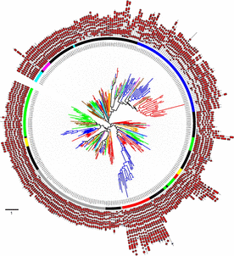
FIG. 3.— Phylogenetic relationships of the OBP proteins. Unrooted phylogenetic tree of OBP protein sequences from ...
Notes:
FIG. 3.— Phylogenetic relationships of the OBP proteins. Unrooted phylogenetic tree of OBP protein sequences from Drosophila melanogaster and D. mojavensis (red branches), Anopheles gambiae (blue branches), Bombyx mori (brown branches), Tribolium castaneum (green branches), Apis mellifera (orange branches), Pediculus humanus (pink branches), and Acyrthosyphon pisum (cyan branches). Inner and outer rings indicate phylogenetic subfamilies (Classic in black, Minus-C in green, Plus-C in blue, Dimer in red, D7 in yellow, ABPI in cyan, ABPII in gray, and PBP/GOBP in pink) and the secondary structure information (box: α-helix; arrow: β-sheet), respectively. The scale bar represents 1 amino acid substitution per site. The image was created using the iTOL web server (Letunic and Bork 2007).
Unless provided in the caption above, the following copyright applies to the content of this slide: © The Author(s) 2011. Published by Oxford University Press on behalf of the Society for Molecular Biology and Evolution.This is an Open Access article distributed under the terms of the Creative Commons Attribution Non-Commercial License (http://creativecommons.org/licenses/by-nc/2.5), which permits unrestricted non-commercial use, distribution, and reproduction in any medium, provided the original work is properly cited.

Slide 4
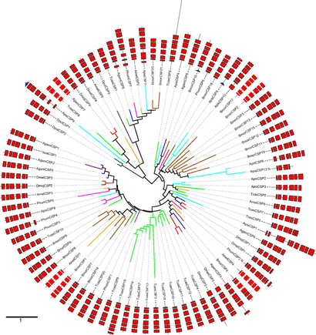
FIG. 4.— Phylogenetic relationships of the CSP proteins. Unrooted phylogenetic tree of CSP protein sequences from ...
Notes:
FIG. 4.— Phylogenetic relationships of the CSP proteins. Unrooted phylogenetic tree of CSP protein sequences from Drosophila melanogaster and D. mojavensis (red branches), Anopheles gambiae (blue branches), Bombyx mori (brown branches), Tribolium castaneum (green branches), Apis mellifera (orange branches), Pediculus humanus (pink branches), Acyrthosyphon pisum (cyan branches), and Daphnia pulex (black lines). Outer ring indicates the secondary structure information (box: α-helix; arrow: β-sheet). The scale bar represents 1 amino acid substitution per site. The tree was displayed using the iTOL web server (Letunic and Bork 2007).
Unless provided in the caption above, the following copyright applies to the content of this slide: © The Author(s) 2011. Published by Oxford University Press on behalf of the Society for Molecular Biology and Evolution.This is an Open Access article distributed under the terms of the Creative Commons Attribution Non-Commercial License (http://creativecommons.org/licenses/by-nc/2.5), which permits unrestricted non-commercial use, distribution, and reproduction in any medium, provided the original work is properly cited.

Slide 5
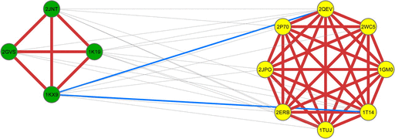
FIG. 5.— Tertiary structure alignments. Representation of the significant alignments between OBP and CSP structures. ...
Notes:
FIG. 5.— Tertiary structure alignments. Representation of the significant alignments between OBP and CSP structures. PDB protein structures are represented as nodes in yellow (OBP) and green (CSP). Significant alignments are depicted as edges between nodes; edge thickness and color range (ranging from gray, blue to red) indicate increasing significance levels.
Unless provided in the caption above, the following copyright applies to the content of this slide: © The Author(s) 2011. Published by Oxford University Press on behalf of the Society for Molecular Biology and Evolution.This is an Open Access article distributed under the terms of the Creative Commons Attribution Non-Commercial License (http://creativecommons.org/licenses/by-nc/2.5), which permits unrestricted non-commercial use, distribution, and reproduction in any medium, provided the original work is properly cited.

Slide 6
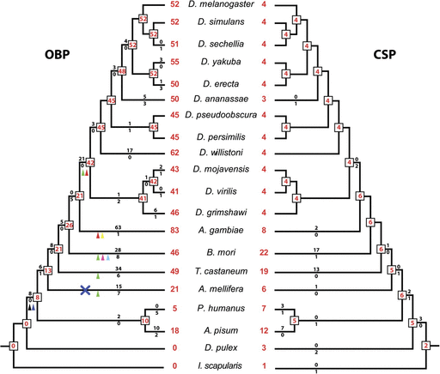
FIG. 6.— OBP and CSP gene gains and losses. The inferred numbers of genes at each phylogenetic node are depicted in ...
Notes:
FIG. 6.— OBP and CSP gene gains and losses. The inferred numbers of genes at each phylogenetic node are depicted in red. Values above and below the branches indicate the number of gene gains and losses, respectively. Subfamily gains (▴) and losses (×) are color-coded (Classic in black, Minus-C in green, Plus-C in blue, Dimer in red, D7 in yellow, ABPI in cyan, ABPII in gray, and PBP/GOBP in pink).
Unless provided in the caption above, the following copyright applies to the content of this slide: © The Author(s) 2011. Published by Oxford University Press on behalf of the Society for Molecular Biology and Evolution.This is an Open Access article distributed under the terms of the Creative Commons Attribution Non-Commercial License (http://creativecommons.org/licenses/by-nc/2.5), which permits unrestricted non-commercial use, distribution, and reproduction in any medium, provided the original work is properly cited.

Slide 7
FIG. 7.— Putative scenario for the evolution of the chemosensory system. Shaded in blue boxes represent the aquatic ...
Notes:
FIG. 7.— Putative scenario for the evolution of the chemosensory system. Shaded in blue boxes represent the aquatic lifestyle. Right: presence or absence of the chemosensory gene families in extant species. Branch lengths are not to scale. Letters from A to F stand for the different evolutionary events (see text).
Unless provided in the caption above, the following copyright applies to the content of this slide: © The Author(s) 2011. Published by Oxford University Press on behalf of the Society for Molecular Biology and Evolution.This is an Open Access article distributed under the terms of the Creative Commons Attribution Non-Commercial License (http://creativecommons.org/licenses/by-nc/2.5), which permits unrestricted non-commercial use, distribution, and reproduction in any medium, provided the original work is properly cited.

