Slide 1
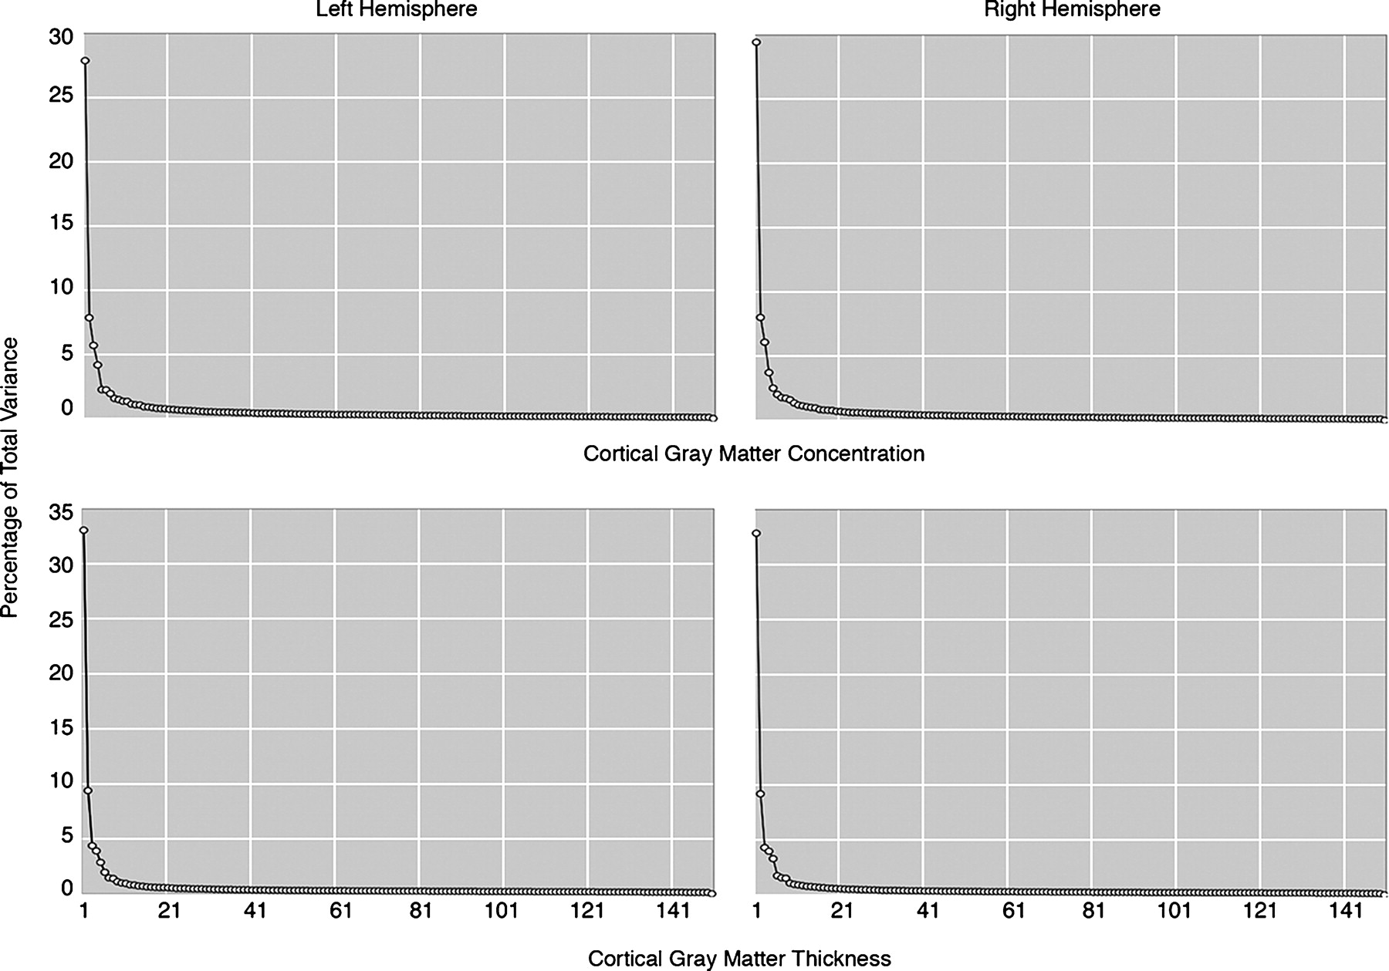
Figure 1. Scree plots showing the total variance from principal components obtained from cortical gray matter ...
Notes:
Figure 1. Scree plots showing the total variance from principal components obtained from cortical gray matter concentration (top) and cortical thickness (bottom) measures for each hemisphere.
Unless provided in the caption above, the following copyright applies to the content of this slide: Cerebral Cortex V 15 N 6 © Oxford University Press 2004; all rights reserved

Slide 2
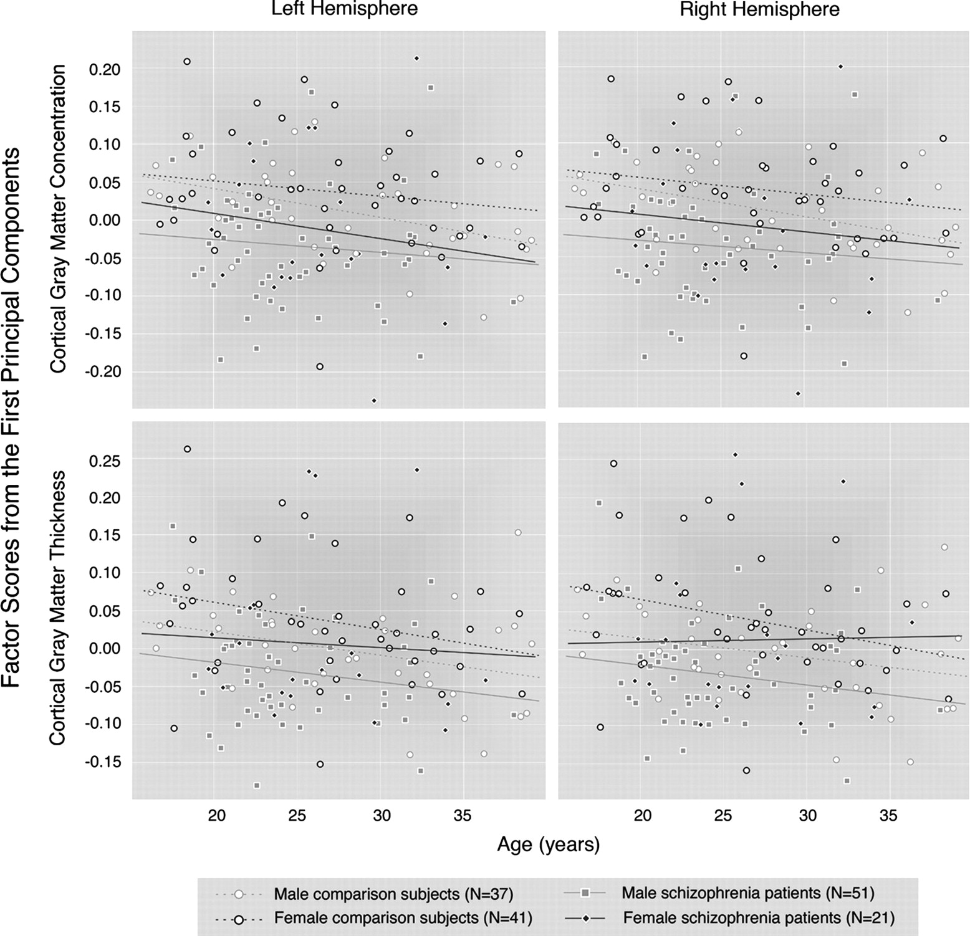
Figure 2. Factor scores from the first principal components for gray matter concentration (top) and cortical thickness ...
Notes:
Figure 2. Factor scores from the first principal components for gray matter concentration (top) and cortical thickness (bottom) plotted by age in groups defined by sex and diagnosis.
Unless provided in the caption above, the following copyright applies to the content of this slide: Cerebral Cortex V 15 N 6 © Oxford University Press 2004; all rights reserved

Slide 3
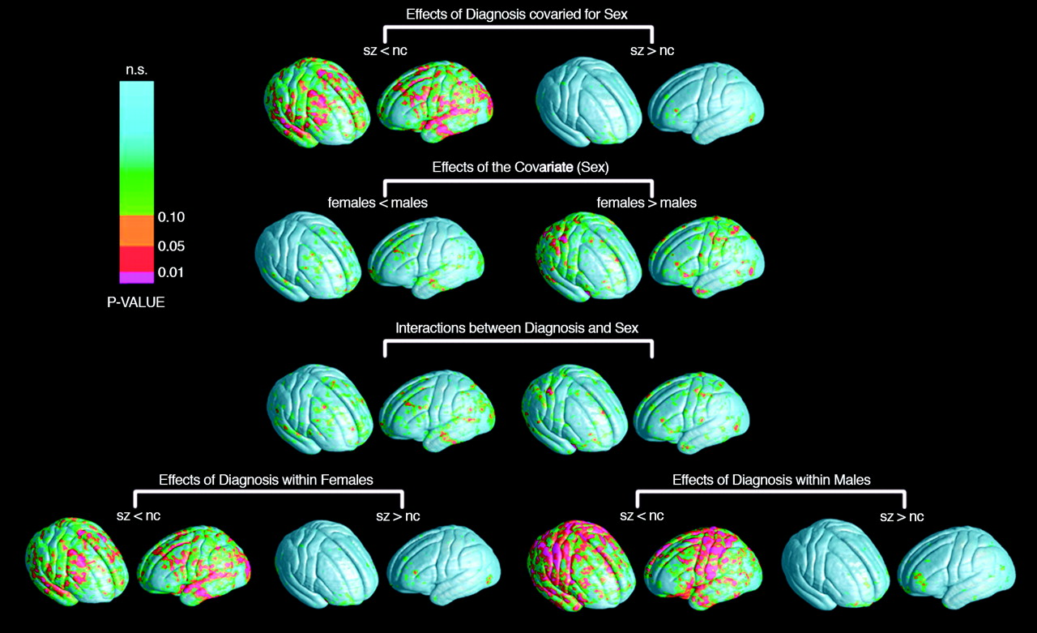
Figure 3. Statistical maps showing significant regional differences in cortical gray matter concentration (i) in ...
Notes:
Figure 3. Statistical maps showing significant regional differences in cortical gray matter concentration (i) in patients with first episode schizophrenia (sz) compared with healthy subjects (nc) after covarying for sex (top row); (ii) between male and female subjects across diagnostic groups (second row); (iii) for interactions between sex and diagnosis (third row); and (iv) between diagnostic groups with in males (right) and females (left). Probability values, indexed in color, show positive and negative effects.
Unless provided in the caption above, the following copyright applies to the content of this slide: Cerebral Cortex V 15 N 6 © Oxford University Press 2004; all rights reserved

Slide 4
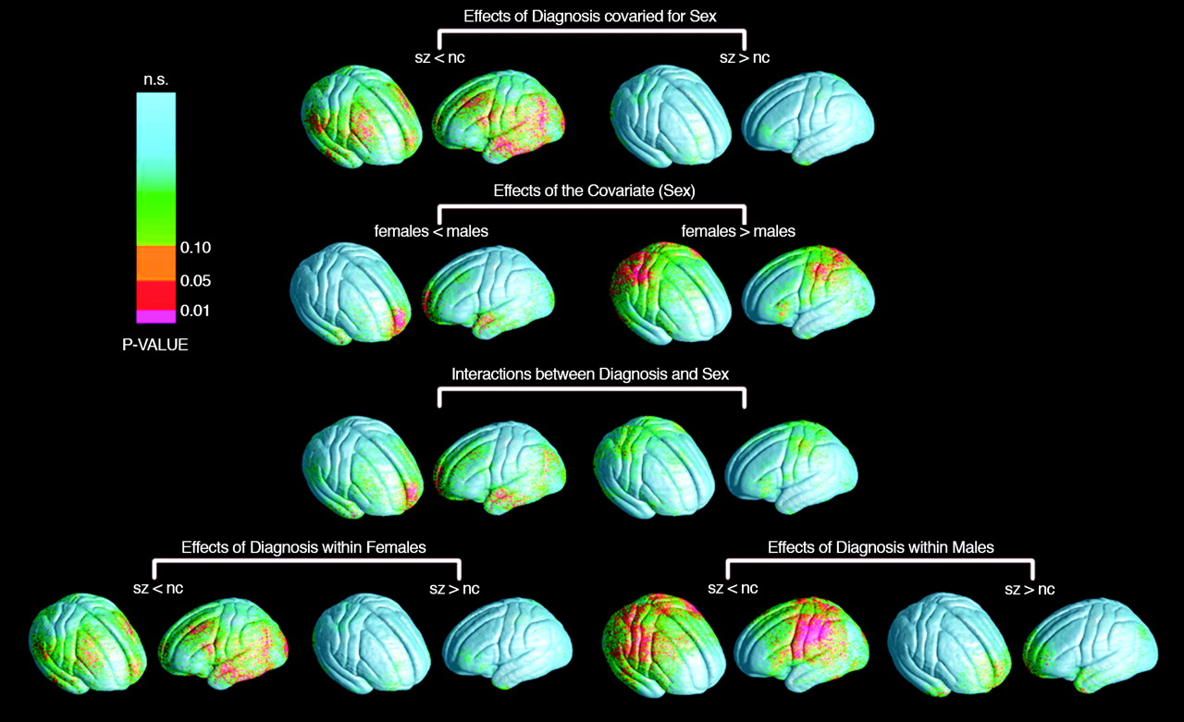
Figure 4. Statistical maps showing significant regional differences in cortical thickness (i) in patients with first ...
Notes:
Figure 4. Statistical maps showing significant regional differences in cortical thickness (i) in patients with first episode schizophrenia (sz) compared with healthy subjects (nc) after covarying for sex (top row); (ii) between male and female subjects across diagnostic groups (second row); (iii) for interactions between sex and diagnosis (third row); and (iv) between diagnostic groups with in males (right) and females (left). Probability values, indexed in color, show positive and negative effects.
Unless provided in the caption above, the following copyright applies to the content of this slide: Cerebral Cortex V 15 N 6 © Oxford University Press 2004; all rights reserved

Slide 5
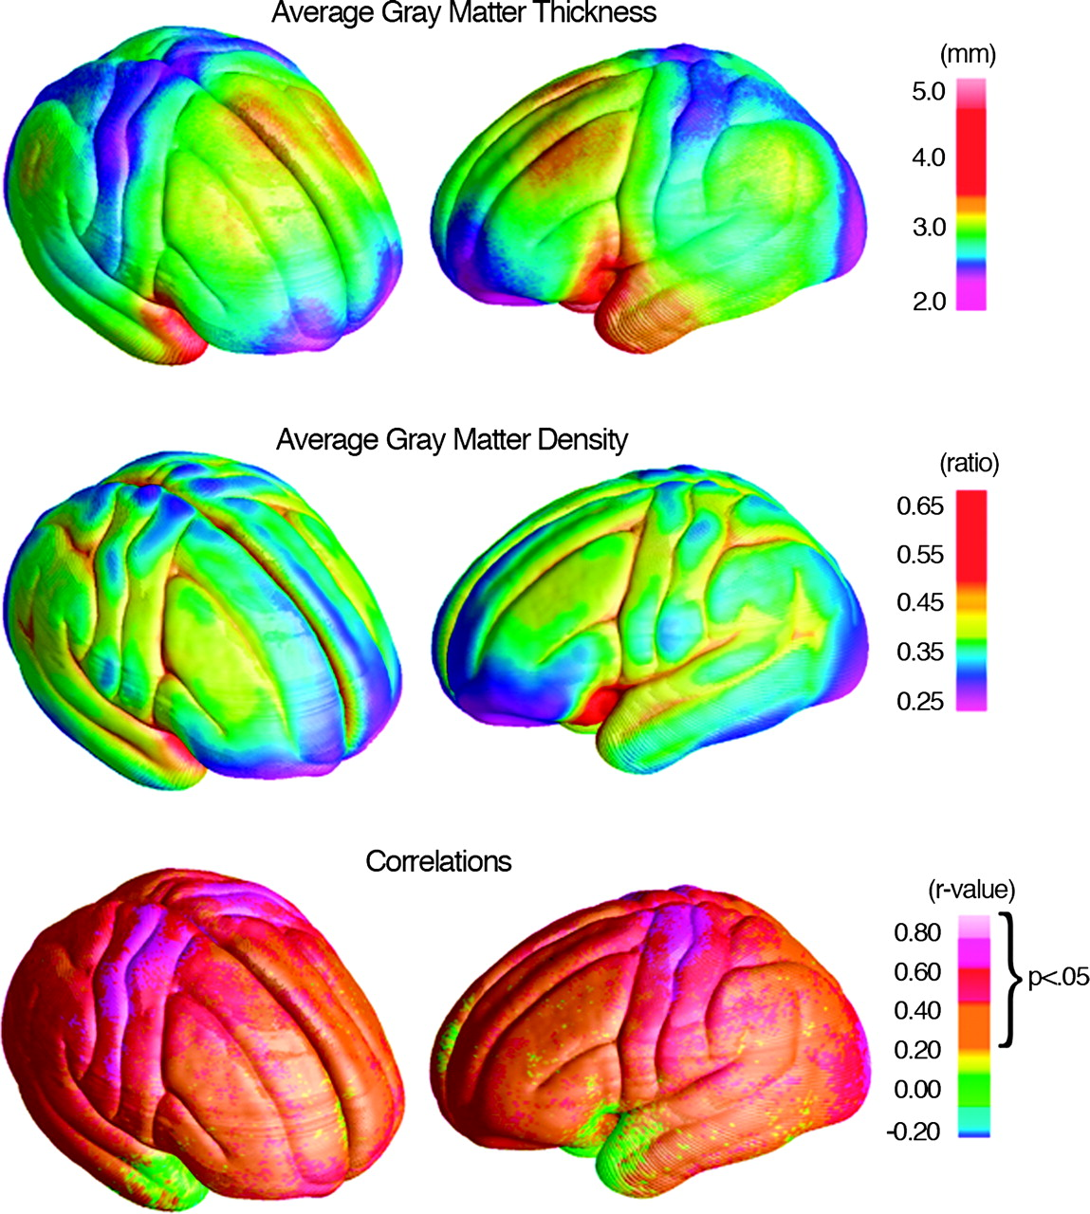
Figure 5. Maps showing average cortical thickness (top) and average gray matter concentration distributions across all ...
Notes:
Figure 5. Maps showing average cortical thickness (top) and average gray matter concentration distributions across all subjects (middle) as indexed by the colorbar. Relationships between cortical thickness and gray matter concentration are shown in the bottom row, where correlation coefficients are indexed in color.
Unless provided in the caption above, the following copyright applies to the content of this slide: Cerebral Cortex V 15 N 6 © Oxford University Press 2004; all rights reserved

