Slide 1
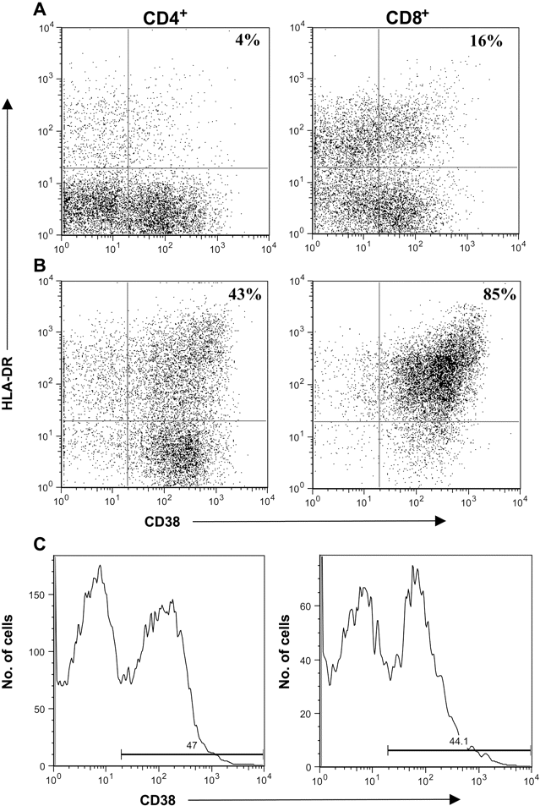
Figure A1 Representative flow-cytometry profiles demonstrating CD38 and human leukocyte antigen (HLA)–DR coexpression ...
Notes:
Figure A1 Representative flow-cytometry profiles demonstrating CD38 and human leukocyte antigen (HLA)–DR coexpression on CD4+ and CD8+ T cells in an HIV-seronegative (A) and an HIV-seropositive antiretroviral-naive (B) individual. Samples were first gated on the CD4+ or CD8+ T cell population, and the percentage of HLA-DR+/CD38+ CD4+ or CD8+ T cells was determined. Preset gating for CD38 (C) and HLA-DR expression on CD4+ and CD8+ T cells was used for all analysis and was based on a natural break seen in HIV-seronegative Ugandans
Unless provided in the caption above, the following copyright applies to the content of this slide: © 2005 by the Infectious Diseases Society of America

Slide 2
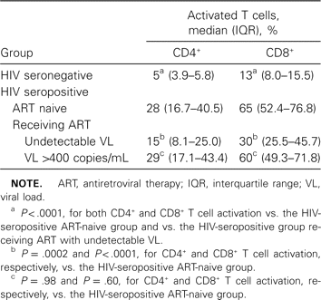
Table 1 CD4+ and CD8+ T cell activation by HIV status
Notes:
Table 1 CD4+ and CD8+ T cell activation by HIV status
Unless provided in the caption above, the following copyright applies to the content of this slide: © 2005 by the Infectious Diseases Society of America

Slide 3
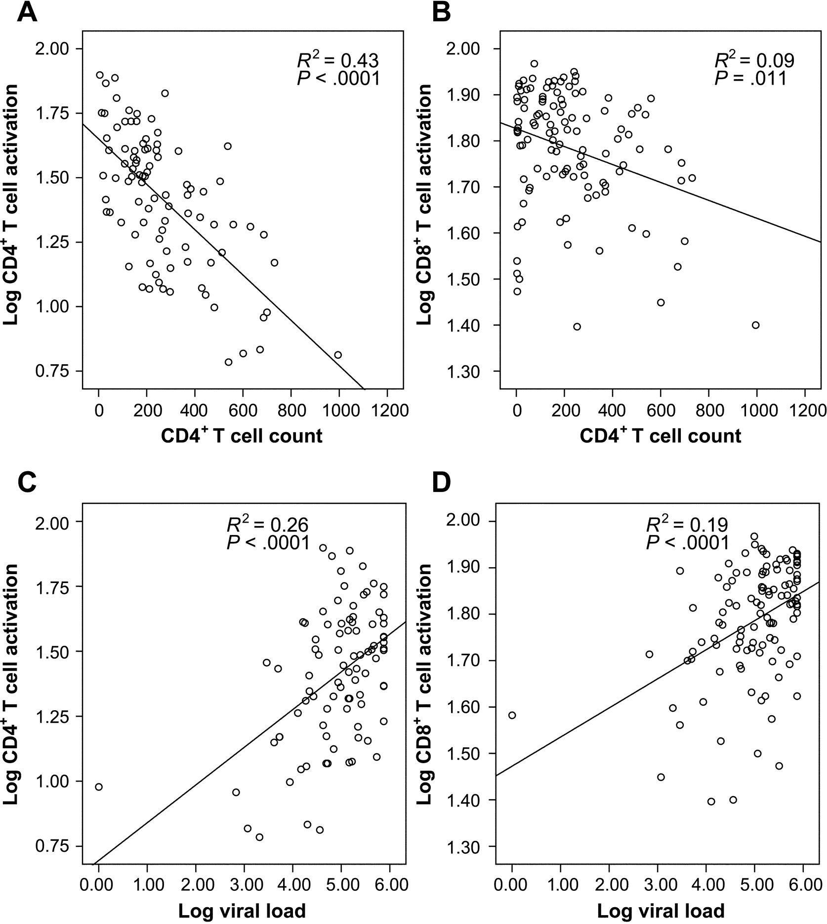
Figure 1 Correlation of CD4⁺ T cell count and viral load with immune activation. Univariate linear ...
Notes:
Figure 1 Correlation of CD4+ T cell count and viral load with immune activation. Univariate linear regression analysis was performed to measure the association between CD4+ T cell count (A and B) and viral load (C and D) and CD4+ and CD8+ T cell activation. Immune activation was defined as the percentage of CD4+ or CD8+ T cells expressing human leukocyte antigen (HLA)–DR and CD38
Unless provided in the caption above, the following copyright applies to the content of this slide: © 2005 by the Infectious Diseases Society of America

Slide 4
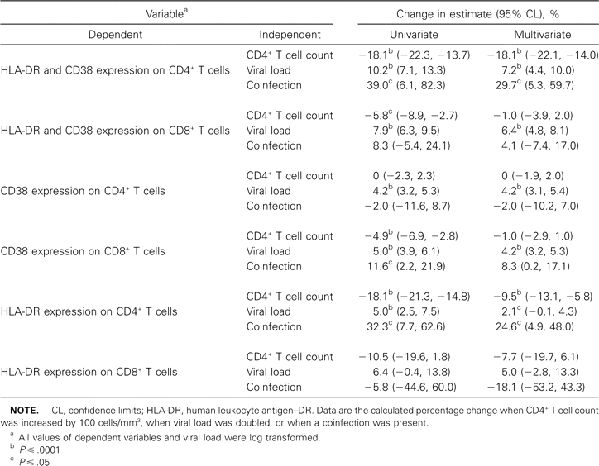
Table 2 Associations between clinical factors and immune activation
Notes:
Table 2 Associations between clinical factors and immune activation
Unless provided in the caption above, the following copyright applies to the content of this slide: © 2005 by the Infectious Diseases Society of America

Slide 5
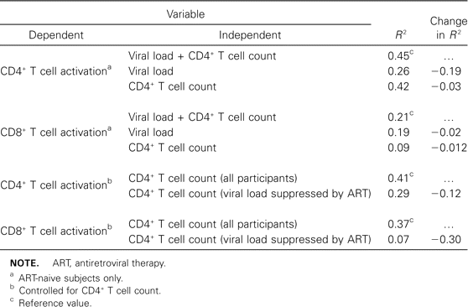
Table 3 Relative effect of viral load and CD4+ T cell depletion on immune activation
Notes:
Table 3 Relative effect of viral load and CD4+ T cell depletion on immune activation
Unless provided in the caption above, the following copyright applies to the content of this slide: © 2005 by the Infectious Diseases Society of America

