Slide 1
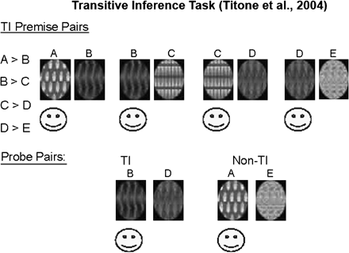
Fig. 1. Transitive Inference Task (Titone et al93).
Notes:
Fig. 1. Transitive Inference Task (Titone et al93).
Unless provided in the caption above, the following copyright applies to the content of this slide: © The Author 2009. Published by Oxford University Press on behalf of the Maryland Psychiatric Research Center. All rights reserved. For permissions, please email: journals.permissions@oxfordjournals.org.

Slide 2
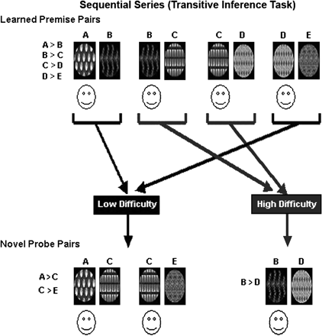
Fig. 2. Sequential Series (Transitive Inference Task).
Notes:
Fig. 2. Sequential Series (Transitive Inference Task).
Unless provided in the caption above, the following copyright applies to the content of this slide: © The Author 2009. Published by Oxford University Press on behalf of the Maryland Psychiatric Research Center. All rights reserved. For permissions, please email: journals.permissions@oxfordjournals.org.

Slide 3
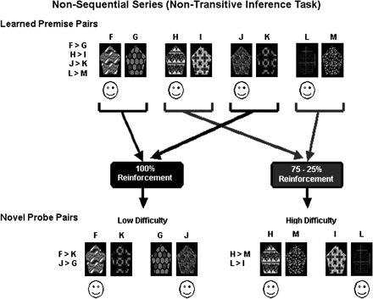
Fig. 3. Nonsequential Series (Nontransitive Inference Task).
Notes:
Fig. 3. Nonsequential Series (Nontransitive Inference Task).
Unless provided in the caption above, the following copyright applies to the content of this slide: © The Author 2009. Published by Oxford University Press on behalf of the Maryland Psychiatric Research Center. All rights reserved. For permissions, please email: journals.permissions@oxfordjournals.org.

Slide 4
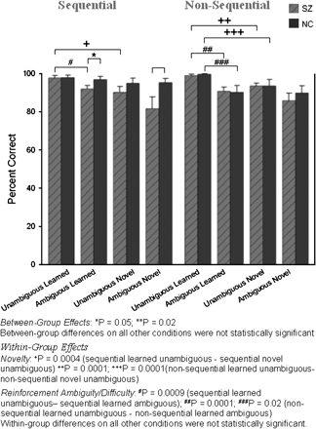
Fig. 4. Means and SEs of Accuracy (Percent Correct) Scores for Schizophrenia Patients and Normal Controls in All ...
Notes:
Fig. 4. Means and SEs of Accuracy (Percent Correct) Scores for Schizophrenia Patients and Normal Controls in All Conditions.
Unless provided in the caption above, the following copyright applies to the content of this slide: © The Author 2009. Published by Oxford University Press on behalf of the Maryland Psychiatric Research Center. All rights reserved. For permissions, please email: journals.permissions@oxfordjournals.org.

Slide 5
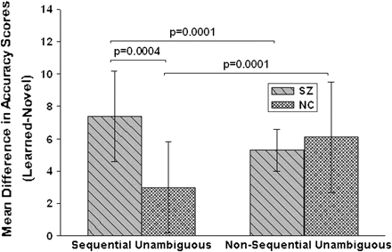
Fig. 5. Mean Novelty Difference Scores (Previously Learned-Novel) in Schizophrenia Patients and Normal Controls on ...
Notes:
Fig. 5. Mean Novelty Difference Scores (Previously Learned-Novel) in Schizophrenia Patients and Normal Controls on Unambiguous Sequential and Nonsequential Conditions.
Unless provided in the caption above, the following copyright applies to the content of this slide: © The Author 2009. Published by Oxford University Press on behalf of the Maryland Psychiatric Research Center. All rights reserved. For permissions, please email: journals.permissions@oxfordjournals.org.

Slide 6
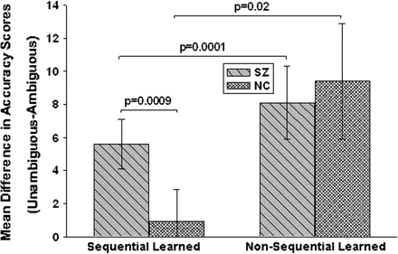
Fig. 6. Mean Reinforcement Difference Scores (Unambiguous-Ambiguous) in Schizophrenia Patients and Normal Controls on ...
Notes:
Fig. 6. Mean Reinforcement Difference Scores (Unambiguous-Ambiguous) in Schizophrenia Patients and Normal Controls on Previously Learned Sequential and Nonsequential Conditions.
Unless provided in the caption above, the following copyright applies to the content of this slide: © The Author 2009. Published by Oxford University Press on behalf of the Maryland Psychiatric Research Center. All rights reserved. For permissions, please email: journals.permissions@oxfordjournals.org.

Slide 7
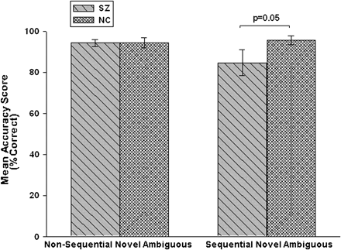
Fig. 7. Nonsequential and Sequential Novel Ambiguous Accuracy Scores of Schizophrenia Patients and Normal Control ...
Notes:
Fig. 7. Nonsequential and Sequential Novel Ambiguous Accuracy Scores of Schizophrenia Patients and Normal Control Subjects Who Performed Above Chance on Nonsequential Novel Ambiguous.
Unless provided in the caption above, the following copyright applies to the content of this slide: © The Author 2009. Published by Oxford University Press on behalf of the Maryland Psychiatric Research Center. All rights reserved. For permissions, please email: journals.permissions@oxfordjournals.org.

Slide 8
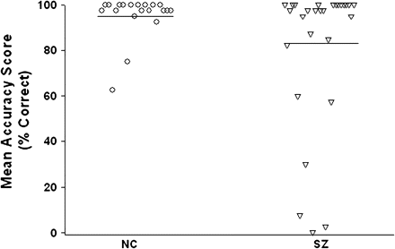
Fig. 8. Mean TI Accuracy Scores of All Schizophrenia and Normal Control (NC) Subjects.
Notes:
Fig. 8. Mean TI Accuracy Scores of All Schizophrenia and Normal Control (NC) Subjects.
Unless provided in the caption above, the following copyright applies to the content of this slide: © The Author 2009. Published by Oxford University Press on behalf of the Maryland Psychiatric Research Center. All rights reserved. For permissions, please email: journals.permissions@oxfordjournals.org.

