Slide 1
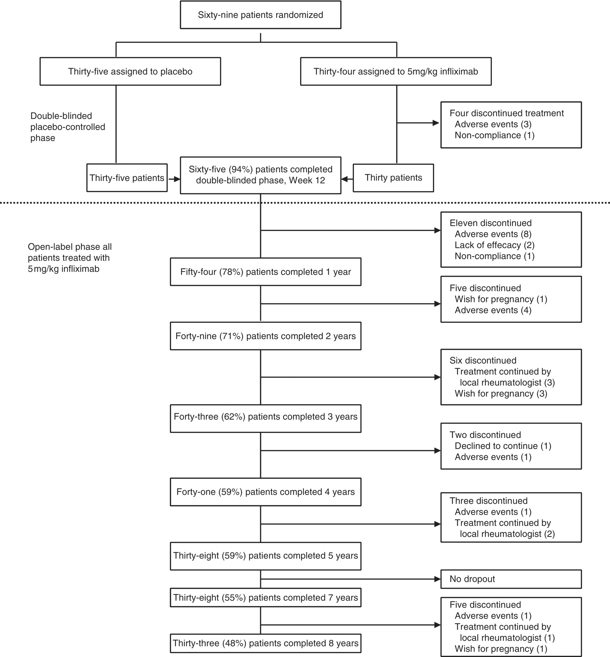
Fig. 1 Summary of patient disposition through the entire study period of 8 years.
Notes:
Fig. 1 Summary of patient disposition through the entire study period of 8 years.
Unless provided in the caption above, the following copyright applies to the content of this slide: © The Author 2011. Published by Oxford University Press on behalf of the British Society for Rheumatology. All rights reserved. For Permissions, please email: journals.permissions@oup.com

Slide 2
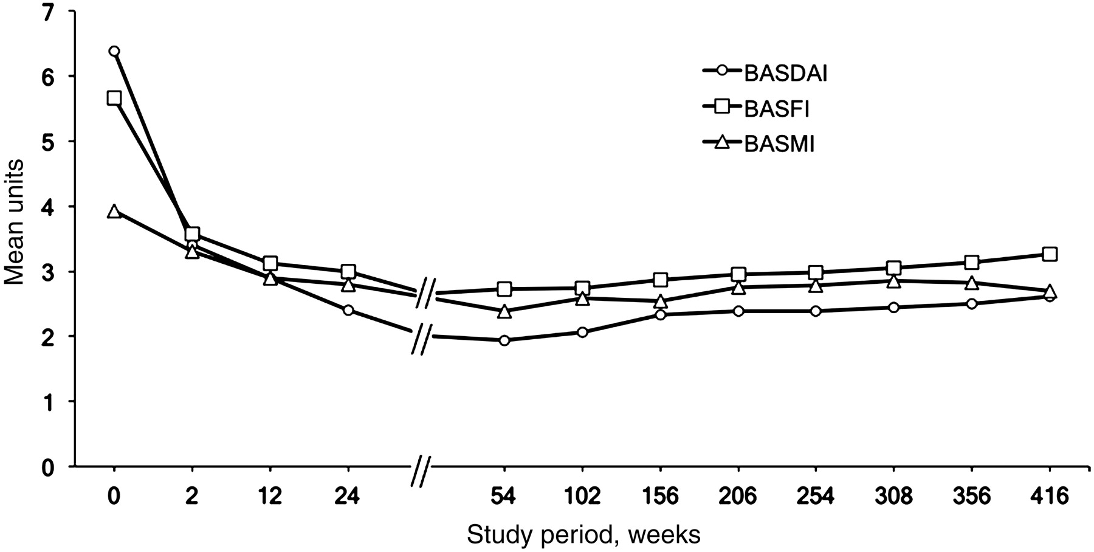
Fig. 2 Course of clinical parameters during the 8 years of the study, including the time of infliximab ...
Notes:
Fig. 2 Course of clinical parameters during the 8 years of the study, including the time of infliximab discontinuation (Year 3 of the study) and retreatment.
Unless provided in the caption above, the following copyright applies to the content of this slide: © The Author 2011. Published by Oxford University Press on behalf of the British Society for Rheumatology. All rights reserved. For Permissions, please email: journals.permissions@oup.com

Slide 3
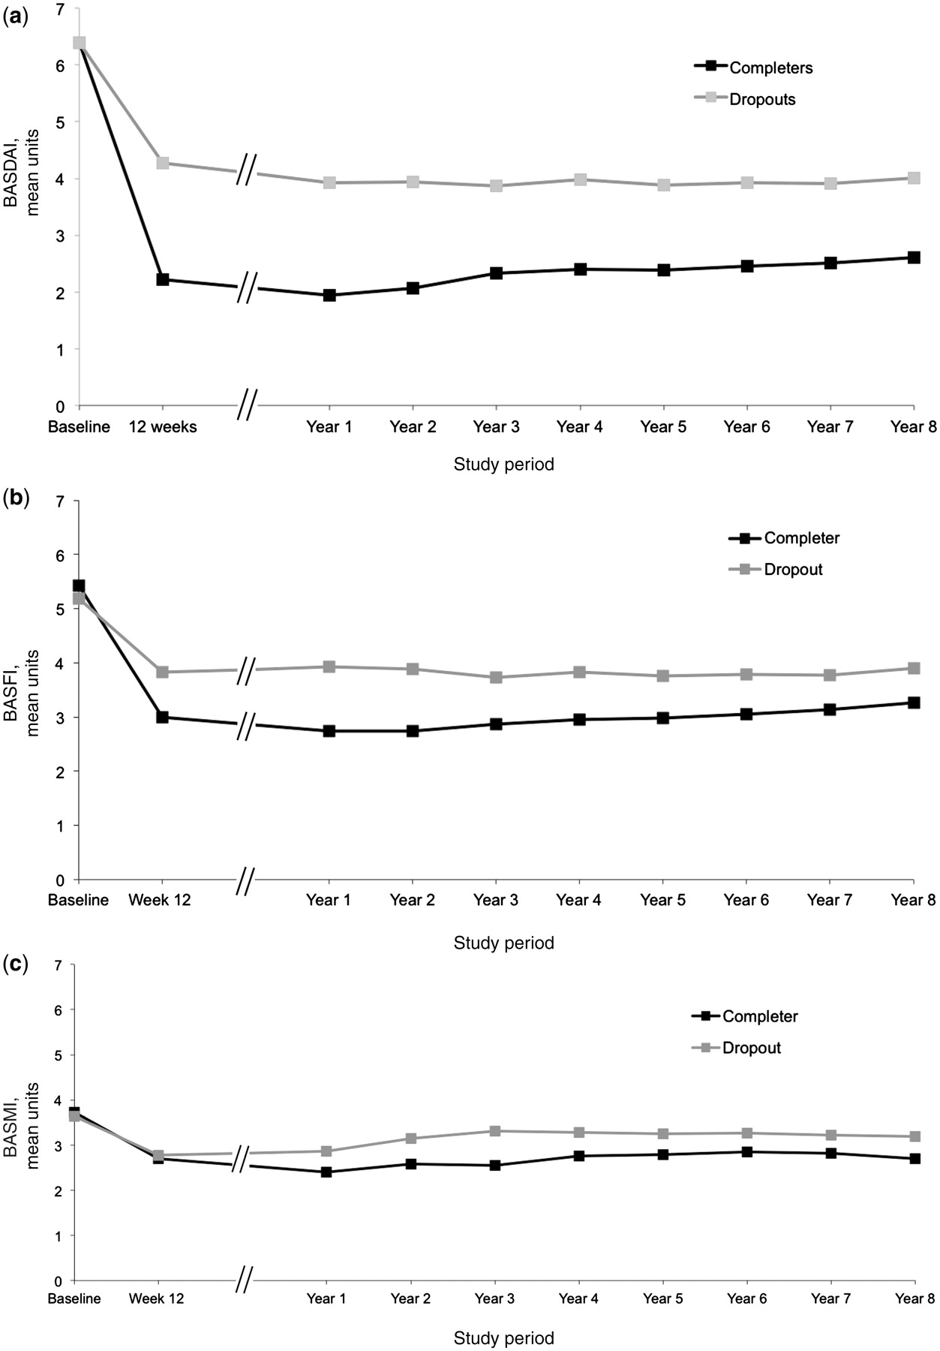
Fig. 3 Course of clinical parameters during the 8 years of the study for BASDAI (a), BASFI (b) and BASMI (c), ...
Notes:
Fig. 3 Course of clinical parameters during the 8 years of the study for BASDAI (a), BASFI (b) and BASMI (c), comparing the mean values of all completers (Completers, completer analysis, n = 33) and patients who dropped out of the study before reaching Year 8 (Dropouts, n = 36, last operation carried forward analysis). Overall, patients who had discontinued the study had significantly higher mean values for disease activity and function as compared with patients who completed Year 8.
Unless provided in the caption above, the following copyright applies to the content of this slide: © The Author 2011. Published by Oxford University Press on behalf of the British Society for Rheumatology. All rights reserved. For Permissions, please email: journals.permissions@oup.com

Slide 4
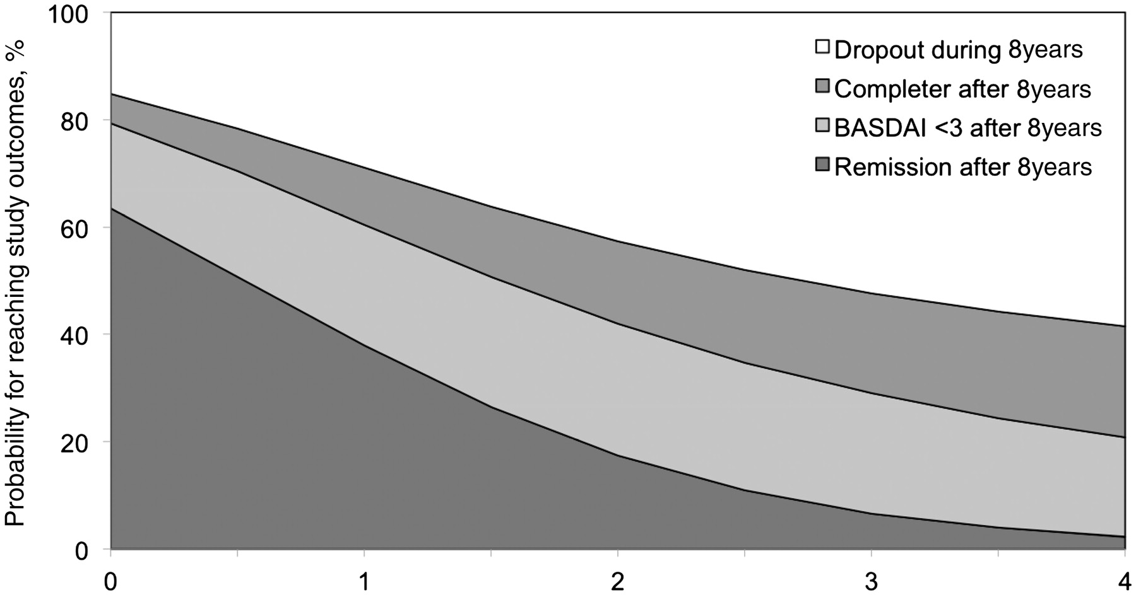
Fig. 4 Prediction for reaching different study outcomes after 8 years, depending on the BASDAI status after 3 months ...
Notes:
Fig. 4 Prediction for reaching different study outcomes after 8 years, depending on the BASDAI status after 3 months of infliximab treatment. In this figure, different treatment outcomes were defined as: state of partial remission (remission), state of low disease activity (BASDAI <3), ongoing treatment medication in any status (Completer) or dropout of the study before Year 8 (Dropout). As an example, a patient with a BASDAI of 1 U after 3 months of infliximab treatment had an estimated probability of 63% of being in partial remission and an estimated probability of 79% of achieving low disease activity (BASDAI < 3) after 8 years of treatment, while the probability of dropping out of the study was 17%. On the other hand, a patient with a BASDAI of 4 after 3 months of infliximab treatment had an estimated probability of only 2.3% of being in partial remission and an estimated probability of only 20.8% of achieving low disease activity (BASDAI < 3), while the dropout probability after 8 years of infliximab treatment was 68%.
Unless provided in the caption above, the following copyright applies to the content of this slide: © The Author 2011. Published by Oxford University Press on behalf of the British Society for Rheumatology. All rights reserved. For Permissions, please email: journals.permissions@oup.com

