Slide 1
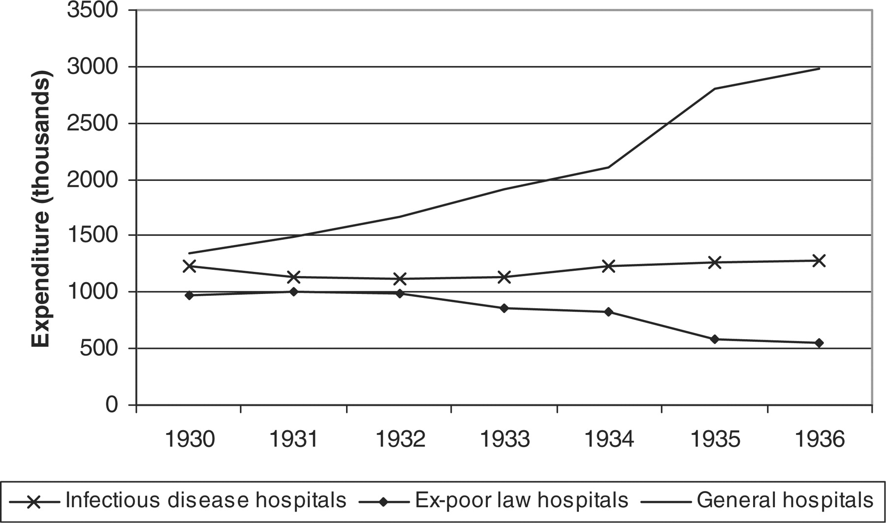
Figure 1 Total expenditure by county boroughs on hospitals, 1930–36. Source: Local Government Financial Statistics, ...
Notes:
Figure 1 Total expenditure by county boroughs on hospitals, 1930–36. Source: Local Government Financial Statistics, 1922–36.
Unless provided in the caption above, the following copyright applies to the content of this slide: © The Author [2009]. Published by Oxford University Press. All rights reserved. For Permissions, please email: journals.permissions@oxfordjournals.org

