Slide 1
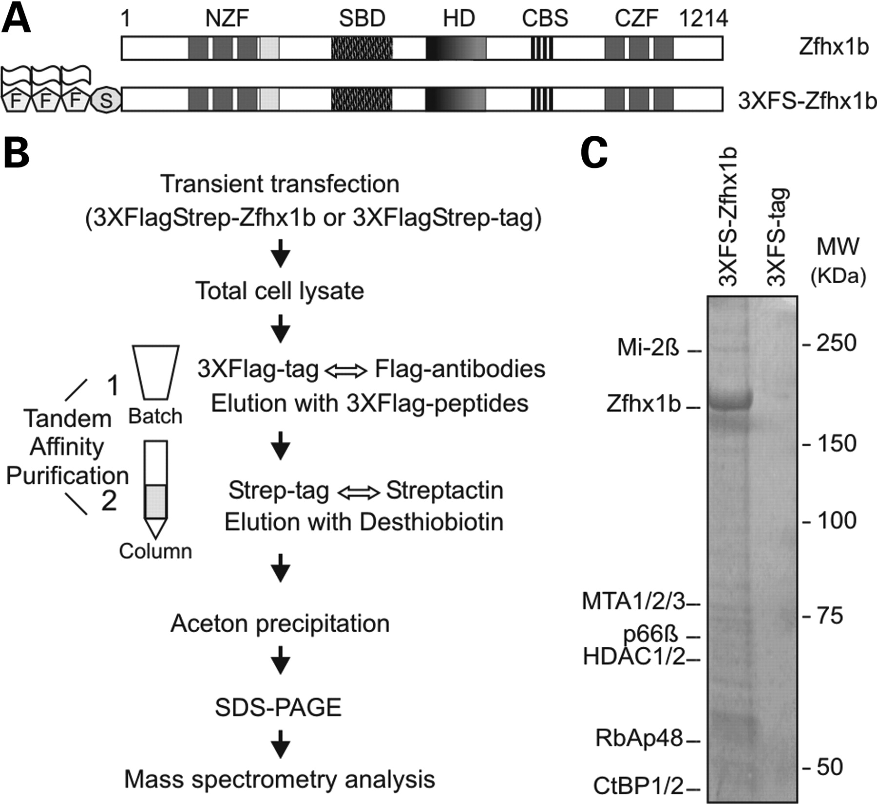
Figure 1. Tandem affinity purified Zfhx1b complexes contain multiple subunits of NuRD. (A) Graphic presentation of the ...
Notes:
Figure 1. Tandem affinity purified Zfhx1b complexes contain multiple subunits of NuRD. (A) Graphic presentation of the mouse Zfhx1b protein and the N-terminally 3XFS-tagged variant. The N-terminal and C-terminal zinc finger domains (NZF and CZF), Smad-binding domain (SBD), homeodomain-like domain (HD), the C3H type zinc finger (light grey box) and the CtBP interacting sites (CBS) are shown. (B) Schematic representation of the variant tandem affinity purification procedure. The first purification involves an in-batch Flag-IP of extracts of HEK293T cells, containing transiently synthesized 3XFS-Zfhx1b proteins. Upon elution with 3XFLAG peptides, the eluted proteins were applied to a streptactin-agarose column for a second purification. Precipitation was done using acetone. (C) Brilliant blue G-colloidal staining of the purified proteins from HEK293T cells transiently producing 3XFS-Zfhx1b or 3XFS-tag only. Co-purified proteins were identified by MS.
Unless provided in the caption above, the following copyright applies to the content of this slide: © The Author 2008. Published by Oxford University Press. All rights reserved. For Permissions, please email: journals.permissions@oxfordjournals.org

Slide 2
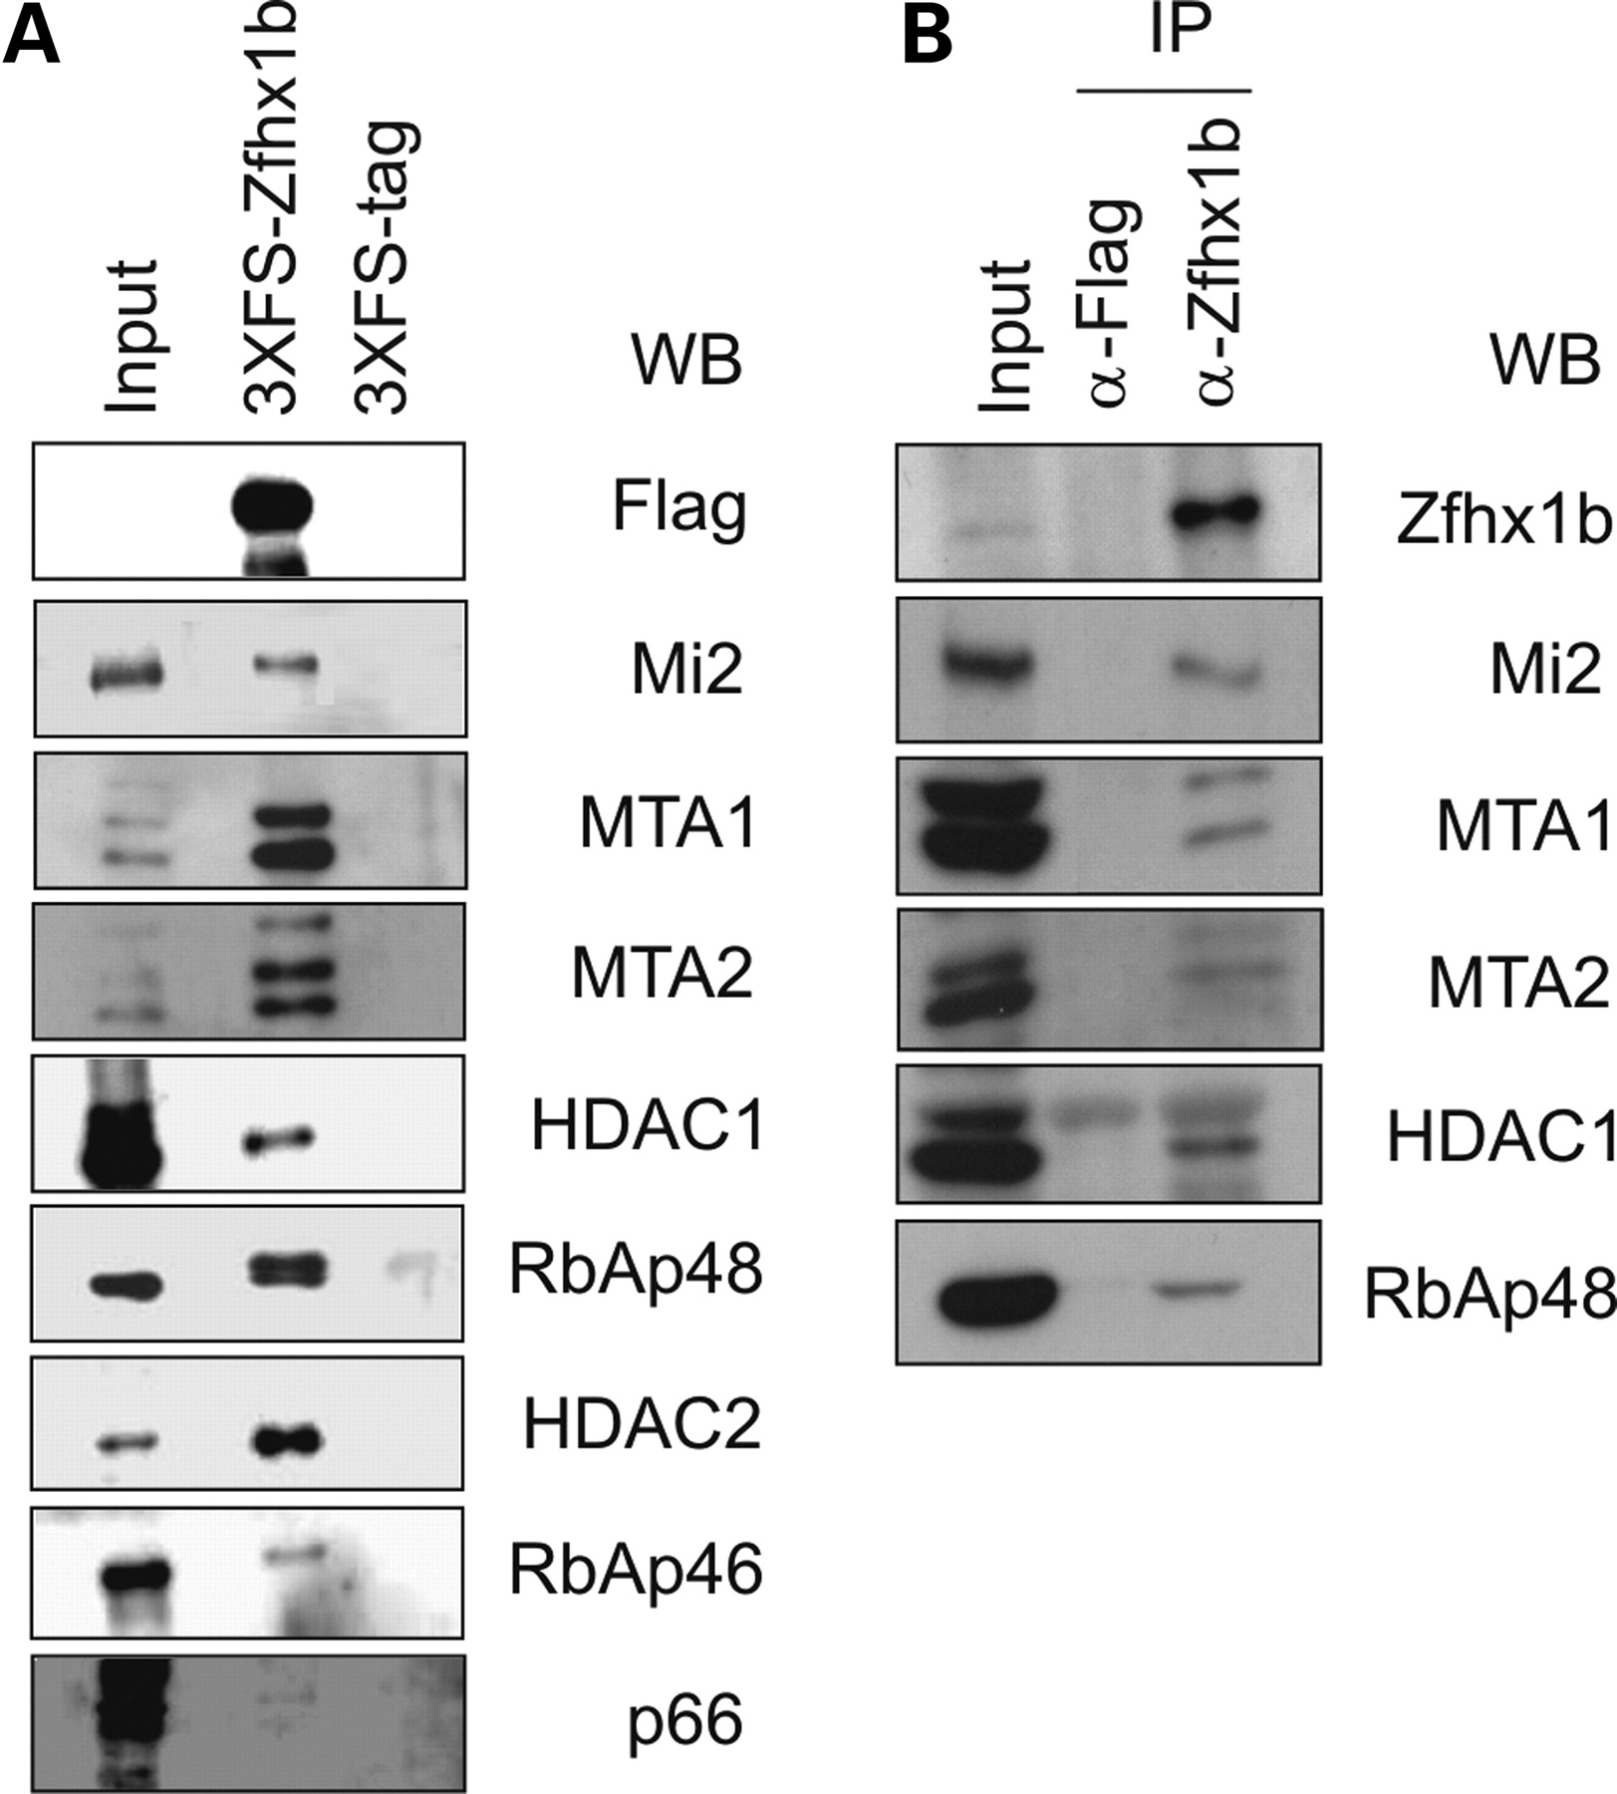
Figure 2. Zfhx1b associates with several subunits of the NuRD complex. (A) Extracts of HEK293T cells containing ...
Notes:
Figure 2. Zfhx1b associates with several subunits of the NuRD complex. (A) Extracts of HEK293T cells containing transiently synthesized 3XFS-Zfhx1b or 3XFS tag as negative control were precipitated in a Flag-dependent manner and eluted using 3XFLAG peptides. Western-blot analysis was performed using antibodies directed against the NuRD subunits. (B) IP of HEK293T cell extracts with Zfhx1b-specific or control anti-Flag antibodies, followed by Western-blot analysis using NuRD subunit-specific antibodies.
Unless provided in the caption above, the following copyright applies to the content of this slide: © The Author 2008. Published by Oxford University Press. All rights reserved. For Permissions, please email: journals.permissions@oxfordjournals.org

Slide 3
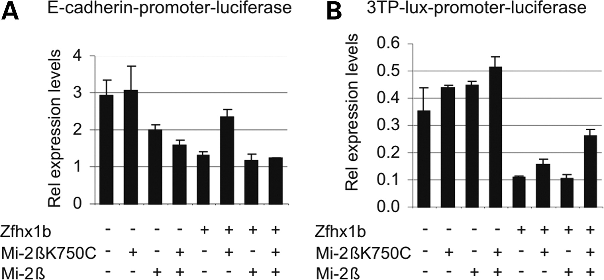
Figure 3. A dominant-negative variant of Mi-2β interferes with Zfhx1b-mediated repression of specific target promoters ...
Notes:
Figure 3. A dominant-negative variant of Mi-2β interferes with Zfhx1b-mediated repression of specific target promoters in reporter constructs. HEK293T cells were transiently transfected with constructs coding for Zfhx1b, wild-type or mutant Mi-2βK750C polypeptides, and the E-cadherin (A), or 3TPlux reporter constructs (B). Cells were harvested 48 h after transfection and were analyzed for luciferase activity. β-galactosidase activity corrected luciferase values are given.
Unless provided in the caption above, the following copyright applies to the content of this slide: © The Author 2008. Published by Oxford University Press. All rights reserved. For Permissions, please email: journals.permissions@oxfordjournals.org

Slide 4
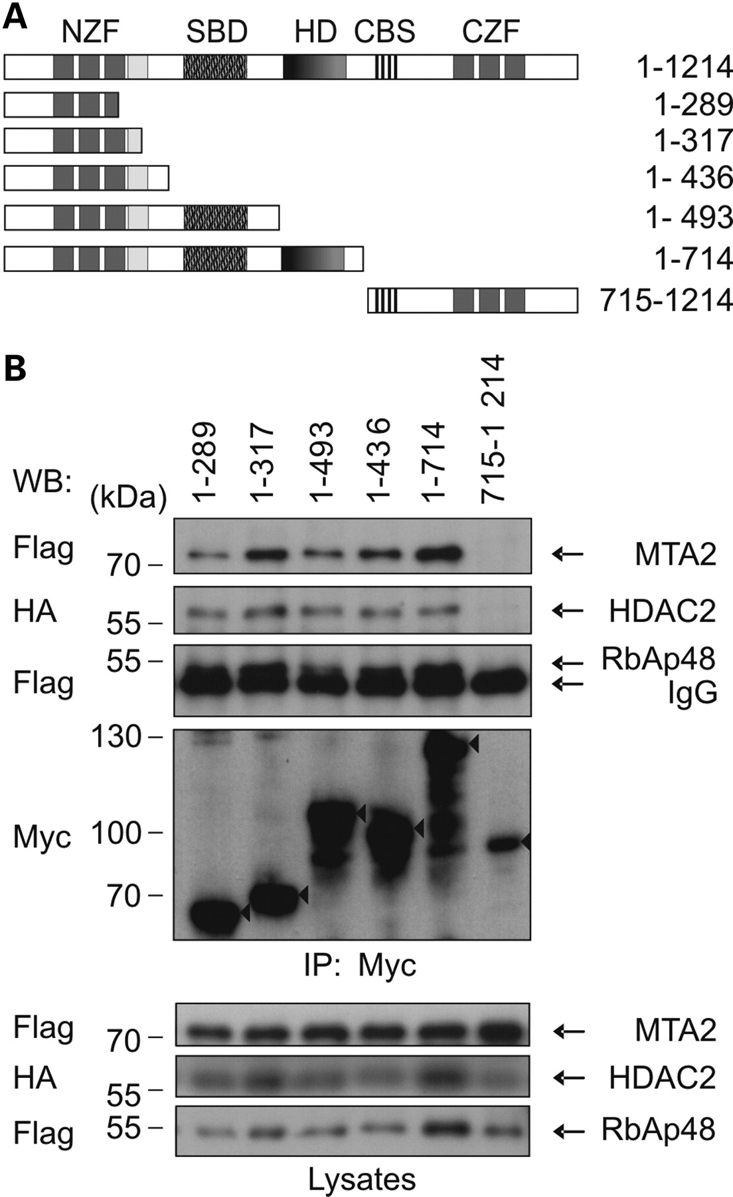
Figure 4. Zfhx1b associates with NuRD via its N-terminal domain. (A) Graphic presentation of wild-type (WT) full-length ...
Notes:
Figure 4. Zfhx1b associates with NuRD via its N-terminal domain. (A) Graphic presentation of wild-type (WT) full-length (FL) and mutant Zfhx1b proteins used in this study. (B) Western-blot detection showing co-immunoprecipitation of Flag-MTA2 and RbAp48, and HA-HDAC2 with the respective Zfhx1b proteins (triangle) tested.
Unless provided in the caption above, the following copyright applies to the content of this slide: © The Author 2008. Published by Oxford University Press. All rights reserved. For Permissions, please email: journals.permissions@oxfordjournals.org

Slide 5
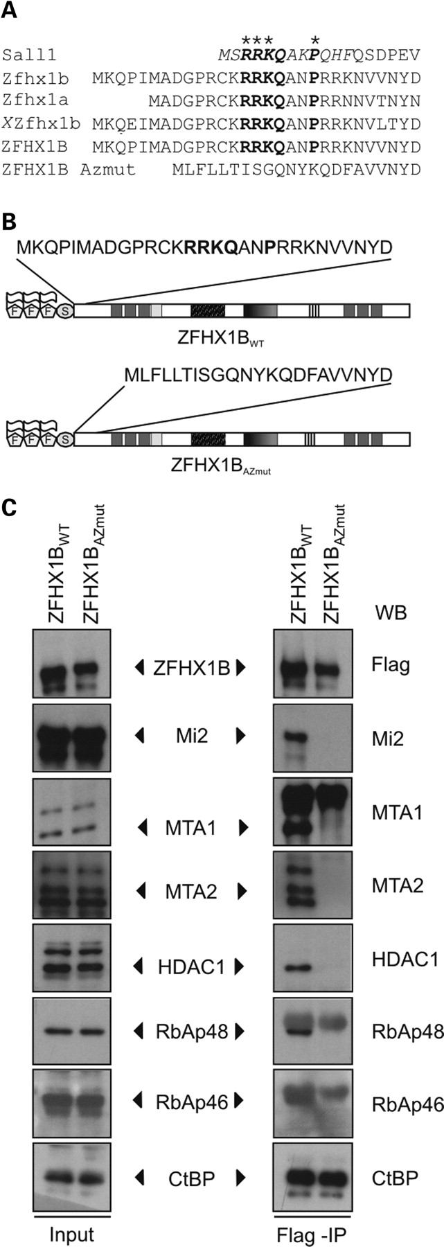
Figure 5. Defective NuRD recruitment by a mutant ZFHX1B protein that causes atypical MWS. (A) Alignment of Sall1, ...
Notes:
Figure 5. Defective NuRD recruitment by a mutant ZFHX1B protein that causes atypical MWS. (A) Alignment of Sall1, Zfhx1a, mouse, Xenopus laevis and human wild-type Zfhx1b, and mutant ZFHX1B amino-terminal domains. The conserved 12 amino acid motif (italics) in Sall1 that is sufficient for NuRD recruitment and the critical residues (*) that abolished binding to NuRD and repression by Sall1 when mutated are indicated. Note that mouse Zfhx1a and mouse, human and Xenopus laevis Zfhx1B but not the Atypical Zweier mutant human Zfhx1b contain the conserved motif (bold) within their N-terminus. (B) Schematic presentation of the ZFHX1BWT and ZFHX1BAZmut proteins used in this study. (C) Western-blot detection showing co-immunoprecipitation of endogenous NuRD subunits with ZFHX1BWT but not ZFHX1BAZmut. Note that CtBP binding by ZFHX1BAZmut proteins is unaffected.
Unless provided in the caption above, the following copyright applies to the content of this slide: © The Author 2008. Published by Oxford University Press. All rights reserved. For Permissions, please email: journals.permissions@oxfordjournals.org

Slide 6
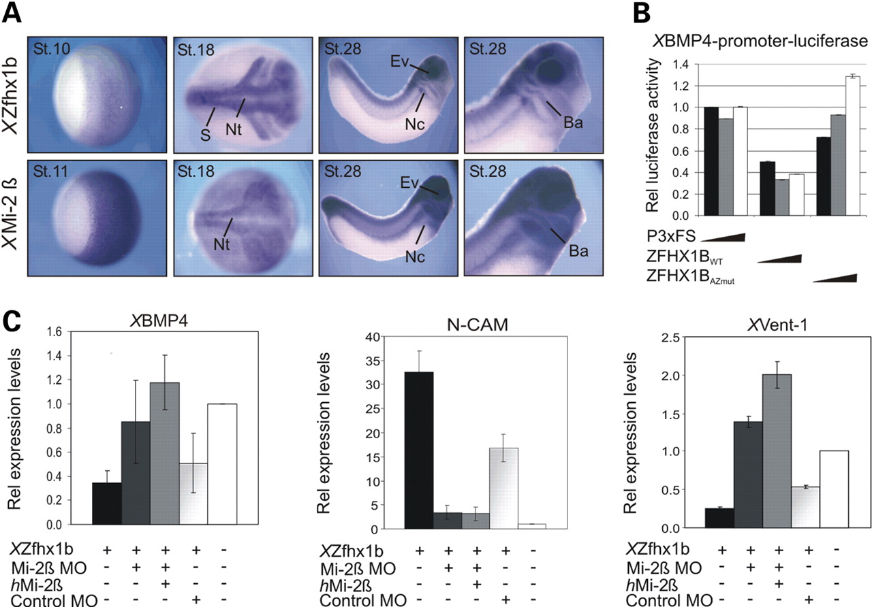
Figure 6. XZfhx1b depends on intact XMi-2β activity in early neural tissue formation. (A) Whole-mount in situ ...
Notes:
Figure 6. XZfhx1b depends on intact XMi-2β activity in early neural tissue formation. (A) Whole-mount in situ hybridization with a cRNA probe for XZfhx1b and XMi-2β at the indicated developmental stages; ba, branchial arches; ev, eye vesicle; nc, neural crest; nt, neural tube; s, somites. (B) The indicated plasmids were transfected into HEK293T cells and cells were analyzed 48 h later for the XBMP4 promoter-driven luciferase activity. β-Galactosidase-corrected luciferase values are given. Note that ZFHX1BWT represses the activity of the reporterconstruct in a dose-dependent manner, while repression by ZFHX1BAZmut proteins is significantly reduced. (C) QRT–PCR expression analysis of the indicated genes on total RNA isolated from animal caps derived from embryos injected with XZfhx1b RNA alone (200 pg/blastomere), co-injected with MOs against XMi-2β, co-injected with MOs against XMi-2β and hMi-2β RNA, co-injected with control MOs, or non-injected. Values were corrected for H4. Note that overexpression of XZfhx1b represses XBMP4 and the BMP-dependent gene XVent-1 and induces the neural gene N-CAM, while knock-down of XMi-2β alleviates XZfhx1b-dependent repression and induction of the respective genes.
Unless provided in the caption above, the following copyright applies to the content of this slide: © The Author 2008. Published by Oxford University Press. All rights reserved. For Permissions, please email: journals.permissions@oxfordjournals.org

