Slide 1
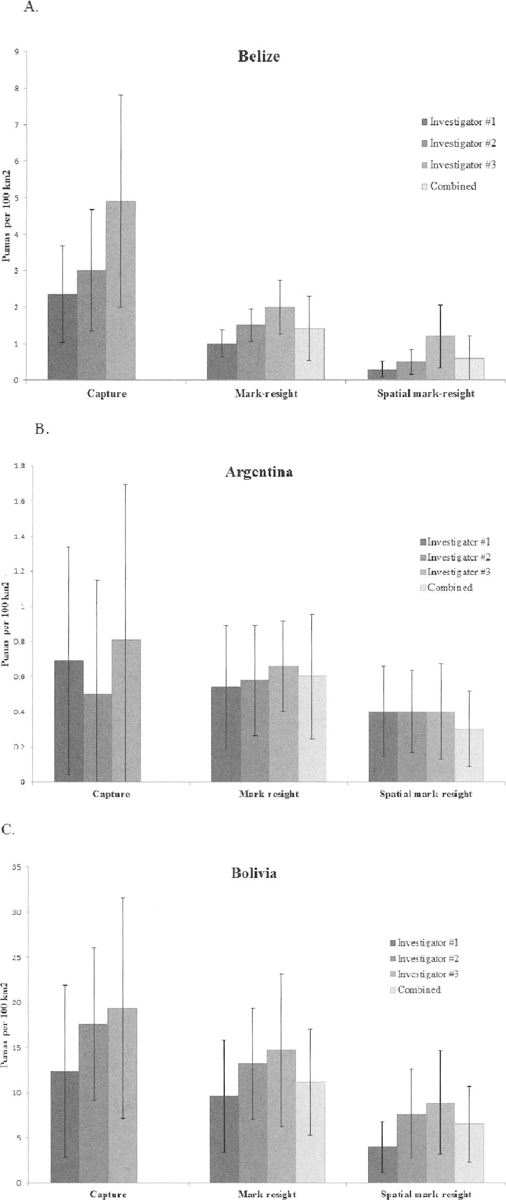
Fig. 1 Estimated density of pumas (Puma concolor), and the associated 95% confidence intervals, generated from ...
Notes:
Fig. 1 Estimated density of pumas (Puma concolor), and the associated 95% confidence intervals, generated from camera-trapping surveys in A) Belize, B) Argentina, and C) Bolivia. Estimates were generated from capture histories constructed by 3 independent investigators from the same data sets, and for mark-resight models from the 3 investigators combined.
Unless provided in the caption above, the following copyright applies to the content of this slide: © 2014 American Society of Mammalogists

