Slide 1
Fig. 1 Section of the standard form accompanying a manuscript admitted to the peer-review process of Cardiovascular ...
Notes:
Fig. 1 Section of the standard form accompanying a manuscript admitted to the peer-review process of Cardiovascular Research.
Unless provided in the caption above, the following copyright applies to the content of this slide: Copyright © 1999, European Society of Cardiology

Slide 2
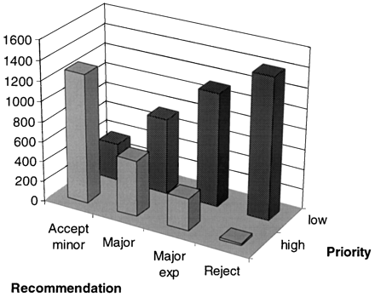
Fig. 2 Graph showing the combined priority indications (‘high’ or ‘low’) and the reviewer’s recommendations (minor ...
Notes:
Fig. 2 Graph showing the combined priority indications (‘high’ or ‘low’) and the reviewer’s recommendations (minor revision, major revision, major revision with experiments, reject) of all reviewers’ reports of original papers submitted to Cardiovascular Research between 1995 and 1999.
Unless provided in the caption above, the following copyright applies to the content of this slide: Copyright © 1999, European Society of Cardiology

