Slide 1
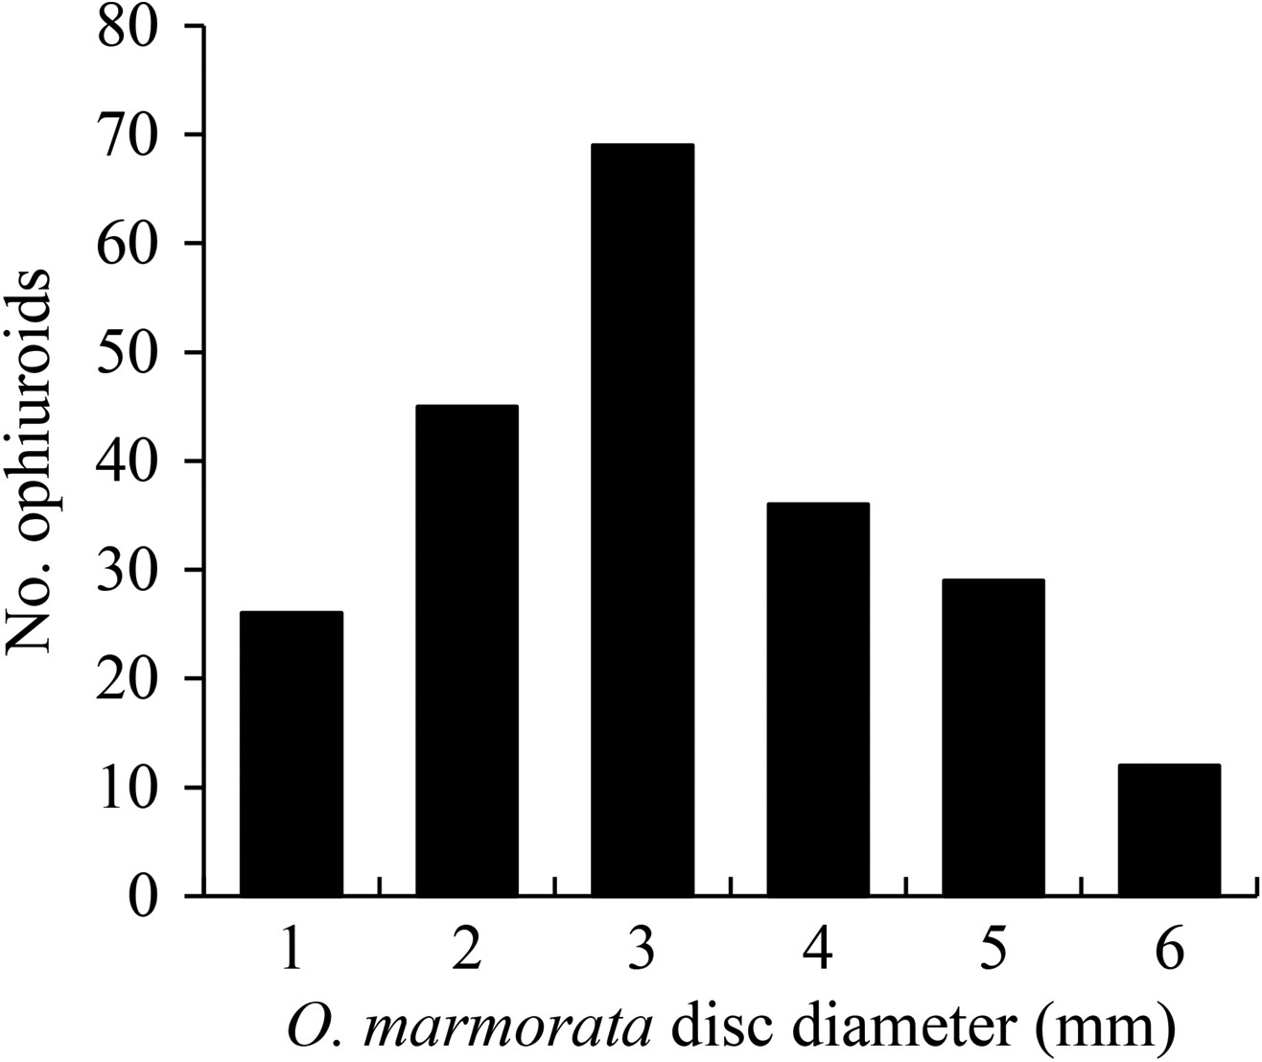
Fig. 1. Size range of O. marmorata associated with A. aurita medusae (N = 217).
Notes:
Fig. 1. Size range of O. marmorata associated with A. aurita medusae (N = 217).
Unless provided in the caption above, the following copyright applies to the content of this slide: © The Author 2016. Published by Oxford University Press. All rights reserved. For permissions, please e-mail: journals.permissions@oup.com

Slide 2
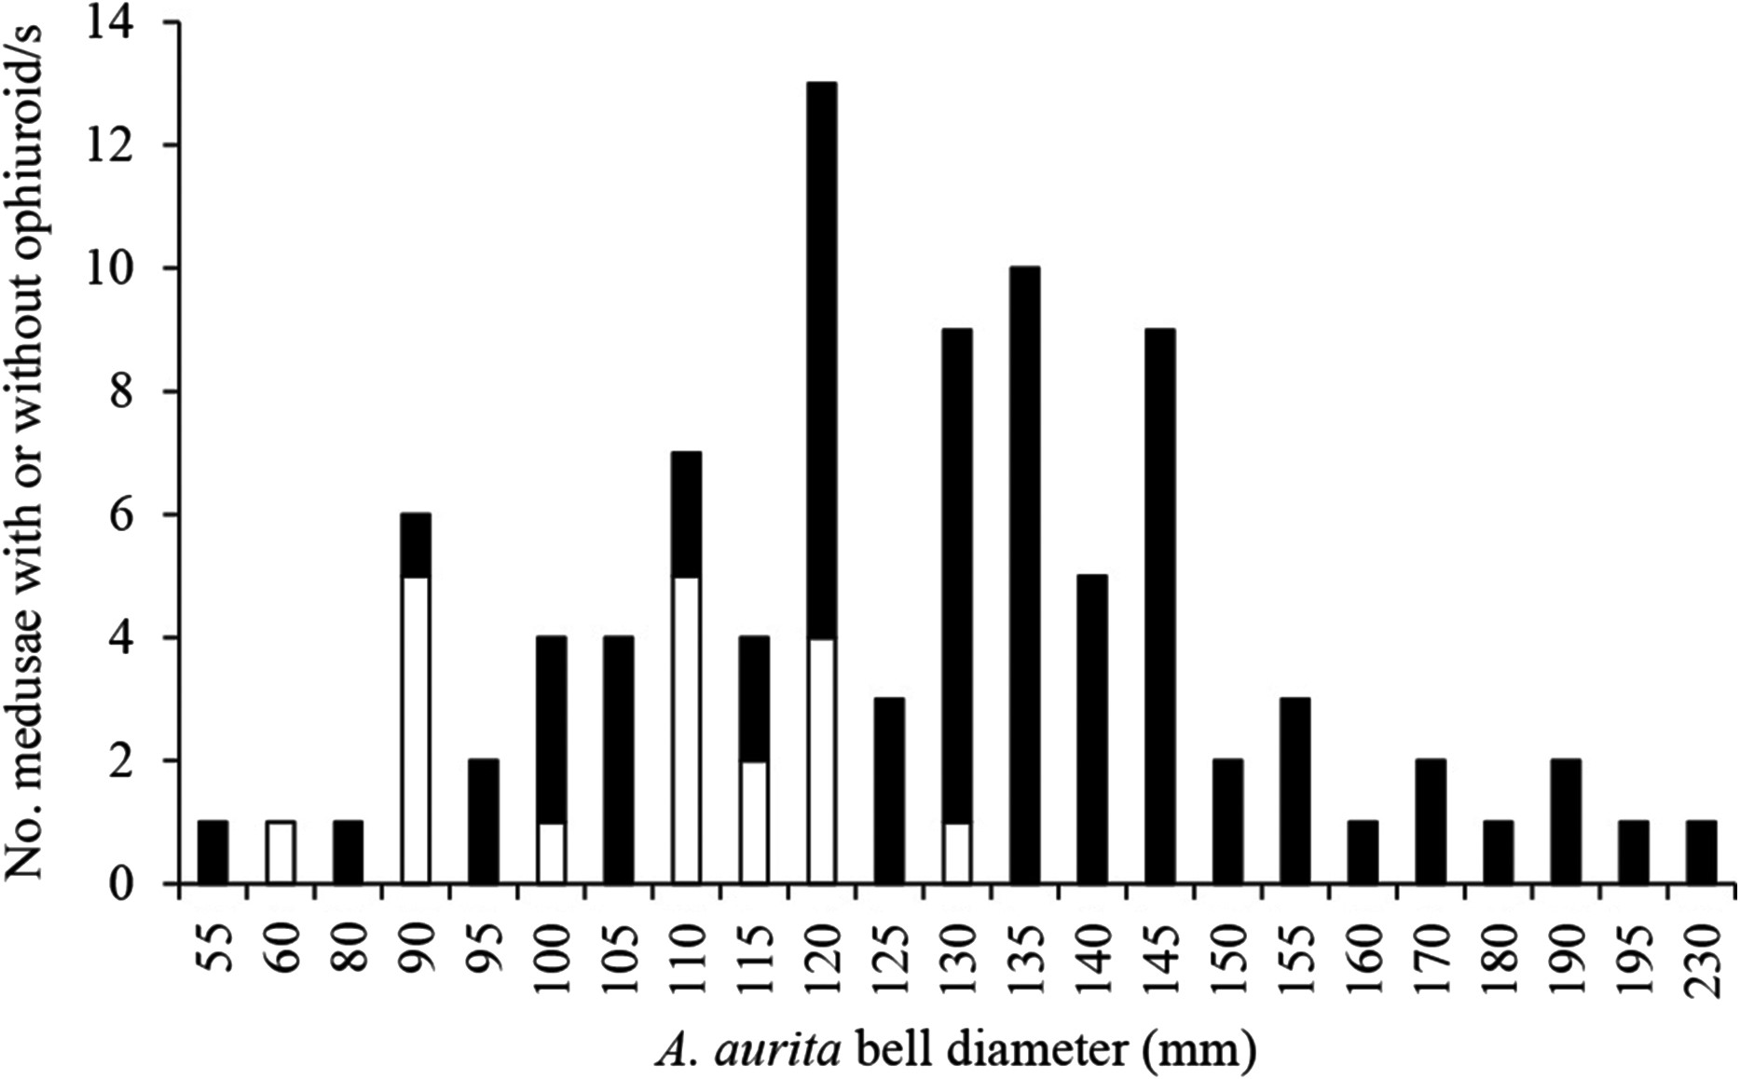
Fig. 2. Size–frequency distribution of A. aurita medusae; medusae without (white bars, N = 19) and with (black bars, ...
Notes:
Fig. 2. Size–frequency distribution of A. aurita medusae; medusae without (white bars, N = 19) and with (black bars, N = 73) ophiuroids.
Unless provided in the caption above, the following copyright applies to the content of this slide: © The Author 2016. Published by Oxford University Press. All rights reserved. For permissions, please e-mail: journals.permissions@oup.com

Slide 3
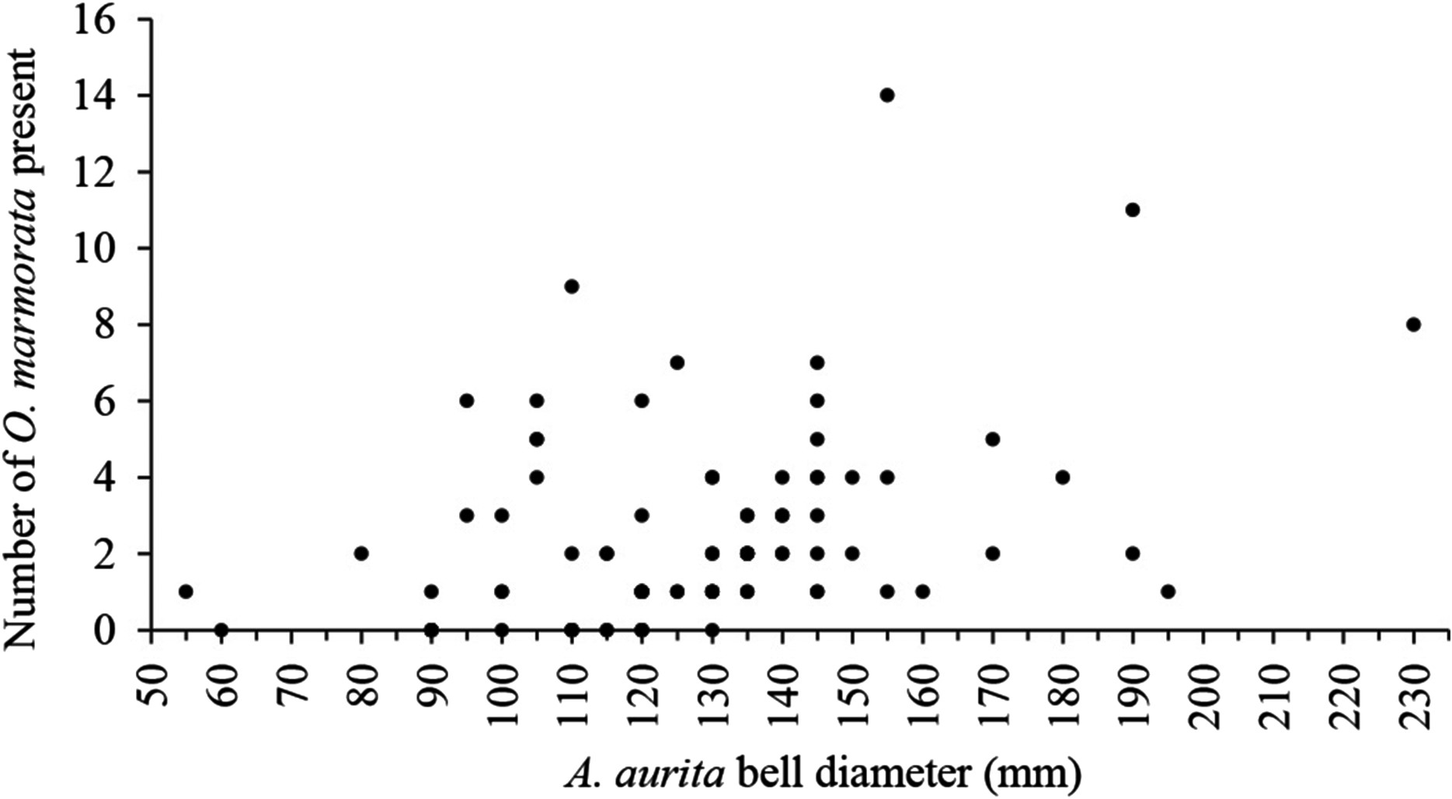
Fig. 3. The relationship between size of A. aurita medusae and number of O. marmorata hosted by an individual ...
Notes:
Fig. 3. The relationship between size of A. aurita medusae and number of O. marmorata hosted by an individual medusa.
Unless provided in the caption above, the following copyright applies to the content of this slide: © The Author 2016. Published by Oxford University Press. All rights reserved. For permissions, please e-mail: journals.permissions@oup.com

Slide 4
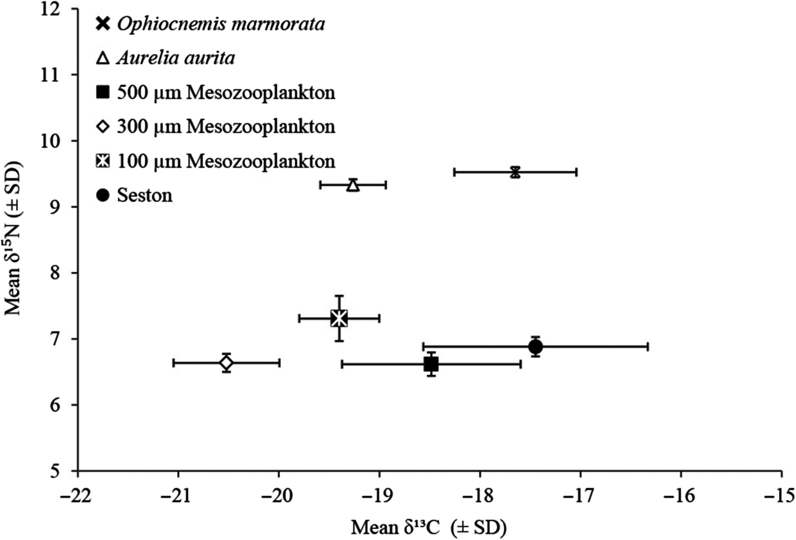
Fig. 4. Isotopic biplot of variation in mean (±SD) δ¹³C and δ¹⁵N (‰) values calculated for O. ...
Notes:
Fig. 4. Isotopic biplot of variation in mean (±SD) δ13C and δ15N (‰) values calculated for O. marmorata and its potential food sources: A. aurita, mesozooplankton (500, 300 and 100 µm size classes) and seston.
Unless provided in the caption above, the following copyright applies to the content of this slide: © The Author 2016. Published by Oxford University Press. All rights reserved. For permissions, please e-mail: journals.permissions@oup.com

Slide 5
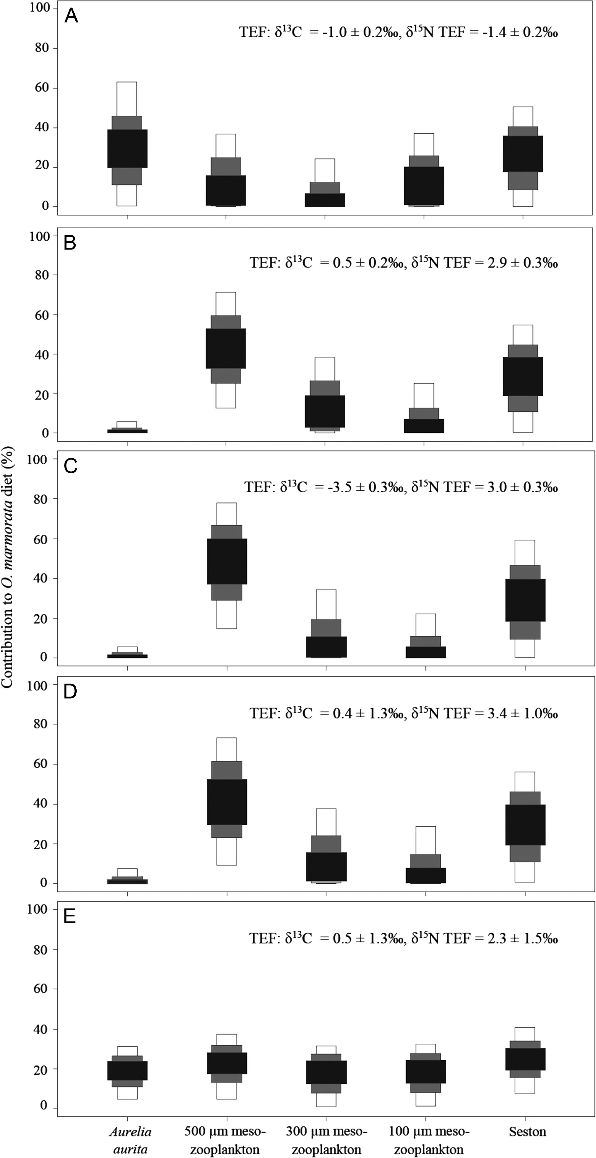
Fig. 5. Percentage contribution of each source to the assimilated diet of O. marmorata with (A) fish-fed ophiuroid ...
Notes:
Fig. 5. Percentage contribution of each source to the assimilated diet of O. marmorata with (A) fish-fed ophiuroid TEF values (Blanchet-Aurigny et al., 2012), (B) mussel-fed ophiuroid TEF values (Blanchet-Aurigny et al., 2012), (C) macroalgae-fed ophiuroid TEF values (Blanchet-Aurigny et al., 2012), and (D) (Post, 2002) and (E) (McCutchan et al., 2003) standard TEF values across taxa (refer to Table I). Grey scale (from light to dark) indicates 95, 75 and 50% confidence intervals, respectively.
Unless provided in the caption above, the following copyright applies to the content of this slide: © The Author 2016. Published by Oxford University Press. All rights reserved. For permissions, please e-mail: journals.permissions@oup.com

