Slide 1
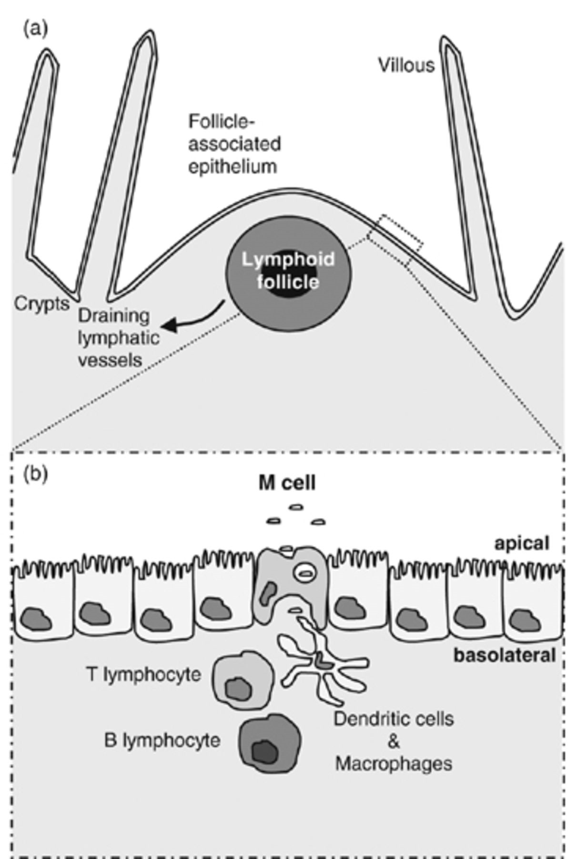
Figure 2 Overview of M-cell location within the PP FAE.
Notes:
Figure 2 Overview of M-cell location within the PP FAE.
Unless provided in the caption above, the following copyright applies to the content of this slide: © 2007 Federation of European Microbiological Societies

Slide 2
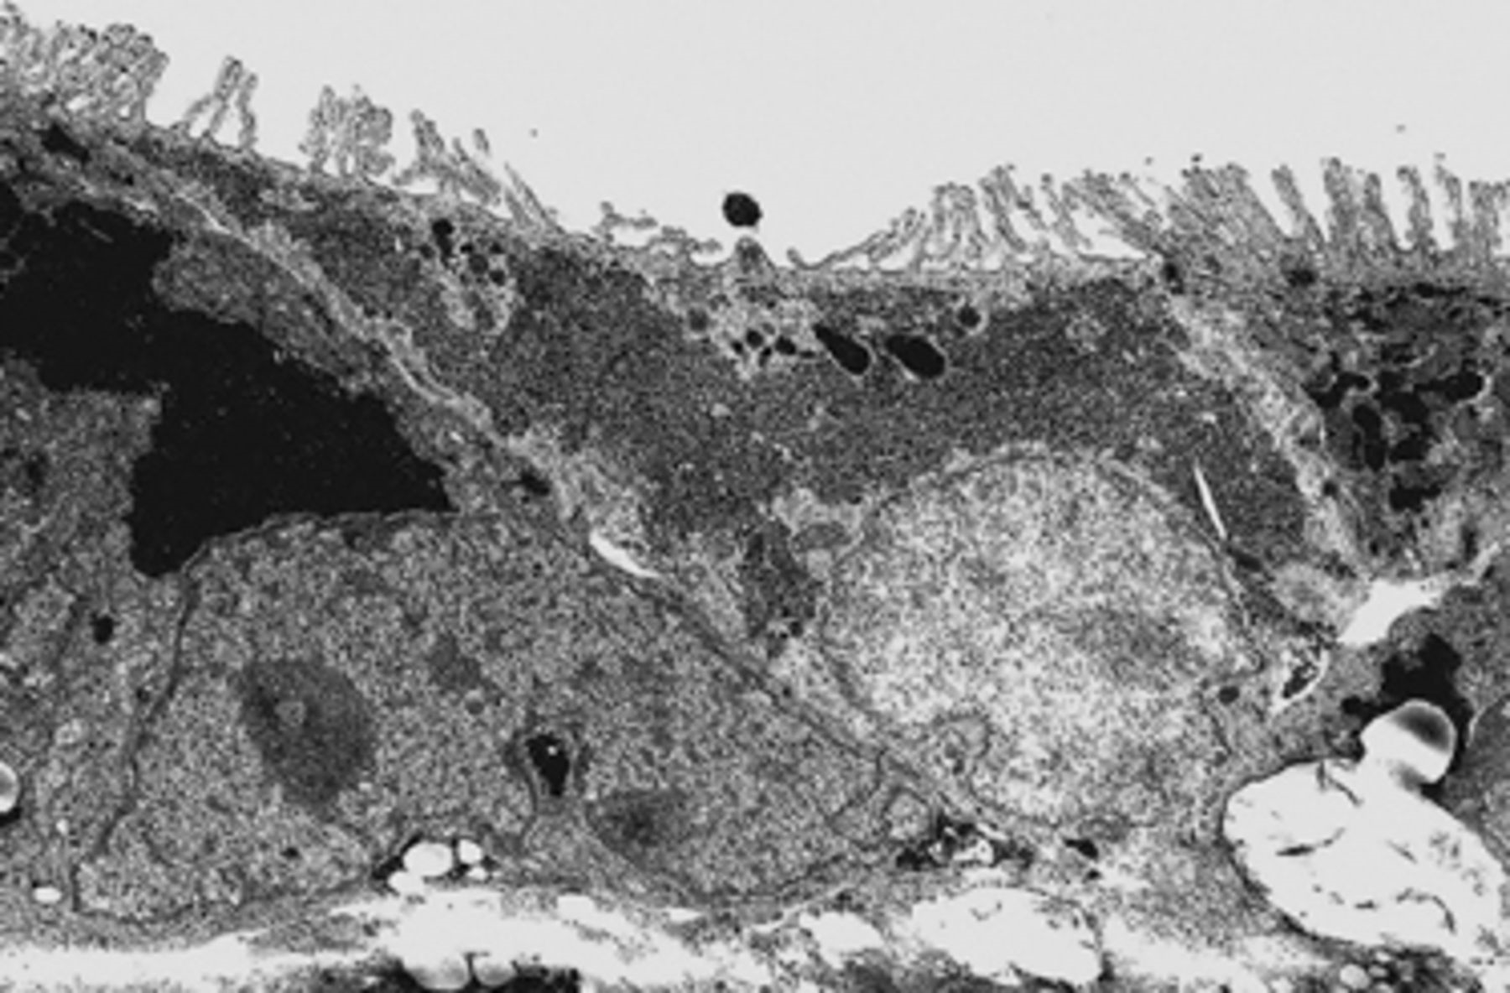
Figure 1 Electronmicrograph of an M-cell from a Caco-2 coculture experiment displaying short irregular microvilli ...
Notes:
Figure 1 Electronmicrograph of an M-cell from a Caco-2 coculture experiment displaying short irregular microvilli (Corr et al., 2006).
Unless provided in the caption above, the following copyright applies to the content of this slide: © 2007 Federation of European Microbiological Societies

Slide 3
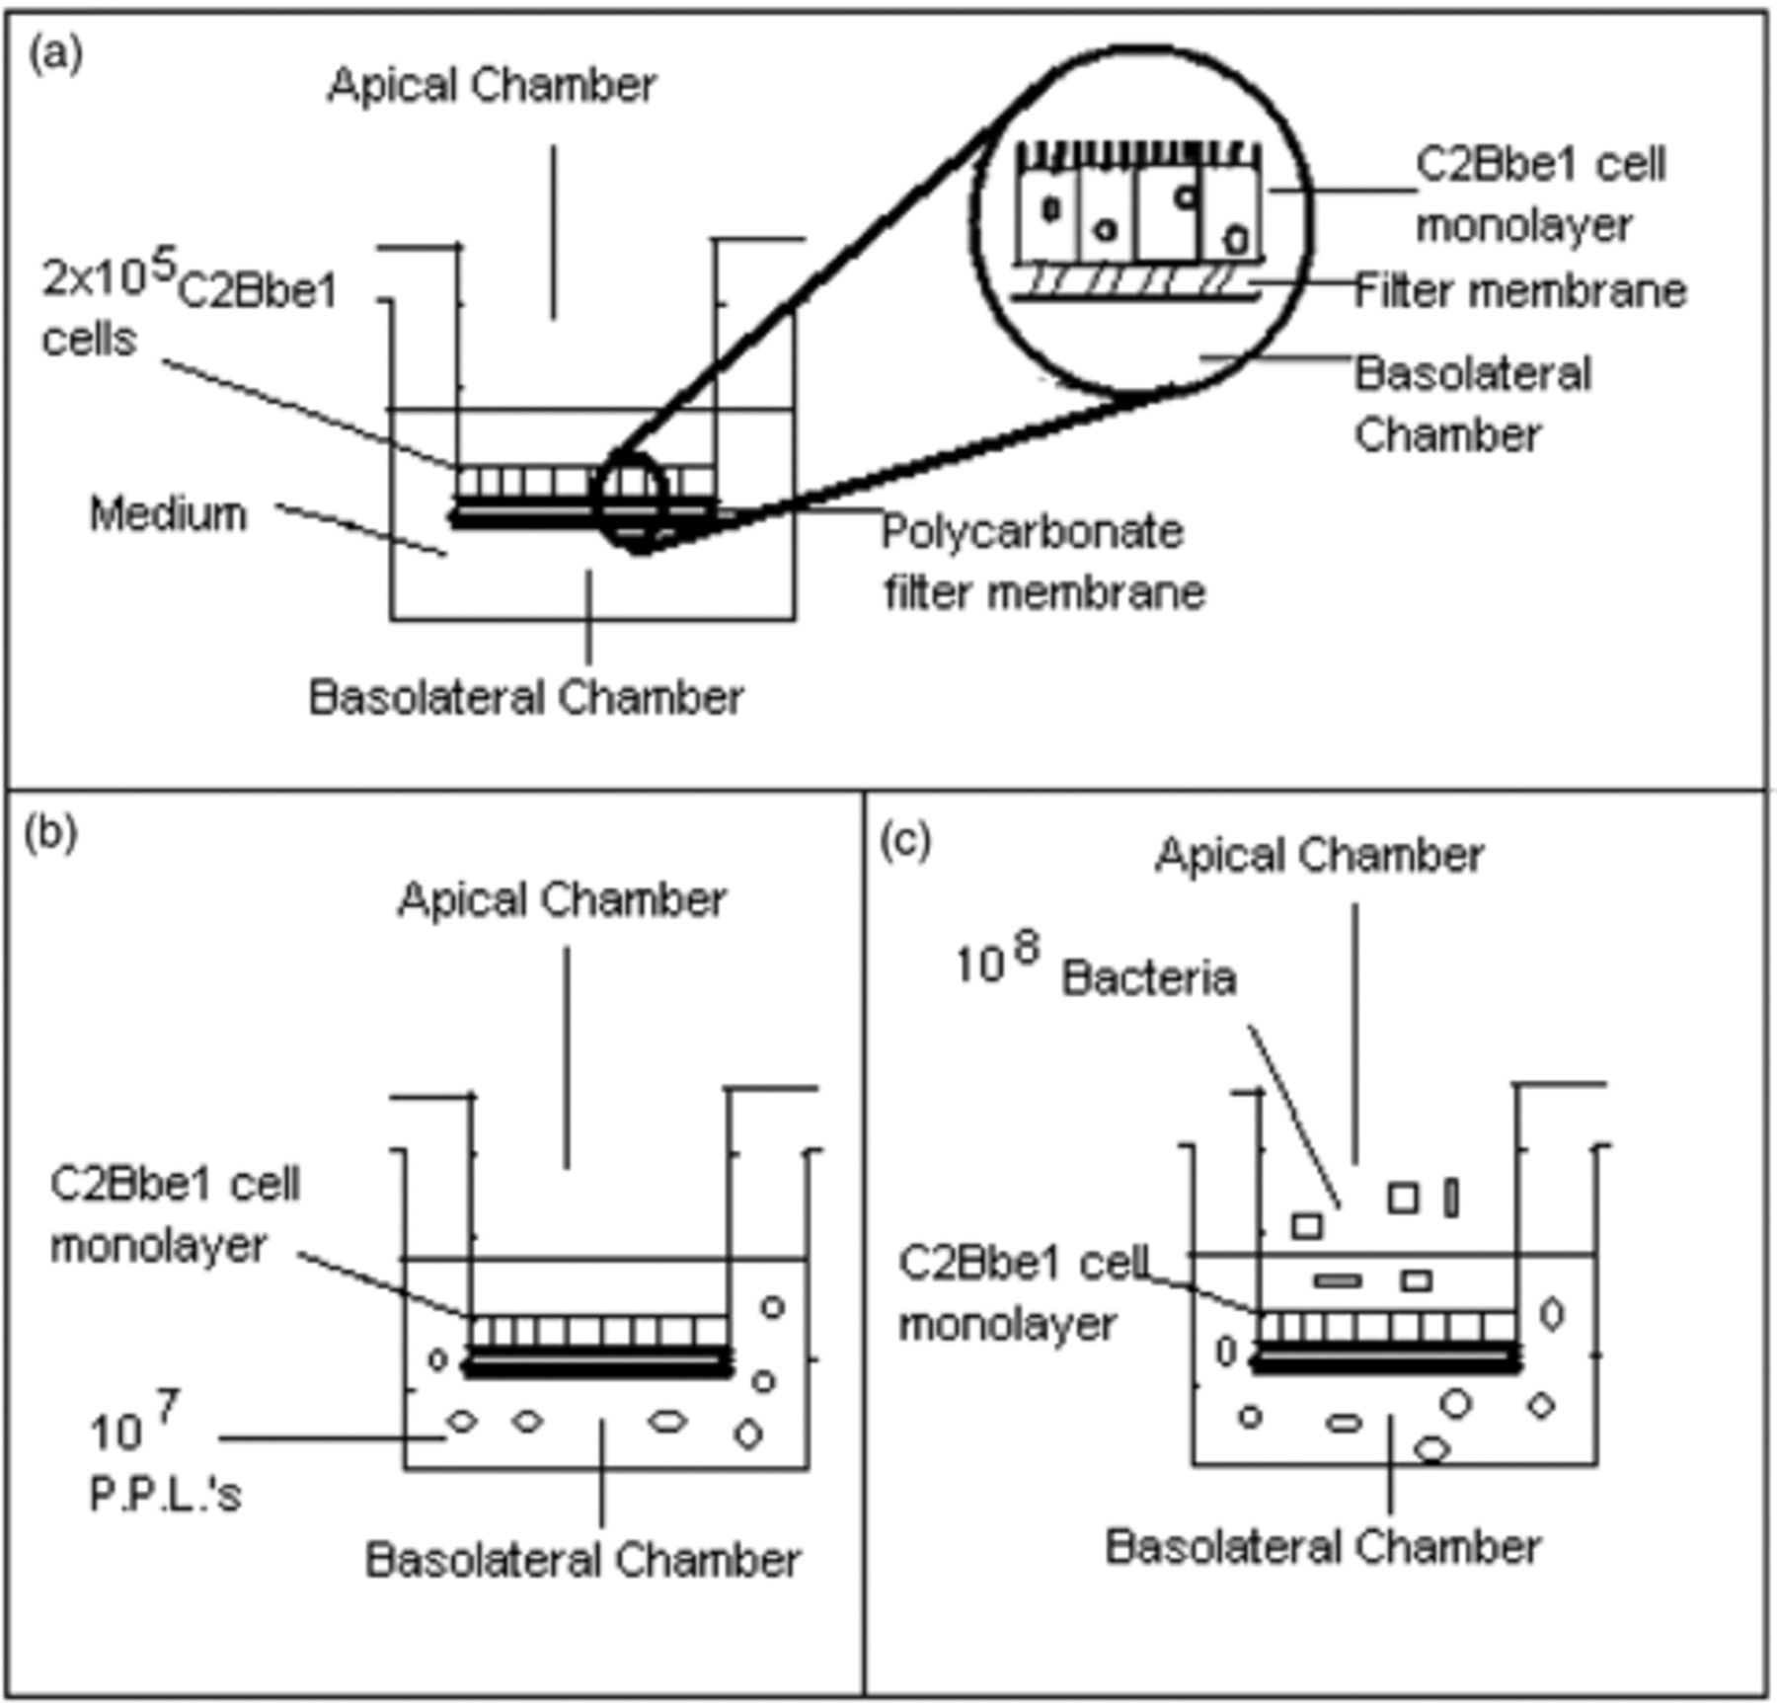
Figure 3 Outline of the in vitro M-cell model (Corr et al., 2006).
Notes:
Figure 3 Outline of the in vitro M-cell model (Corr et al., 2006).
Unless provided in the caption above, the following copyright applies to the content of this slide: © 2007 Federation of European Microbiological Societies

