Slide 1
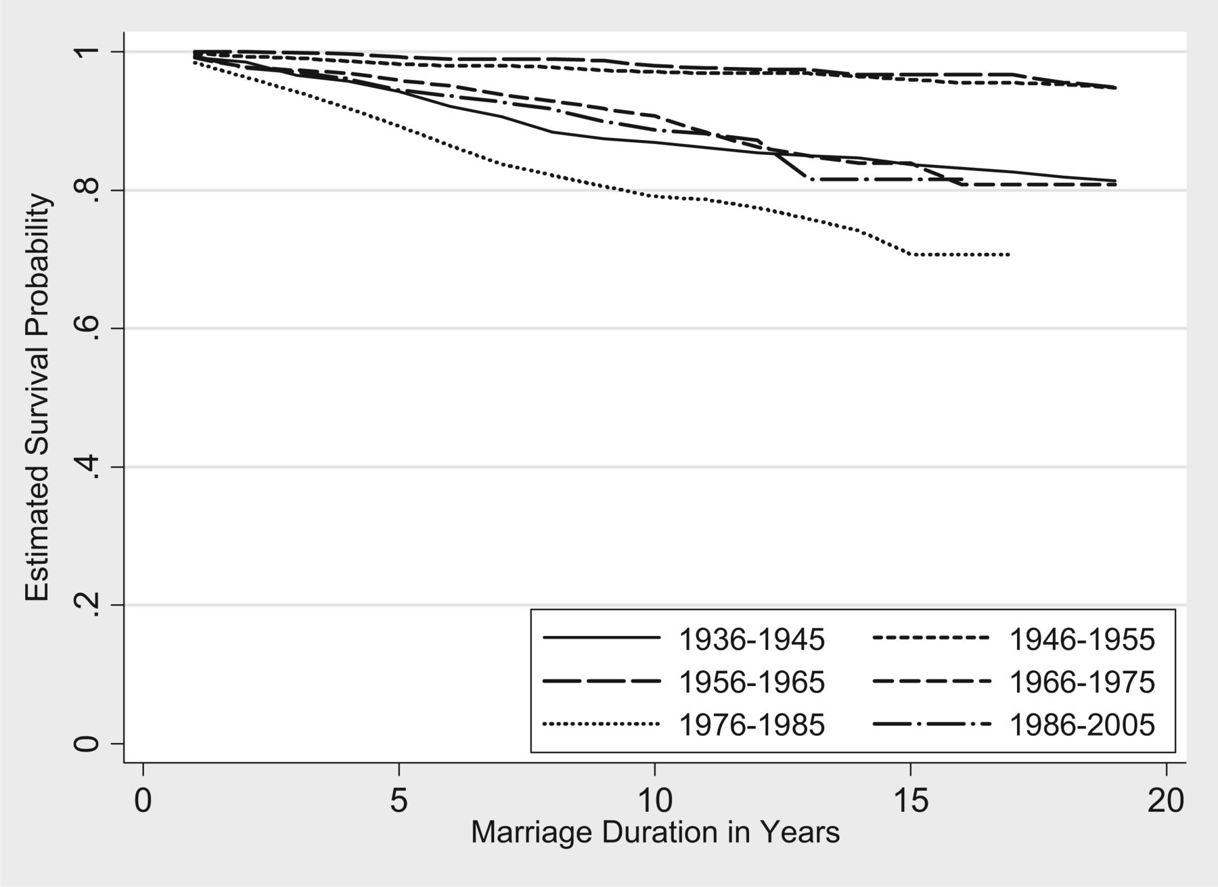
Figure 1. Proportion of non-disrupted marriages by marriage duration and marriage cohort. Source : GLHS
Notes:
Figure 1. Proportion of non-disrupted marriages by marriage duration and marriage cohort. Source : GLHS
Unless provided in the caption above, the following copyright applies to the content of this slide: © The Author 2015. Published by Oxford University Press. All rights reserved. For permissions, please e-mail: journals.permissions@oup.com

Slide 2
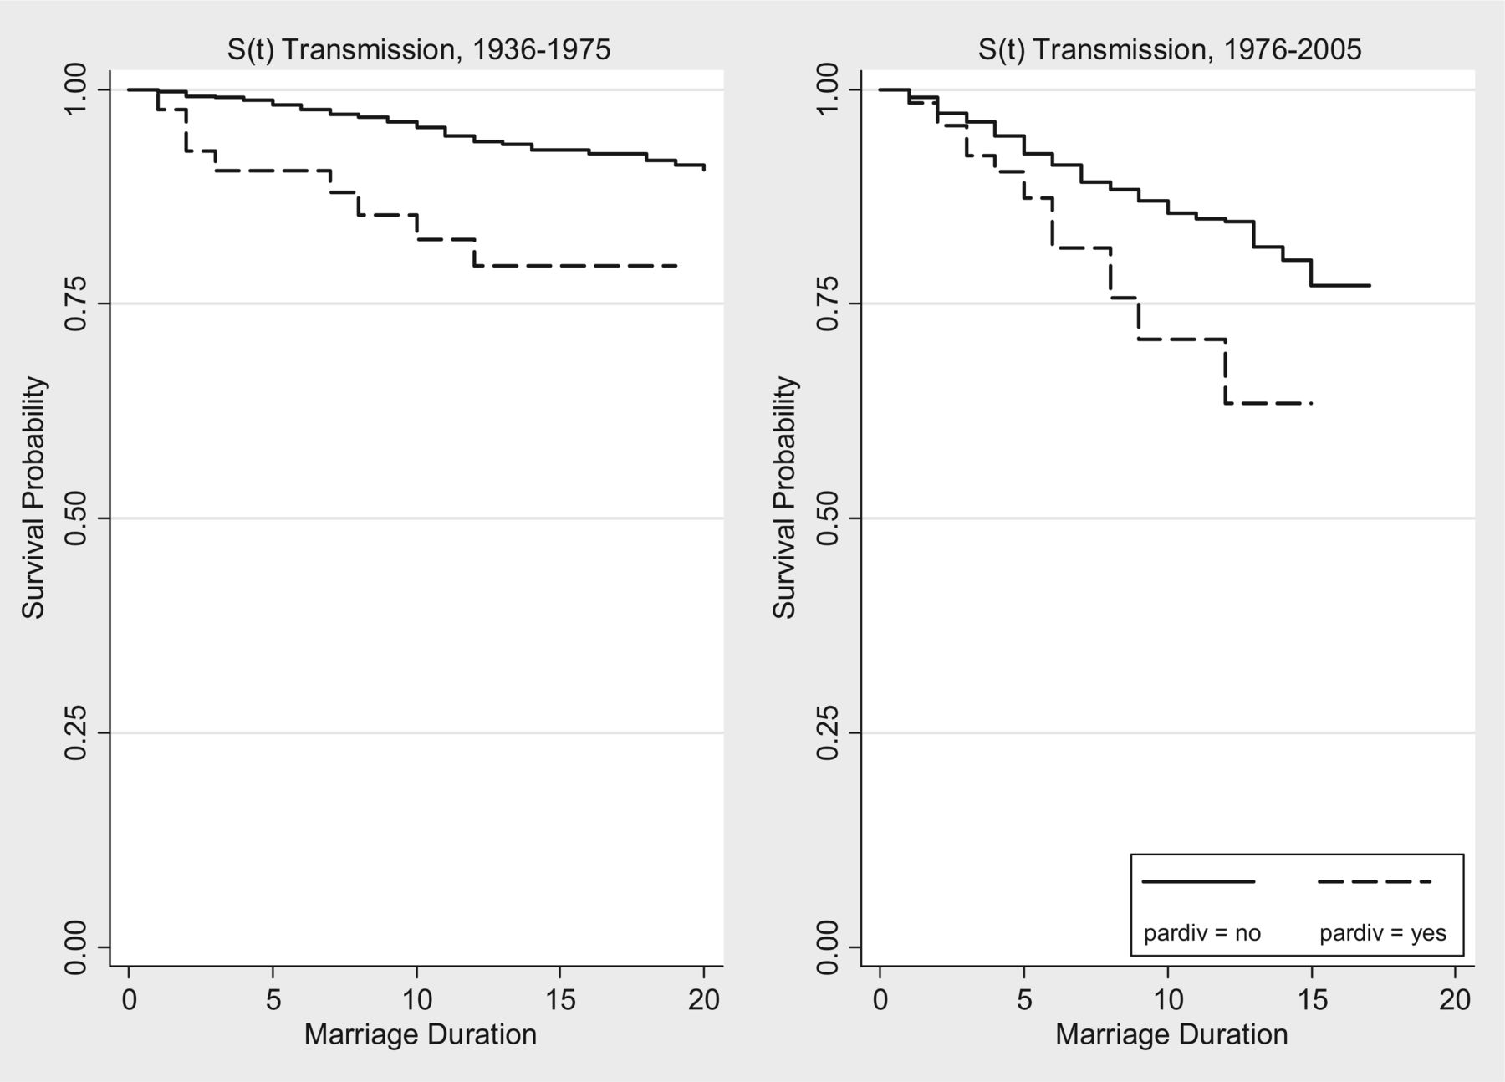
Figure 2. Proportion of non-disrupted marriages by parental divorce and two marriage cohorts. Source : GLHS
Notes:
Figure 2. Proportion of non-disrupted marriages by parental divorce and two marriage cohorts. Source : GLHS
Unless provided in the caption above, the following copyright applies to the content of this slide: © The Author 2015. Published by Oxford University Press. All rights reserved. For permissions, please e-mail: journals.permissions@oup.com

Slide 3
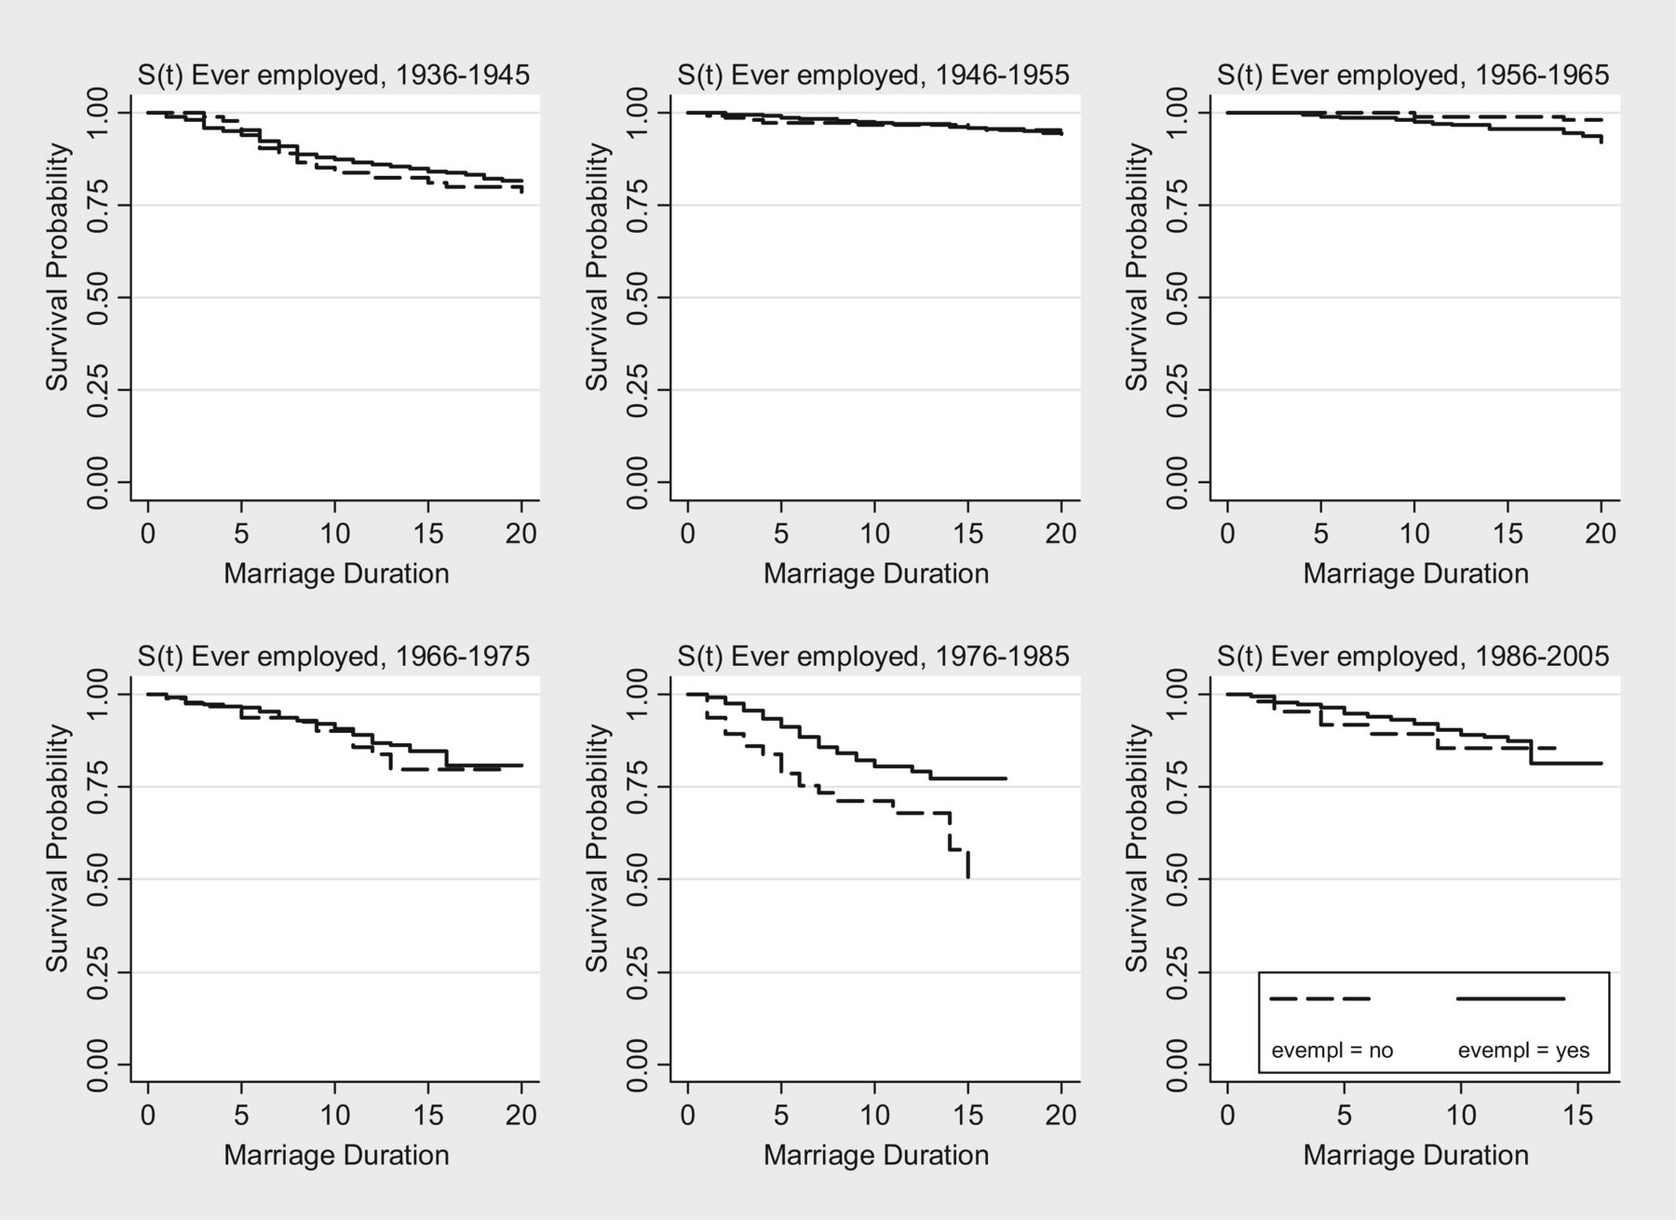
Figure 3. Proportion of non-disrupted marriages by women's employment and marriage cohort . Source : GLHS
Notes:
Figure 3. Proportion of non-disrupted marriages by women's employment and marriage cohort . Source : GLHS
Unless provided in the caption above, the following copyright applies to the content of this slide: © The Author 2015. Published by Oxford University Press. All rights reserved. For permissions, please e-mail: journals.permissions@oup.com

Slide 4
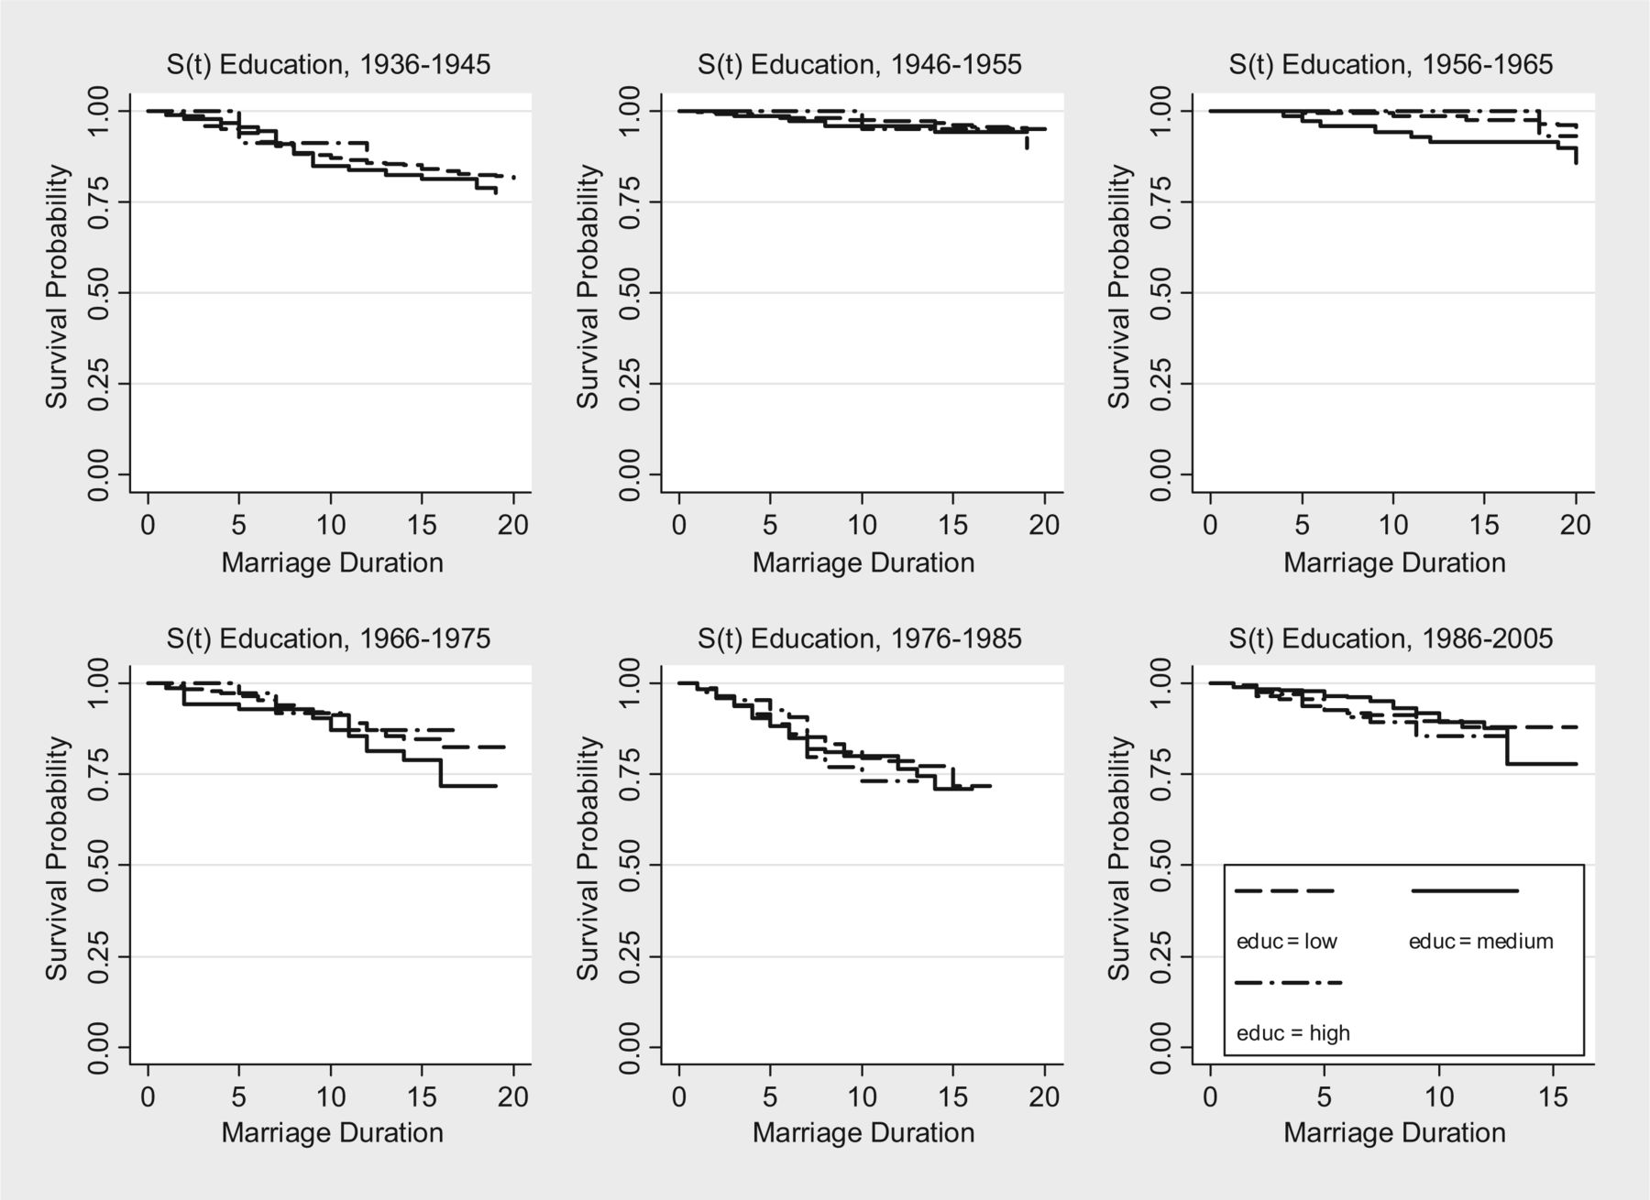
Figure 4. Proportion of non-disrupted marriages by women's education and marriage cohort . Source : GLHS
Notes:
Figure 4. Proportion of non-disrupted marriages by women's education and marriage cohort . Source : GLHS
Unless provided in the caption above, the following copyright applies to the content of this slide: © The Author 2015. Published by Oxford University Press. All rights reserved. For permissions, please e-mail: journals.permissions@oup.com

Slide 5
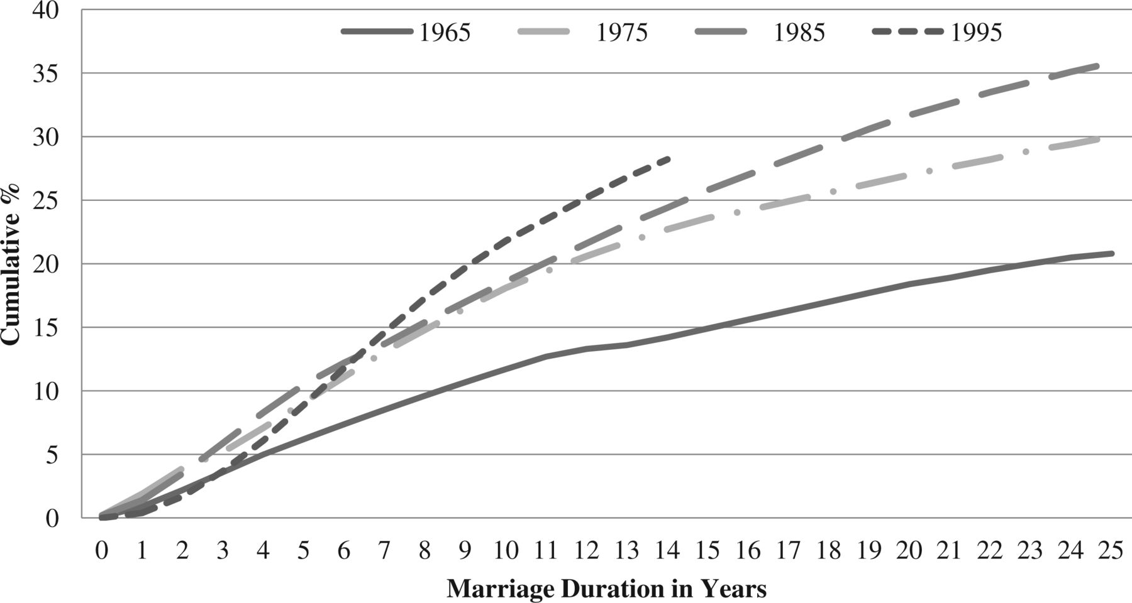
Figure A1. Proportion of divorced marriages of marriage cohorts 1965, 1975, 1985, and 1995 by marriage duration in ...
Notes:
Figure A1. Proportion of divorced marriages of marriage cohorts 1965, 1975, 1985, and 1995 by marriage duration in Germany ( Source : Federal Institute for Population Research)
Unless provided in the caption above, the following copyright applies to the content of this slide: © The Author 2015. Published by Oxford University Press. All rights reserved. For permissions, please e-mail: journals.permissions@oup.com

Slide 6
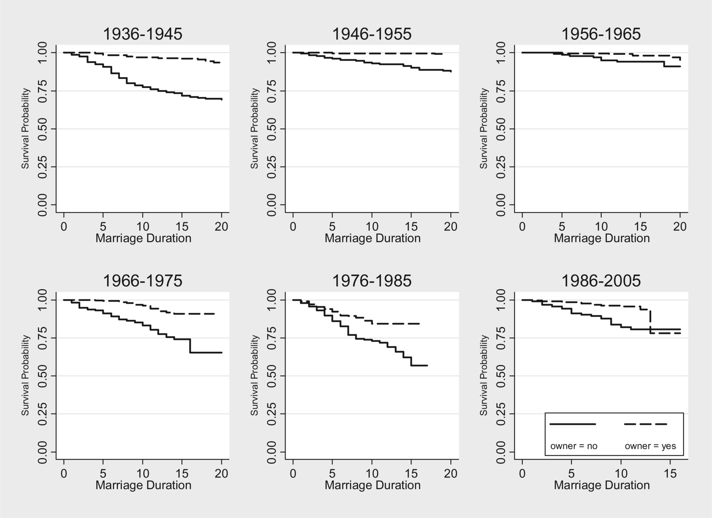
Figure A2. Proportion of non-disrupted marriages by homeownership and marriage cohort ( Source : GLHS)
Notes:
Figure A2. Proportion of non-disrupted marriages by homeownership and marriage cohort ( Source : GLHS)
Unless provided in the caption above, the following copyright applies to the content of this slide: © The Author 2015. Published by Oxford University Press. All rights reserved. For permissions, please e-mail: journals.permissions@oup.com

Slide 7
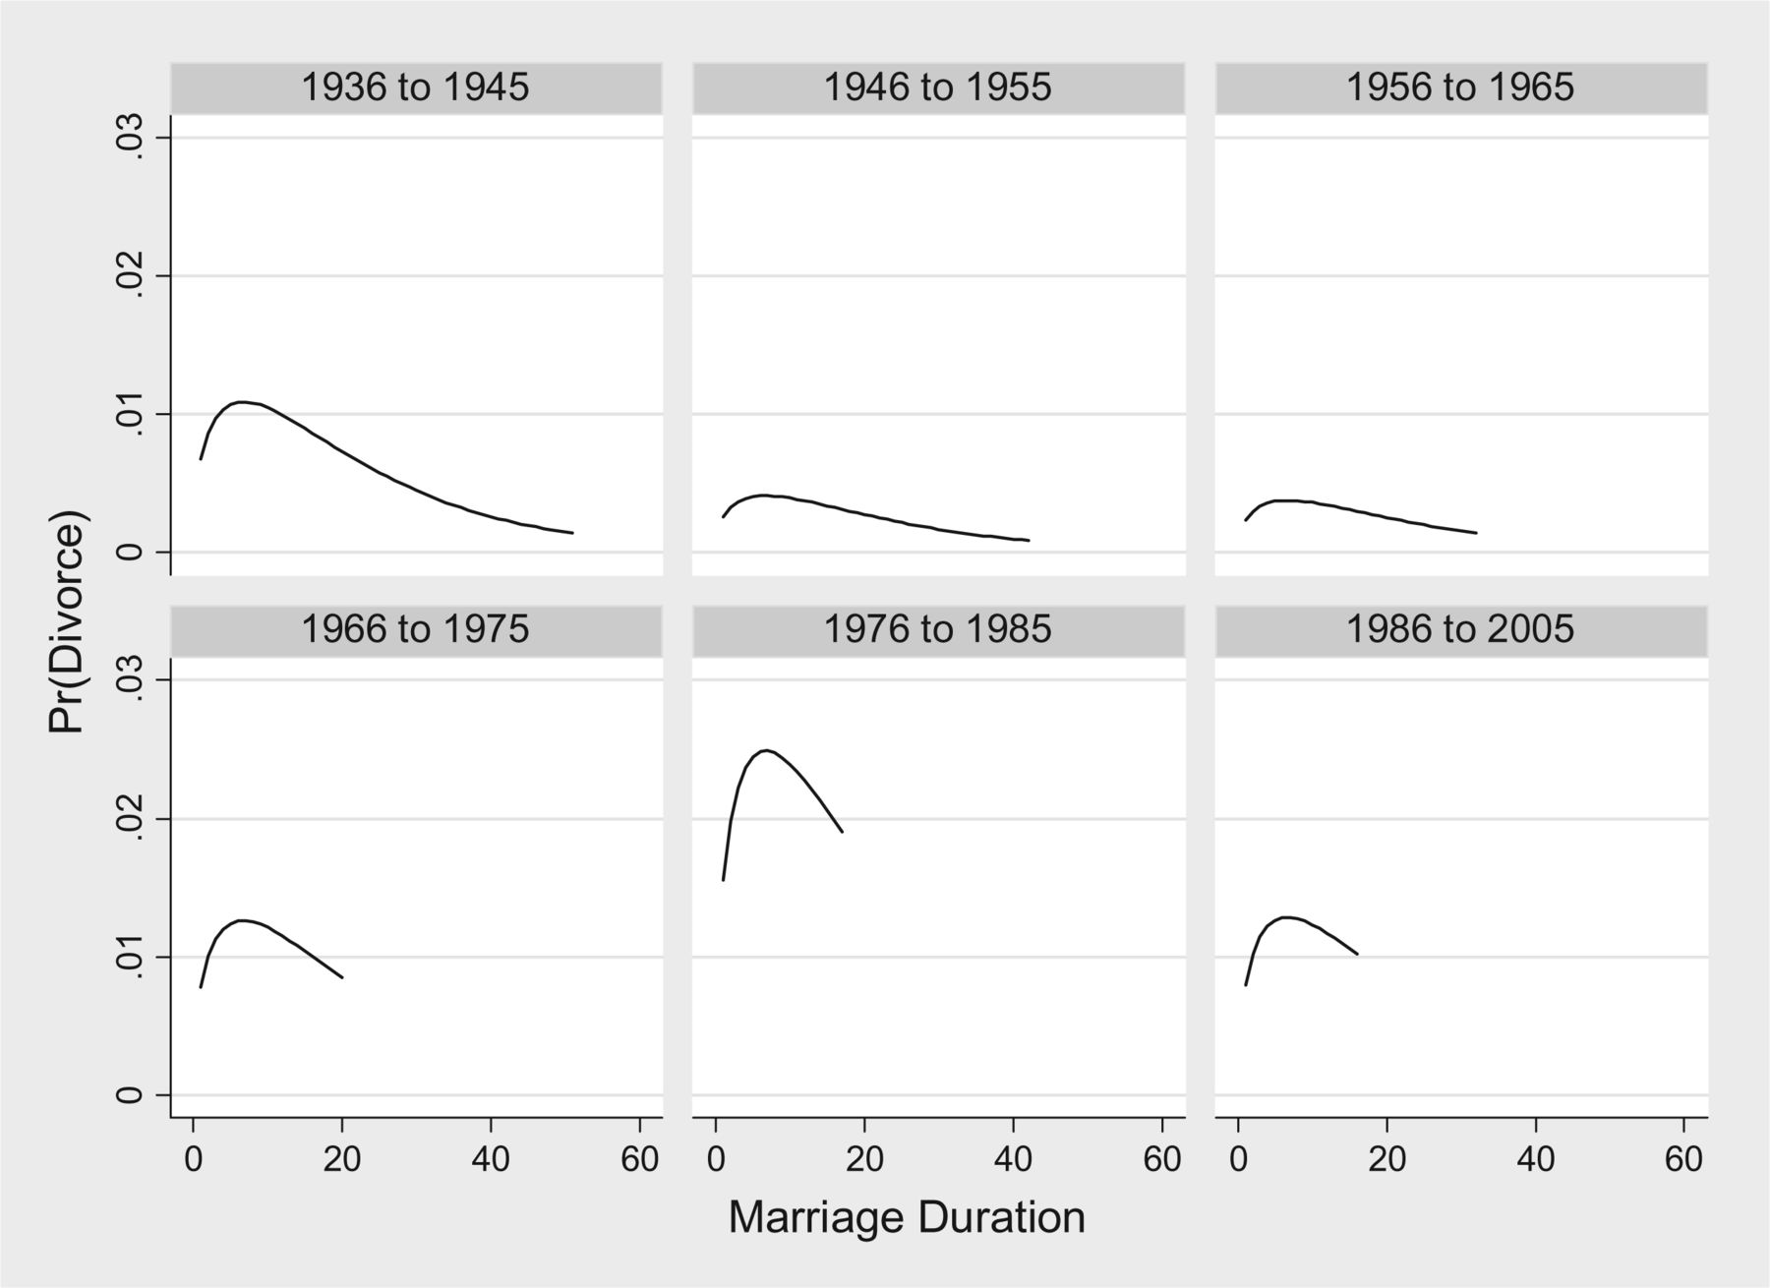
Figure A3. Hazard rate of divorce (marriage duration in years) by marriage cohorts (based on the ‘cohort model’ in ...
Notes:
Figure A3. Hazard rate of divorce (marriage duration in years) by marriage cohorts (based on the ‘cohort model’ in Table 3 ) ( Source : GLHS)
Unless provided in the caption above, the following copyright applies to the content of this slide: © The Author 2015. Published by Oxford University Press. All rights reserved. For permissions, please e-mail: journals.permissions@oup.com

Slide 8
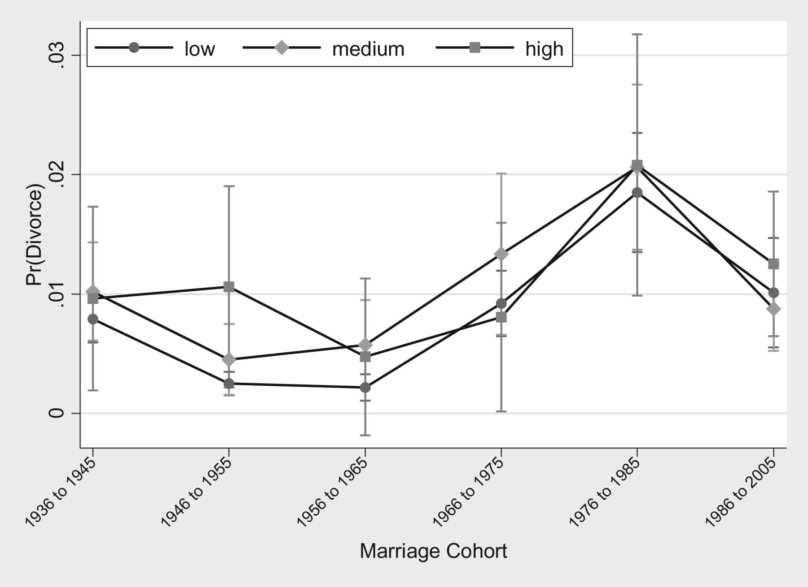
Figure A4. Predicted probabilities of divorce and 95% confidence intervals by marriage cohort and educational ...
Notes:
Figure A4. Predicted probabilities of divorce and 95% confidence intervals by marriage cohort and educational attainment ( Source : GLHS)
Unless provided in the caption above, the following copyright applies to the content of this slide: © The Author 2015. Published by Oxford University Press. All rights reserved. For permissions, please e-mail: journals.permissions@oup.com

Slide 9
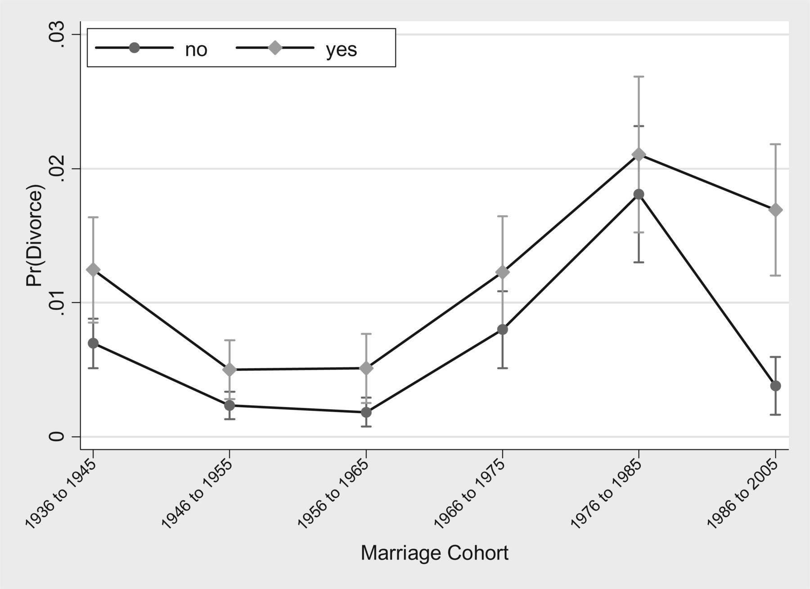
Figure A5. Predicted probabilities of divorce and 95% confidence intervals by marriage cohort and women’s employment ...
Notes:
Figure A5. Predicted probabilities of divorce and 95% confidence intervals by marriage cohort and women’s employment (time-dependent) ( Source : GLHS)
Unless provided in the caption above, the following copyright applies to the content of this slide: © The Author 2015. Published by Oxford University Press. All rights reserved. For permissions, please e-mail: journals.permissions@oup.com

