Slide 1
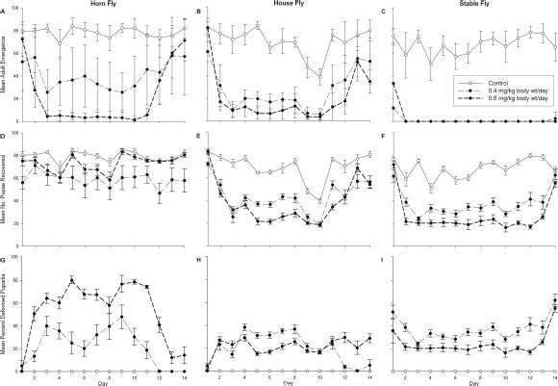
Fig. 1. Effects of two rates of a feed-through formulation of novaluron on adult emergence (±SE; A–C), number of ...
Notes:
Fig. 1. Effects of two rates of a feed-through formulation of novaluron on adult emergence (±SE; A–C), number of pupae recovered (±SE; D–F), and puparial deformity (±SE; G–I) of horn flies, house flies, and stable flies. Animals were treated for the first 10 d of the study, and treatments were withdrawn for the last 4 d. All data shown are raw data.
Unless provided in the caption above, the following copyright applies to the content of this slide: © 2014 Entomological Society of AmericaThis is an Open Access article distributed under the terms of the Creative Commons Attribution Non-Commercial License (http://creativecommons.org/licenses/by-nc/3.0/), which permits non-commercial reuse, distribution, and reproduction in any medium, provided the original work is properly cited. For commercial re-use, please contact journals.permissions@oup.com

