Slide 1
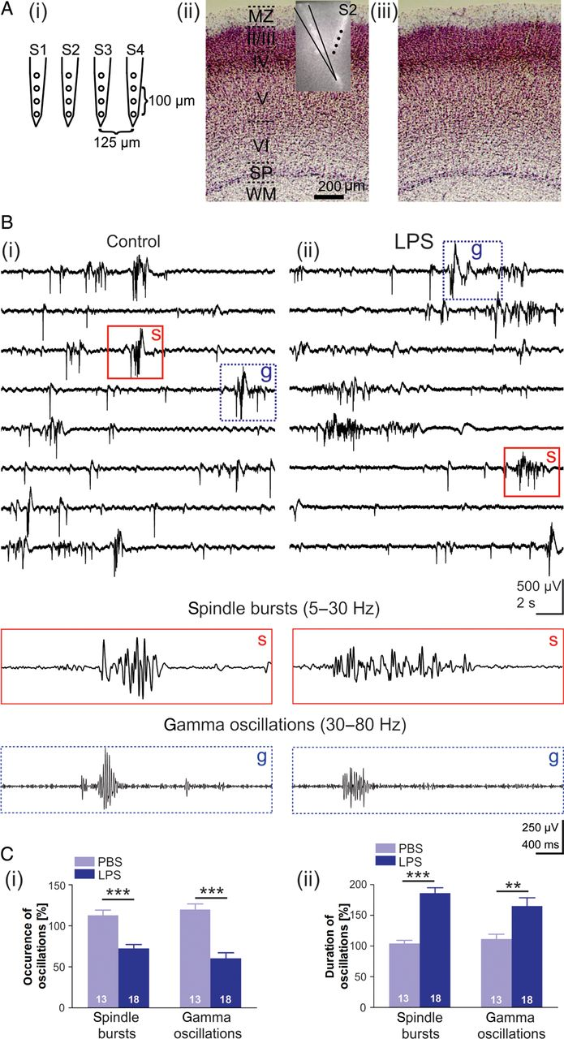
Figure 1. LPS-induced inflammation in the newborn rat somatosensory cortex in vivo leads to alterations in spontaneous ...
Notes:
Figure 1. LPS-induced inflammation in the newborn rat somatosensory cortex in vivo leads to alterations in spontaneous neuronal network activity. (A) A schematic illustration of a 4-shank 16-channel electrode (i). Image of a Nissl-stained coronal section superimposed with the DiI track of a glass pipette and a multi-electrode shank2 (S2) from one P3 rat (ii). The same photograph of the Nissl-stained coronal section in (ii) shows no obvious damage induced by the glass pipette or multi-electrode (iii). (B) Continuous extracellular field-potential recordings of spontaneous activity in a P4 rat under control conditions (i) and 3 h after LPS injection (ii). Lower traces show spindle bursts (s) (5–30 Hz filtered) and gamma oscillations (g) (30–80 Hz filtered) boxed in the upper panel at higher temporal resolution. (C) LPS-induced modifications in the relative occurrence (i) and duration (ii) of spontaneous spindle bursts (left) and gamma oscillations (right) when compared with PBS-treated control animals. The number of PBS-treated controls and LPS-injected animals is 13 and 18, respectively. In this and the following figures data are presented as mean ± SEM and the number of experiments is indicated in the bars.
Unless provided in the caption above, the following copyright applies to the content of this slide: © The Author 2012. Published by Oxford University Press. All rights reserved. For Permissions, please e-mail: journals.permissions@oup.com

Slide 2
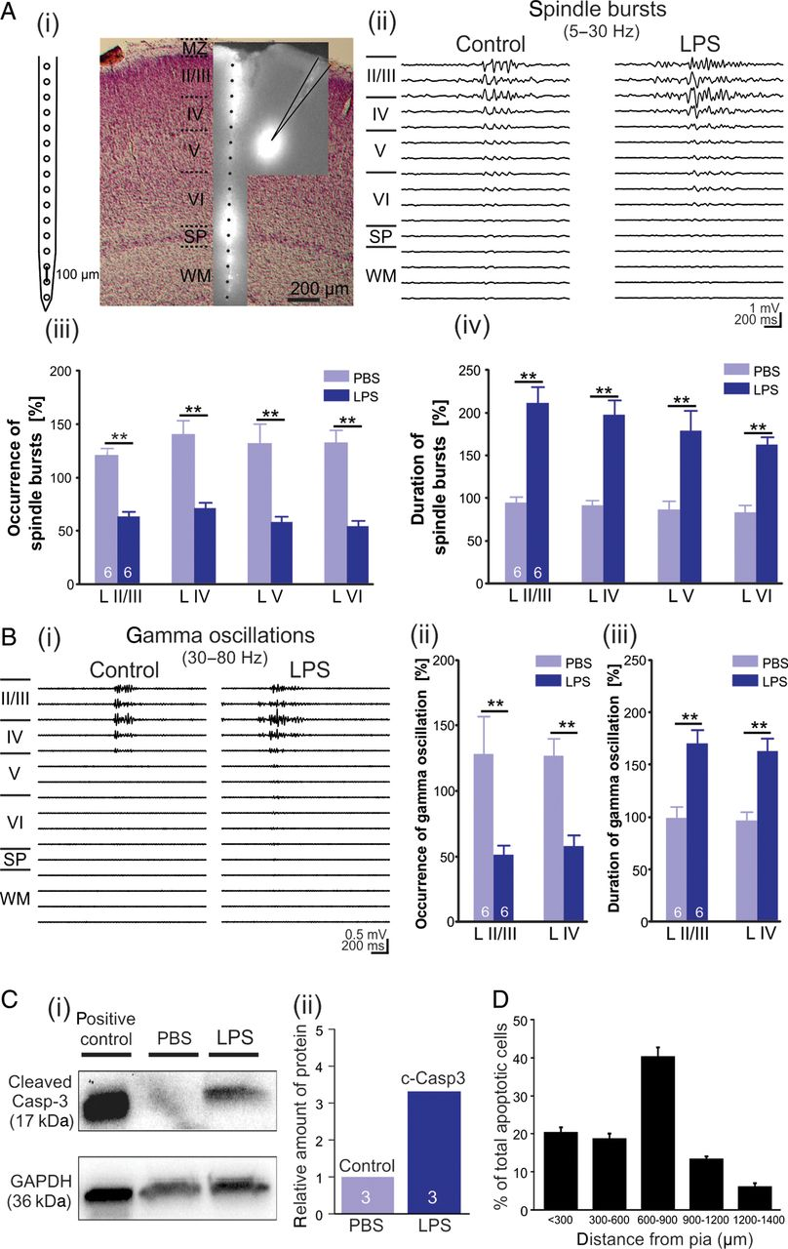
Figure 2. (A) A schematic illustration of a 1-shank 16-channel electrode (i, left) and photograph of Nissl-stained ...
Notes:
Figure 2. (A) A schematic illustration of a 1-shank 16-channel electrode (i, left) and photograph of Nissl-stained coronal section superimposed with a DiI track of the glass pipette and the multi-electrode in a P4 rat (i, right). Recordings with 16-channel electrode demonstrating the effect of LPS on the duration of spindle bursts in all layers (ii). LPS-induced modifications in the relative occurrence (iii) and duration (iv) of spontaneous spindle bursts when compared with PBS-treated control animals in layers II/III, IV, V, and VI. (B) Recordings with 16-channel electrode illustrating the effect of LPS on the duration of gamma oscillations in layers II/III and IV (i). LPS-induced modifications in the relative occurrence (ii) and duration (iii) of spontaneous gamma oscillations when compared with PBS-treated control animals in layers II/III and IV. (C) Western blot analyses from the somatosensory cortex of 3 PBS-treated controls and 3 LPS-injected P4–P5 rats (i). Band at 17 kDa corresponds to cleaved casp-3. GAPDH served as a loading control and neocortical slices from mice treated with 100 nM staurosporine for 24 h were used as positive control. (ii) Densitometric analysis and normalization to GAPDH shows a relative increase of cleaved casp-3 protein in LPS-treated tissue when compared with PBS-treated controls. (D) Laminar distribution of apoptotic cells in percentage, relative to the total amount of cells demonstrating the highest amount of apoptotic cells are at a cortical depth of 600–900 µm (n = 15 slices from 7 animals).
Unless provided in the caption above, the following copyright applies to the content of this slide: © The Author 2012. Published by Oxford University Press. All rights reserved. For Permissions, please e-mail: journals.permissions@oup.com

Slide 3
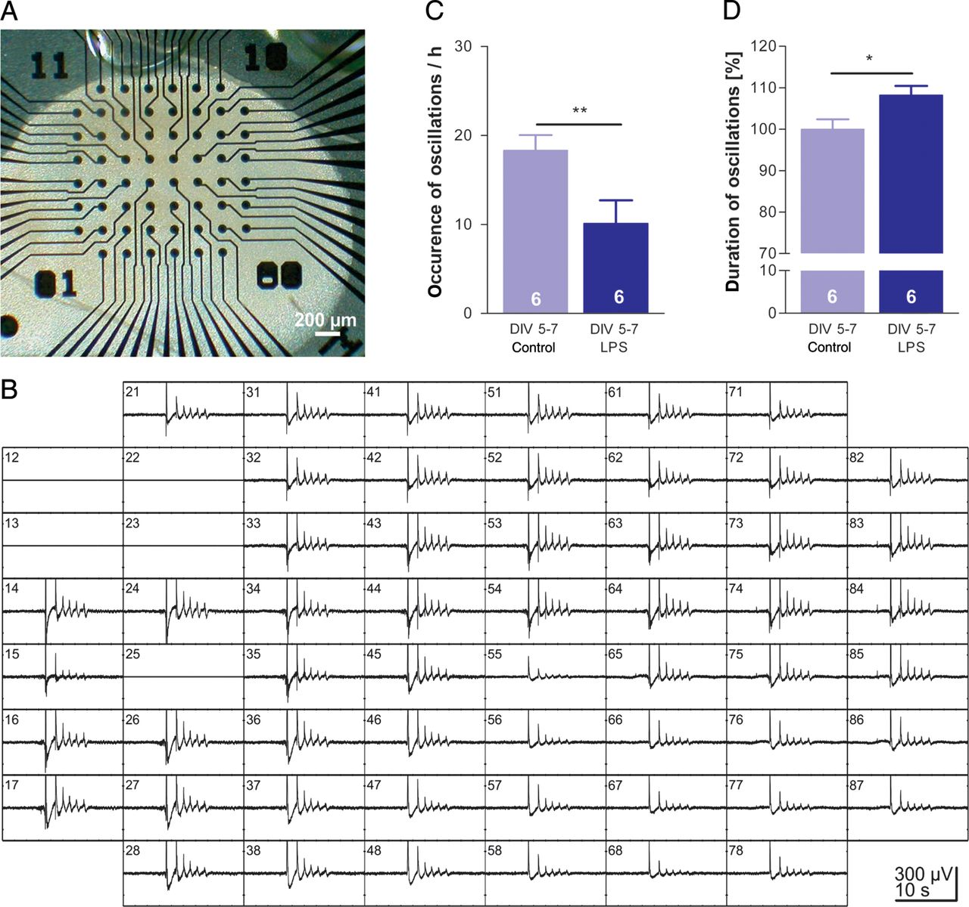
Figure 3. Effects of LPS on synchronized spontaneous network activity in neocortical slice cultures. (A) Image of a 5 ...
Notes:
Figure 3. Effects of LPS on synchronized spontaneous network activity in neocortical slice cultures. (A) Image of a 5 DIV organotypic neocortical slice culture placed on a 60-channel MEA. Black dots represent extracellular recording electrodes separated by 200 µm. (B) A simultaneous 60-channel MEA recording of synchronized network oscillations in a control organotypic neocortical slice culture. Five channels are damaged and were switched off. (C and D) Treatment of 5–7 DIV organotypic cultures with LPS for 1.5 h causes a significant decrease in the occurrence of spontaneous network oscillations (C) and an increase in their duration (D) when compared with untreated controls.
Unless provided in the caption above, the following copyright applies to the content of this slide: © The Author 2012. Published by Oxford University Press. All rights reserved. For Permissions, please e-mail: journals.permissions@oup.com

Slide 4
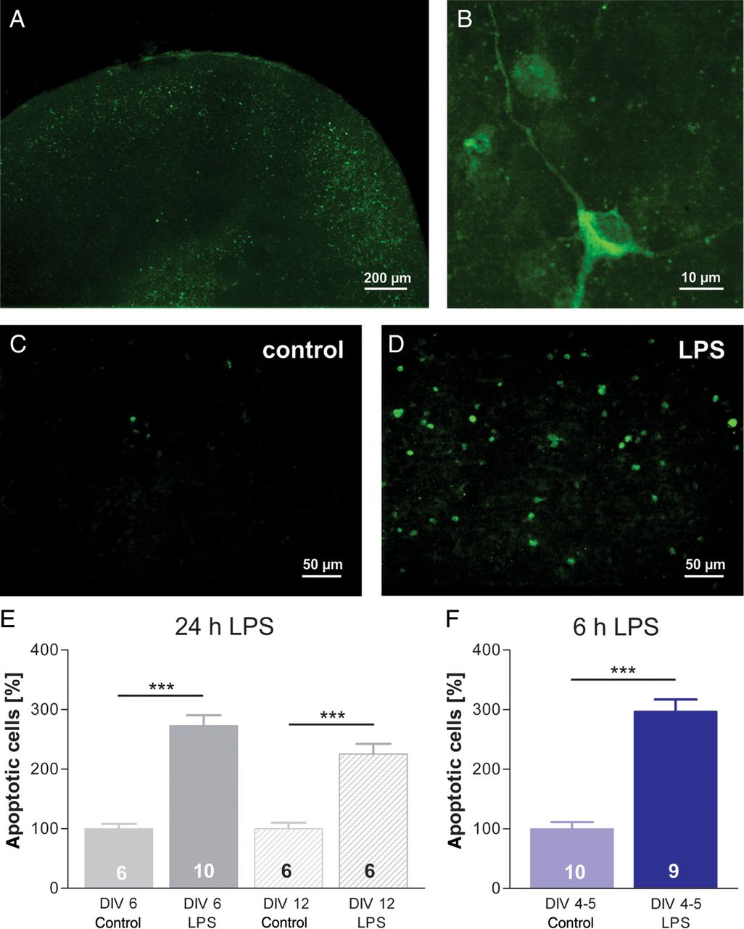
Figure 4. LPS causes apoptotic cell death in organotypic neocortical slice cultures. (A) Fluorescence image of a ...
Notes:
Figure 4. LPS causes apoptotic cell death in organotypic neocortical slice cultures. (A) Fluorescence image of a cleaved casp-3 stained slice culture at 3 DIV. (B) A high magnification fluorescence image of a cleaved casp-3 positive neuron. (C and D) Stained cleaved casp-3 positive neurons (DIV 9) 24 h after control treatment with saline (C) or after LPS (10 µg/mL) treatment (D). (E) Casp-3–dependent cell death in 6 and 12 DIV organotypic slice cultures treated for 24 h with 10 µg/mL LPS when compared with untreated controls. (F) A significant increase in percentage of apoptotic cells in 4–5 DIV cultures after LPS treatment for 6 h.
Unless provided in the caption above, the following copyright applies to the content of this slide: © The Author 2012. Published by Oxford University Press. All rights reserved. For Permissions, please e-mail: journals.permissions@oup.com

Slide 5
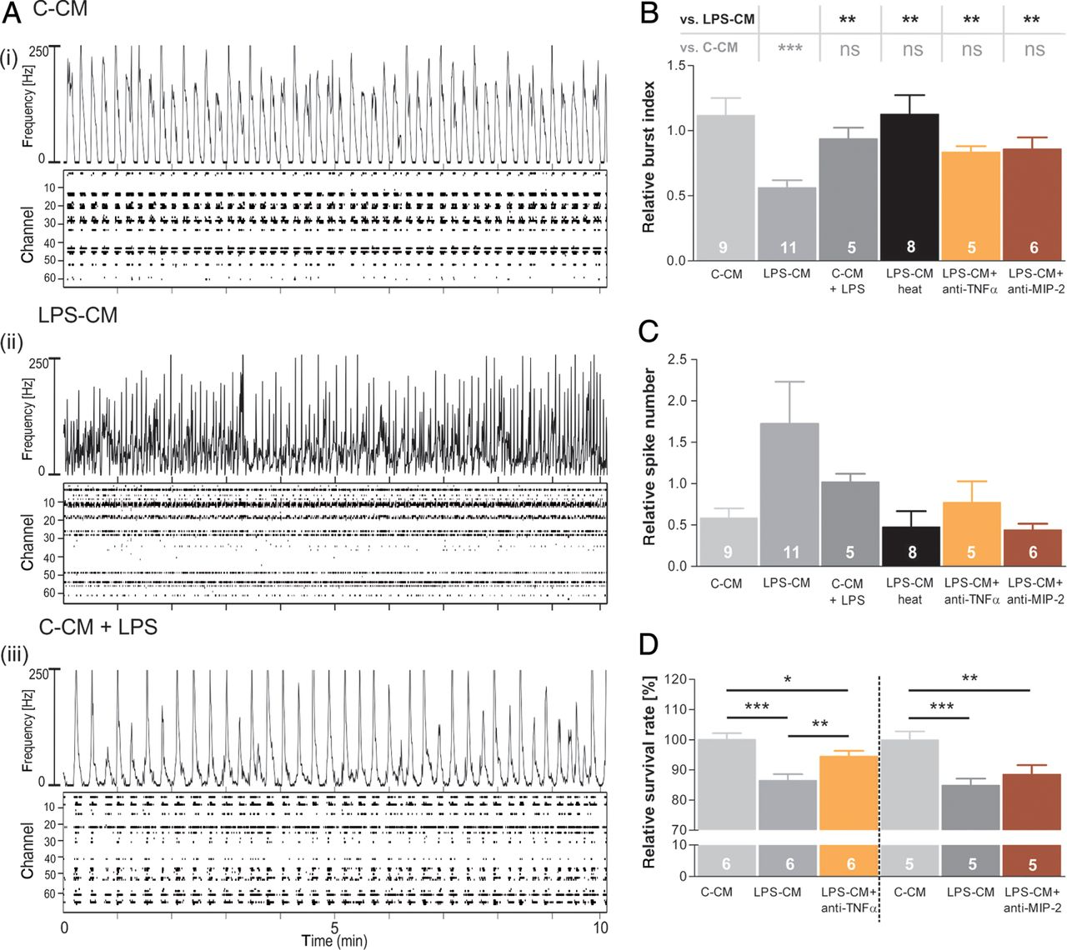
Figure 5. Identification of pro-inflammatory factors causing network desynchronization and cell death. (A) ...
Notes:
Figure 5. Identification of pro-inflammatory factors causing network desynchronization and cell death. (A) Representative MEA recordings of a 14 DIV dissociated neuronal culture under control conditions (C-CM, i), after 1 h application with the medium of LPS-treated BV-2 cells (LPS-CM, ii) and after 1 h treatment with LPS only (C-CM + LPS, iii). (B–D) Relative BI (B), spike number (C), and survival rate (D) under various experimental conditions: control conditions (C-CM); after 1 h application with the supernatant of LPS-treated BV-2 cells (LPS-CM); after 1 h treatment with LPS only (C-CM + LPS); after application of heat-inactivated LPS-CM (LPS-CM heat); LPS-CM + anti-TNFα; and LPS-CM + anti-MIP-2.
Unless provided in the caption above, the following copyright applies to the content of this slide: © The Author 2012. Published by Oxford University Press. All rights reserved. For Permissions, please e-mail: journals.permissions@oup.com

Slide 6
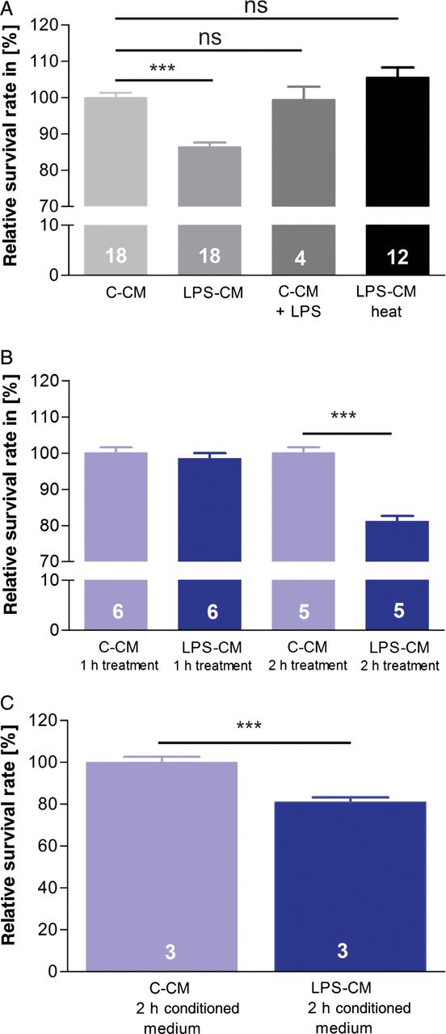
Figure 6. LPS-CM induces a rapid decrease in neuronal survival. (A) The relative survival rate in dissociated neuronal ...
Notes:
Figure 6. LPS-CM induces a rapid decrease in neuronal survival. (A) The relative survival rate in dissociated neuronal cultures under control conditions (C-CM), after 6 h application with the supernatant of LPS-treated BV-2 cells (LPS-CM), and after 6 h treatment with LPS only (C-CM + LPS). No change in the survival rate of dissociated neurons could be detected when LPS was added to C-CM (C-CM + LPS) or when LPS-CM was heat-inactivated before treatment (LPS-CM heat). (B) Treatment with LPS-CM (6-h conditioned medium) for only 1 h leads to no significant change in the survival rate, while 2 h treatment causes a significant decrease in cell survival. (C) Conditioning of the medium for only 2 h already leads to decreased cell survival after 6 h application.
Unless provided in the caption above, the following copyright applies to the content of this slide: © The Author 2012. Published by Oxford University Press. All rights reserved. For Permissions, please e-mail: journals.permissions@oup.com

Slide 7
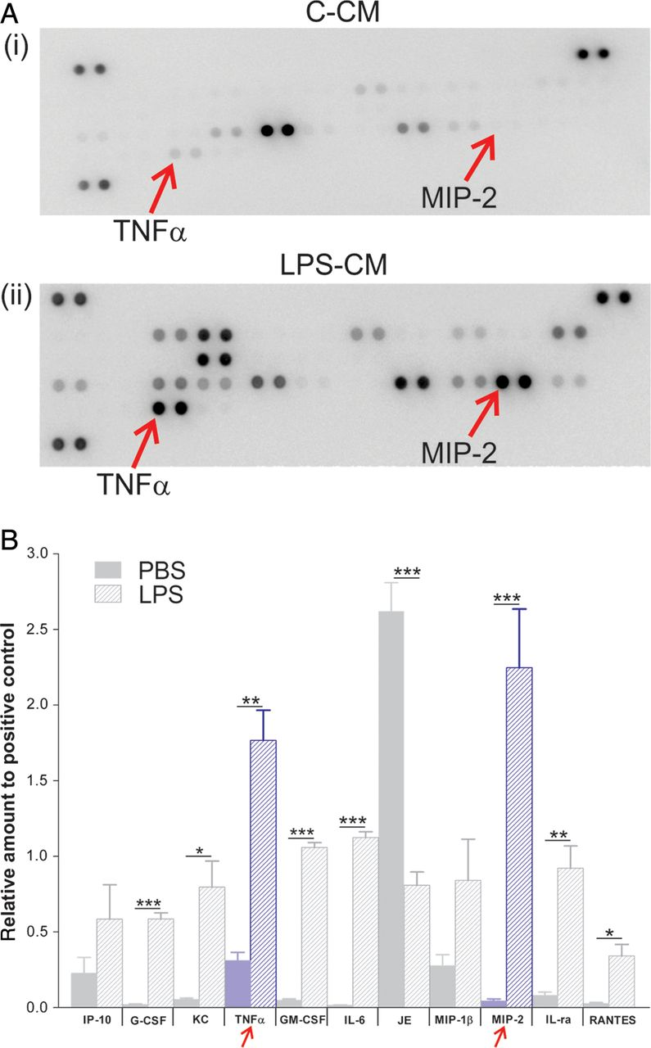
Figure 7. LPS leads to the release of various cytokines in microglial (BV-2) cells. (A) Cytokine array analysis ...
Notes:
Figure 7. LPS leads to the release of various cytokines in microglial (BV-2) cells. (A) Cytokine array analysis demonstrates prominent LPS-induced up-regulation of various cytokines in BV-2 cell medium. Cytokine assay for control-conditioned medium (i) and LPS-CM (ii). (B) Quantitative analysis of up- and down-regulated cytokines. TNFα and MIP-2 were significantly up-regulated in LPS condition.
Unless provided in the caption above, the following copyright applies to the content of this slide: © The Author 2012. Published by Oxford University Press. All rights reserved. For Permissions, please e-mail: journals.permissions@oup.com

Slide 8
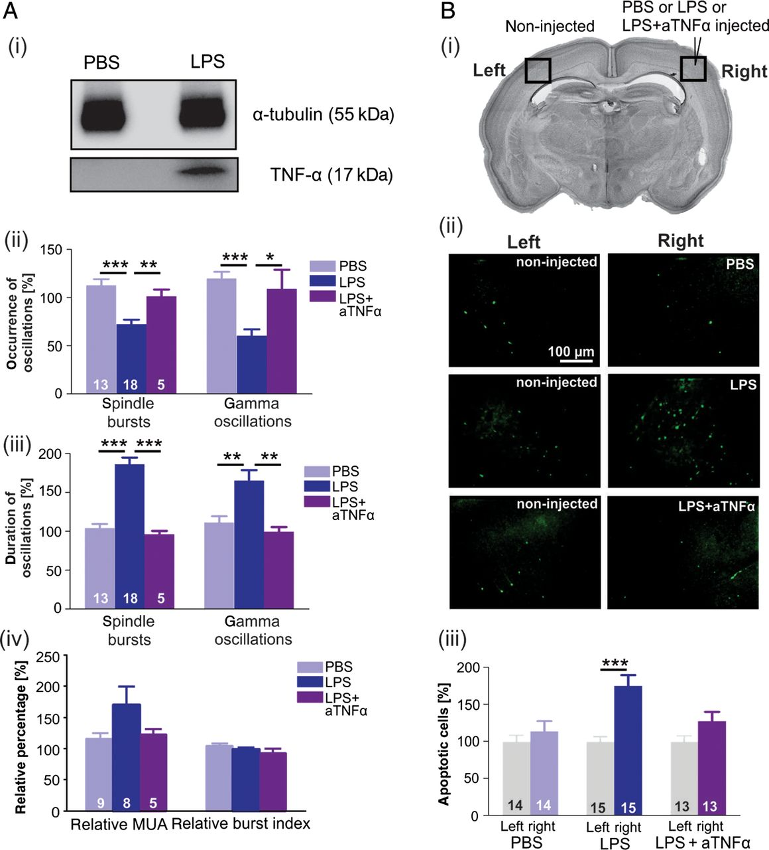
Figure 8. LPS-induced inflammation in the newborn rat somatosensory cortex in vivo can be blocked by treatment with ...
Notes:
Figure 8. LPS-induced inflammation in the newborn rat somatosensory cortex in vivo can be blocked by treatment with anti-TNFα (aTNFα) antibodies. (A) Western blot analyses show an increase of soluble TNFα protein in LPS-treated tissue when compared with PBS-treated controls. The levels of the loading control α-tubulin are similar in both samples (i). LPS-induced modifications in the relative occurrence (ii) and duration (iii) of spontaneous spindle bursts (left) and gamma oscillations (right) when compared with PBS-treated control animals and LPS + anti-TNFα–treated animals. (iv) A comparison of relative multi-unit activity (MUA) and relative BI reveals no significant difference between the 3 groups. (Bi) Image of Nissl-stained coronal section shows the regions selected for quantification, a region marked by rectangle in the non-injected left hemisphere serves as a control, while the region marked by rectangle in the right hemisphere is close to the injection site. (ii) Images show cleaved casp-3–positive cells in the non-injected site (left), and cleaved casp-3–positive cells in the PBS, LPS, and LPS + anti-TNFα–injected site (right). (iii) PBS injection has no effect on the number of apoptotic cells. LPS treatment leads to a significant increase in casp-3–positive cells, which is blocked by injection of LPS + anti-TNFα. Data are based on 14 slices from 5 rats in the PBS group, 15 slices from 7 rats in the LPS group, and 13 slices from 5 rats in the LPS + aTNFα group.
Unless provided in the caption above, the following copyright applies to the content of this slide: © The Author 2012. Published by Oxford University Press. All rights reserved. For Permissions, please e-mail: journals.permissions@oup.com

