Slide 1
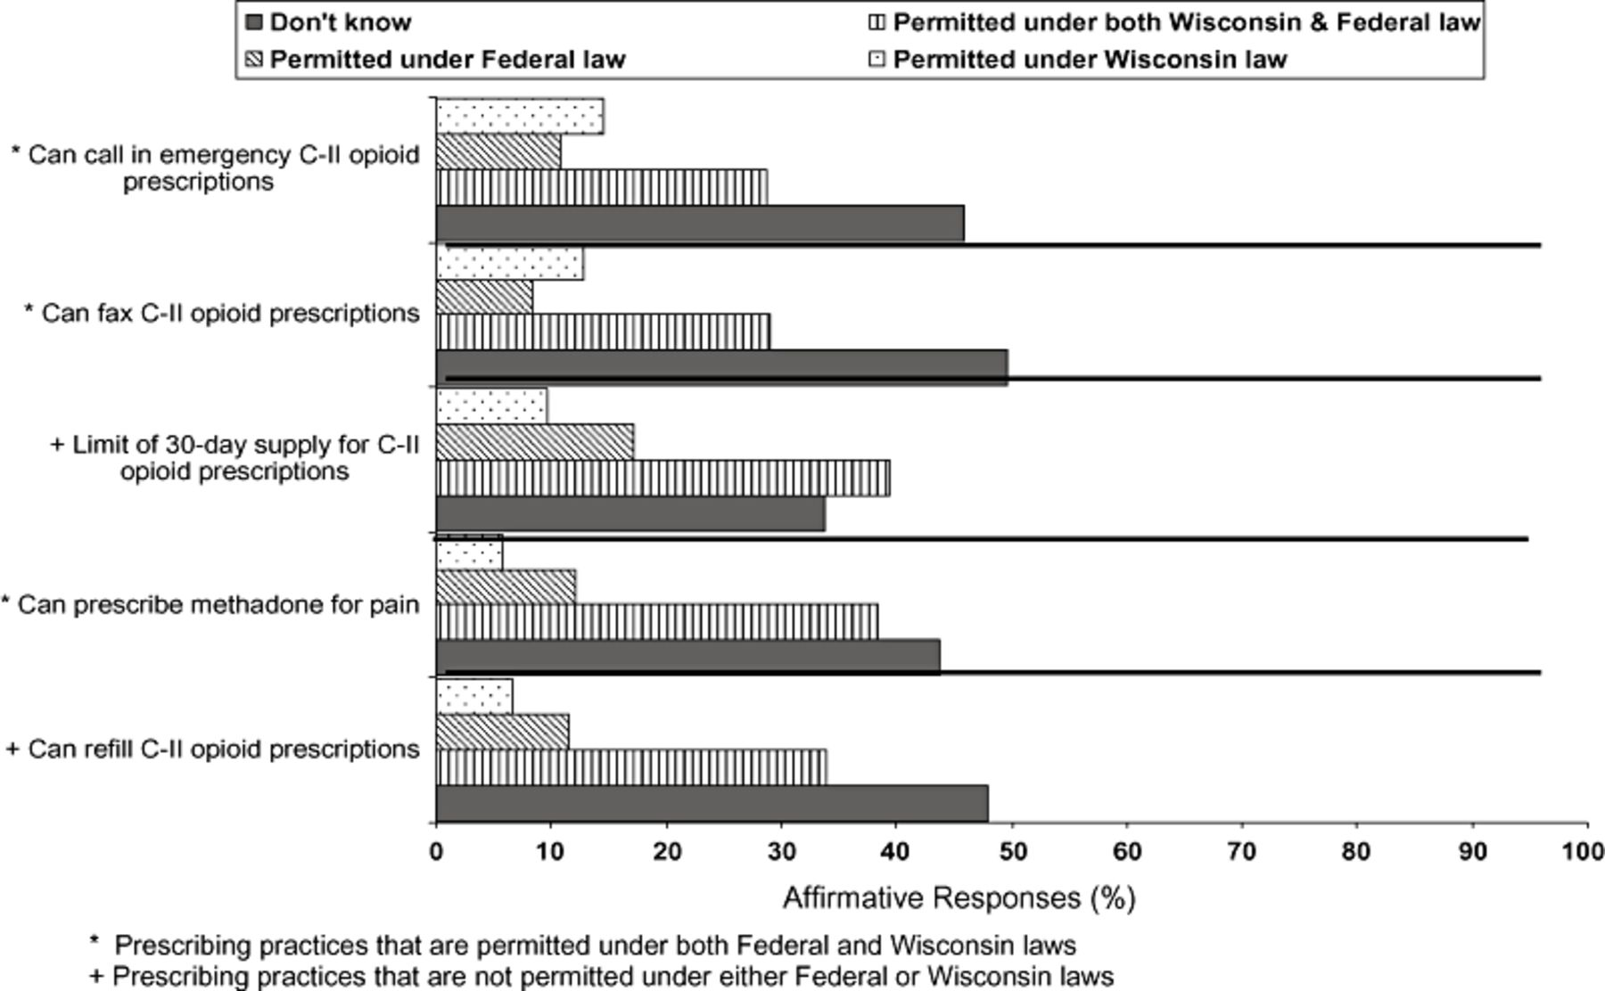
Figure 1 Physician responses to questions about whether federal or Wisconsin state laws mandate prescribing practices ...
Notes:
Figure 1 Physician responses to questions about whether federal or Wisconsin state laws mandate prescribing practices of opioids.
Unless provided in the caption above, the following copyright applies to the content of this slide: © American Academy of Pain Medicine

