Slide 1
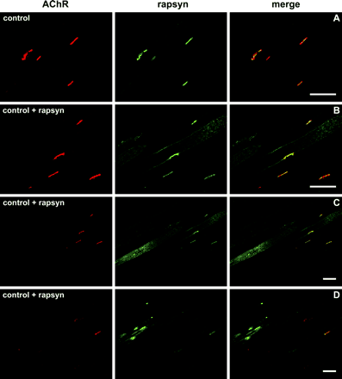
Fig. 1 Immunohistochemical staining of control and rapsyn-treated control muscles. Cryosections of muscles were ...
Notes:
Fig. 1 Immunohistochemical staining of control and rapsyn-treated control muscles. Cryosections of muscles were double-stained with Alexa594-conjugated α-bungarotoxin (left) and mouse anti-rapsyn mAb1234 (middle); merge on the right. (A) AChR and rapsyn staining of untreated tibialis anterior muscle of a control rat. (B–D) Rapsyn overexpression in control rats induced an increased rapsyn concentration in the endplate and variable amounts of extrasynaptic rapsyn aggregates, which did not co-localize with AChR. Bars are 100 µm; all pictures are taken under the same conditions.
Unless provided in the caption above, the following copyright applies to the content of this slide: © The Author (2005). Published by Oxford University Press on behalf of the Guarantors of Brain. All rights reserved. For Permissions, please email: journals.permissions@oxfordjournals.org

Slide 2
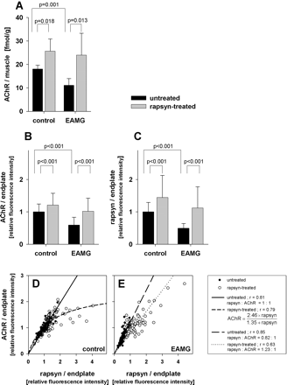
Fig. 2 Effect of rapsyn overexpression on AChR and rapsyn level in mAb 35-induced EAMG rats. The AChR concentration ...
Notes:
Fig. 2 Effect of rapsyn overexpression on AChR and rapsyn level in mAb 35-induced EAMG rats. The AChR concentration of untreated and rapsyn-treated tibialis anterior muscles was measured by using 125I-labelled α-bungarotoxin as shown in A and by quantifying α-BT-Alexa594 staining of endplates as shown in B. In the same endplates rapsyn levels as shown in C were analysed by quantification of immunohistochemical staining with anti-rapsyn mAb 1234. Endplate areas were identified using a polyclonal antibody against the VAChT, and the intensities of α-BT-Alexa594 and rapsyn staining were normalized against the intensity of this protein. The average AChR and rapsyn concentration of the untreated muscle of the control animals was set to 1. The relative amount of AChR versus rapsyn in individual endplates is plotted for the control animals in D and for the EAMG animals in E. Closed symbols, endplates of untreated muscles; open symbols, endplates of rapsyn-treated muscles. In the rapsyn-treated muscles, a large proportion of endplates have an increased amount of rapsyn and AchR.
Unless provided in the caption above, the following copyright applies to the content of this slide: © The Author (2005). Published by Oxford University Press on behalf of the Guarantors of Brain. All rights reserved. For Permissions, please email: journals.permissions@oxfordjournals.org

Slide 3
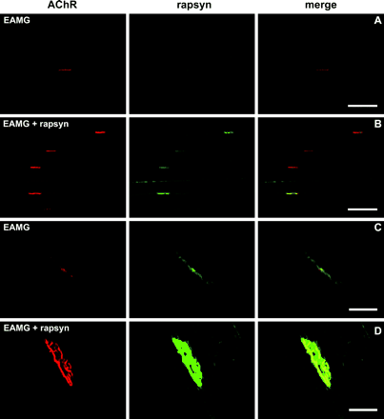
Fig. 3 Immunohistochemical analysis of rapsyn expression in the NMJ of EAMG rats using standard fluorescence (A and ...
Notes:
Fig. 3 Immunohistochemical analysis of rapsyn expression in the NMJ of EAMG rats using standard fluorescence (A and B; scale bars are 100 µm) and two-photon laser scanning microscopy (C and D; scale bars are 20 µm). (A and C) Endplates of an untreated tibialis anterior muscle 2 days after induction of EAMG. Endplates showed reduced concentration or complete loss of AChR and rapsyn. (B and D) Rapsyn overexpression in the contralateral tibialis anterior muscle of the same EAMG animal. Rapsyn-treated endplates appeared very similar to those of rats without EAMG (Fig. 1).
Unless provided in the caption above, the following copyright applies to the content of this slide: © The Author (2005). Published by Oxford University Press on behalf of the Guarantors of Brain. All rights reserved. For Permissions, please email: journals.permissions@oxfordjournals.org

Slide 4
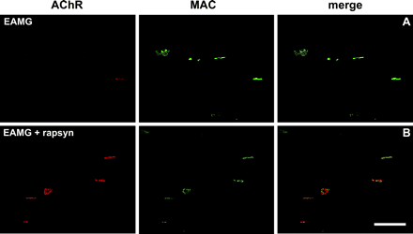
Fig 4. Immunohistochemical staining of MAC in the NMJs in EAMG rats. Endplates of untreated and rapsyn-treated ...
Notes:
Fig 4. Immunohistochemical staining of MAC in the NMJs in EAMG rats. Endplates of untreated and rapsyn-treated muscles as shown in A and B respectively were stained with Alexa594-α-BT (left) and mAb 2A1 against rat C5b-9 (MAC, middle); merge on the right. In untreated muscle, there was a little AchR at the end points but strong MAC staining; whereas in rapsyn-treated muscle both AchR and MAC staining was found.
Unless provided in the caption above, the following copyright applies to the content of this slide: © The Author (2005). Published by Oxford University Press on behalf of the Guarantors of Brain. All rights reserved. For Permissions, please email: journals.permissions@oxfordjournals.org

Slide 5
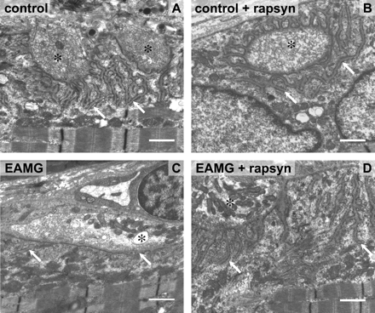
Fig 5. Electron microscopic examination of the postsynaptic folds of motor endplates. NMJ in an untreated and ...
Notes:
Fig 5. Electron microscopic examination of the postsynaptic folds of motor endplates. NMJ in an untreated and rapsyn-treated tibialis anterior muscle as shown in A and B respectively. (C) Damaged postsynaptic membrane without folds in an untreated tibialis anterior muscle of an EAMG animal. (D) Normal postsynaptic membrane with folds in rapsyn-treated tibialis anterior of an EAMG animal. Arrows indicate the postsynaptic membranes; asterisks indicate the nerve terminals; scale bars are 1 µm.
Unless provided in the caption above, the following copyright applies to the content of this slide: © The Author (2005). Published by Oxford University Press on behalf of the Guarantors of Brain. All rights reserved. For Permissions, please email: journals.permissions@oxfordjournals.org

