Slide 1
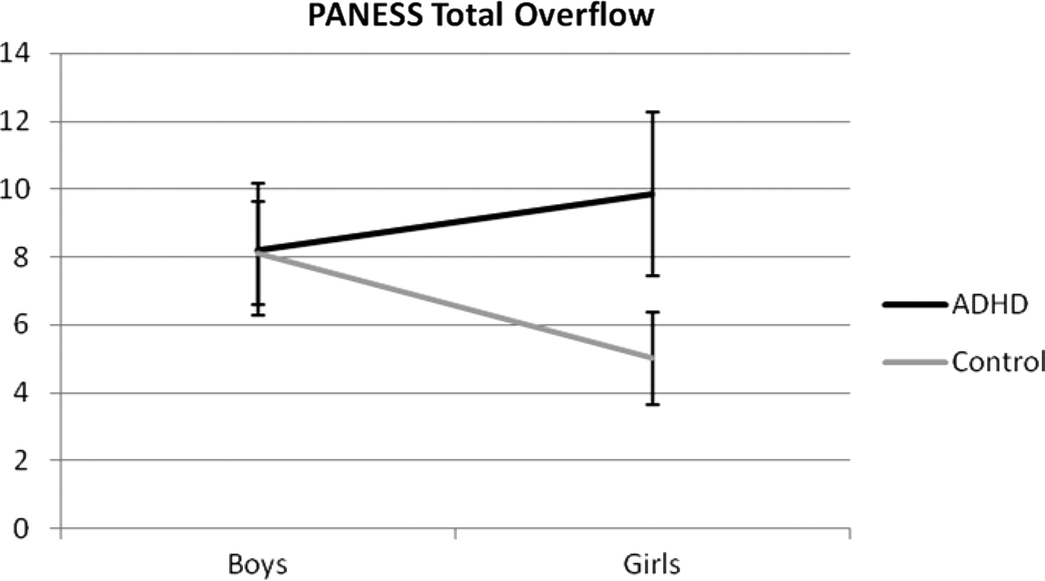
Fig. 1. PANESS Total Overflow mean scores in boys and girls with and without ADHD.
Notes:
Fig. 1. PANESS Total Overflow mean scores in boys and girls with and without ADHD.
Unless provided in the caption above, the following copyright applies to the content of this slide: © The Author 2010. Published by Oxford University Press. All rights reserved. For permissions, please e-mail: journals.permissions@oxfordjournals.org.

Slide 2
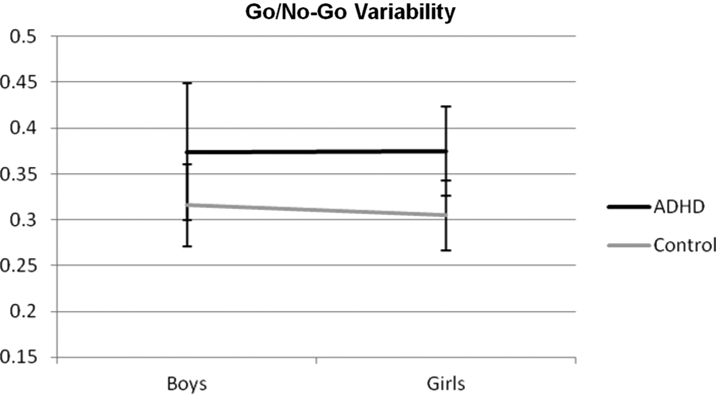
Fig. 2. Go/No-Go Variability means in boys and girls with and without ADHD.
Notes:
Fig. 2. Go/No-Go Variability means in boys and girls with and without ADHD.
Unless provided in the caption above, the following copyright applies to the content of this slide: © The Author 2010. Published by Oxford University Press. All rights reserved. For permissions, please e-mail: journals.permissions@oxfordjournals.org.

Slide 3
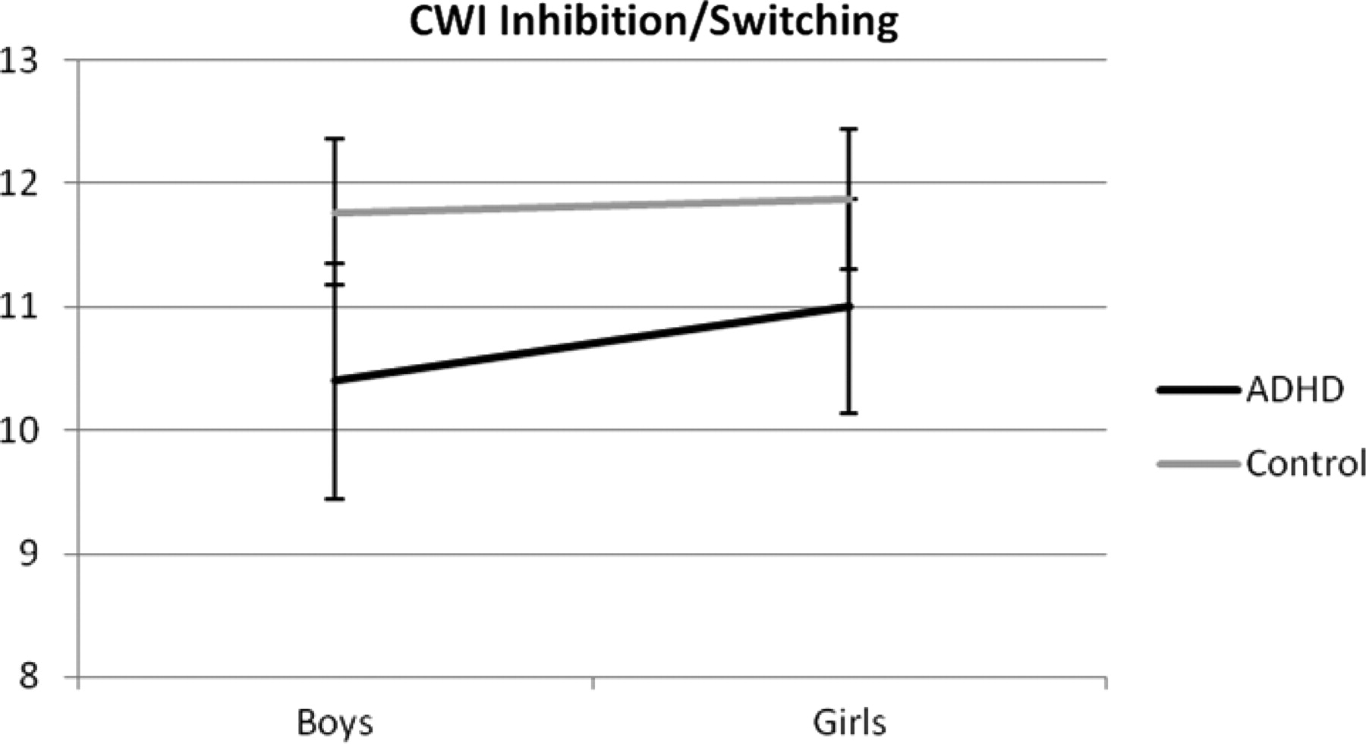
Fig. 3. D-KEFS CWI Inhibition/Switching means in boys and girls with and without ADHD.
Notes:
Fig. 3. D-KEFS CWI Inhibition/Switching means in boys and girls with and without ADHD.
Unless provided in the caption above, the following copyright applies to the content of this slide: © The Author 2010. Published by Oxford University Press. All rights reserved. For permissions, please e-mail: journals.permissions@oxfordjournals.org.

Slide 4
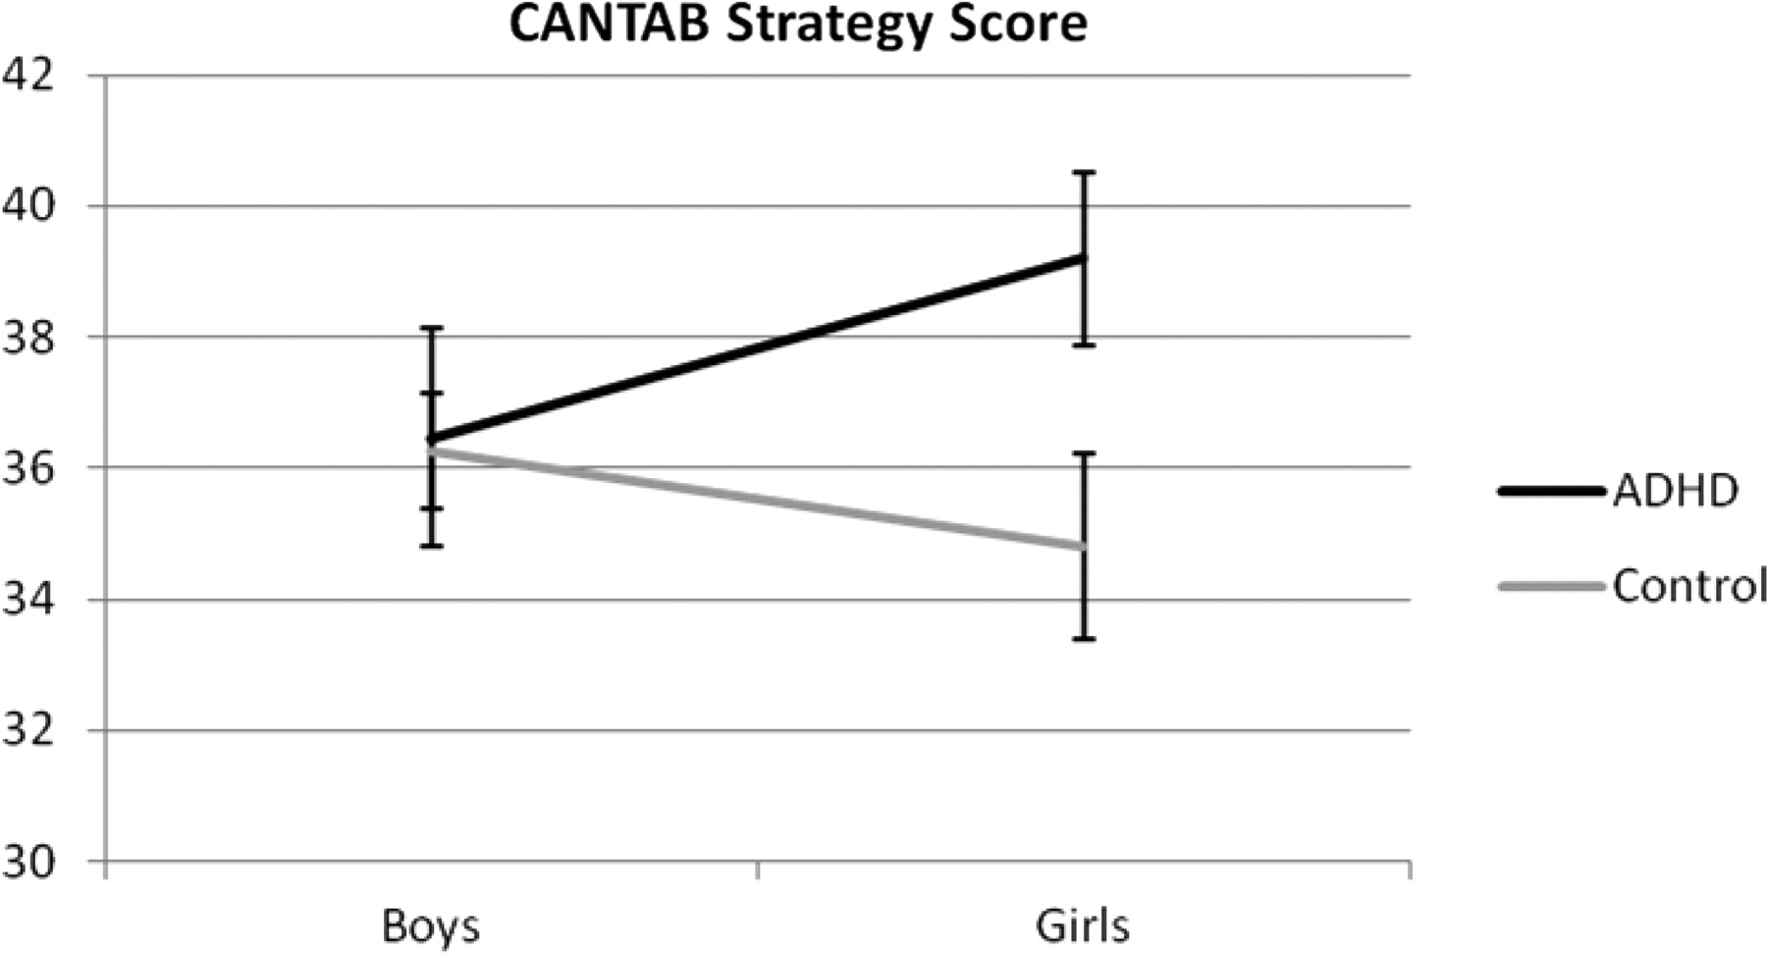
Fig. 4. CANTAB Strategy Score means in boys and girls with and without ADHD.
Notes:
Fig. 4. CANTAB Strategy Score means in boys and girls with and without ADHD.
Unless provided in the caption above, the following copyright applies to the content of this slide: © The Author 2010. Published by Oxford University Press. All rights reserved. For permissions, please e-mail: journals.permissions@oxfordjournals.org.

