Slide 1
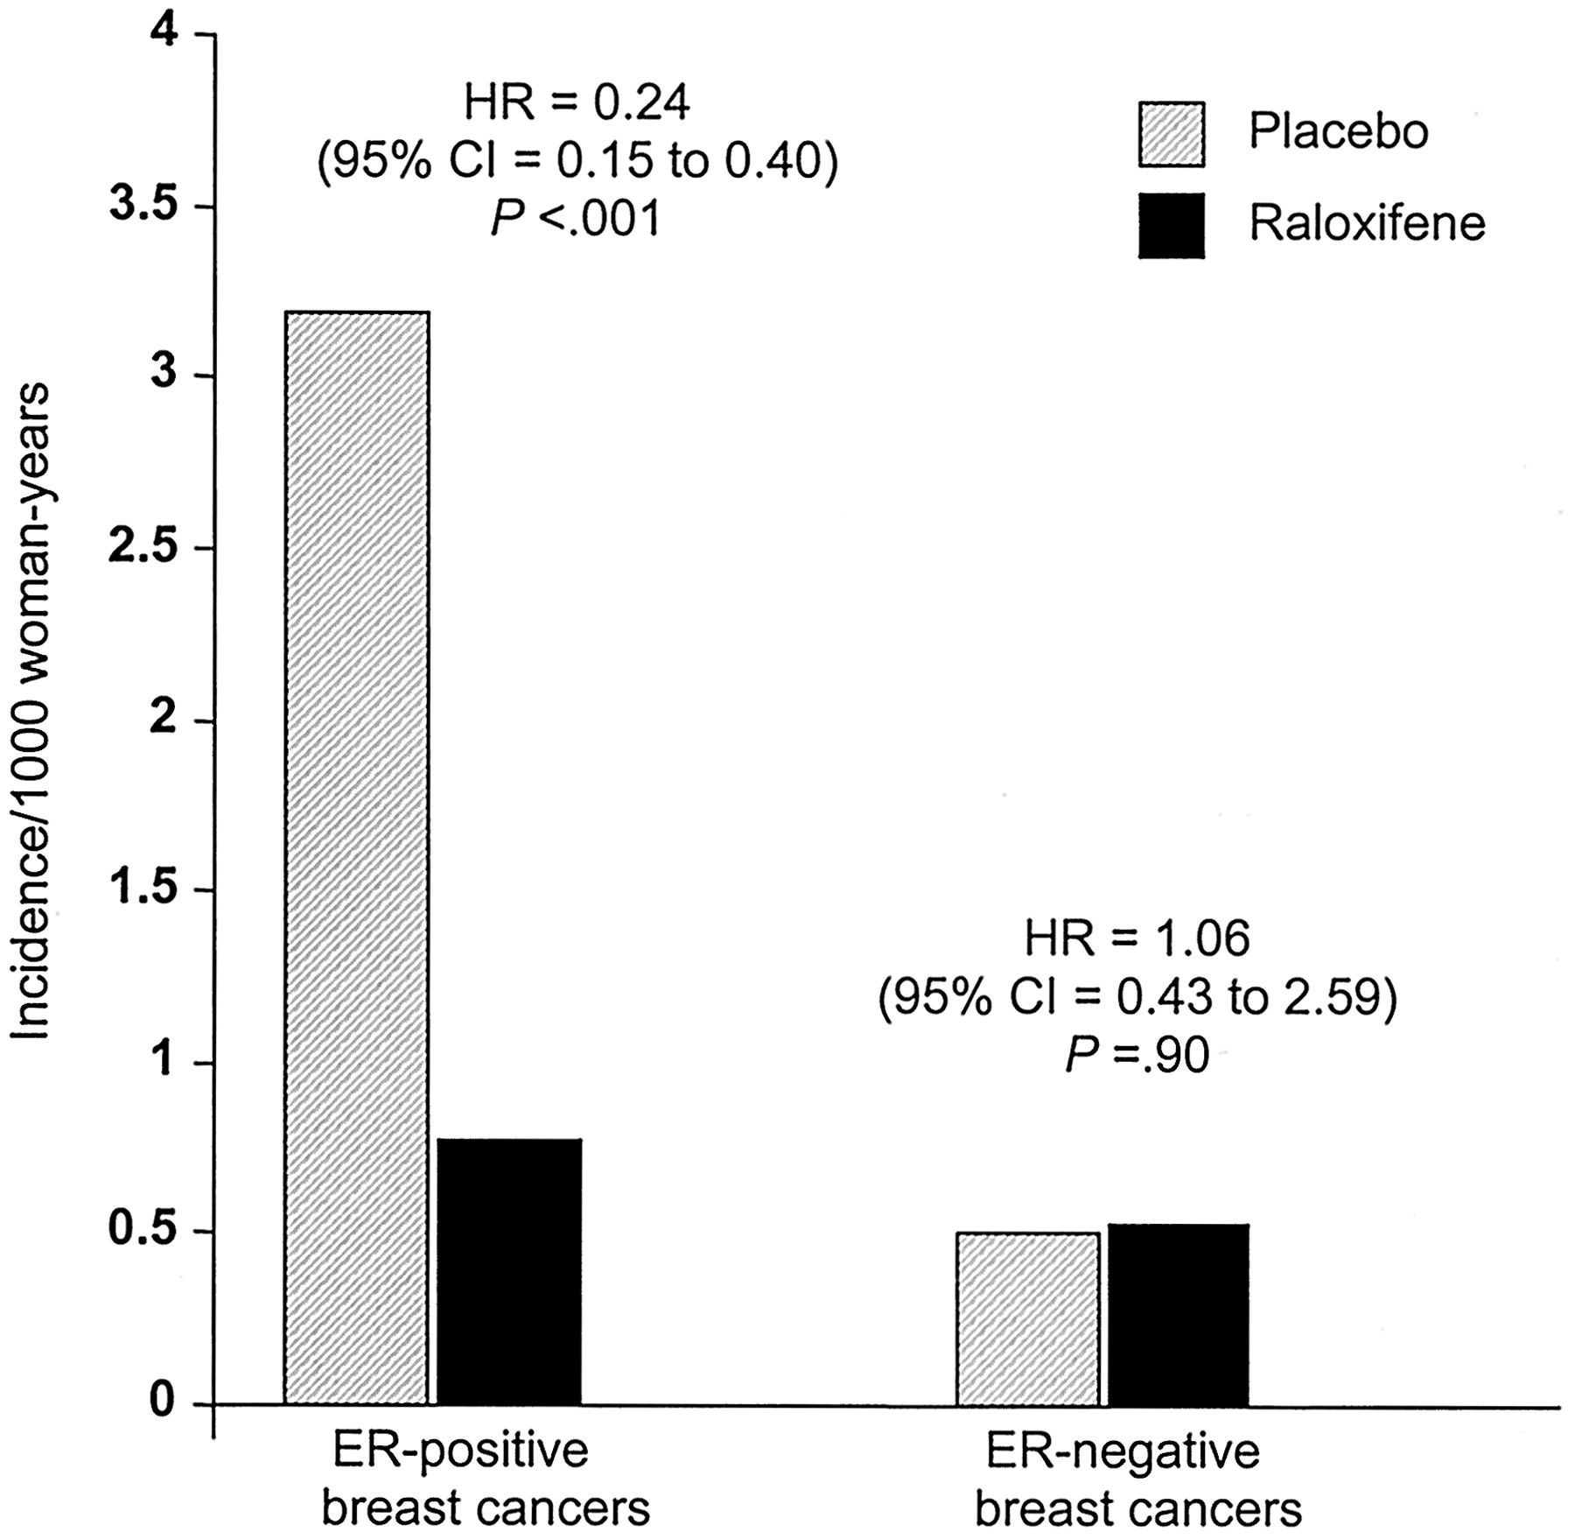
Fig. 4. Annual incidence rate per 1000 woman-years of follow-up for adjudicated invasive breast cancers over the 8 ...
Notes:
Fig. 4. Annual incidence rate per 1000 woman-years of follow-up for adjudicated invasive breast cancers over the 8 years from the time of randomization in the MORE trial to the end of the CORE trial for the 7705 MORE participants. The numbers of ER-positive invasive breast cancers in the placebo and raloxifene groups were 44 and 22, respectively; the numbers of ER-negative invasive breast cancers in the placebo and raloxifene groups were 7 and 15, respectively. Hazard ratios and 95% CIs for the raloxifene group relative to placebo are shown for ER-positive and ER-negative invasive breast cancers. Statistical significance of the difference between treatment groups was assessed by two-sided log-rank tests.
Unless provided in the caption above, the following copyright applies to the content of this slide: © Oxford University Press

Slide 2
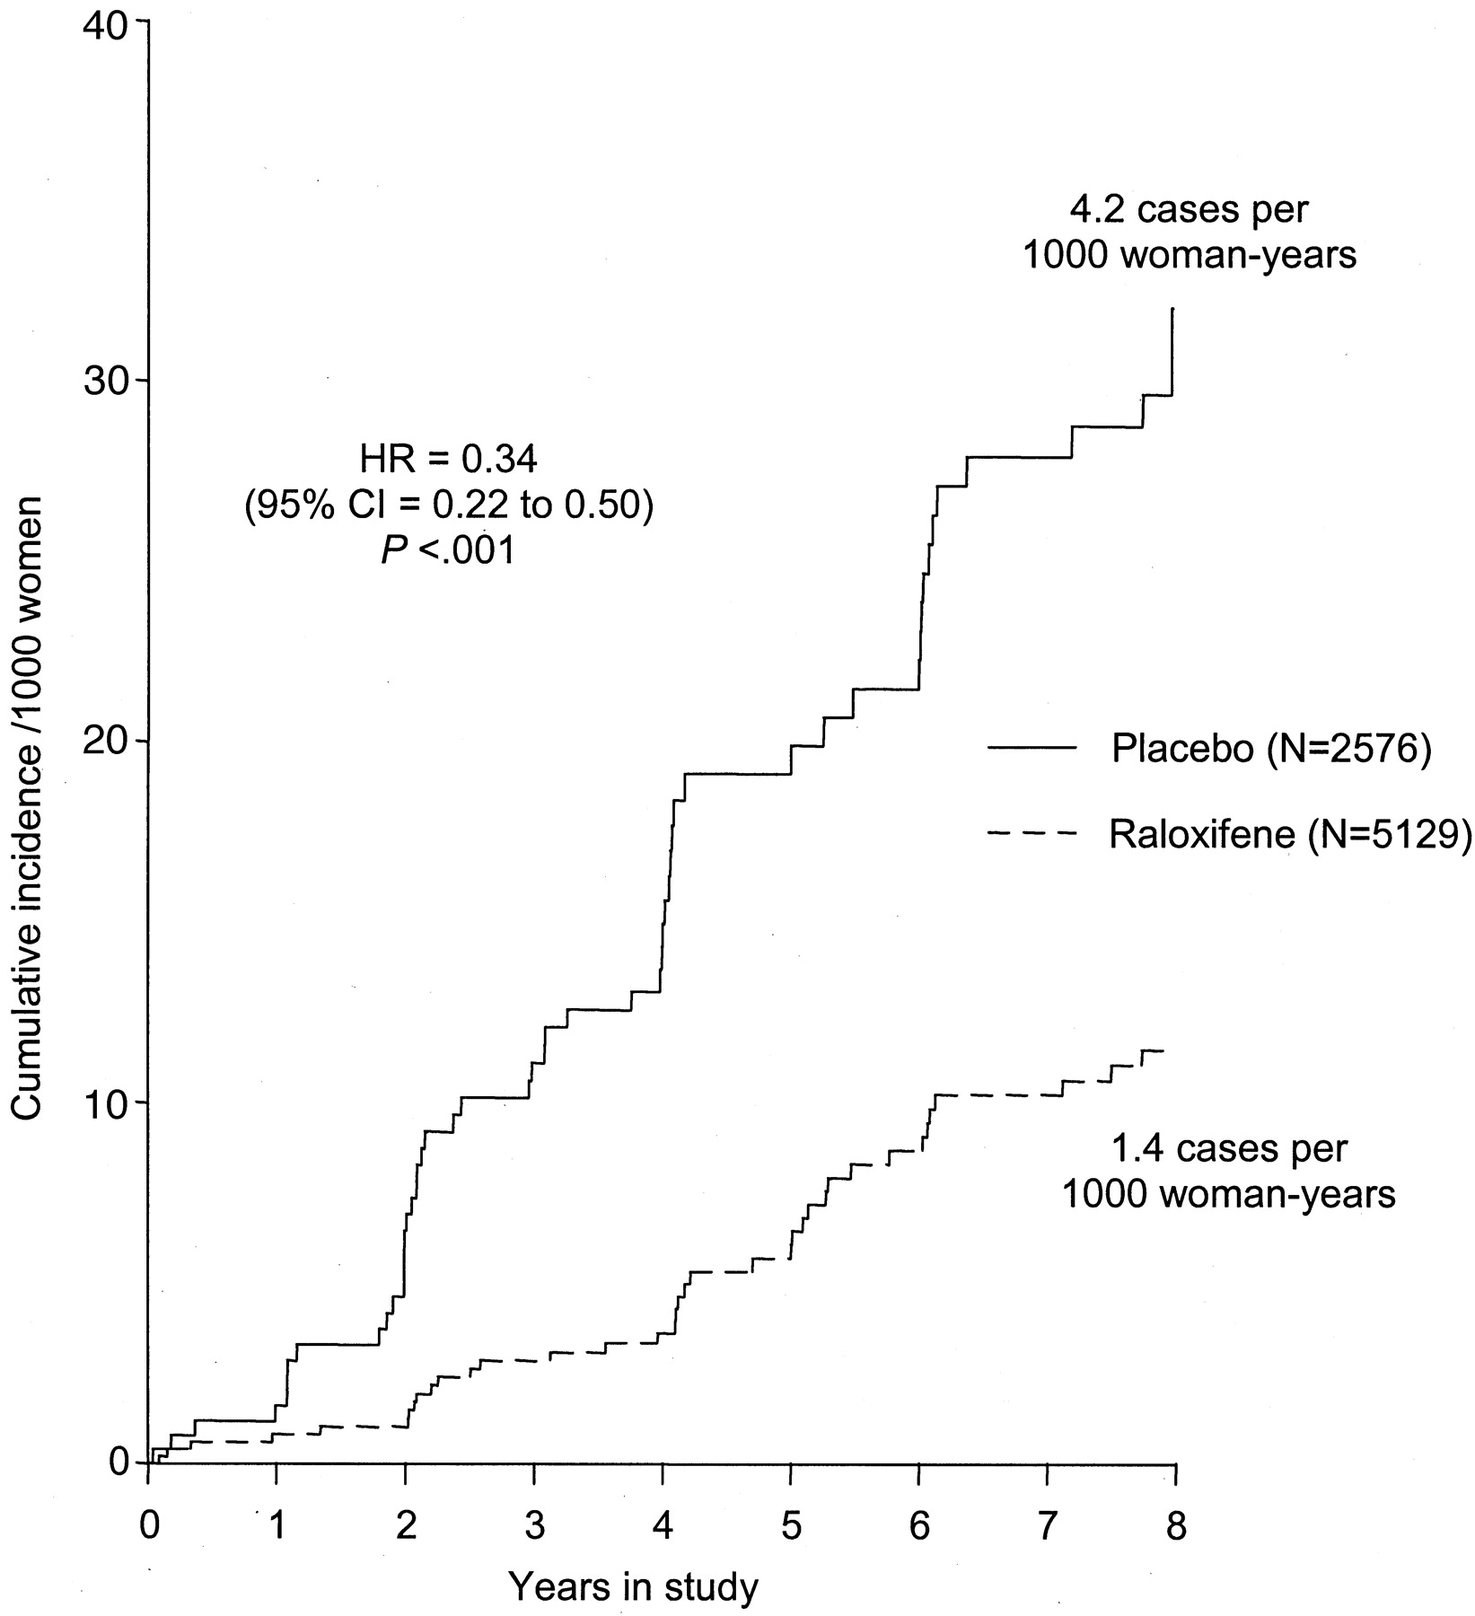
Fig. 3. Cumulative incidence of adjudicated invasive breast cancers per 1000 women over the 8 years from ...
Notes:
Fig. 3. Cumulative incidence of adjudicated invasive breast cancers per 1000 women over the 8 years from randomization in the MORE trial to the end of the CORE trial for the 7705 MORE participants. Statistical significance of the difference between treatment groups was assessed by a two-sided log-rank test.
Unless provided in the caption above, the following copyright applies to the content of this slide: © Oxford University Press

Slide 3
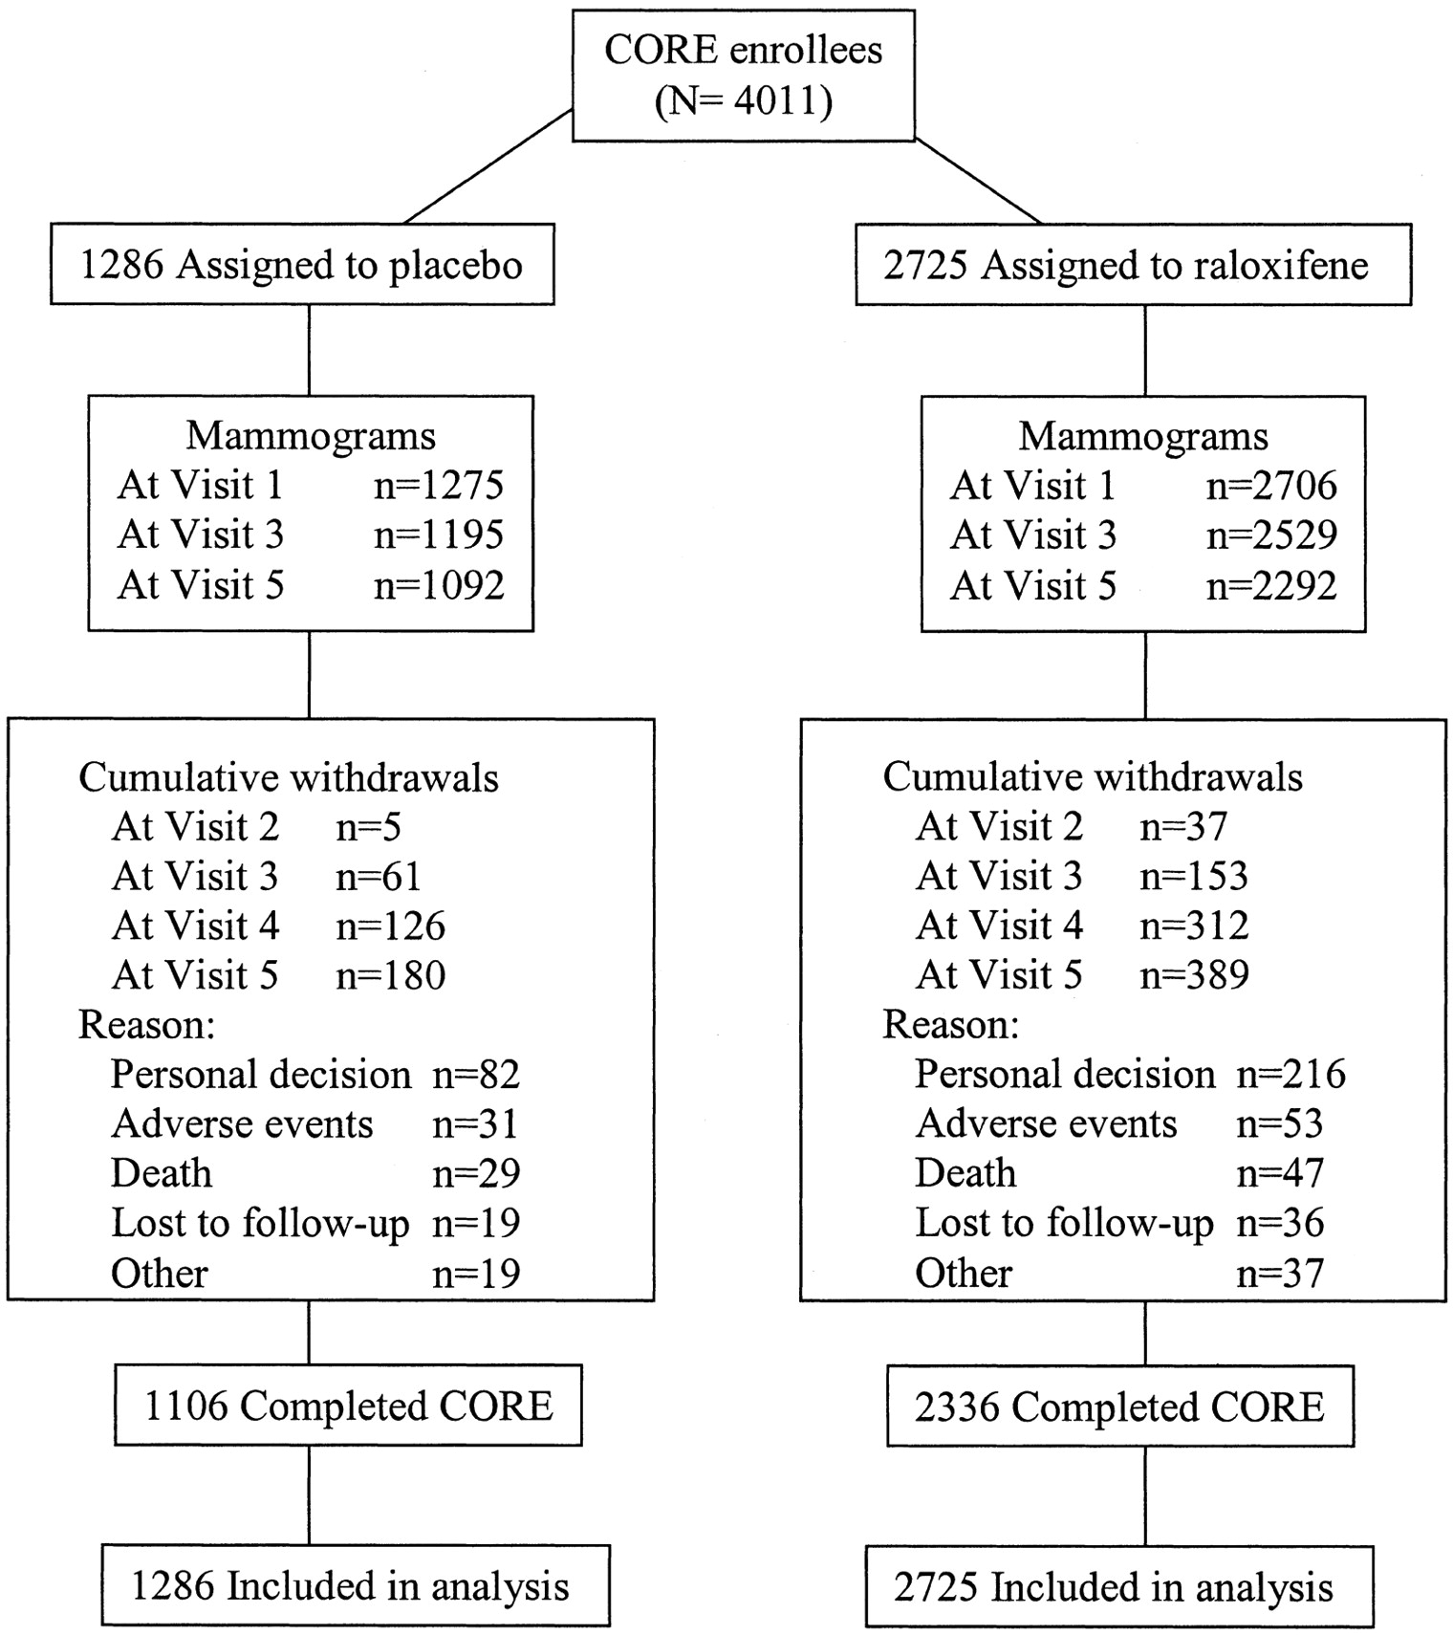
Fig. 2. Follow-up of CORE trial enrollees. Visit 1 was scheduled at time of enrollment in the CORE trial and ...
Notes:
Fig. 2. Follow-up of CORE trial enrollees. Visit 1 was scheduled at time of enrollment in the CORE trial and generally occurred 4.5–5 years after randomization in the MORE trial. Visits 2, 3, 4, and 5 occurred approximately 5, 6, 7, and 8 years, respectively, after randomization in the MORE trial. The category “other” under “Reasons for withdrawal” included participant having moved, protocol entry criteria not having been met, and protocol variance.
Unless provided in the caption above, the following copyright applies to the content of this slide: © Oxford University Press

Slide 4
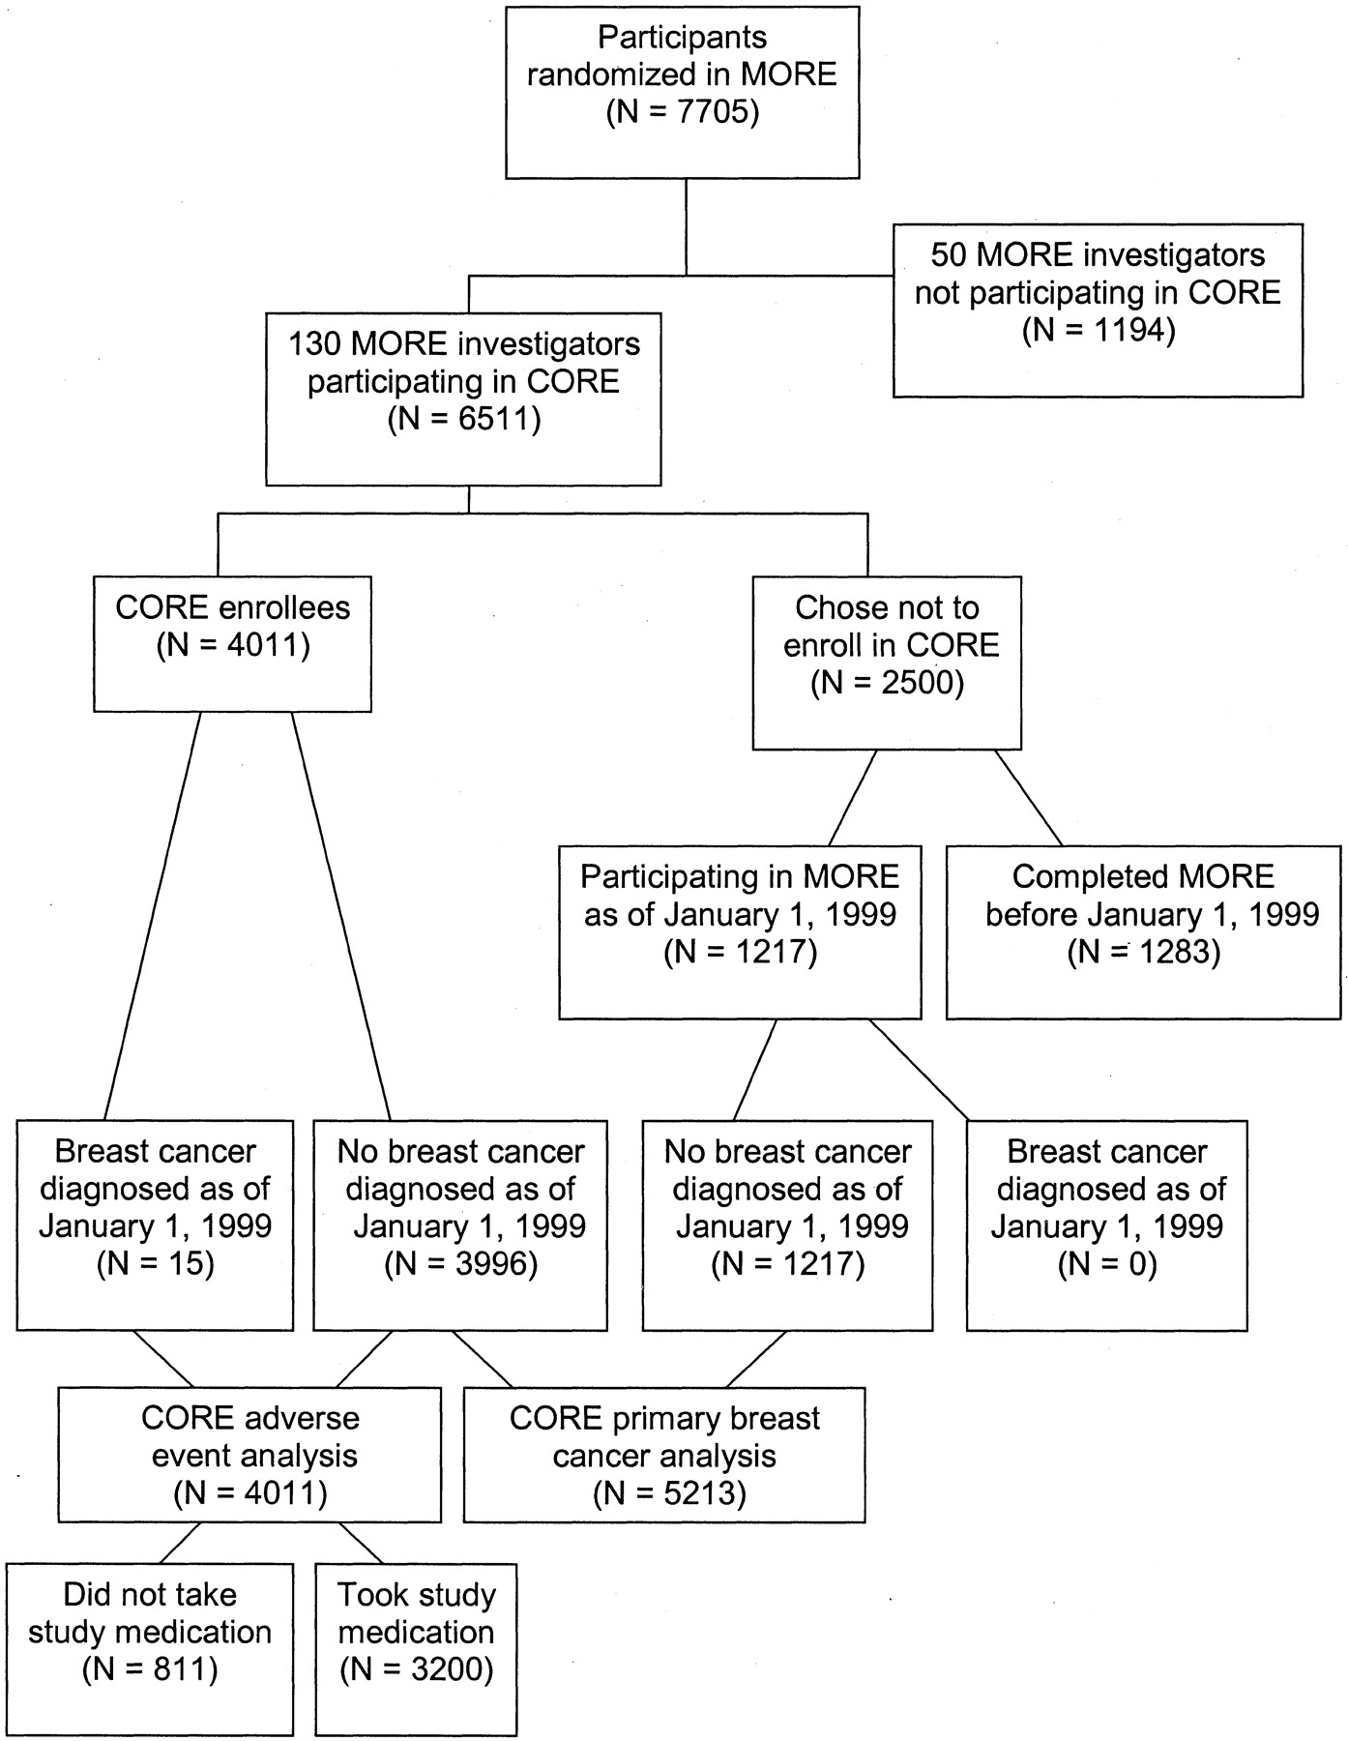
Fig. 1. Flow of participants from the MORE trial into the CORE trial.
Notes:
Fig. 1. Flow of participants from the MORE trial into the CORE trial.
Unless provided in the caption above, the following copyright applies to the content of this slide: © Oxford University Press

