Slide 1
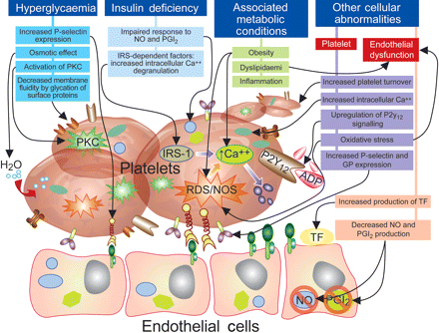
Figure 1 Mechanisms involved in platelet dysfunction and prothrombotic status in diabetes mellitus patients. ADP, ...
Notes:
Figure 1 Mechanisms involved in platelet dysfunction and prothrombotic status in diabetes mellitus patients. ADP, adenosine diphosphate; CA++, calcium; GP, glycoprotein; IRS, insulin receptor substrate; NO, nitric oxide; PGI2, prostacycline; PKC, protein kinase C; ROS/NOS, reactive oxygen and nitrogen species; TF, tissue factor; H2O, water. Adapted with permission from Ferreiro and Angiolillo.7
Unless provided in the caption above, the following copyright applies to the content of this slide: Published on behalf of the European Society of Cardiology. All rights reserved. © The Author 2011. For permissions please email: journals.permissions@oup.com

Slide 2
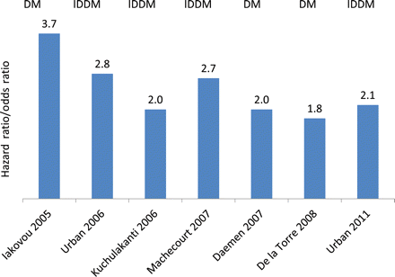
Figure 2 Studies having detected diabetes mellitus or insulin-dependent diabetes mellitus as independent predictor of ...
Notes:
Figure 2 Studies having detected diabetes mellitus or insulin-dependent diabetes mellitus as independent predictor of drug-eluting stent thrombosis. Reported are the hazard ratio or odds ratio of multivariable analyses. Data extracted from Iakovou et al.,65 Urban et al.,66 Kuchulakanti et al.,67 Machecourt et al.,10 Daemen et al.,68 de la Torre et al.,69 and Urban et al.70
Unless provided in the caption above, the following copyright applies to the content of this slide: Published on behalf of the European Society of Cardiology. All rights reserved. © The Author 2011. For permissions please email: journals.permissions@oup.com

Slide 3
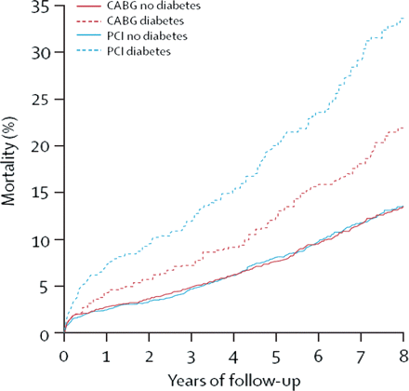
Figure 3 Mortality in patients assigned to coronary artery bypass graft or percutaneous coronary intervention by ...
Notes:
Figure 3 Mortality in patients assigned to coronary artery bypass graft or percutaneous coronary intervention by diabetes status in an analysis of 10 randomized trials. Reproduced with permission from Hlatky et al.27
Unless provided in the caption above, the following copyright applies to the content of this slide: Published on behalf of the European Society of Cardiology. All rights reserved. © The Author 2011. For permissions please email: journals.permissions@oup.com

Slide 4
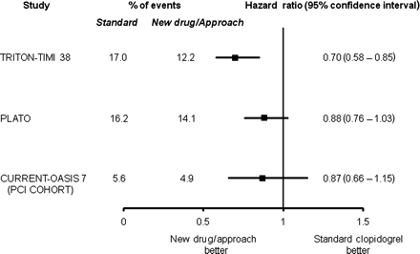
Figure 7 Novel strategies to enhance platelet inhibition in diabetic patients with acute coronary syndromes. The data ...
Notes:
Figure 7 Novel strategies to enhance platelet inhibition in diabetic patients with acute coronary syndromes. The data presented represents the composite of cardiovascular death, myocardial infarction, or stroke in the diabetes mellitus cohorts of TRITON-TIMI 38 (prasugrel vs. clopidogrel), PLATO (ticagrelor vs. clopidogrel), and CURRENT-OASIS 7 (high dose vs. standard dose clopidogrel). Reproduced with permission from Ferreiro and Angiolillo.7
Unless provided in the caption above, the following copyright applies to the content of this slide: Published on behalf of the European Society of Cardiology. All rights reserved. © The Author 2011. For permissions please email: journals.permissions@oup.com

Slide 5
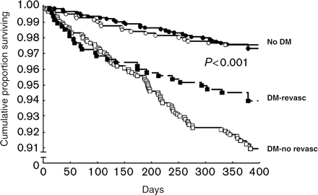
Figure 6 Kaplan–Meier curves on survival comparing patients with and without diabetes who were revascularized or not ...
Notes:
Figure 6 Kaplan–Meier curves on survival comparing patients with and without diabetes who were revascularized or not in the Euro Heart Survey on Diabetes. Reproduced with permission from Anselmino et al.38
Unless provided in the caption above, the following copyright applies to the content of this slide: Published on behalf of the European Society of Cardiology. All rights reserved. © The Author 2011. For permissions please email: journals.permissions@oup.com

Slide 6
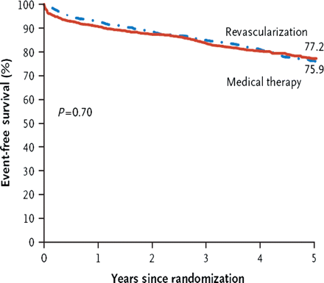
Figure 5 Freedom from major cardiovascular events, revascularization vs. medical therapy at 5 years in the BARI 2D ...
Notes:
Figure 5 Freedom from major cardiovascular events, revascularization vs. medical therapy at 5 years in the BARI 2D trial. Reproduced with permission from Frye et al.34
Unless provided in the caption above, the following copyright applies to the content of this slide: Published on behalf of the European Society of Cardiology. All rights reserved. © The Author 2011. For permissions please email: journals.permissions@oup.com

Slide 7
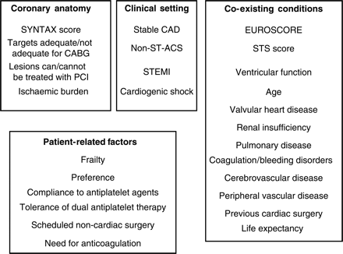
Figure 4 Parameters guiding the choice of revascularization strategy in diabetic patients. STEMI, ST-elevation ...
Notes:
Figure 4 Parameters guiding the choice of revascularization strategy in diabetic patients. STEMI, ST-elevation myocardial infarction; ACS, acute coronary syndromes; CAD, coronary artery disease; CABG, coronary artery bypass grafting; PCI, percutaneous coronary interventions; STS, Society of Thoracic Surgery. Modified with permission from Roffi and Brandle.71
Unless provided in the caption above, the following copyright applies to the content of this slide: Published on behalf of the European Society of Cardiology. All rights reserved. © The Author 2011. For permissions please email: journals.permissions@oup.com

