Slide 1
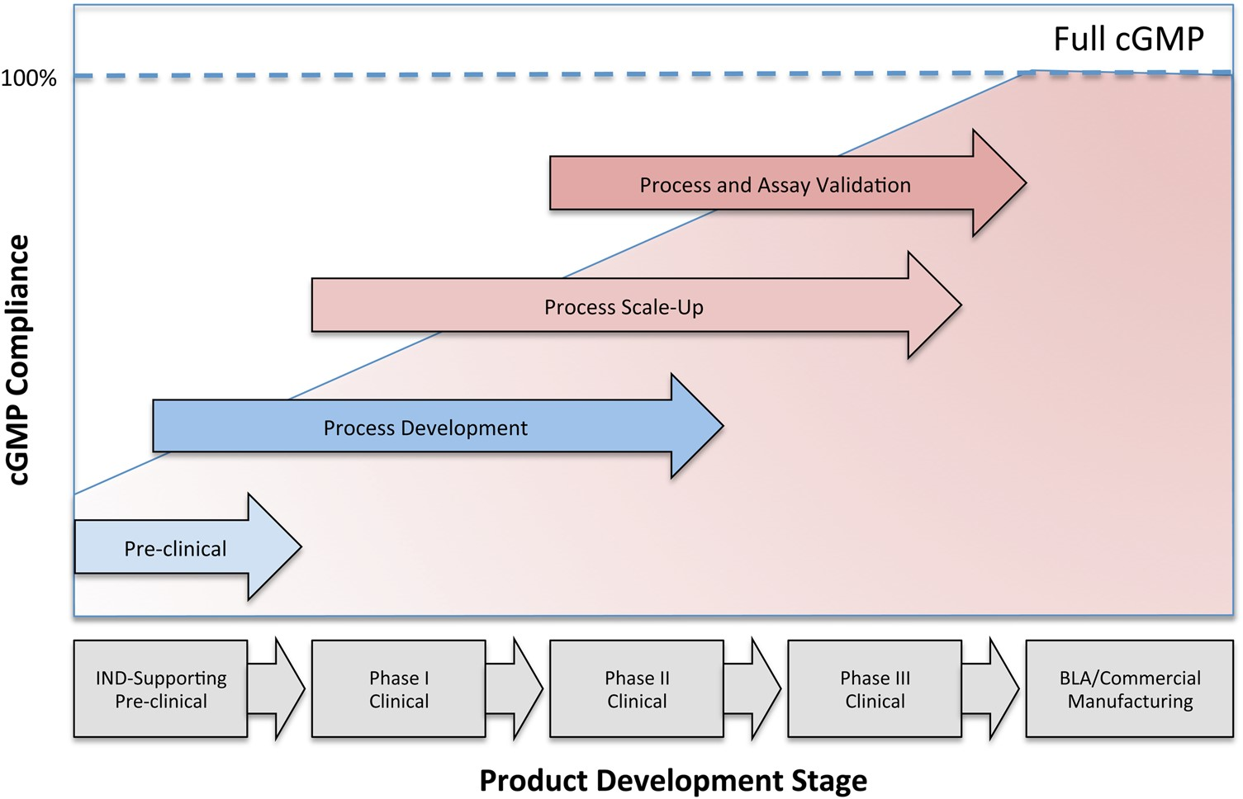
Figure 1. Progression of cGMP compliance at different stages of product development: illustration of the increase in ...
Notes:
Figure 1. Progression of cGMP compliance at different stages of product development: illustration of the increase in the level of compliance with cGMP as products progress from a pre-clinical stage to the Biological License Application and Commercial Manufacturing.
Unless provided in the caption above, the following copyright applies to the content of this slide: © The Author 2015. Published by Oxford University Press. All rights reserved. For Permissions, please email: journals.permissions@oup.com

