Slide 1
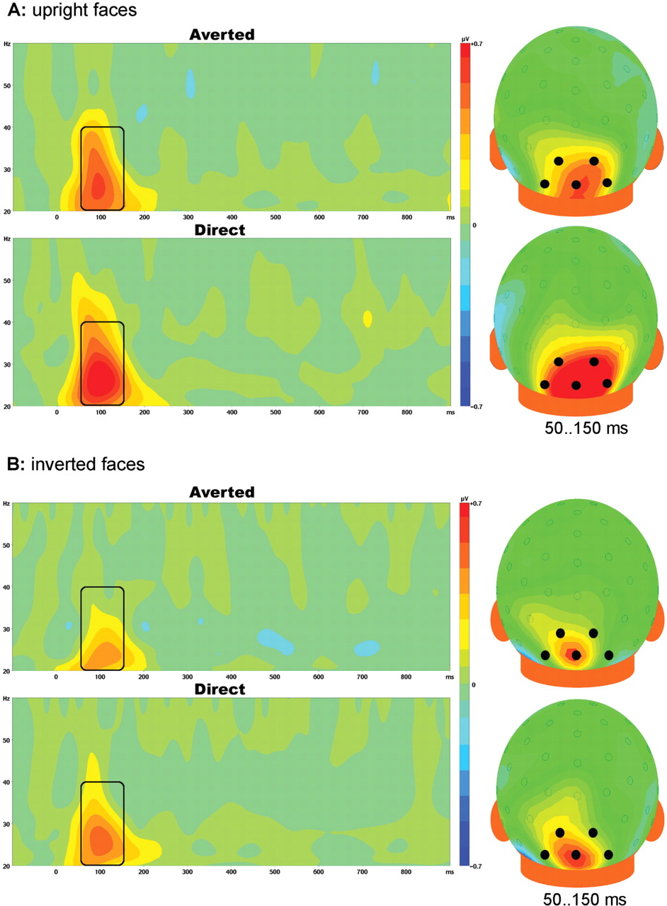
Fig. 1 Evoked (phase-locked) gamma-band (20–60 Hz) EEG responses to averted and direct gaze. The time-frequency plot ...
Notes:
Fig. 1 Evoked (phase-locked) gamma-band (20–60 Hz) EEG responses to averted and direct gaze. The time-frequency plot represents the average amplitude of oscillatory activation measured at the five occipital electrodes marked on the scalp surface maps (right). The rectangles in the time-frequency plots indicate the gamma bursts that were significantly different from baseline. A: Upright face condition, B: Inverted face condition.
Unless provided in the caption above, the following copyright applies to the content of this slide: © The Author(s) (2007). Published by Oxford University Press.This is an Open Access article distributed under the terms of the Creative Commons Attribution Non-Commercial License (http://creativecommons.org/licenses/by-nc/4.0/), which permits non-commercial re-use, distribution, and reproduction in any medium, provided the original work is properly cited. For commercial re-use, please contact journals.permissions@oup.com

Slide 2
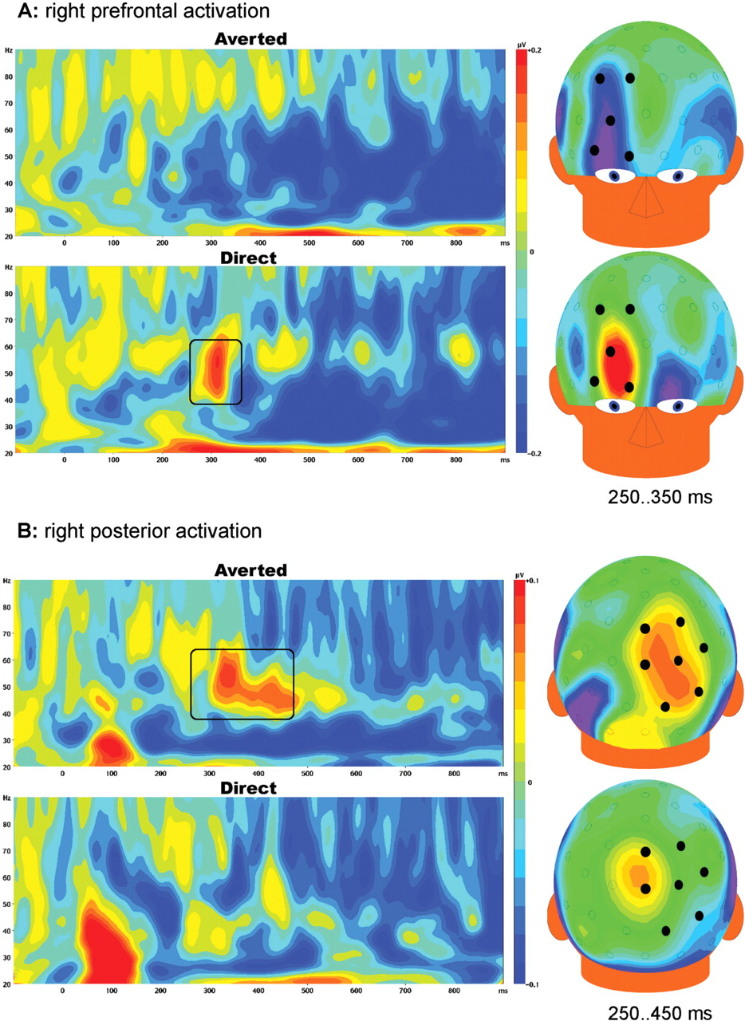
Fig. 2 Induced gamma-band (20–90 Hz) EEG responses to averted and direct gaze in the context of an upright face. The ...
Notes:
Fig. 2 Induced gamma-band (20–90 Hz) EEG responses to averted and direct gaze in the context of an upright face. The time-frequency plots represent the average oscillatory activity measured at electrodes over the right hemisphere marked on the scalp surface maps (right). A: Prefrontal activation, B: Posterior activation.
Unless provided in the caption above, the following copyright applies to the content of this slide: © The Author(s) (2007). Published by Oxford University Press.This is an Open Access article distributed under the terms of the Creative Commons Attribution Non-Commercial License (http://creativecommons.org/licenses/by-nc/4.0/), which permits non-commercial re-use, distribution, and reproduction in any medium, provided the original work is properly cited. For commercial re-use, please contact journals.permissions@oup.com

