Slide 1
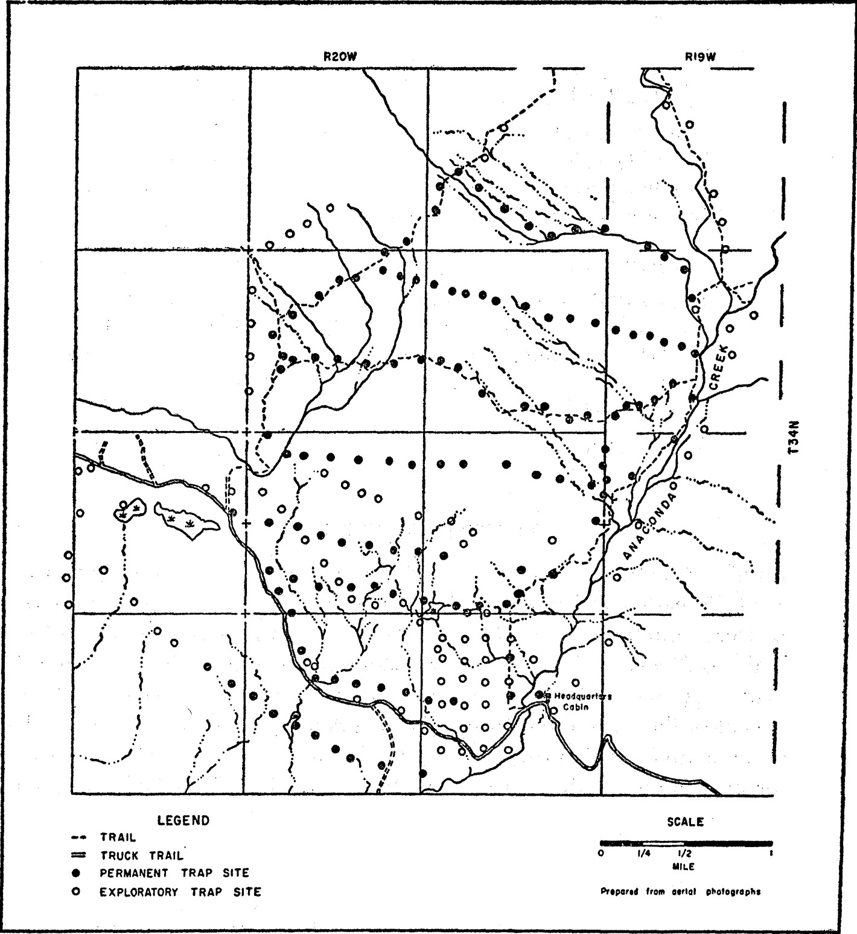
Fig. 1 Live-trapping study area for marten, Glacier National Park, Montana.
Notes:
Fig. 1 Live-trapping study area for marten, Glacier National Park, Montana.
Unless provided in the caption above, the following copyright applies to the content of this slide: 1957 American Society of Mammalogists

