Slide 1
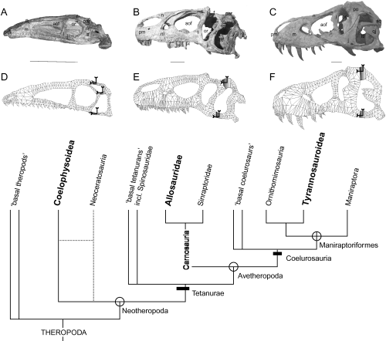
Figure 1. Finite element (FE) models created in this study with respect to taxonomic position with the Theropoda. From ...
Notes:
Figure 1. Finite element (FE) models created in this study with respect to taxonomic position with the Theropoda. From left to right: A, Coelophysis bauri, skull and D, FEA model; B, Allosaurus fragilis, skull and E, FEA model; C, Tyrannosaurus rex, skull and F, FEA model. Grey patches on mesh indicate constrained region of model (in direction indicated by arrows). Scale bar = 10 cm. Phylogeny adapted from Holtz (2000) and Rauhut (2003); open circles indicate node-based taxa; black lines indicate stem-based taxa. Abbreviations : aof, antorbital fenestra; f, frontal; j, jugal; l, lacrimal; ltf, lower temporal fenestra; m, maxilla; n, nasal; or, orbit; par, parietal; po, postorbital; pm, premaxilla; qj, quadratojugal; sq, squamosal.
Unless provided in the caption above, the following copyright applies to the content of this slide: © 2005 The Linnean Society of London

Slide 2
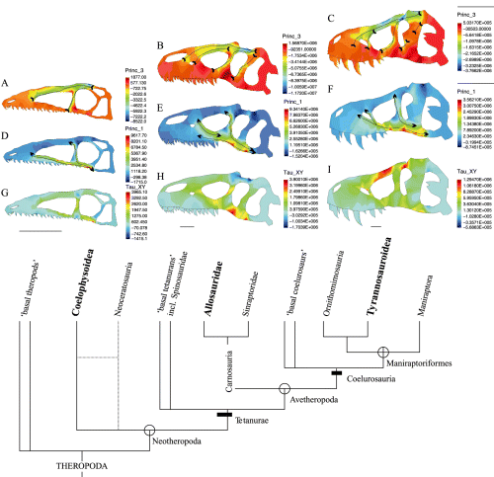
Figure 2. Stress distribution within the crania of Coelophysis (A, D, G), Allosaurus (B, E, H) and Tyrannosaurus (C, F, ...
Notes:
Figure 2. Stress distribution within the crania of Coelophysis (A, D, G), Allosaurus (B, E, H) and Tyrannosaurus (C, F, I) during bite loading. See scale for stress type and magnitude (tension is positive; compression negative); units are Pascals (1 Pa = 1 N/m2). A–C, principal stress 3, mainly compression; D–F: principal stress 1, mainly tensile; G–I, In-plane shear stress (Tau XY). Divergent arrows indicate orientation of tensile stress, convergent arrows indicate orientation of compressive stress, phylogeny as for Fig. 1. 10 000 N bite load applied to all models.
Unless provided in the caption above, the following copyright applies to the content of this slide: © 2005 The Linnean Society of London

