Slide 1
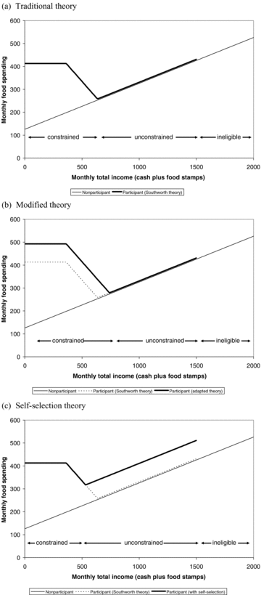
Monthly at-home food spending as a function of monthly total income (cash plus food stamps), by FSP ...
Notes:
Monthly at-home food spending as a function of monthly total income (cash plus food stamps), by FSP participation status, from three theoretical perspectives
Unless provided in the caption above, the following copyright applies to the content of this slide: Copyright 2009 Agricultural and Applied Economics Association

Slide 2
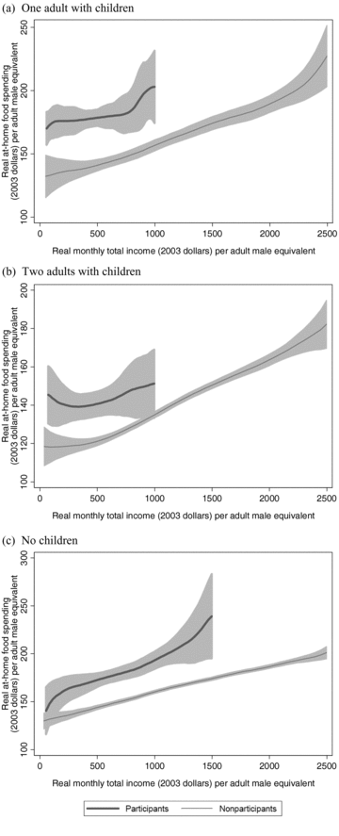
Monthly at-home food spending as a function of monthly total income (cash plus food stamps), by FSP ...
Notes:
Monthly at-home food spending as a function of monthly total income (cash plus food stamps), by FSP participation status
Unless provided in the caption above, the following copyright applies to the content of this slide: Copyright 2009 Agricultural and Applied Economics Association

Slide 3
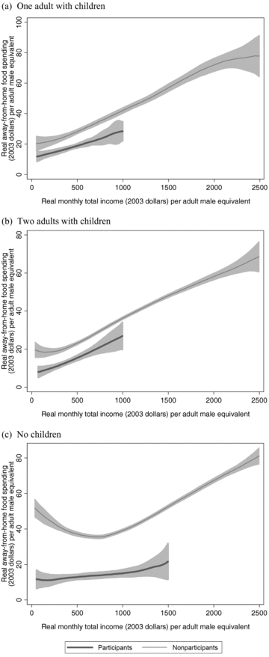
Monthly away-from-home food spending as a function of monthly total income (cash plus food stamps), by FSP ...
Notes:
Monthly away-from-home food spending as a function of monthly total income (cash plus food stamps), by FSP participation status
Unless provided in the caption above, the following copyright applies to the content of this slide: Copyright 2009 Agricultural and Applied Economics Association

