Slide 1
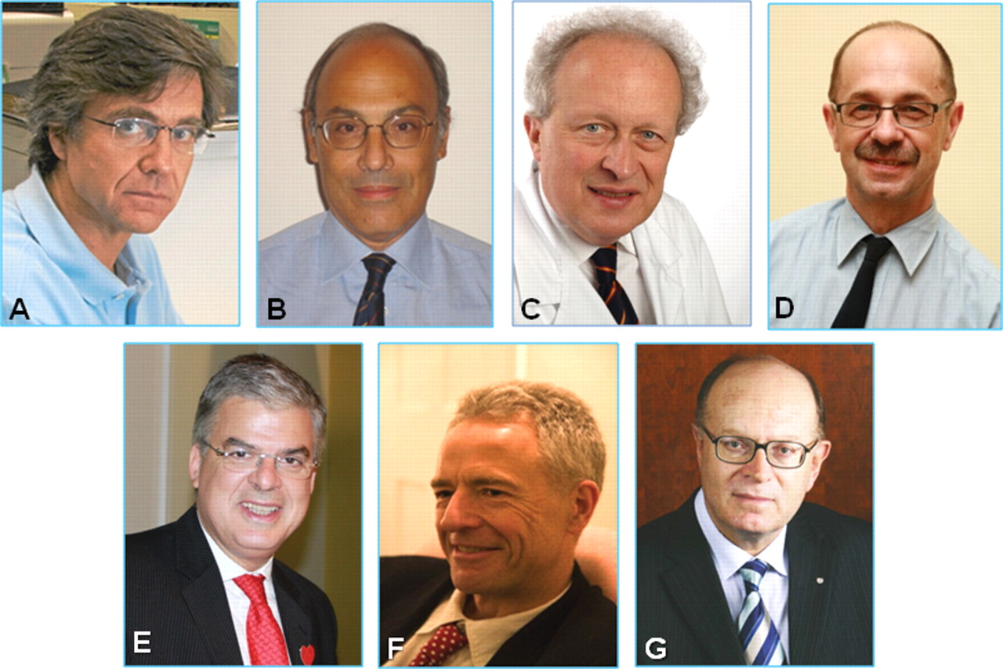
Figure 1 Nucleus members of the ESC Editors’ Network: (A) Fernando Alfonso, MD, PhD, FESC (Chairman) (Past ...
Notes:
Figure 1 Nucleus members of the ESC Editors’ Network: (A) Fernando Alfonso, MD, PhD, FESC (Chairman) (Past Editor-in-Chief, Revista Española de Cardiología); (B) Giuseppe Ambrosio, MD, PhD, FESC (Past Editor-in-Chief, Giornale Italiano di Cardiología); (C) Hugo Ector, MD, PhD, FESC (Editor-in-Chief, Acta Cardiologica); (D) Piotr Kulakowski, MD, PhD, FESC (Editor-in-Chief, Kardiologia Polska); (E) Fausto J. Pinto, MD, PhD, FESC (Editor-in-Chief, Revista Portuguesa de Cardiología); (F) Adam Timmis, MD, PhD, FESC (Editor-in-Chief, Heart); (G) Panos Vardas, MD, PhD, FESC (Editor-in-Chief, Hellenic Journal of Cardiology); on behalf of the Editors' Network ESC Task Force.
Unless provided in the caption above, the following copyright applies to the content of this slide: Published on behalf of the European Society of Cardiology. All rights reserved. © The Author 2011. For permissions please email: journals.permissions@oup.com

