Slide 1
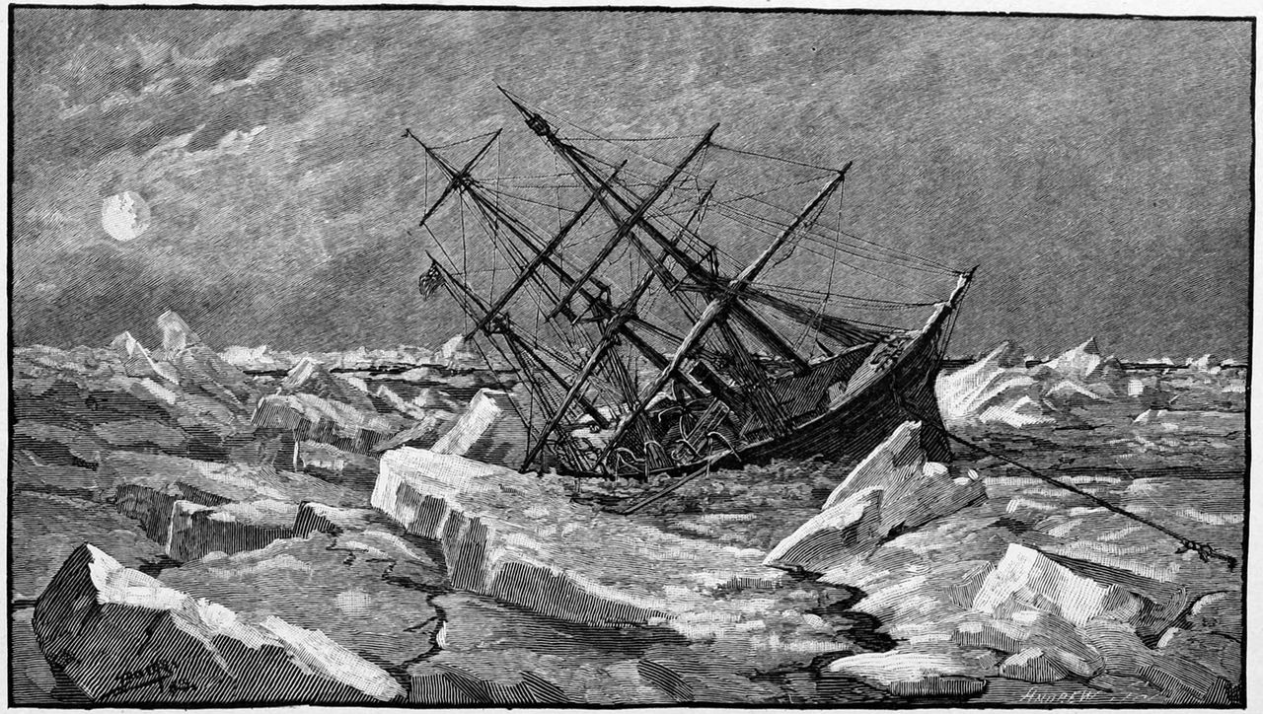
1 The sinking of the Jeannette in 1881, after almost two years trapped in the ice between 65° and 70° north. ...
Notes:
1 The sinking of the Jeannette in 1881, after almost two years trapped in the ice between 65° and 70° north. (US Naval History and Heritage Command)
Unless provided in the caption above, the following copyright applies to the content of this slide: © 2016 Royal Astronomical Society

Slide 2
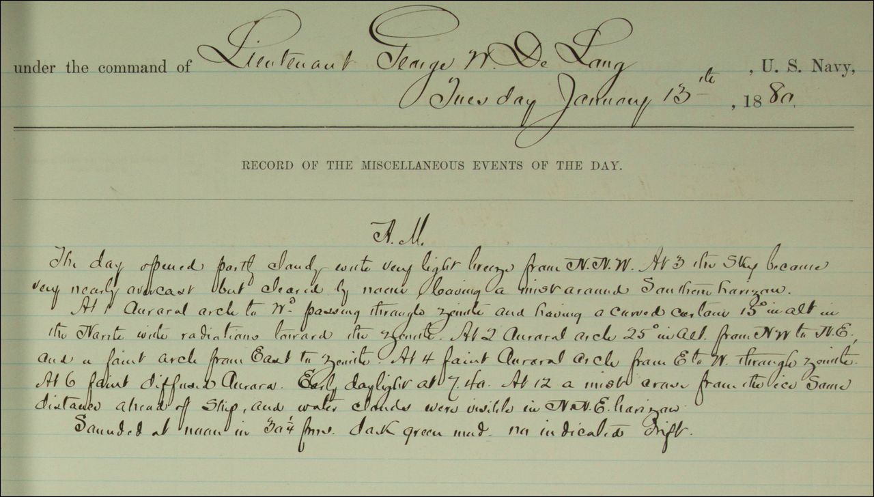
2 Logbook entry for the morning watch on 13 January 1880. “At 1 Auroral arch to Wd passing through zenith and ...
Notes:
2 Logbook entry for the morning watch on 13 January 1880. “At 1 Auroral arch to Wd passing through zenith and having a curved curtain 15° in alt in the North with radiations toward the zenith…” (http://research.archives.gov/description/6919191)
Unless provided in the caption above, the following copyright applies to the content of this slide: © 2016 Royal Astronomical Society

Slide 3
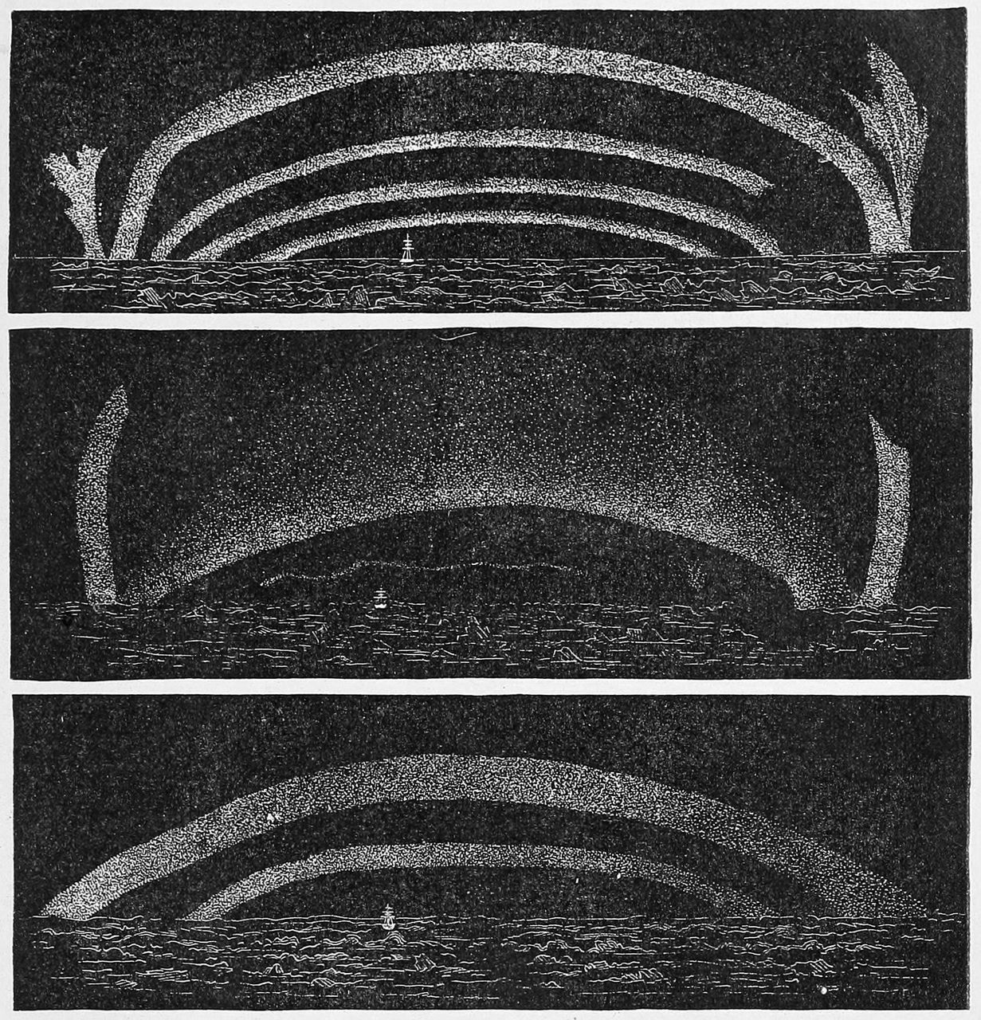
3 Sketches of Arctic aurorae. (Newcomb 1888)
Notes:
3 Sketches of Arctic aurorae. (Newcomb 1888)
Unless provided in the caption above, the following copyright applies to the content of this slide: © 2016 Royal Astronomical Society

Slide 4
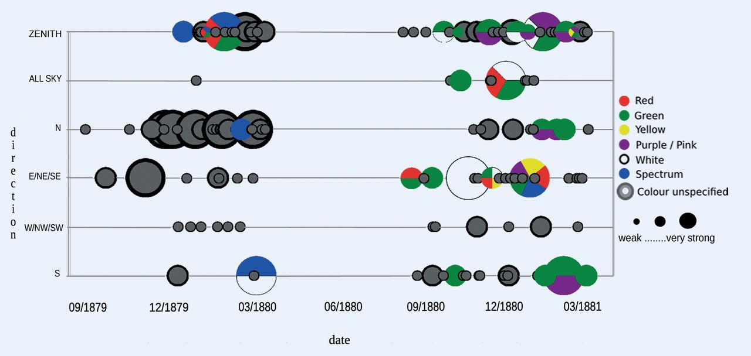
4 Combined direction strength and colour information for 189 observations. On days when there were multiple ...
Notes:
4 Combined direction strength and colour information for 189 observations. On days when there were multiple auroral displays of varied strengths, the display ranked the strongest is used to represent the strength and colour(s) on that day. (Magnetic latitude range is 65° to 70°.)
Unless provided in the caption above, the following copyright applies to the content of this slide: © 2016 Royal Astronomical Society

Slide 5
5 Strength and colour of auroral observations, when reported, with lunar age. All three strengths of aurora are ...
Notes:
5 Strength and colour of auroral observations, when reported, with lunar age. All three strengths of aurora are represented on this day along with the colour information relating to each strength.
Unless provided in the caption above, the following copyright applies to the content of this slide: © 2016 Royal Astronomical Society

Slide 6
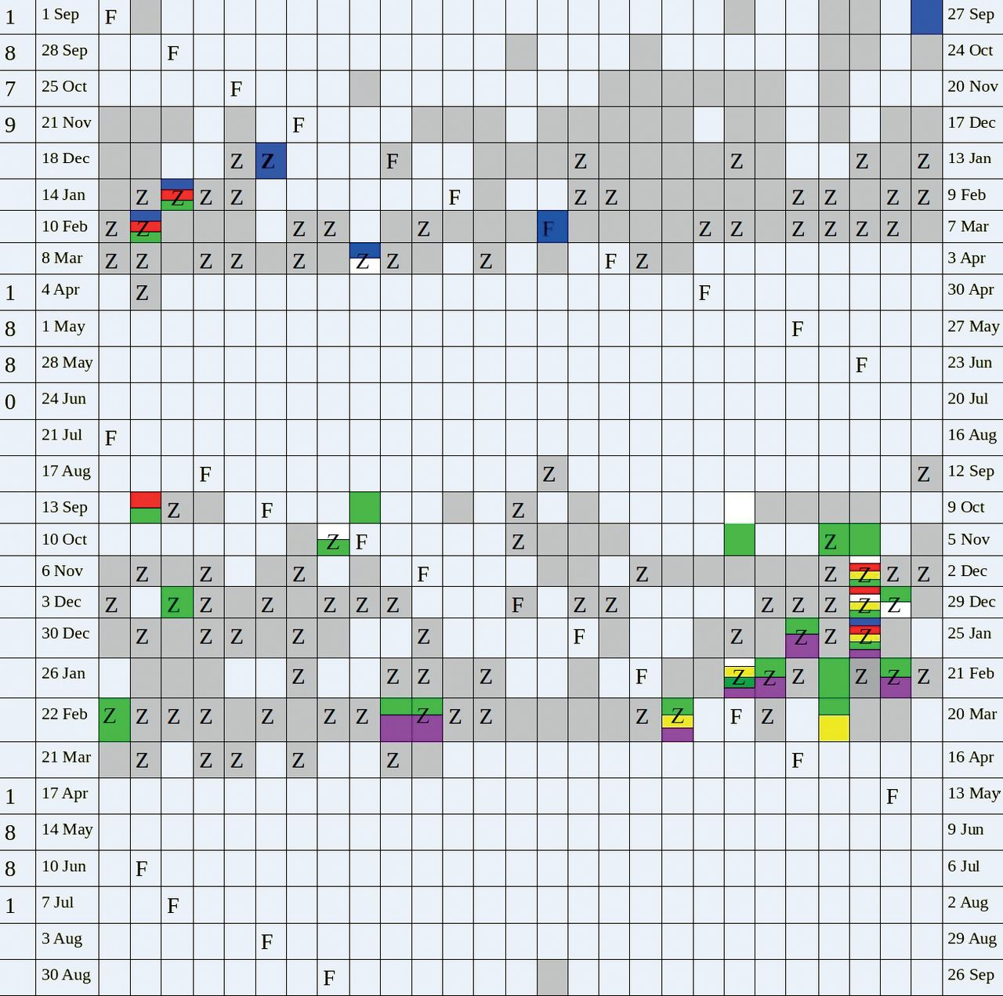
6 A representation of recurrent auroral activity during the USS Jeannette's two-year observation period. Each ...
Notes:
6 A representation of recurrent auroral activity during the USS Jeannette's two-year observation period. Each row represents 27 days with each cell representing one day. Ship time (UT-12).
Unless provided in the caption above, the following copyright applies to the content of this slide: © 2016 Royal Astronomical Society

