Slide 1
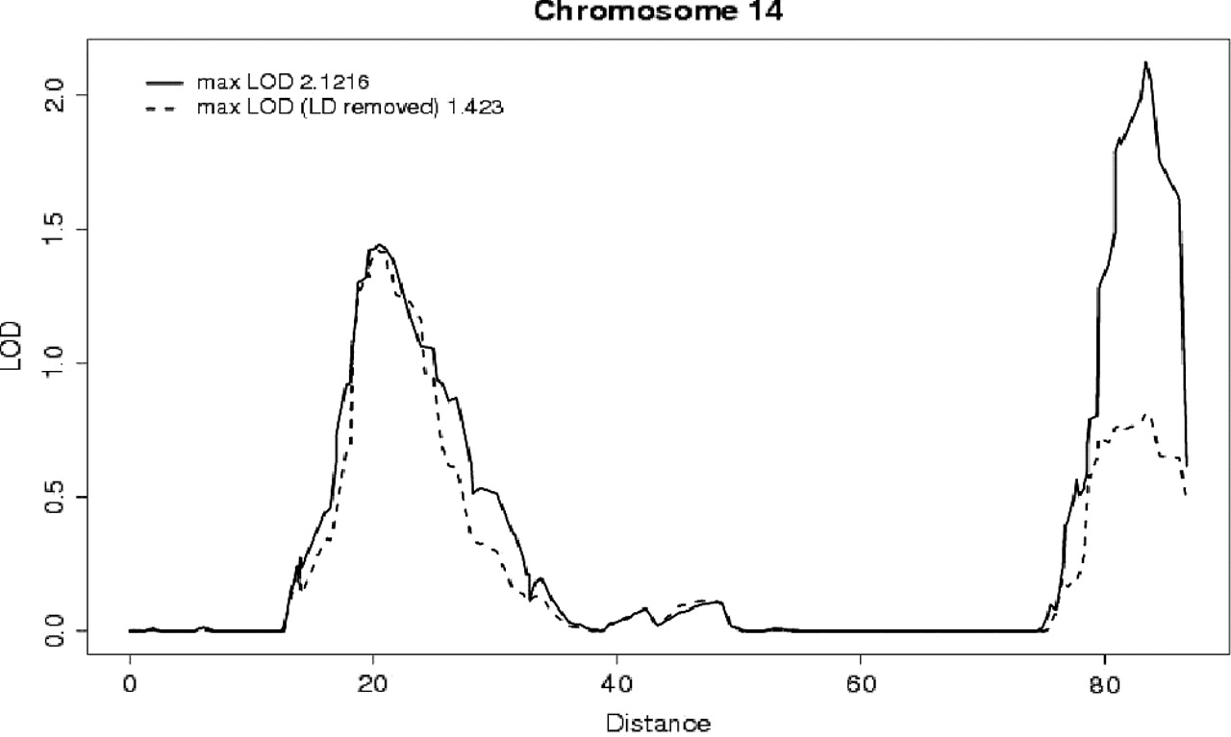
Fig. 1 Example of the output obtained from SNPLINK showing a plot of the multipoint LOD score across chromosome 14 ...
Notes:
Fig. 1 Example of the output obtained from SNPLINK showing a plot of the multipoint LOD score across chromosome 14 without (solid line) and with (dashed line) correction for LD between markers. An apparent linkage peak on the q arm disappears when LD is removed so that the maximum linkage peak is now on the p arm. The corresponding loss in information content (IC) was small throughout the chromosome (graphs available in SNPLINK) indicating that the reduction of the linkage peak was due to the removal of high LD between markers and not a consequence of reduced IC.
Unless provided in the caption above, the following copyright applies to the content of this slide: © The Author 2005. Published by Oxford University Press. All rights reserved. For Permissions, please email: journals.permissions@oupjournals.org

