Slide 1
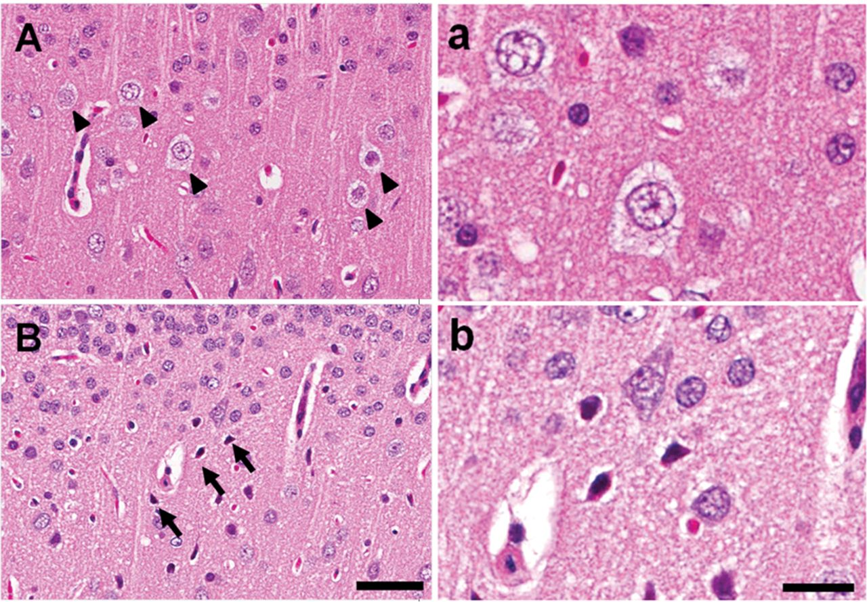
Fig. 1. Neuronal changes revealed by hematoxylin and eosin staining of the RS/PC cortex region of rats treated with ...
Notes:
Fig. 1. Neuronal changes revealed by hematoxylin and eosin staining of the RS/PC cortex region of rats treated with 1mg/kg MK-801. Neuronal vacuolation appeared in the RS/PC cortex region of rat 4h after MK-801 administration (A and a). No neuronal vacuolation was observed 24h after MK-801 administration; instead, neuronal cell death was detected in the same region (B and b). The arrowhead and arrow point to neuronal vacuolation and neuronal cell death, respectively. Scale bar: 50 µm at low magnification (A and B) and 20 µm at high magnification (a and b).
Unless provided in the caption above, the following copyright applies to the content of this slide: © The Author 2013. Published by Oxford University Press on behalf of the Society of Toxicology. All rights reserved. For permissions, please email: journals.permissions@oup.com.

Slide 2
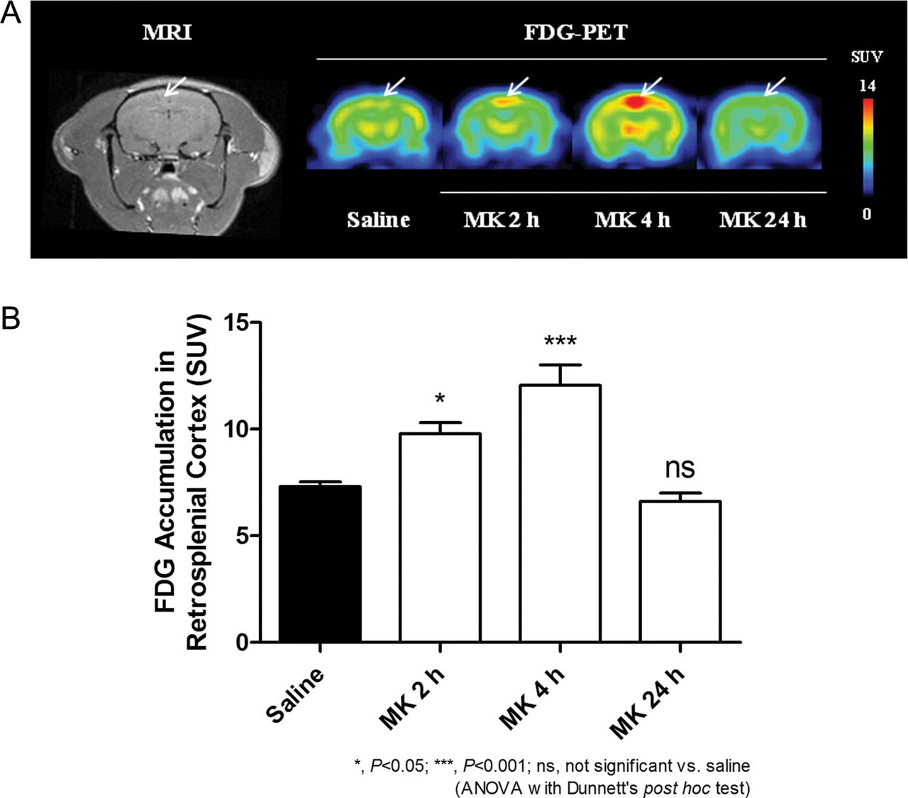
Fig. 2. Effect of MK-801 on glucose metabolism in rat brain. (A) Representative MR and PET images for the slice ...
Notes:
Fig. 2. Effect of MK-801 on glucose metabolism in rat brain. (A) Representative MR and PET images for the slice corresponding to the RS/PC cortex region of rat brain acquired 2, 4, and 24h after sc administration of 1mg/kg MK-801 or saline control. Arrows, RS/PC cortex region. SUV is a normalized tracer concentration indicating glucose utilization for [18F]FDG, reflecting neuronal activity. The [18F]FDG uptake in RS/PC cortex region was elevated in MK-801-treated animals at 2 and 4h. (B) Quantitative analysis of [18F]FDG-PET images of the RS/PC cortex region at 0h (saline), 2h (MK), 4h (MK), and 24h (MK) after administration of MK-801 at 1mg/kg. Mean ± SEM (n = 6).
Unless provided in the caption above, the following copyright applies to the content of this slide: © The Author 2013. Published by Oxford University Press on behalf of the Society of Toxicology. All rights reserved. For permissions, please email: journals.permissions@oup.com.

Slide 3
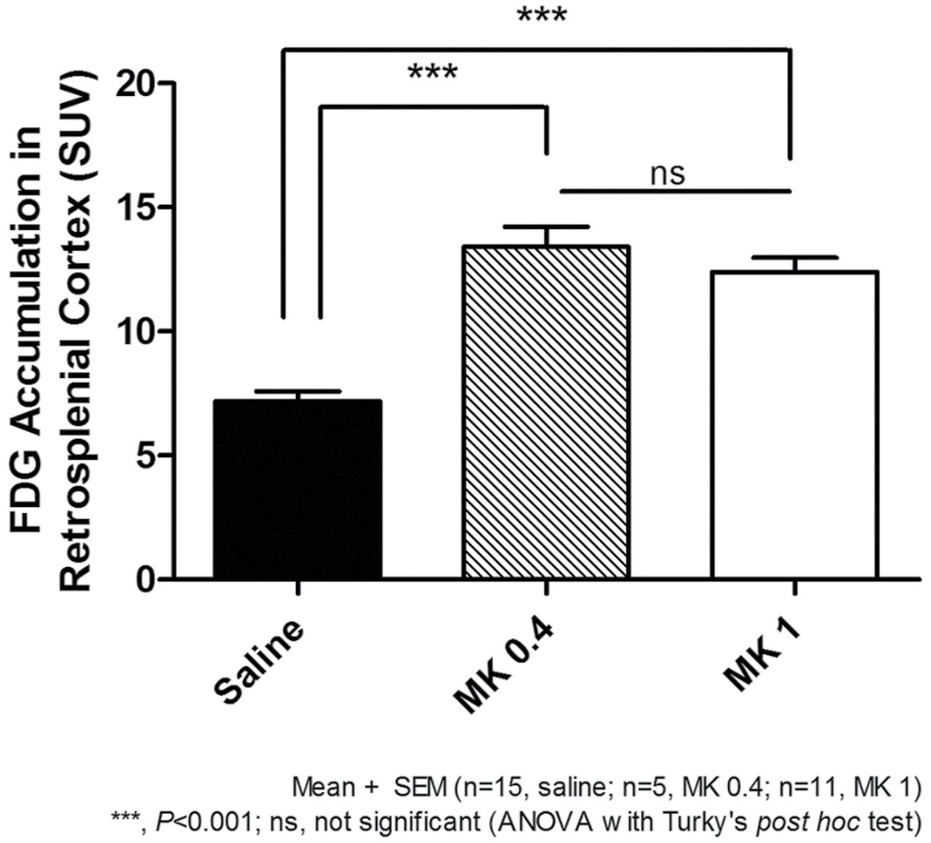
Fig. 3. Dose-dependent effect of MK-801 on glucose metabolism in rat brain. Quantitative analysis of ...
Notes:
Fig. 3. Dose-dependent effect of MK-801 on glucose metabolism in rat brain. Quantitative analysis of [18F]FDG-PET images of the RS/PC cortex region 4h after administration of saline (saline, n = 15), or MK-801 at 0.4mg/kg (MK 0.4, n = 5) or 1mg/kg (MK 1, n = 11). Mean ± SEM.
Unless provided in the caption above, the following copyright applies to the content of this slide: © The Author 2013. Published by Oxford University Press on behalf of the Society of Toxicology. All rights reserved. For permissions, please email: journals.permissions@oup.com.

Slide 4
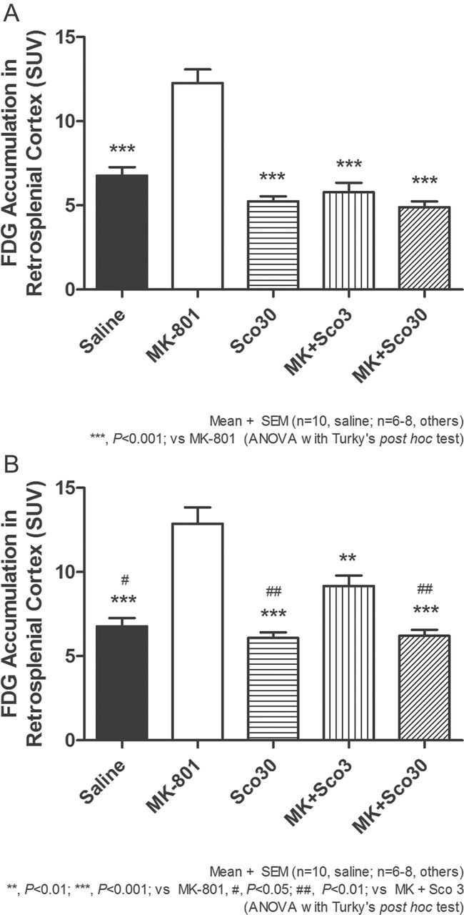
Fig. 4. Effect of scopolamine coadministration on increased glucose metabolism by MK-801 in rat brain. (A) ...
Notes:
Fig. 4. Effect of scopolamine coadministration on increased glucose metabolism by MK-801 in rat brain. (A) Quantitative analysis of [18F]FDG-PET images of the RS/PC cortex region 2h after administration in rats treated with saline (saline, n = 10), 1mg/kg of MK-801 (MK-801, n = 6), 30mg/kg of scopolamine (Sco30, n = 6), 1mg/kg of MK-801 plus 3mg/kg of scopolamine (MK + Sco3, n = 8), or 1mg/kg of MK-801 plus 30mg/kg of scopolamine (MK + Sco30, n = 7). (B) Quantitative analysis of [18F]FDG-PET images of the RS/PC cortex region 4h after administration in rats treated with saline (saline, n = 10), 1mg/kg of MK-801 (MK-801, n = 6), 30mg/kg of scopolamine (Sco30, n = 7), 1mg/kg of MK-801 plus 3mg/kg of scopolamine (MK + Sco3, n = 6), or 1mg/kg of MK-801 plus 30mg/kg of scopolamine (MK + Sco30, n = 8). Mean ± SEM.
Unless provided in the caption above, the following copyright applies to the content of this slide: © The Author 2013. Published by Oxford University Press on behalf of the Society of Toxicology. All rights reserved. For permissions, please email: journals.permissions@oup.com.

