Slide 1
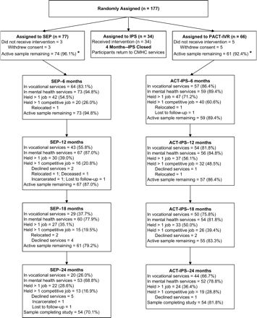
Fig. 1. Participant Flow—Random Assignment Through End of 24-Month Participation Period. Note: Numbers (percentages) ...
Notes:
Fig. 1. Participant Flow—Random Assignment Through End of 24-Month Participation Period. Note: Numbers (percentages) for all variables refer to service receipt and job activity within each of the 4 6-month intervals. “Active sample remaining” (i.e., the inverse of attrition) is defined as the percentage of participants in each program with any form of continuing study involvement through each succeeding 6-month interval (i.e., receipt of vocational or mental health services or employed as reported directly by study providers). SEP = Supported Employment Program, ACT-IPS = Assertive Community Treatment–Individual Placement and Support Program, IPS = Individual Placement and Support.
Unless provided in the caption above, the following copyright applies to the content of this slide: © The Author 2005. Published by Oxford University Press on behalf of the Maryland Psychiatric Research Center. All rights reserved. For permissions, please email: journals.permissions@oupjournals.org.

