Slide 1
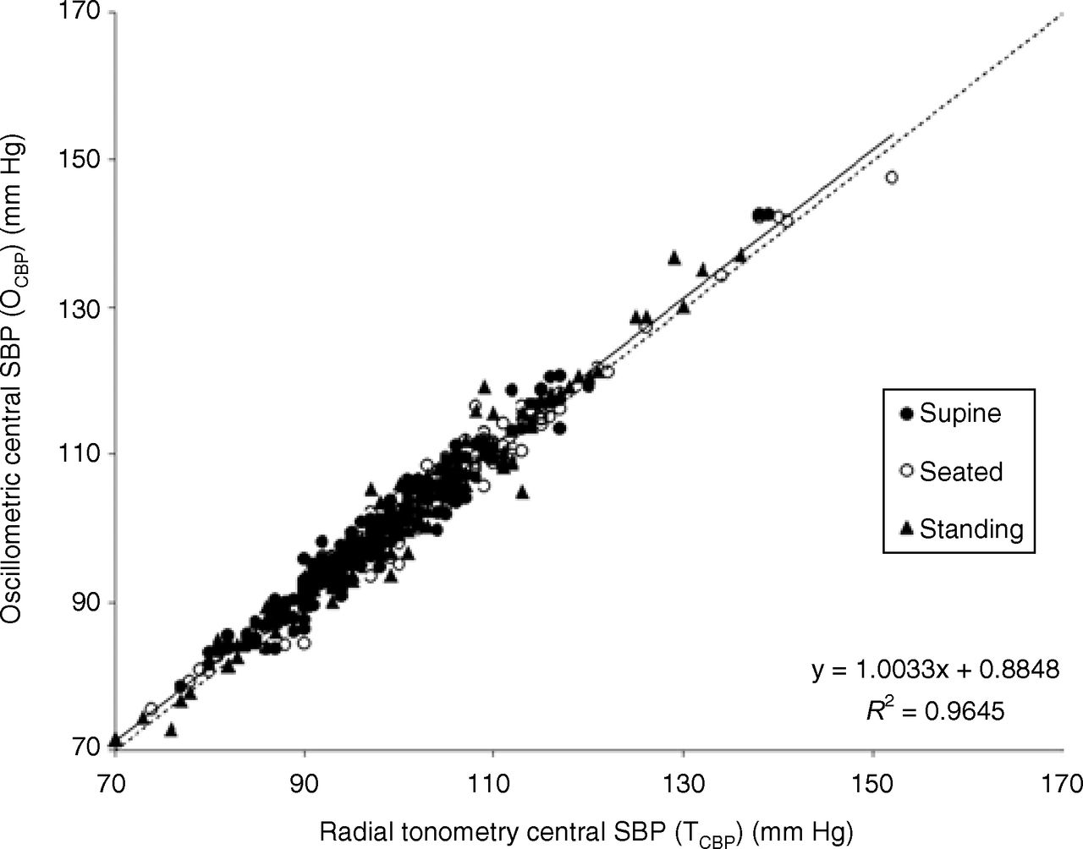
Figure 1. Effects of valsartan, losartan, or placebo on trough mean sitting diastolic blood pressure (MSDBP) and mean ...
Notes:
Figure 1. Effects of valsartan, losartan, or placebo on trough mean sitting diastolic blood pressure (MSDBP) and mean sitting systolic blood pressure (MSSBP). MSDBP (top) and MSSBP (bottom) after 4 weeks of treatment with 80 mg valsartan, 50 mg losartan, or placebo, and a further 4 weeks of treatment with 160 mg valsartan, 100 mg losartan, or placebo. Numbers given (n) refer to week 8. Differences between active treatments, valsartan and losartan, and placebo are statistically significant (P < .001) at week 4 and week 8. Differences between the two active treatments are not statistically significant.
Unless provided in the caption above, the following copyright applies to the content of this slide: © American Journal of Hypertension, Ltd. 1999

