Slide 1
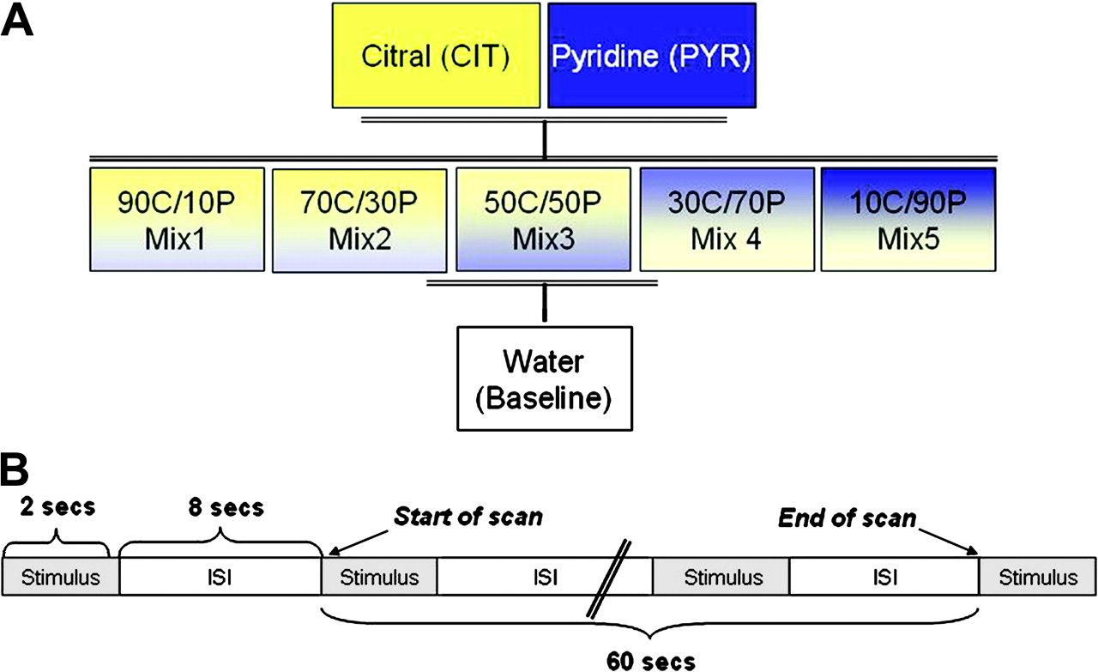
Figure 1. A) Illustration of single olfactory stimuli, their 5 isointense mixtures, and the baseline condition. CIT and ...
Notes:
Figure 1. A) Illustration of single olfactory stimuli, their 5 isointense mixtures, and the baseline condition. CIT and PYR were mixed in varying physical proportion from 90% CIT and 10% PYR (90C/10P) to 10% CIT and 90% PYR (10C/90P). B) Schematic representation of protocol used during individual scanning conditions. Timing of events was identical in each of the 8 scanning conditions, with the only difference between them being that subjects smelled different odors (or water in the baseline). Each scan lasted 60 s, whereas the stimulation lasted 90 s, starting before and ending after the scan.
Unless provided in the caption above, the following copyright applies to the content of this slide: Published by Oxford University Press 2008.

Slide 2
Figure 2. Results from ratings obtained immediately after each scan. A) Perceived intensity and B) perceived ...
Notes:
Figure 2. Results from ratings obtained immediately after each scan. A) Perceived intensity and B) perceived pleasantness ratings obtained using 11-point visual analog scale. Error bars denote standard error of the mean.
Unless provided in the caption above, the following copyright applies to the content of this slide: Published by Oxford University Press 2008.

Slide 3
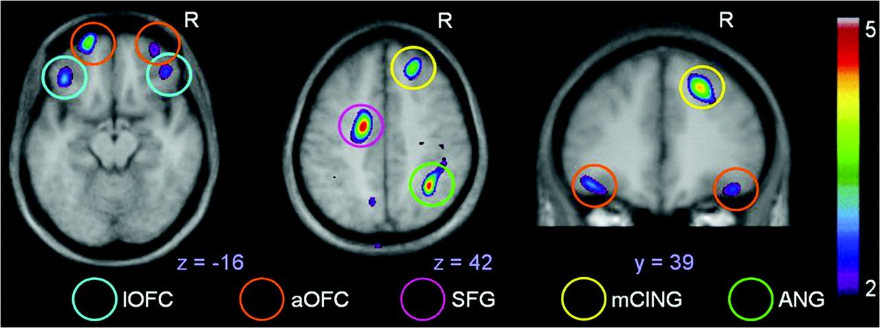
Figure 3. Areas of rCBF increase demonstrated by the mixtures minus single odorants subtraction. Increased activations ...
Notes:
Figure 3. Areas of rCBF increase demonstrated by the mixtures minus single odorants subtraction. Increased activations in the bilateral anterior OFC (aOFC) and lateral OFC (lOFC) are shown on the horizontal section at z = −16, and the lOFC is shown in the coronal section at y = 39; left superior frontal gyrus (SFG) and angular gyrus (ANG) in the parietal cortex and right middle cingulate cortex (mCING) are shown on the horizontal section at z = 42.
Unless provided in the caption above, the following copyright applies to the content of this slide: Published by Oxford University Press 2008.

Slide 4
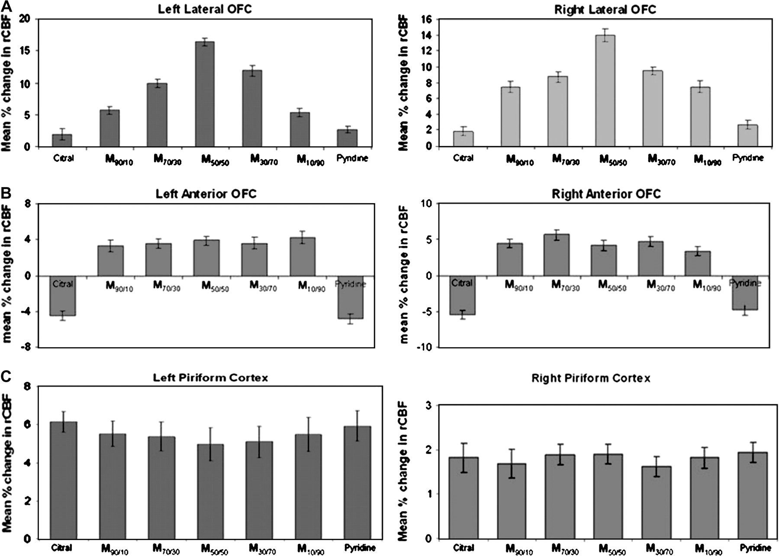
Figure 4. A) rCBF values extracted from the left and right lateral OFC show increased activation as odor impurity ...
Notes:
Figure 4. A) rCBF values extracted from the left and right lateral OFC show increased activation as odor impurity increases. B) rCBF values extracted from the left and right anterior OFC show increased activation in response to odor mixtures but not to single odorants. C) rCBF values extracted from the left and right piriform cortex show an equal increase in activation in response to all odor stimuli. All rCBF changes were calculated as a mean percent change from baseline.
Unless provided in the caption above, the following copyright applies to the content of this slide: Published by Oxford University Press 2008.

