Slide 1
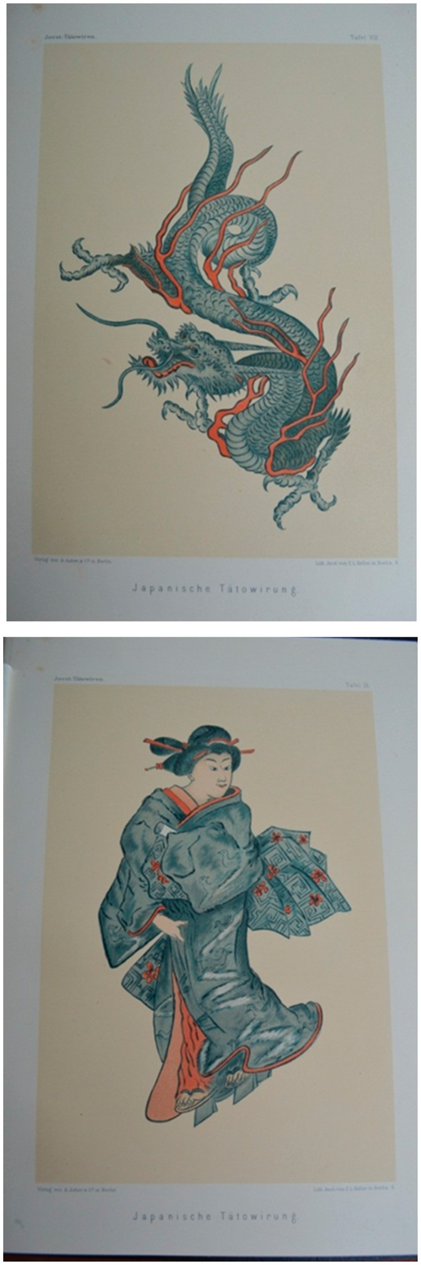
1. Top: Wilhelm Joest’s tattoo (left arm) Bottom: Wilhelm Joest’s tattoo (right arm) From Wilhelm Joest, ...
Notes:
1. Top: Wilhelm Joest’s tattoo (left arm) Bottom: Wilhelm Joest’s tattoo (right arm) From Wilhelm Joest, T��towiren Narbenzeichenen und K�rperbemalen: ein Beitrag zur vergleichenden Ethnologie (Berlin, 1887), Plates viii and ix.
Unless provided in the caption above, the following copyright applies to the content of this slide: � The Past and Present Society, Oxford, 2017This article is published and distributed under the terms of the Oxford University Press, Standard Journals Publication Model (https://academic.oup.com/journals/pages/open_access/funder_policies/chorus/standard_publication_model)

Slide 2
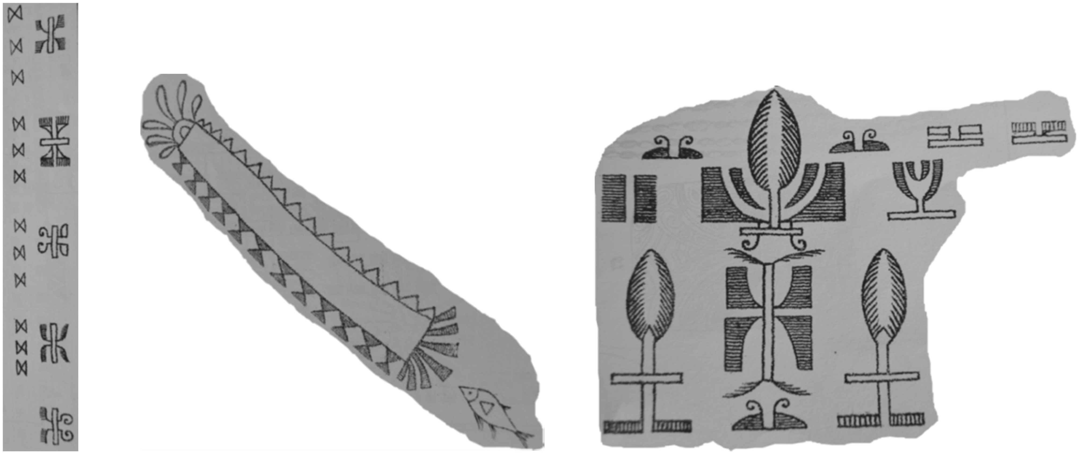
2. Friedrich Gerst�cker’s tattoos From Heinrich Wuttke, Die Entstehung der Schrift, die verschiedenen ...
Notes:
2. Friedrich Gerst�cker’s tattoos From Heinrich Wuttke, Die Entstehung der Schrift, die verschiedenen Schriftsysteme und das Schrifttum der nicht alfabetarisch schreibenden V��lker (Leipzig, 1872), Appendices x and xi.
Unless provided in the caption above, the following copyright applies to the content of this slide: � The Past and Present Society, Oxford, 2017This article is published and distributed under the terms of the Oxford University Press, Standard Journals Publication Model (https://academic.oup.com/journals/pages/open_access/funder_policies/chorus/standard_publication_model)

