Slide 1
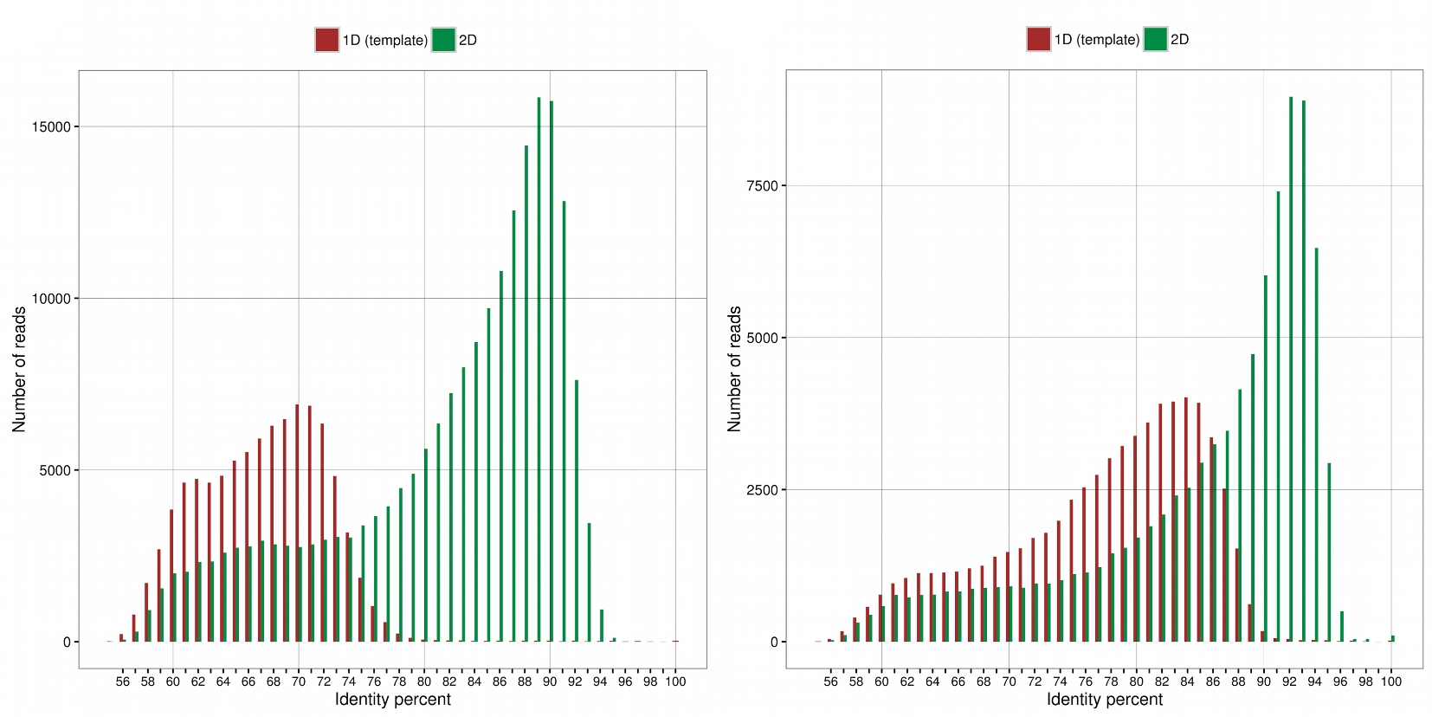
Figure 1: Identity distribution of Nanopore reads. Percent identity of the aligned MinION 1D (red bars) and 2D (green ...
Notes:
Figure 1: Identity distribution of Nanopore reads. Percent identity of the aligned MinION 1D (red bars) and 2D (green bars) reads. The MinION reads were aligned using LAST software. (a) R7.3 chemistry. (b) R9 chemistry.
Unless provided in the caption above, the following copyright applies to the content of this slide: © The Author 2017. Published by Oxford University Press.This is an Open Access article distributed under the terms of the Creative Commons Attribution License (http://creativecommons.org/licenses/by/4.0/), which permits unrestricted reuse, distribution, and reproduction in any medium, provided the original work is properly cited.

Slide 2
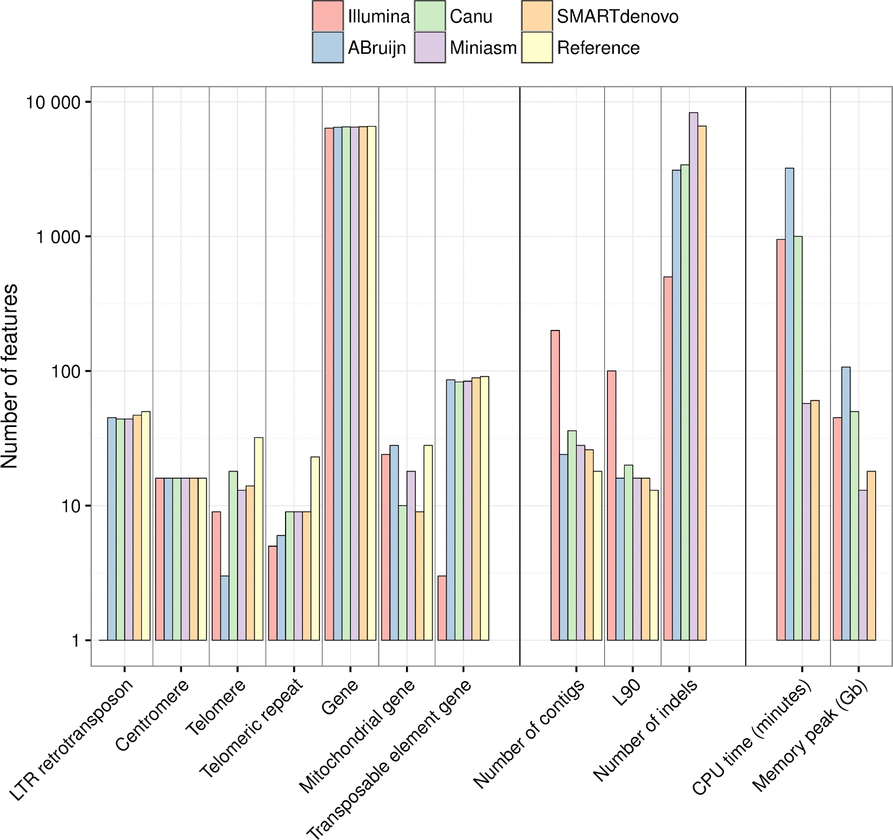
Figure 2: Feature composition of the S288C assemblies, assembly and quality metrics, and assembler running statistics. ...
Notes:
Figure 2: Feature composition of the S288C assemblies, assembly and quality metrics, and assembler running statistics. The feature content of the best S288C assemblies for each assembler is shown in the left part of the figure. The feature composition was obtained by aligning each assembly to the S288C reference genome. Assembly and quality metrics for each assembly, obtained by using Quast, are shown in the middle part of the figure. The running time and the memory usage of each assembler are shown in the right part of the figure.
Unless provided in the caption above, the following copyright applies to the content of this slide: © The Author 2017. Published by Oxford University Press.This is an Open Access article distributed under the terms of the Creative Commons Attribution License (http://creativecommons.org/licenses/by/4.0/), which permits unrestricted reuse, distribution, and reproduction in any medium, provided the original work is properly cited.

Slide 3
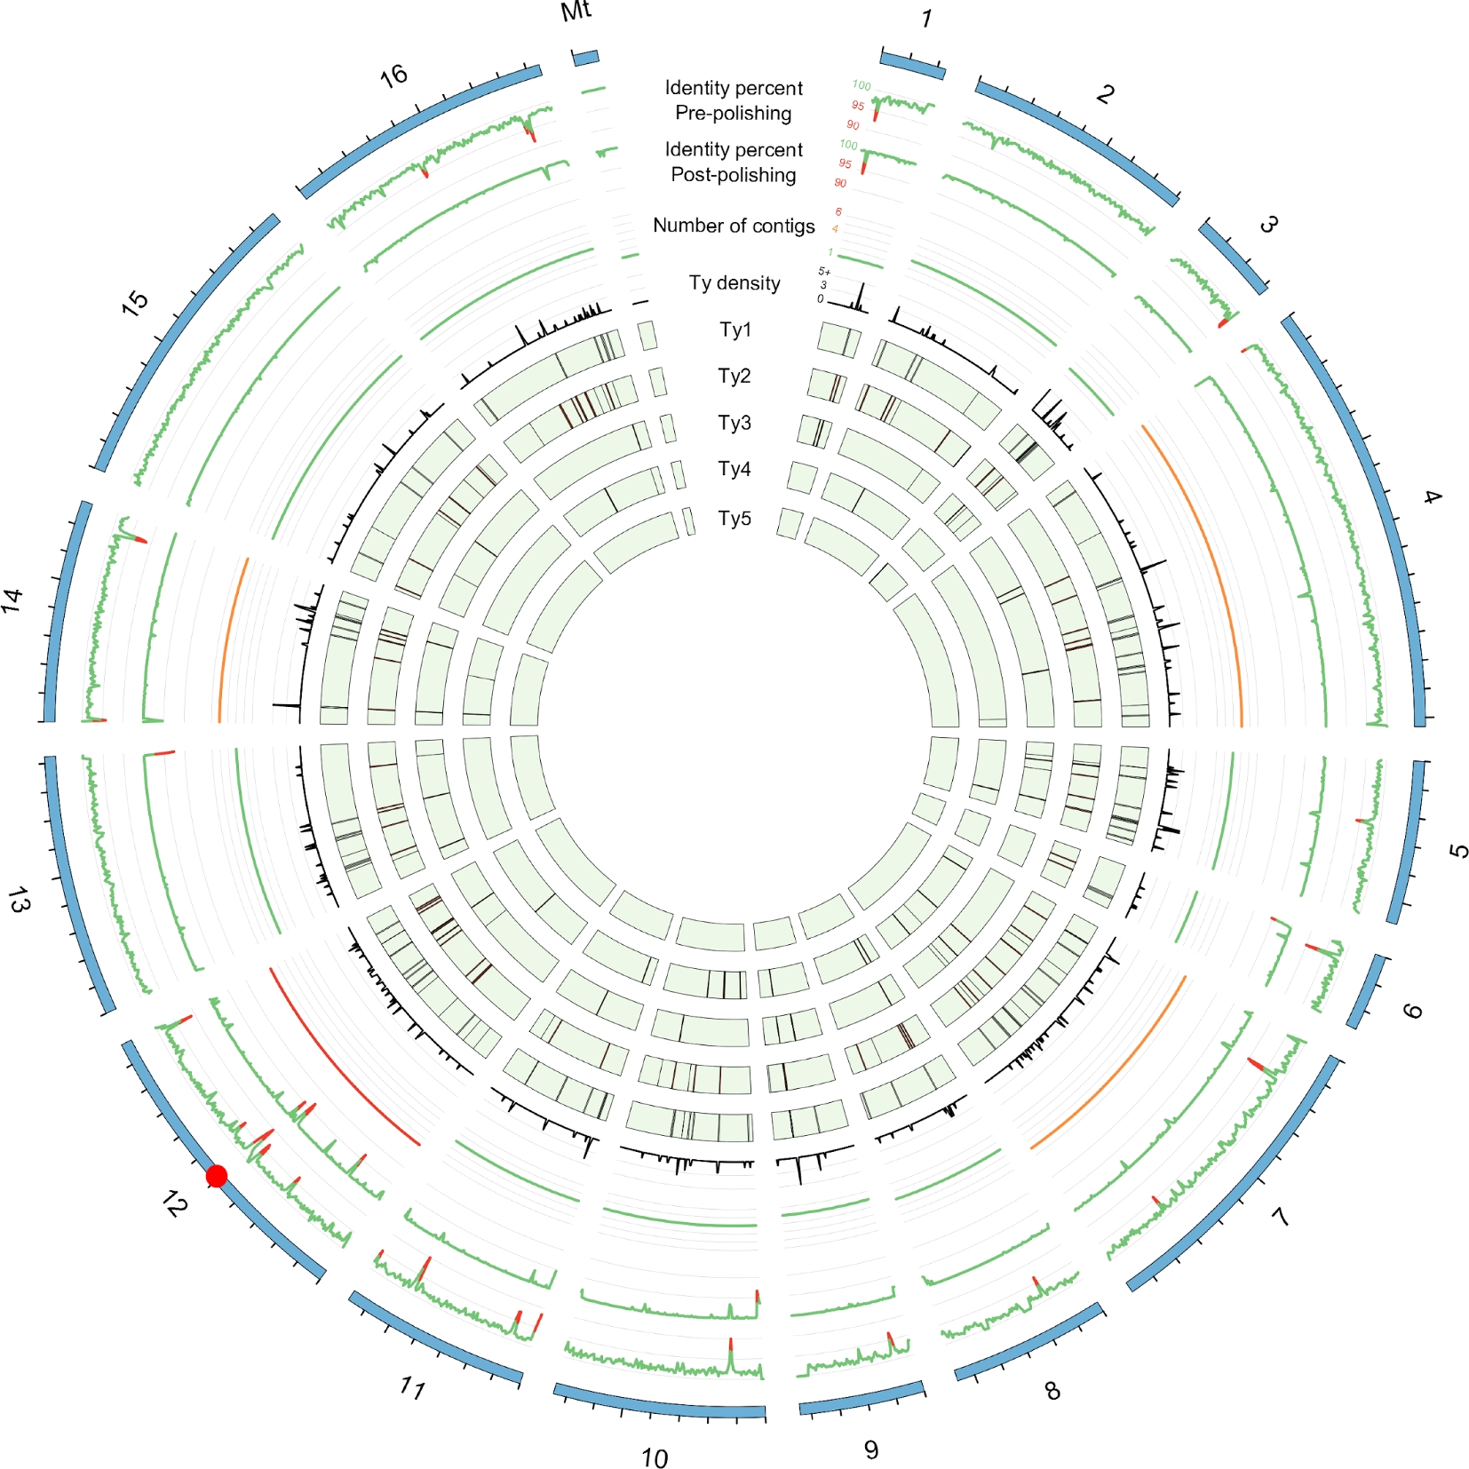
Figure 3: Cartography of the Ty transposon family. First and second tracks show, respectively, the percentage identity ...
Notes:
Figure 3: Cartography of the Ty transposon family. First and second tracks show, respectively, the percentage identity of the SMARTdenovo S288C assembly before and after polishing with Illumina paired-end reads using Pilon. The third track shows the 80th percentile number of contigs obtained for each strain and for all chromosomes. The remaining tracks show the density of Ty transposons or positions of the Ty1, Ty2, Ty3, Ty4, and Ty5 transposons across all the yeast strains. The red dot on the karyotype track shows the position of the rDNA cluster.
Unless provided in the caption above, the following copyright applies to the content of this slide: © The Author 2017. Published by Oxford University Press.This is an Open Access article distributed under the terms of the Creative Commons Attribution License (http://creativecommons.org/licenses/by/4.0/), which permits unrestricted reuse, distribution, and reproduction in any medium, provided the original work is properly cited.

