Slide 1
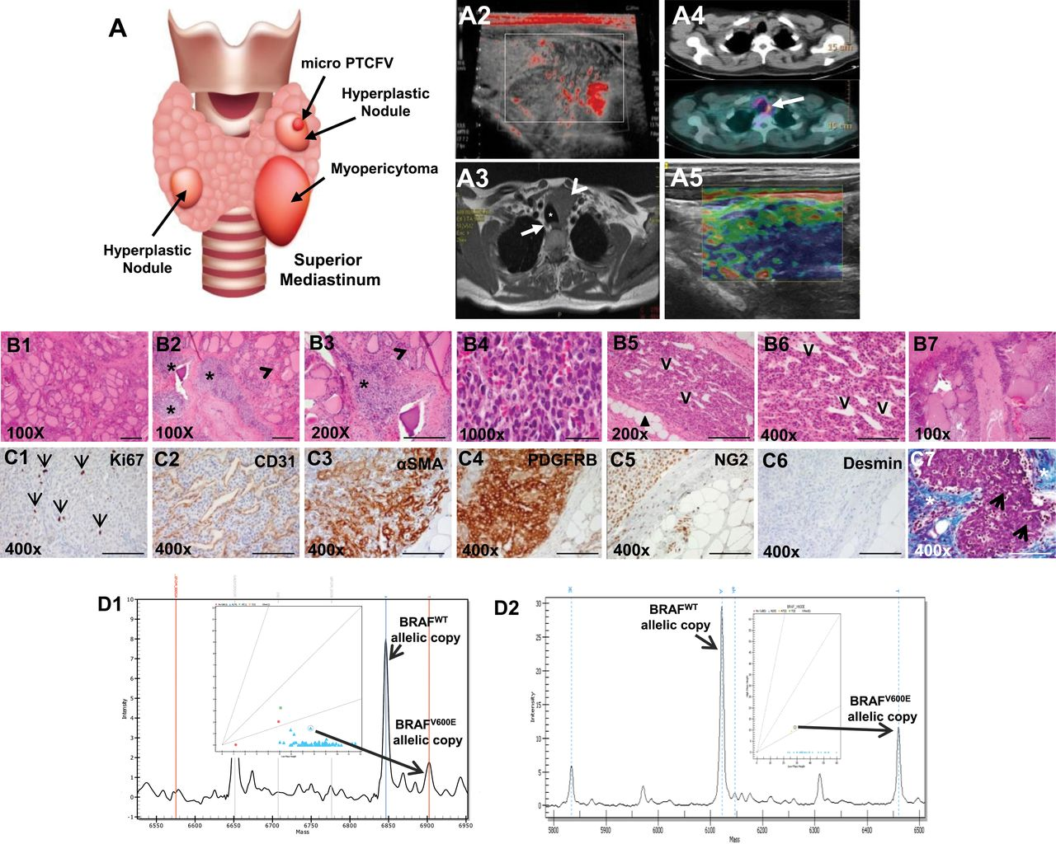
Figure 1. A multimodality perioperative evaluation of patient with multifocal infiltrating thyroid myopericytoma ...
Notes:
Figure 1. A multimodality perioperative evaluation of patient with multifocal infiltrating thyroid myopericytoma harboring the heterozygous BRAFWT/V600E mutation. A1) Multinodular thyroid disease, 1.5mm follicular variant papillary thyroid microcarcinoma (PTCFV) in the left thyroid lobe and a left thyroid mass (myopericytoma [MPC]) with mediastinal extension in a 44-year old woman. A2) Neck Doppler ultrasound shows a 4.0×3.4cm irregular, hypo-echoic, hyper-vascular mass in the left thyroid lobe with mediastinal extension. A3) Contrast enhanced T1-weighted magnetic resonance imaging before thyroid surgery shows a four-cm, hyper-intense mass (arrowhead) localized in the left thyroid lobe with mediastinal extension, impingement, rightward tracheal (asterisk) deviation and possible extension into soft tissue (arrow highlights a right thyroid nodule). A4) Total body 18F-FDG (fluorodeoxyglucose) PET (Positron emission tomography)/CT (Computed Tomography) exam reveals high 18F-FDG uptake in the left persistent/recurrent mass (arrow). A5) Elastography analysis shows a non-deformable pattern (the arrow highlights a reduction of the elasticity, blue color) in the vast majority part of the left persistent/recurrent MPC. B1-B7) Histology of the thyroid and perithyroidal soft tissue with multifocal and infiltrating thyroid MPC (hematoxylin and eosin staining). (B1, scale bar = 500µ) Macrofollicular thyroid tissue. (B2-B3, scale bar = 200µ) The thyroid MPC is present in several foci (asterisk) in the thyroid gland (B2-B3, arrowhead highlights thyroid follicles). (B4, scale bar = 500µ) The MPC cells with apparent differentiation toward perivascular myoid cells and pericytes, best appreciated under oil immersion lens, show a bland, ovoid, and epithelioid to spindled morphology. (B5, scale bar = 200µ) MPC shows a somewhat infiltrative appearance through adipose tissue (arrowheads) with: (B6, scale bar = 100µ) radial and multilayered perivascular growth with a staghorn-like vascular growth pattern; and (B7, scale bar = 500µ) destruction of thyroid tissue. (C1-C7, scale bar = 100µ) Immunohistochemistry staining in the thyroid MPC: C1) the Ki67 proliferation index (arrows highlight nuclear staining) is low in the MPC cells. C2) The MPC cells are clustered with a fascicular growth pattern around the vessels (clear, slit-like spaces, V) with intralesional, thin-walled branching vessels of small caliber, highlighted by CD31 (C2). C3-C4) MPC cells show cytoplasmic to membranous staining with antibodies against α-smooth muscle actin (αSMA) and platelet-derived growth factor receptor beta (PDGFRB). C5) MPC cells also show positivity (punctate) for NG2 (chondroitin sulfate proteoglycan 4) but are negative for desmin (C6). C7) Trichrome staining highlights the abundant amount of collagen deposition (blue staining, asterisk) surrounding the MPC (purple staining) or the intratumoral deposition of collagen (arrows). D1-D2) DNA genotyping analysis by mass spectrometry (MS) traces of formalin-fixed paraffin embedded thyroid (n = 1) (D1) and (D2) skin (eg, leg) (n = 28) MPC tissue samples reveals a heterozygous BRAFWT/V600E allele (long arrows) (A > T). The intensity of the signal vs mass of the analyte is plotted in the background, while the inset shows the cluster plot with all samples analyzed in the run (intensity of the signals of the two alleles). The long arrow links the actual sample (circle in the inset) to the mass of the expected mutant V600E allele. Color coded by the software is automatic allele calls. Cyan squares for heterozygous samples, orange triangles for homozygous. Ambiguous calls are identified by a red dot. Allele frequencies deviating from the expected values are assigned ambiguous or homozygous calls by the software.
Unless provided in the caption above, the following copyright applies to the content of this slide: © The Author 2014. Published by Oxford University Press. All rights reserved. For Permissions, please e-mail: journals.permissions@oup.com.

Slide 2
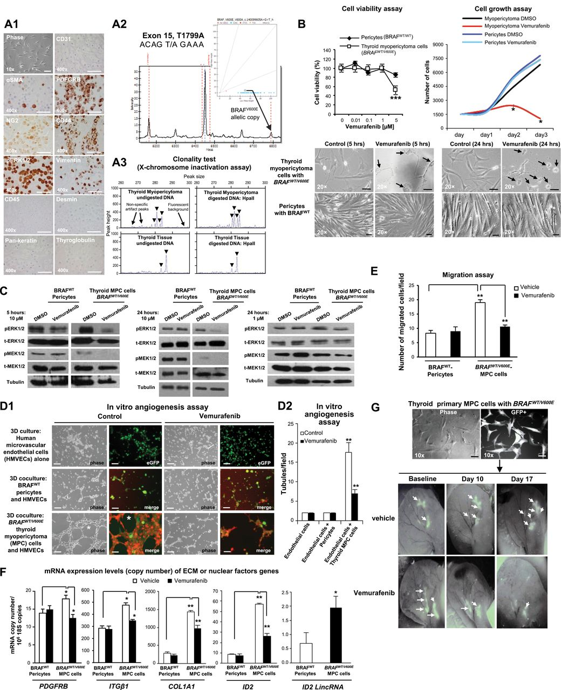
Figure 2. In vitro and in vivo preclinical model of human primary thyroid myopericytoma harboring the heterozygous ...
Notes:
Figure 2. In vitro and in vivo preclinical model of human primary thyroid myopericytoma harboring the heterozygous BRAFWT/V600E mutation. A1) Immunocytochemistry of established non-immortalized primary human thyroid myopericytoma (MPC) cells with the heterozygous BRAFWT/V600E mutation. Phase image of MPC cells, scale bar = 100µ. Immunohistochemistry staining (scale bar = 400µ) in the thyroid MPC cells show cytoplasmic to membranous staining with antibodies against α-smooth muscle actin (αSMA), platelet-derived growth factor receptor beta (PDGFRB), and CD44 (stem cell and cell adhesion marker). Thyroid MPC cells also show positivity for NG2 (chondroitin sulfate proteoglycan 4), phospho(p)-ERK1/2, and vimentin. CD31, CD45, pan-keratin, desmin, and thyroglobulin (Tg) immunostains are negative. A2) DNA genotyping analysis by mass spectrometry (MS) traces of the human primary thyroid MPC cells (n = 1) reveals a heterozygous BRAFWT/V600E allele (long arrows) (A > T). The intensity of the signal vs mass of the analyte is plotted in the background, while the inset shows the cluster plot with all samples analyzed in the run (intensity of the signals of the two alleles). The long arrow links the actual sample (circle in the inset) to the mass of the expected mutant V600E allele. Color coded by the software is automatic allele calls. Cyan squares for heterozygous samples, orange triangles for homozygous. Ambiguous calls are identified by a red dot. Allele frequencies deviating from the expected values are assigned ambiguous or homozygous calls by the software. These findings were validated by two independent experiments. A3) Methylation-sensitive PCR analysis of the X-chromosome locus was assessed on DNA isolated from manually dissected female thyroid MPC (n = 1) or non-malignant adjacent thyroid tissue (n = 1) formalin fixed paraffin embedded specimen. Screenshot of electropherogram displaying discordant patterns of X-chromosome inactivation (arrowheads) in the thyroid MPC vs the benign thyroid tissue. For each sample, the corresponding plot is a quantitative representation of the size and amount of fluorescent PCR products amplified from undigested DNA or digested DNA with the methylation-sensitive enzyme HpaII when analyzed on an automated DNA sequencer. The peaks indicate the estimated allele size (in base pairs) that is the corresponding peak height (amount of PCR product), as quantified by DNA Genotyper software. These findings were validated by triplicate sample assays. B) Thyroid MPC cells with heterozygous BRAFWT/V600E or normal pericytes with BRAFWild Type(WT) were treated with the indicated concentrations of vemurafenib for 48 hours, and viability was determined using the Cell Titer-Glo ATP-based luminescence assay, with Dimethyl sulfoxide, control (DMSO)–treated cells as the control. Cell growth curves were determined following two to three days of treatment with DMSO or vemurafenib. Arrows highlight change of cell shape in MPC cells vs control. All scale bars are =10µ (MPC cells images) and 50µ (pericytes images). These data represent the average ± standard deviation (error bars) of eight independent replicate measurements (*P < .05, **P < .01, ***P < .001, Mann-Whitney test, two-sided). C) A parallel plate similar to (B) was set up and corresponding phospho(p)ERK1/2 and pMEK1/2 protein levels measured from BRAFWT/V600E-MPC cells or BRAFWT pericytes protein samples using western blotting assays. These data are representative of three independent experiments. D1-D2) BRAFWT/V600E-thyroid MPC cells cocultured with human microvascular endothelial cells (HMVECs) induce tubule formation (asterisk, control) (magnifications in all images: 20×; scale bars = 200µ) on growth factors reduced Matrigel in the presence of very low serum concentration (0.2%) within six hours compared to cocultures of HMVECs and BRAFWT pericytes or HMVECs alone, in the presence of vehicle (control) or vemurafenib treatment. Phase-contrast images were captured by optical microscopy. GFP (green fluorescent protein) and merge images were captured on a different microscopy field by confocal microscopy analysis: HMVECs alone are stained with ICAM-1 (human intercellular adhesion molecule) (green); merge= GFP-tagged MPC cells or Alexa Fluo 488-conjugated CD90 (green)–tagged pericytes, and Alexa Fluo 594-conjugated actin (red)–tagged HMVECs. These data represent the average ± standard deviation (error bars) of six independent replicate measurements (**P = .002, Mann-Whitney test, two-sided). E) Cell migration assays within five hours in human primary thyroid MPC cells with BRAFWT/V600E or in pericytes with BRAFWT in the presence of vehicle (control) or vemurafenib treatment. These data represent the average ± standard deviation (error bars) of six independent replicate measurements (**P = .002, Mann-Whitney test, two-sided). F) Quantitation of mRNA expression levels (copy number) by multi-gene transcriptional real-time reverse transcriptase PCR (RT-PCR) analysis of genes fundamental for extracellular matrix (ECM) remodeling and angiogenesis in human primary thyroid MPC cells with BRAFWT/V600E or in pericytes with BRAFWT in the presence of vehicle (control) or vemurafenib treatment for 24 hours (0.2% serum cell growth medium). Gene expression was classified as “low copy number” if it was below 1 mRNA copy/106 18S copies, “moderate copy number” if it was between 1 and 15 mRNA copies/106 18S copies, and “high copy number” if it was greater than 15 mRNA copies/106 18S copies. These data represent the average ± standard deviation (error bars) of four to six independent replicate measurements (*P < .05; **P < .01: ***P < .001, Mann-Whitney test, two-sided). Genes showing difference in values of comparisons (P values <.05) were considered differentially expressed and statistically significant. G) A patient-derived xenograft (PDX) mouse model of BRAFWT/V600E-human primary thyroid MPC cells engineered to express GFP (green fluorescent protein, scale bar=100µ) injected in the subcutaneous compartment of the left ear of nude mice (n = 10) to visually follow perivascular growth of MPC cells over time in vivo. Mice were treated starting four days after BRAFWT/V600E-MPC cells implantation (defined ‘baseline’) with vemurafenib (100mg/kg twice daily by oral gavage) (n = 5) or vehicle (n = 5) for two consecutive weeks. MPC cell viability was determined by the CS5.1 histogram software calculating the absolute number of pixels in the GFP-positive areas (arrows) of the left ear divided by the total number of pixels (247,545) in the highlighted selection area. These data represent the average ± standard deviation of two independent experiments (control-treated mice vs vemurafenib-treated mice, P = .007, Mann-Whitney test).
Unless provided in the caption above, the following copyright applies to the content of this slide: © The Author 2014. Published by Oxford University Press. All rights reserved. For Permissions, please e-mail: journals.permissions@oup.com.

