Slide 1
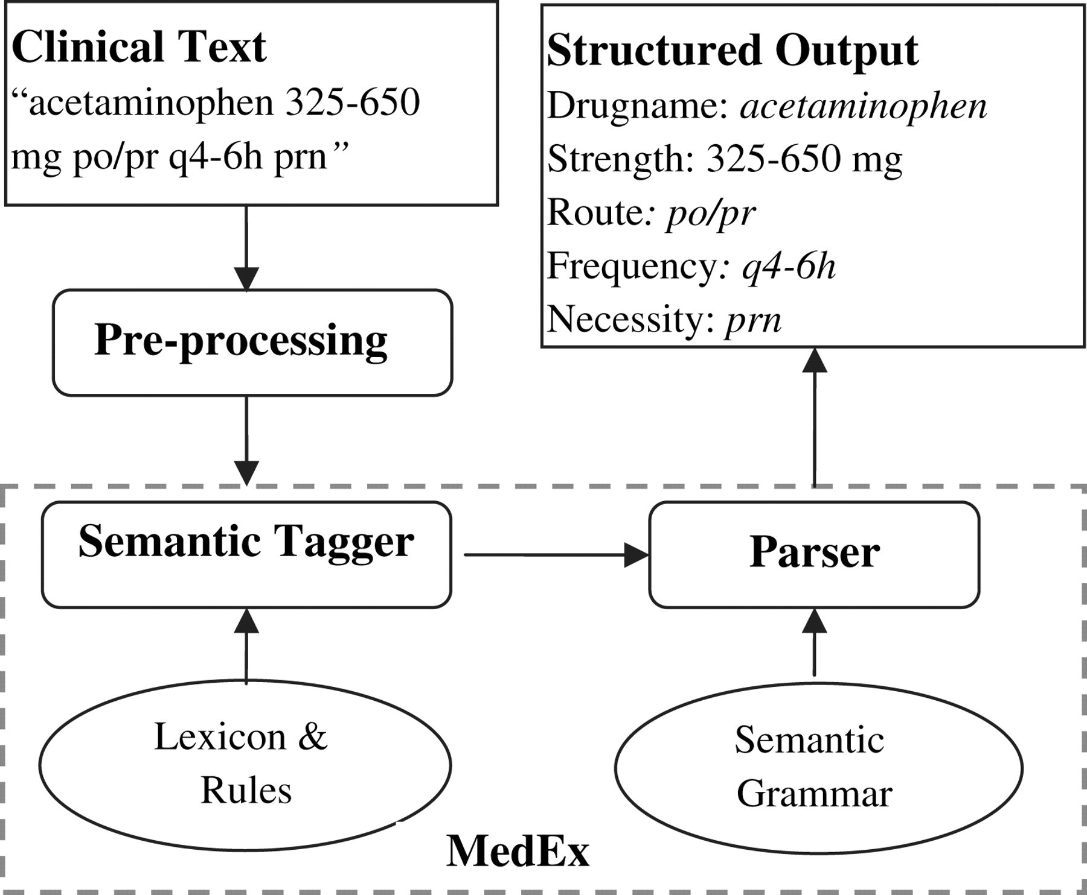
Figure 1 An overview of the MedEx system.
Notes:
Figure 1 An overview of the MedEx system.
Unless provided in the caption above, the following copyright applies to the content of this slide: © 2009, Published by the BMJ Publishing Group Limited For permission to use, (where not already granted under a licence) please go to http://group.bmj.com/group/rights-licensing/permissions.

Slide 2
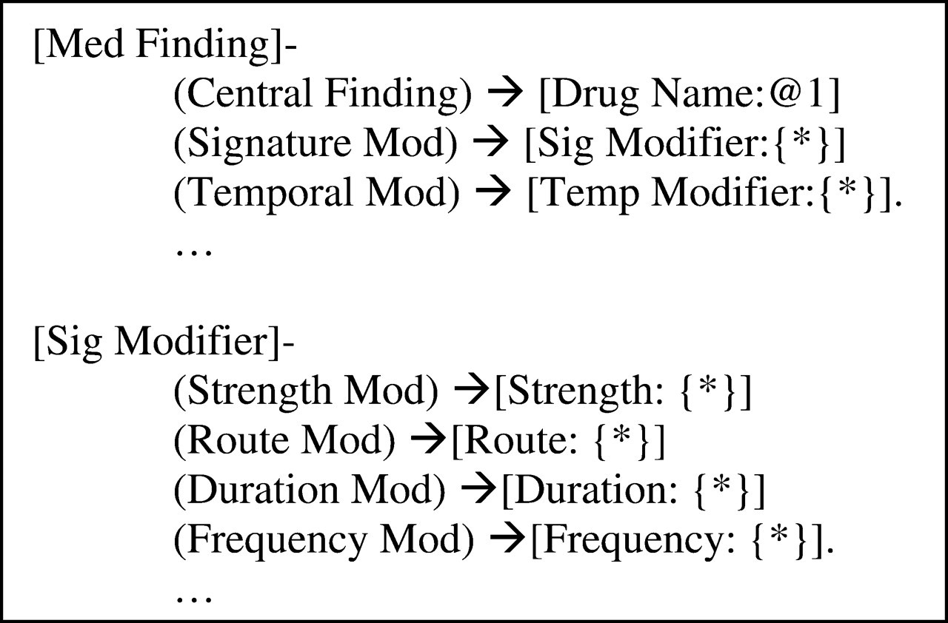
Figure 2 A simplified model to represent medication findings and signature modifiers in the notation of conceptual ...
Notes:
Figure 2 A simplified model to represent medication findings and signature modifiers in the notation of conceptual graphs. A concept is enclosed in square brackets and followed by the relations associated with it. Each relation appears in parentheses and its values are specified by another concept that follows the relations after an arrow (‘→’). The number of values that a relation is permitted to have (its cardinality) is defined by following constraint:{*} means that the relation must have 0 or more values;{*}@>0 means that the relation must have 1 or more values; and:{*}@<2 means that the relation must have 0 or 1 values; the default cardinality is exactly 1.
Unless provided in the caption above, the following copyright applies to the content of this slide: © 2009, Published by the BMJ Publishing Group Limited For permission to use, (where not already granted under a licence) please go to http://group.bmj.com/group/rights-licensing/permissions.

Slide 3
Figure 3 An example of the sequential semantic tagger.
Notes:
Figure 3 An example of the sequential semantic tagger.
Unless provided in the caption above, the following copyright applies to the content of this slide: © 2009, Published by the BMJ Publishing Group Limited For permission to use, (where not already granted under a licence) please go to http://group.bmj.com/group/rights-licensing/permissions.

Slide 4
Figure 4 Partial representation of the semantic grammar.
Notes:
Figure 4 Partial representation of the semantic grammar.
Unless provided in the caption above, the following copyright applies to the content of this slide: © 2009, Published by the BMJ Publishing Group Limited For permission to use, (where not already granted under a licence) please go to http://group.bmj.com/group/rights-licensing/permissions.

