Slide 1
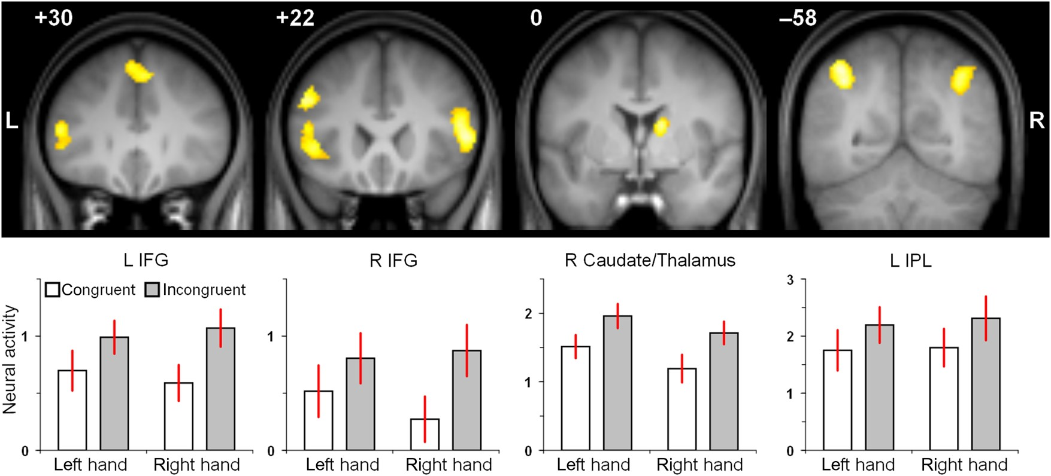
Figure 1. Brain regions showing significant subliminal visuomotor priming, that is, lower brain activity for trials ...
Notes:
Figure 1. Brain regions showing significant subliminal visuomotor priming, that is, lower brain activity for trials with congruent than with incongruent shape–response assignments. Effects were overlaid on coronal sections of the group averaged T1 image using MRIcron (http://www.mccauslandcenter.sc.edu/mricro/mricron/, last accessed 30 March, 2015). White numbers refer to the y-coordinates of the coronal sections in MNI space. Averaged parameter estimates representing neural activity [arbitrary unit] associated with the 4 event types are depicted below. Estimates were extracted from and averaged across the entire respective cluster listed in Table 1. The information “left hand” versus “right hand” refers to the response side associated with the target stimulus. Error bars represent standard error of the mean (31 subjects). L: left; R: right; IFG: inferior frontal gyrus; IPL: inferior parietal lobule.
Unless provided in the caption above, the following copyright applies to the content of this slide: © The Author 2015. Published by Oxford University Press. All rights reserved. For Permissions, please e-mail: journals.permissions@oup.com

Slide 2
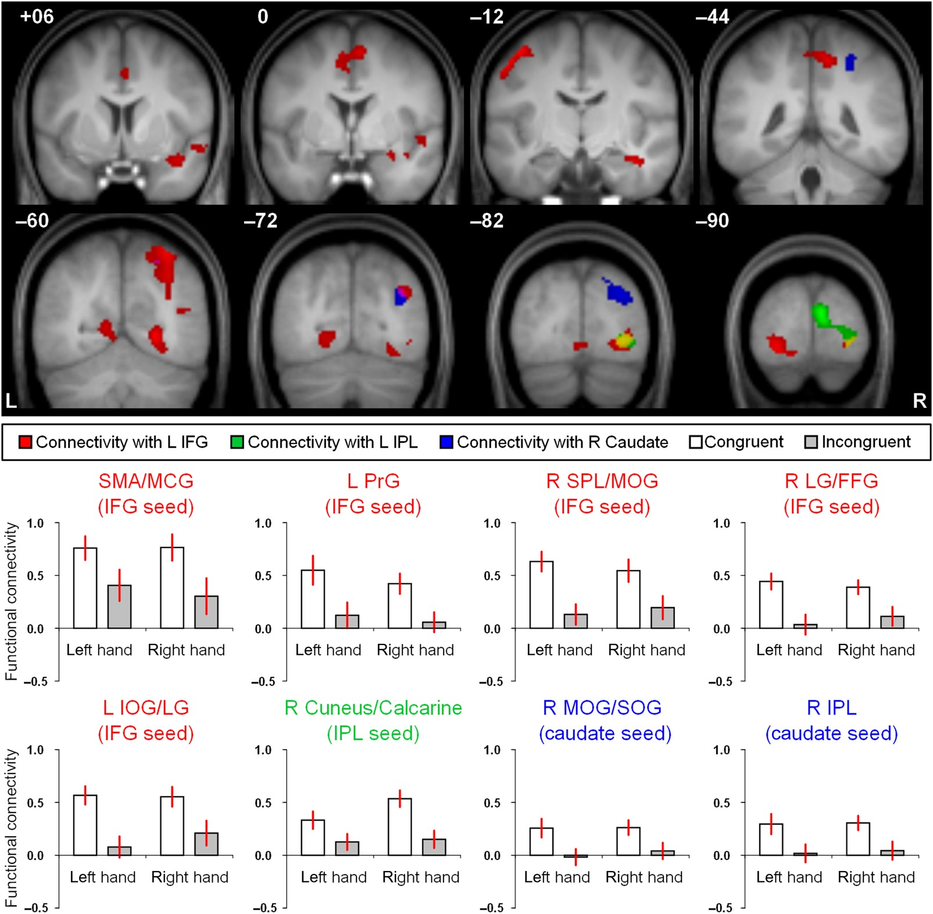
Figure 2. Congruency-modulated functional connectivity with 3 seed regions (contrast: congruent > incongruent). ...
Notes:
Figure 2. Congruency-modulated functional connectivity with 3 seed regions (contrast: congruent > incongruent). Depending on the specific seed region, functionally connected brain regions are depicted in red (L IFG seed, [−46, 20, 30]), in green (L IPL seed, [−36, −58, 42]), or in blue (R caudate nucleus seed, [14, 0, 14]). Overlap between red and green is displayed in yellow, and overlap between red and blue is shown in violet. Functional connectivity patterns were overlaid on the group averaged T1 image using MRIcron. White numbers refer to the y-coordinates of the coronal sections in MNI space. Averaged parameter estimates representing functional connectivity [arbitrary unit] associated with the 4 event types are depicted below. Estimates were extracted from and averaged across the entire respective cluster listed in Tables 2, 3, or 4, respectively. The information “left hand” vs. “right hand” refers to the response side associated with the target stimulus. Error bars represent standard error of the mean (31 subjects). L: left; R: right; FFG: fusiform gyrus; IFG: inferior frontal gyrus; IOG: inferior occipital gyrus; IPL: inferior parietal lobule; LG: lingual gyrus; MCG: middle cingulate gyrus; MOG: middle occipital gyrus; PrG: precentral gyrus; SMA: supplementary motor area; SOG: superior occipital gyrus; SPL: superior parietal lobule.
Unless provided in the caption above, the following copyright applies to the content of this slide: © The Author 2015. Published by Oxford University Press. All rights reserved. For Permissions, please e-mail: journals.permissions@oup.com

