Slide 1
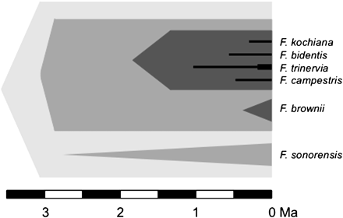
Fig. 1. Temporal representation of the gradual C₃ to C₄ transition in Flaveria. According to ...
Notes:
Fig. 1. Temporal representation of the gradual C3 to C4 transition in Flaveria. According to McKown and Dengler (2007), the ancestor of the Flaveria group evolved increased vein density that represent a C4 precondition (light grey). This was co-opted twice to evolve C3-C4 photosynthesis (grey), which in turn was co-opted twice to evolve a C4-like trait (dark grey). The C4-like ancestors, in turn, gave rise to multiple C4 descendants (black). Note that this scenario assumes strictly directional C3 to C4 transitions but reversals between the different states cannot be excluded. For each group, triangles or thin bars represent the interval between the stem and crown nodes (interval in which the trait could have evolved).
Unless provided in the caption above, the following copyright applies to the content of this slide: © The Author [2011]. Published by Oxford University Press [on behalf of the Society for Experimental Biology]. All rights reserved. For Permissions, please e-mail: journals.permissions@oup.com

Slide 2
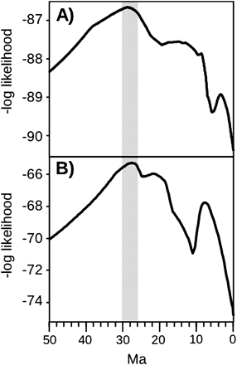
Fig. 2. Comparison of transition models for eudicots and grasses. The likelihood of the model allowing different ...
Notes:
Fig. 2. Comparison of transition models for eudicots and grasses. The likelihood of the model allowing different rates of C3/C4 transitions after a time threshold is presented for all possible thresholds between 50 and 0 million years ago (Ma), for (A) eudicots and (B) grasses. The graph for grasses was redrawn from Christin et al. 2008, and reprinted by kind permission of Elsevier Ltd © 2008. The vertical grey bar shows the overlap between the optima for grasses and eudicots.
Unless provided in the caption above, the following copyright applies to the content of this slide: © The Author [2011]. Published by Oxford University Press [on behalf of the Society for Experimental Biology]. All rights reserved. For Permissions, please e-mail: journals.permissions@oup.com

Slide 3
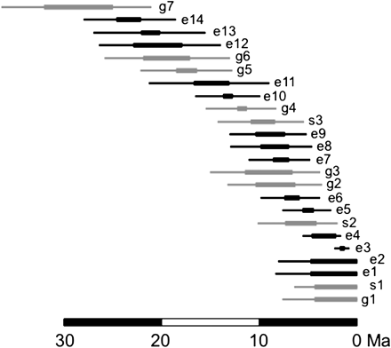
Fig. 3. Comparison of the ages of C₄ monocots and C₄ eudicots. The estimated age is indicated ...
Notes:
Fig. 3. Comparison of the ages of C4 monocots and C4 eudicots. The estimated age is indicated for each C4 origin where the interval between the stem and crown nodes is smaller than 5 My, and for the putative oldest C4 origin in the subfamily Chloridoideae of grasses. For each group, thick bars represent the interval between stem and crown nodes, and thin bars the confidence interval. Monocots are in grey and eudicots in black. For Flaveria, only one of the transitions to the C4-like state is represented. Ages of monocots are based on Christin et al. (2008) and Besnard et al. (2009). Names on the right are numbered for eudicots, sedges, and grasses; e1, Gisekia; e2, Sesuvium sesuvioides; e3, C4 and C4-like Flaveria; e4, Boerhavia/Okenia; e5, Suaeda sect. Schoberia; e6, C4Alternanthera; e7, Gomphreneae; e8, Suaeda sect. Salsina; e9, Chamaesyce; e10, Haloxylon/Anabasis; e11, Camphorosmeae; e12, Kali; e13, Trianthema; e14 Caroxyloneae; s1, Eleocharis vivipara; s2, C4Rhynchospora; s3, C4 Cypereae; g1, Neurachne munroi; g2, Panicum prionitis group; g3, Eriachne; g4, Mesosetum clade; g5, main C4 Paniceae; g6, Andropogoneae; g7, Chloridoideae.
Unless provided in the caption above, the following copyright applies to the content of this slide: © The Author [2011]. Published by Oxford University Press [on behalf of the Society for Experimental Biology]. All rights reserved. For Permissions, please e-mail: journals.permissions@oup.com

Slide 4
Fig. 4. Temporal representation of the gradual C₃ to C₄ transition in Mollugo. This diagram is ...
Notes:
Fig. 4. Temporal representation of the gradual C3 to C4 transition in Mollugo. This diagram is drawn based on the conclusions of Christin et al. (2011). The ancestor of the group evolved enlarged bundle sheath cells that represent a C4 precondition (light grey) more than 20 Ma. This was co-opted to evolve C3–C4 photosynthesis (grey), which served twice to evolve a C4 trait (black). For each group, triangles or thin bars represent the interval between the stem and crown nodes (interval in which the trait could have evolved).
Unless provided in the caption above, the following copyright applies to the content of this slide: © The Author [2011]. Published by Oxford University Press [on behalf of the Society for Experimental Biology]. All rights reserved. For Permissions, please e-mail: journals.permissions@oup.com

