Slide 1
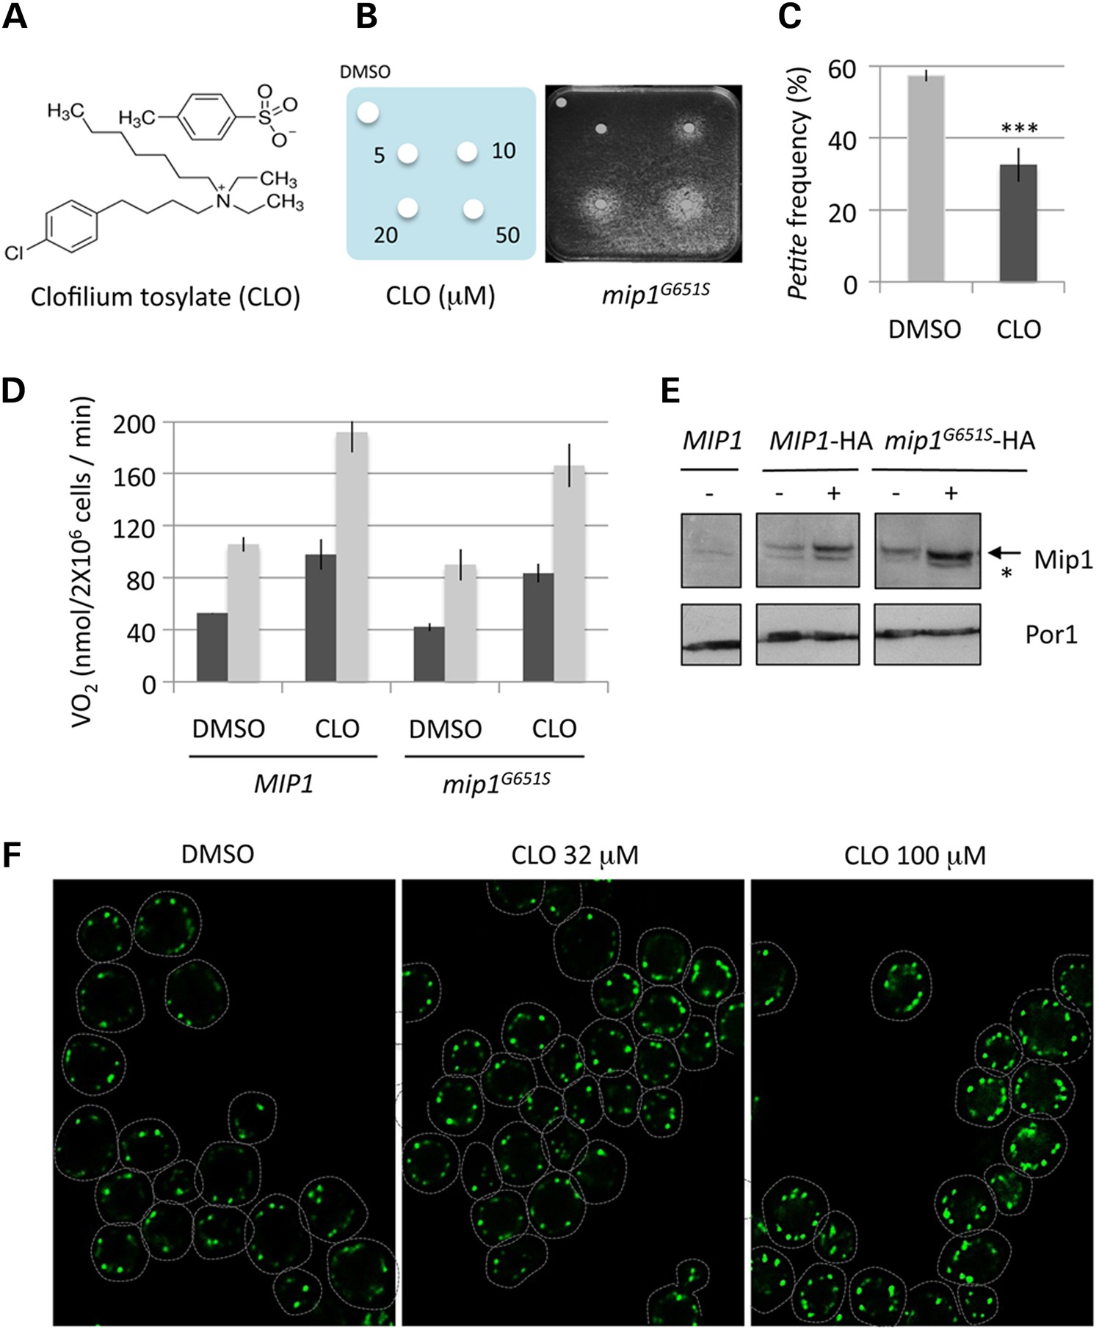
Figure 1. Identification of CLO and mtDNA instability suppression by CLO. (A) The chemical structure of CLO. (B) CLO ...
Notes:
Figure 1. Identification of CLO and mtDNA instability suppression by CLO. (A) The chemical structure of CLO. (B) CLO rescues the respiratory growth defect of mipG651S in a dose-dependent manner. The mip1G651Scells were spread onto solid rich ethanol medium. Concentrations of CLO spotted onto filters are indicated. Plates were incubated at 36°C for 5 days. DMSO, compound vehicle. (C) Petite frequency in mip1G651S mutant strain is partially suppressed by 32 µm of CLO. ***P < 0.005 in an unpaired two-tailed Student's t-test, unequal variance; error bars represent standard deviation (SD). (D) Mean respiration rates of the wt MIP1 and the mip1G651S mutant cells treated in vivo with 32 µm CLO or DMSO. Respiration rates were determined using ethanol as substrate and in the absence (black bars) or presence (grey bars) of the membrane potential uncoupler CCCP (gray bars). Error bars represent SD. (E) Western blot analysis of enriched mitochondrial protein extracts of the wt, MIP1-HA and mip1G651S-HA strains treated with DMSO (−) or 32 µm CLO (+). Porin was used as loading control. Arrow, Mip1 signal; asterisk, cross-reaction of the anti-HA antibody. (F) Replicating nucleoids were visualized with Green Fluorescent Protein (GFP) fused to the Mip1 protein. Wt cells expressing MIP1-GFP at the chromosomal locus were grown in YPE for 12 h with DMSO or two amounts of CLO (32 and 100 µm) and imaging. Representative images are flattened z-stacks.
Unless provided in the caption above, the following copyright applies to the content of this slide: © The Author 2015. Published by Oxford University Press. All rights reserved. For Permissions, please email: journals.permissions@oup.com

Slide 2
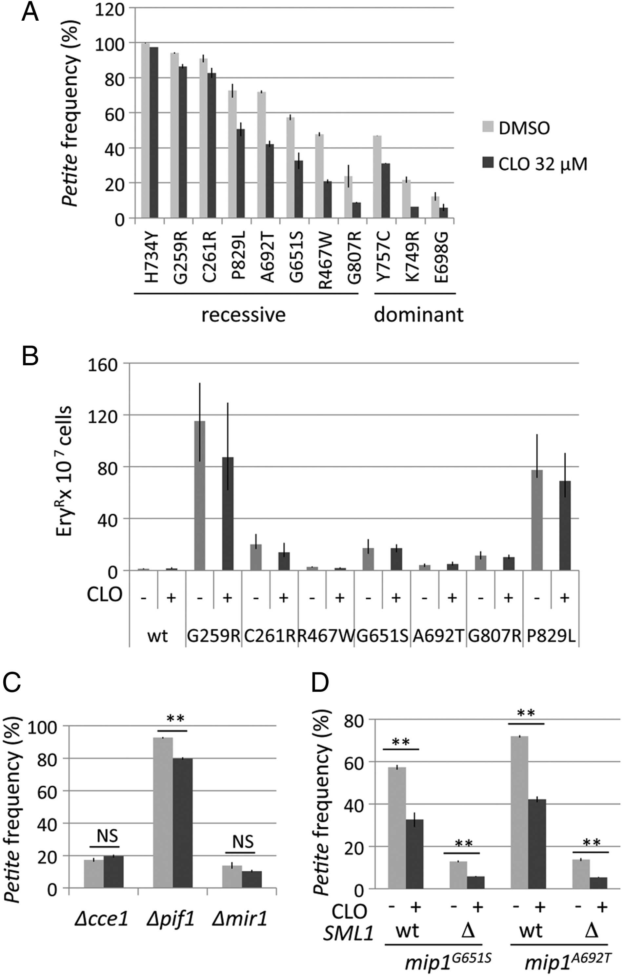
Figure 2. CLO suppresses the petite production of all mip1 mutants tested. (A) The percentage of petite colonies ...
Notes:
Figure 2. CLO suppresses the petite production of all mip1 mutants tested. (A) The percentage of petite colonies produced in different mip1 mutant strains (yeast mutant changes) grown in the presence of DMSO (gray bars) or treated with 32 µm CLO (black bars). Petite frequencies were defined as the percentage of colonies showing the petite phenotype after 5 days of incubation at 28°C. More than 3000 colonies per strain were scored. (B) The percentage of EryR mutants produced in different mip1 backgrounds grown with DMSO (−) or 32 µm CLO (+). The EryR mutant frequency was calculated as the number of erythromycin-resistant colonies over the total number of colonies, as described in the Materials and Methods section. Errors bars represent the 95% confidence interval. (C) The percentage of petite production of the mip1G651S mutant in the Δcce1, Δpif1 and Δmir1 context. Cells were treated with 32 µm CLO (dark bars) or DMSO (gray bars). NS: not significant. (D) Additive effect of CLO and increased dNTP pool availability on the production of petite mutants in two mip1 mutant strains. The percentage of petite produced in single mip1G651S or mip1A692T mutants or in mip1 mutants combined with Δsml1 mutation, cultured in the presence of DMSO (gray bars) or 32 µm CLO (black bars). The data represent the mean of at least three independent experiments. Error bars represent SD. (C and D) **P < 0.01 in an unpaired two-tailed Student's t-test, unequal variance.
Unless provided in the caption above, the following copyright applies to the content of this slide: © The Author 2015. Published by Oxford University Press. All rights reserved. For Permissions, please email: journals.permissions@oup.com

Slide 3
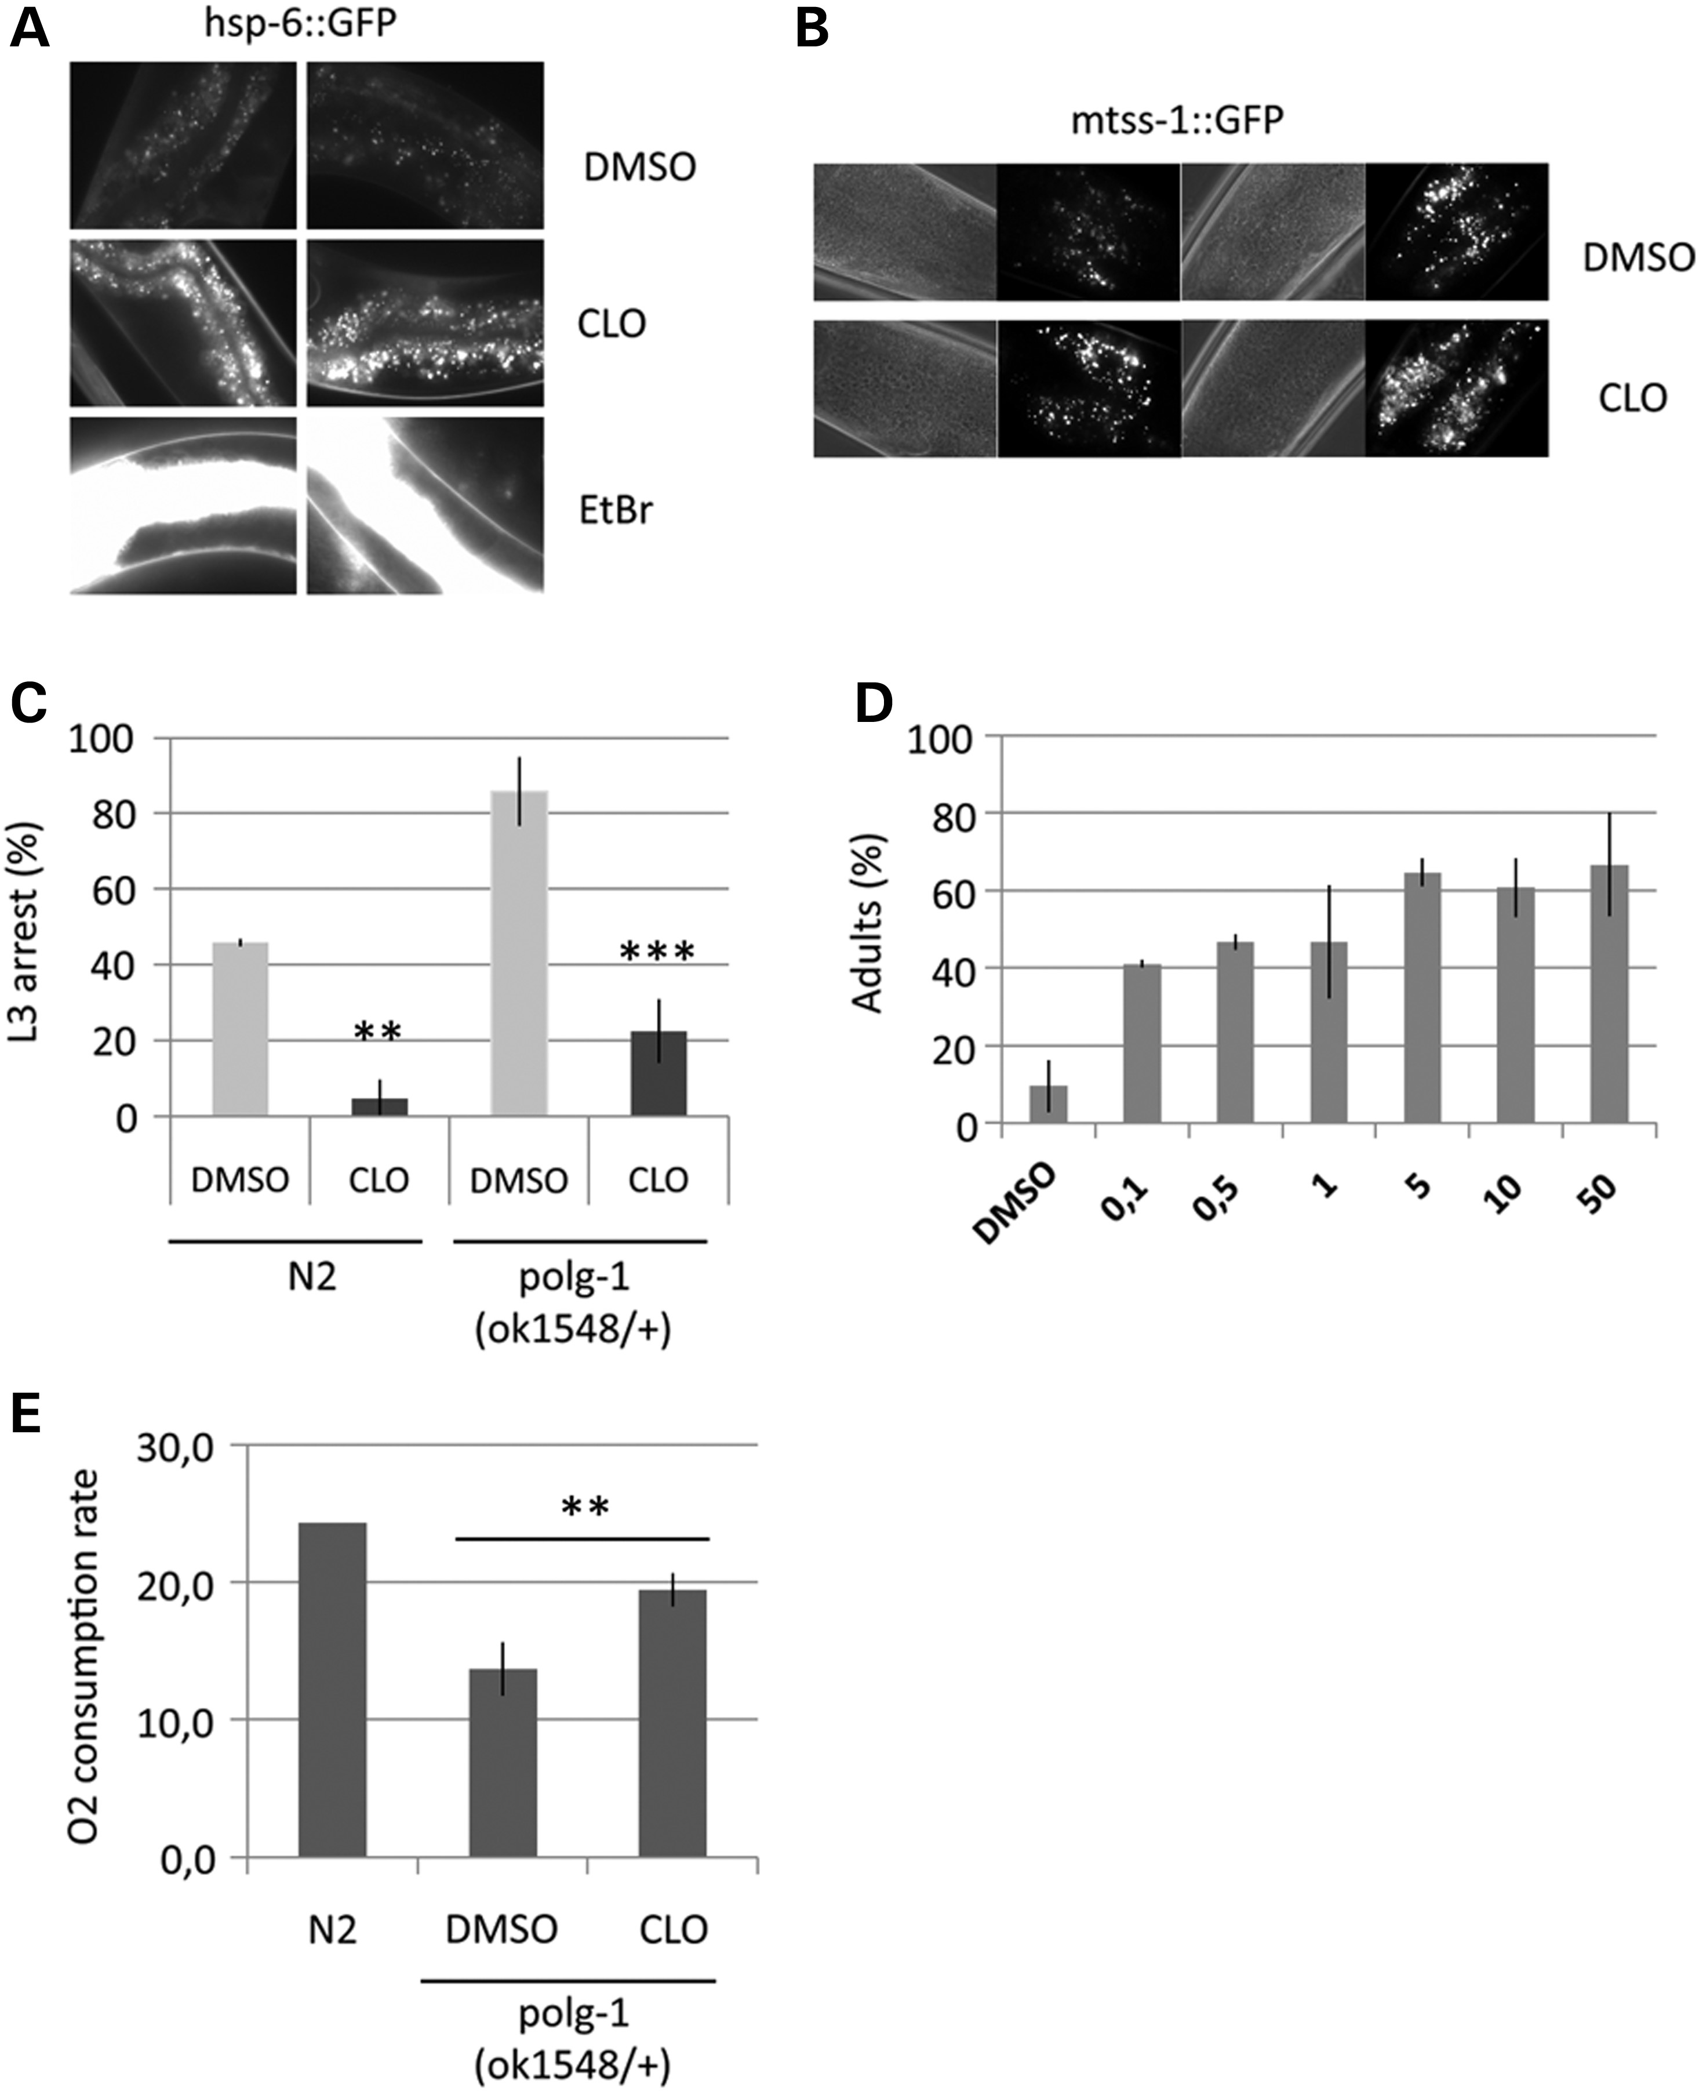
Figure 3. Effect of CLO on wt and polg-1(ok1548/+) animals. (A) Representative GFP fluorescence micrographs of living ...
Notes:
Figure 3. Effect of CLO on wt and polg-1(ok1548/+) animals. (A) Representative GFP fluorescence micrographs of living hsp-6::GFP worm cells (gut) from two different animals exposed to DMSO, 50 µm CLO or 10 µg/ml EtBr. The animals were grown 4 days at 20°C in the presence of drugs and were observed with the same exposition time (1000 ms) and magnification (63×/1.4); (n = 7). Each image was identically treated. (B) Representative differential interference contrast (DIC) and GFP fluorescence micrographs of living mtss1::GFP worm cells (pharynx muscle cells) from two different animals exposed to 50 µm CLO or DMSO. Animals were grown for 4 days at 20°C in the presence of CLO or DMSO and were observed with the same exposition time (1500 ms) and magnification (100×/1.4); (n = 7). Each image was identically treated. (C) The percentage of L3 development arrest of wt N2 and polg-1(ok1543/+) worms in the presence of 30 µg/ml of EtBr and after 4 days of treatment with 50 µm of CLO or with DMSO. Thirty synchronized L1 larvae were exposed to 30 µg/ml of EtBr and DMSO or CLO 50 µm on nematode growth medium (NGM) plates. The percentage of L3 arrest was determined after 4 days at 20°C. Experiment was independently performed three times and data are the mean ± SEM (n = 90). **P < 0.01 and ***P < 0.005 indicate statistical significance between DMSO and CLO treatments, using an unpaired two-tailed Student's t-test. (D) Dose–response of CLO on polg-1(ok1543/+) animals exposed to 30 µg/ml EtBr. The percentage of L1 larvae reaching the adulthood after 4 days of increasing concentrations of CLO (µm) in the presence of 30 µg/ml EtBr. All experiments were performed three times independently and data are the mean ± SEM (n = 90). (E) Oxygen consumption rates of wt N2 and polg-1(ok1543/+) worms exposed to 50 µM of CLO or DMSO are expressed as nmoles of O2 consumed/min/1000 adult animals and are presented as the mean ± SD of at least three independent experiments. **P < 0.01 indicates statistical significance between DMSO and CLO treatments, using an unpaired two-tailed Student's t-test.
Unless provided in the caption above, the following copyright applies to the content of this slide: © The Author 2015. Published by Oxford University Press. All rights reserved. For Permissions, please email: journals.permissions@oup.com

Slide 4
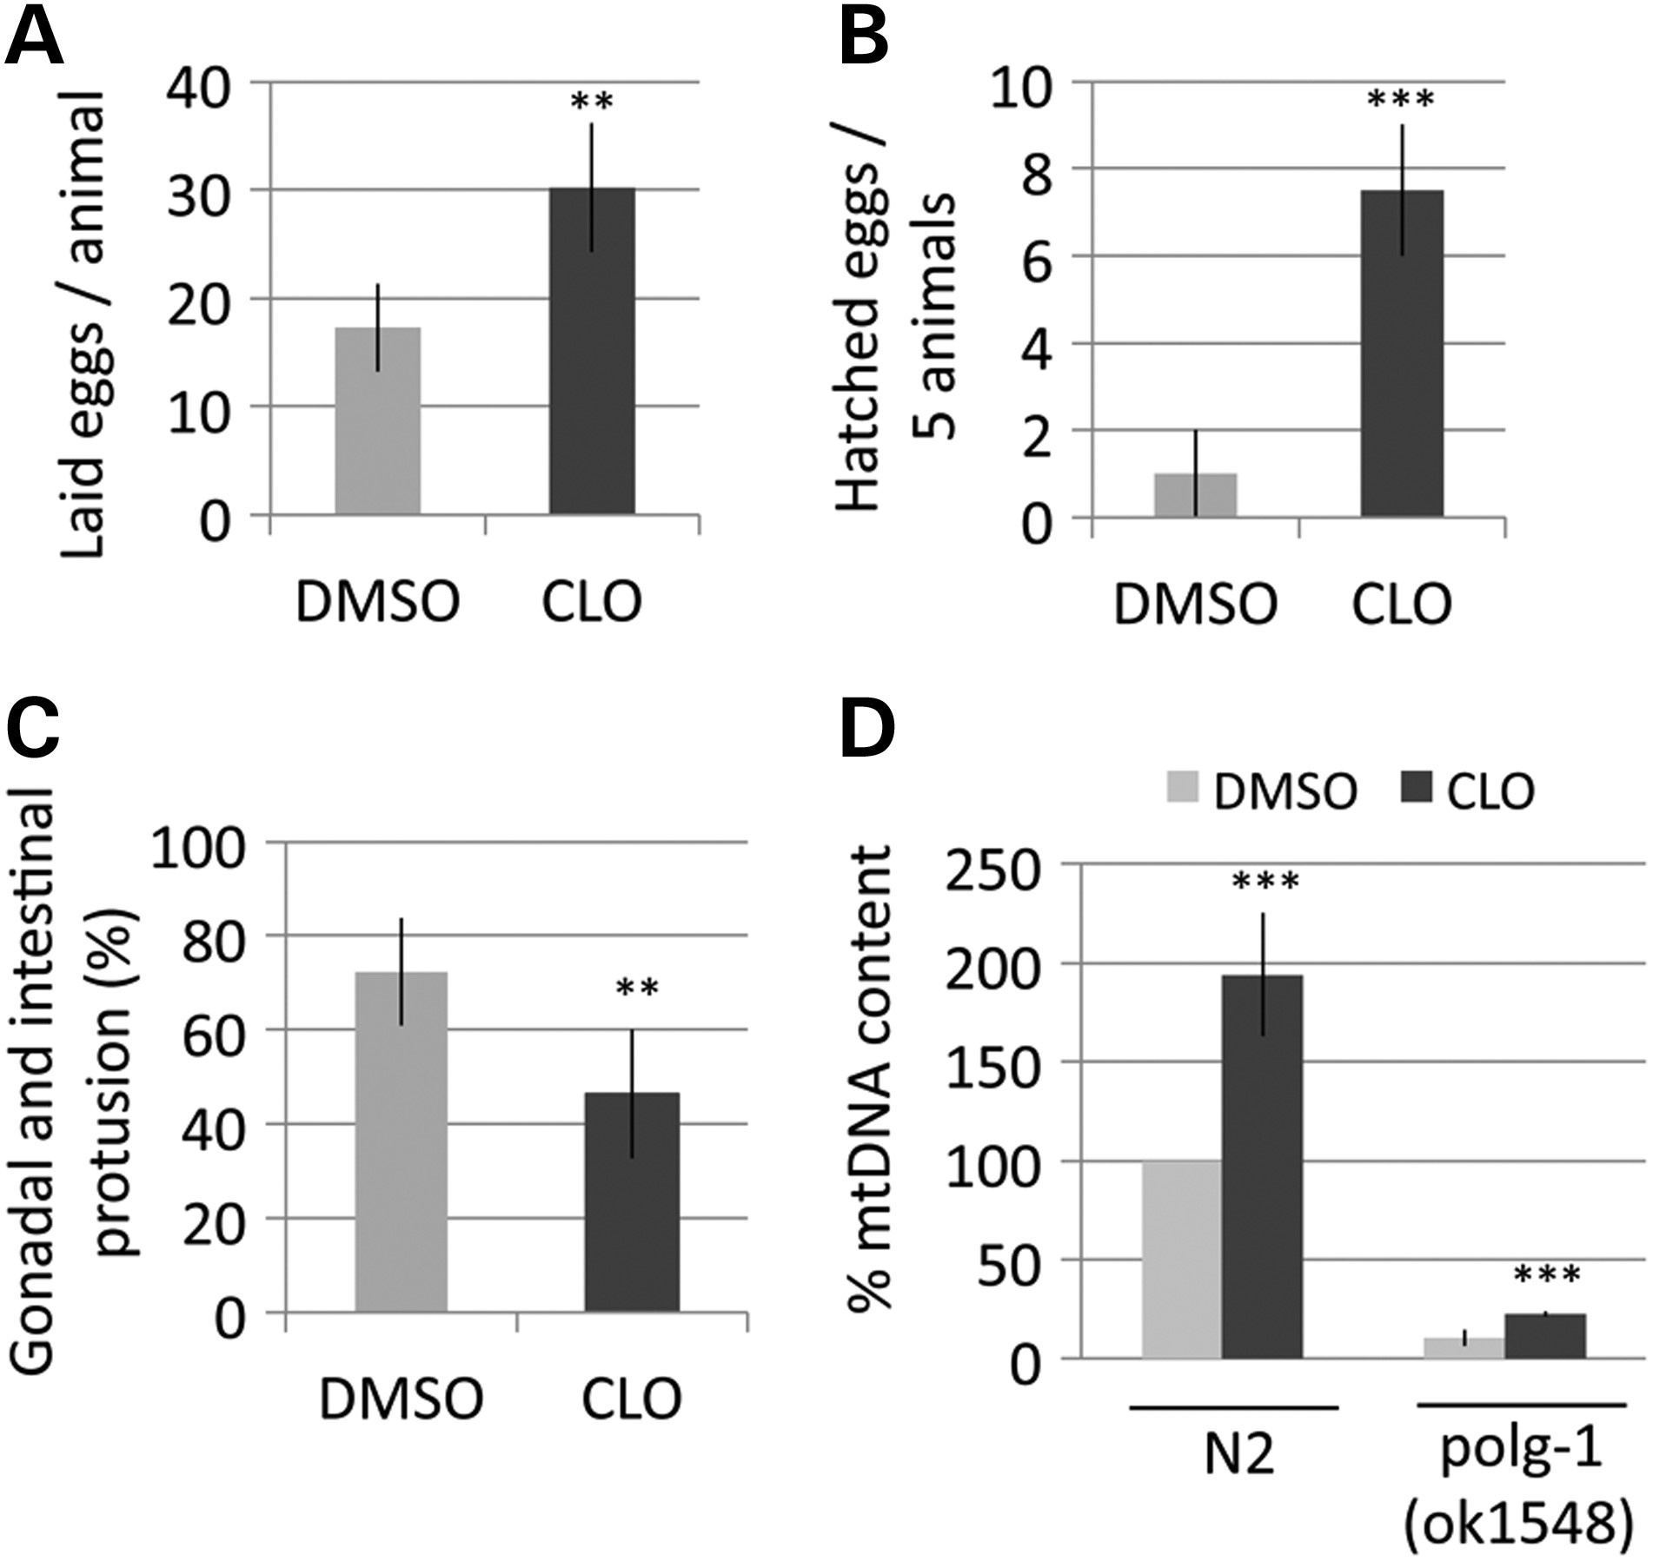
Figure 4. Effect of CLO on the homozygous polg-1(ok1548) mutant. (A and B) The brood size of polg-1(ok1548) mutant. ...
Notes:
Figure 4. Effect of CLO on the homozygous polg-1(ok1548) mutant. (A and B) The brood size of polg-1(ok1548) mutant. Synchronized L3/L4 worms were incubated on NGM plates supplemented with 50 µm CLO (dark bars) or DMSO (gray bars) at 20°C. (A) The number of laid eggs per adult and (B) the number of hatched eggs per five adults. Values are the average value of 12 broods counted in each condition. (A–D) **P < 0.01 and ***P < 0.005 indicate a statistical significance between DMSO and CLO treatments, using an unpaired two-tailed Student's t-test. (C) The percentage of polg-1(ok1548) mutant animals that developed gonad protrusion during their lifespan in the presence of 50 µm CLO or DMSO. Synchronized L3/L4 polg-1(ok1548) mutant worms (n = 21) were incubated on NGM plates supplemented with 50 µm CLO (dark bars) or DMSO (gray bars) at 20°C during 8 days of adulthood. Animals presenting gonad or intestinal protrusion were scored. Experiment was performed three times independently and data are the mean ± SEM. (D) mtDNA copy number measured for N2 and polg-1(ok1548) animals in the presence of 50 µm CLO. The ratio of mtDNA to nuclear DNA amount per adult worm (Day 6 of adulthood) exposed to DMSO or 50 µm CLO was quantified. Values represent the mtDNA content in polg-1(ok1548) relative to mtDNA content of N2 animals. Experiment was performed three times independently in triplicates and data are the mean ± SD.
Unless provided in the caption above, the following copyright applies to the content of this slide: © The Author 2015. Published by Oxford University Press. All rights reserved. For Permissions, please email: journals.permissions@oup.com

Slide 5
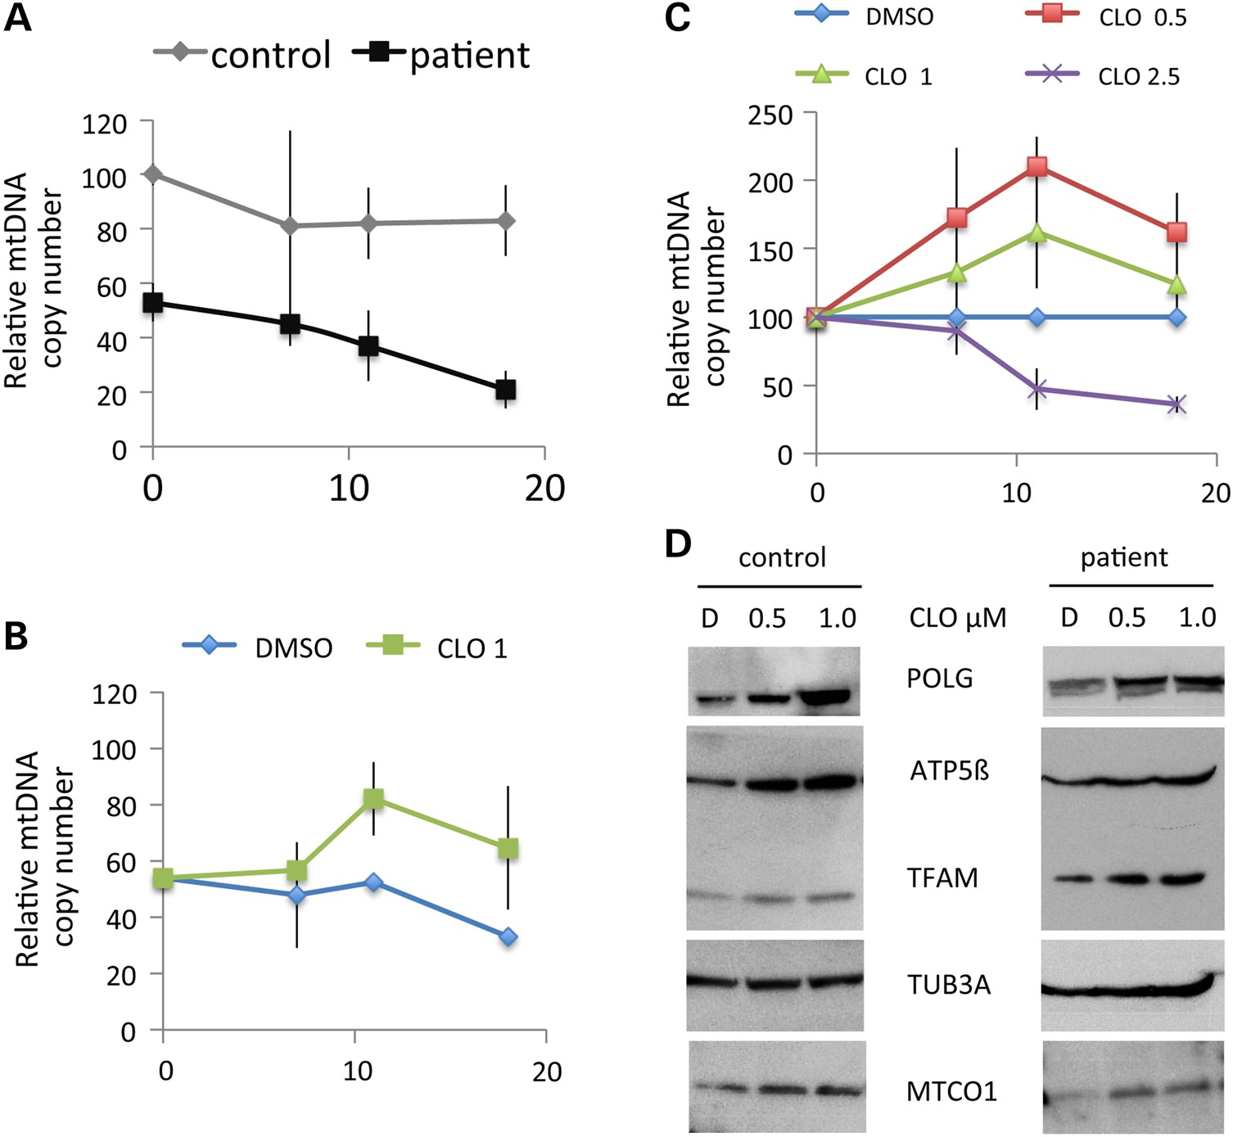
Figure 5. Effect of CLO on mtDNA copy number of POLG-deficient cultured fibroblasts grown in quiescent condition. (A) ...
Notes:
Figure 5. Effect of CLO on mtDNA copy number of POLG-deficient cultured fibroblasts grown in quiescent condition. (A) Relative mtDNA copy number of control and POLG-deficient patient cell lines grown for 18 days in quiescent condition. (B) The progression of mtDNA copy number in response to 1 µm of CLO treatment in quiescent POLG-deficient fibroblasts. Results are expressed as the mean ± SEM of three independent cultures, and plotted as percentages of the ratios obtained for parallel-untreated cultures from healthy controls. (C) The progression of mtDNA copy number in POLG-deficient fibroblasts after treatment with 0.5; 1.0 and 2.5 µm of CLO. Results are expressed as the mean ± SEM of three independent cultures, and plotted as percentages of the ratios obtained for parallel-untreated patient fibroblast cultures. (D) POLG, ATP5B, MTCO1, TFAM and TUB3A detected by western blot analysis with antibodies from crude protein extracts of control and patient fibroblasts treated with CLO or not (D: DMSO).
Unless provided in the caption above, the following copyright applies to the content of this slide: © The Author 2015. Published by Oxford University Press. All rights reserved. For Permissions, please email: journals.permissions@oup.com

Slide 6
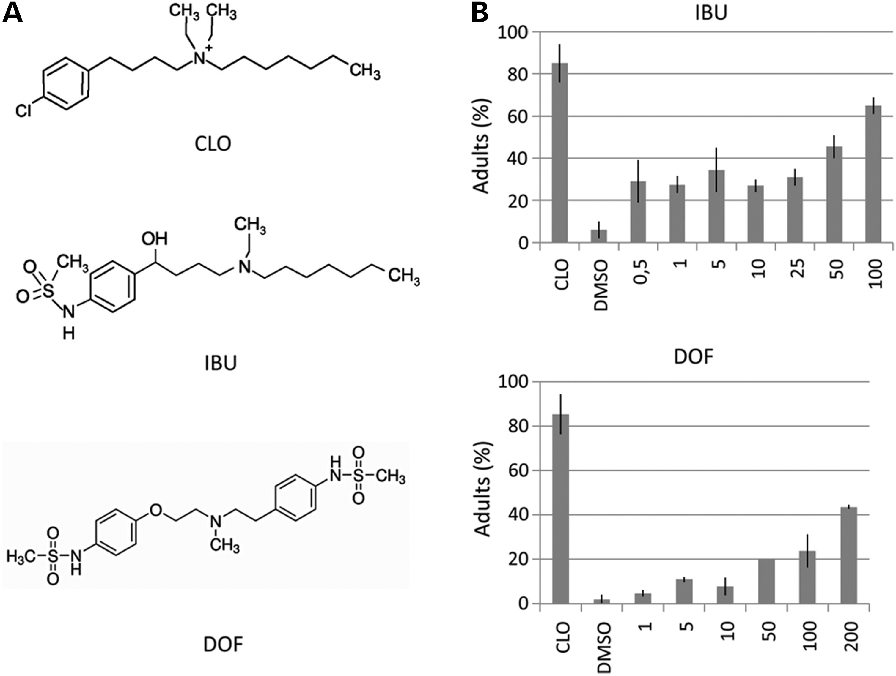
Figure 6. Two CLO-related drugs suppress the sensitivity of polg-1(ok1543/+) worms toward EtBr. (A) The chemical ...
Notes:
Figure 6. Two CLO-related drugs suppress the sensitivity of polg-1(ok1543/+) worms toward EtBr. (A) The chemical structure of CLO, Ibutilide (IBU), Dofetilide (DOF). (B) Dose–response of IBU and DOF on polg-1(ok1543/+) animals exposed to 30 µg/ml EtBr. Percentage of L1 larvae reaching the adulthood after 4 days of increasing concentrations of IBU or DOF in the presence of 30 µg/ml EtBr. All experiments were performed three times independently and data are the mean ± SEM (n = 90).
Unless provided in the caption above, the following copyright applies to the content of this slide: © The Author 2015. Published by Oxford University Press. All rights reserved. For Permissions, please email: journals.permissions@oup.com

