Slide 1
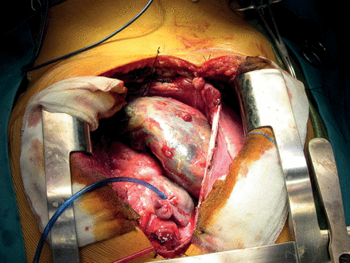
Figure 1: There were no signs of the lesion infiltrating the left heart chambers and, finally, the right phrenic nerve ...
Notes:
Figure 1: There were no signs of the lesion infiltrating the left heart chambers and, finally, the right phrenic nerve was also affected.
Unless provided in the caption above, the following copyright applies to the content of this slide: © The Author 2012. Published by Oxford University Press on behalf of the European Association for Cardio-Thoracic Surgery. All rights reserved.

Slide 2
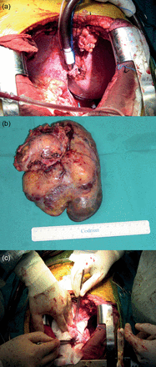
Figure 2: (a) For the complete and radical resection of the tumour. (b) The excised mass was 14 × 8, 5 × 6 cm. (c) We ...
Notes:
Figure 2: (a) For the complete and radical resection of the tumour. (b) The excised mass was 14 × 8, 5 × 6 cm. (c) We finally used the rest of the Peri-Guard® patch to reconstruct the right atrium.
Unless provided in the caption above, the following copyright applies to the content of this slide: © The Author 2012. Published by Oxford University Press on behalf of the European Association for Cardio-Thoracic Surgery. All rights reserved.

