Slide 1
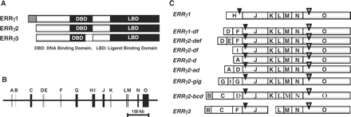
Fig. 1. Structural constitution of ERRγ mRNA isoforms and ERRγ protein isoforms. (A) Structure of ERRγ protein ...
Notes:
Fig. 1. Structural constitution of ERRγ mRNA isoforms and ERRγ protein isoforms. (A) Structure of ERRγ protein isoforms. ERRγ1 has 23-mer amino-acid extension at the N-terminus of ordinary ERRγ, namely ERRγ2. ERRγ3 has a 39-mer amino-acid deletion in the DNA binding domain. (B) Structural constitution of exon and intron of human ERRγ genomic gene. Alphabetic letters A–O each indicate an independent exon. (C) Structural constitution of exons in nine ERRγ mRNA isoforms. Closed arrowheads indicate the position of an AUG initiation codon, and open arrowheads indicate the position of a termination codon in the ERRγ open reading frame.
Unless provided in the caption above, the following copyright applies to the content of this slide: © The Authors 2009. Published by Oxford University Press on behalf of the Japanese Biochemical Society. All rights reserved

Slide 2
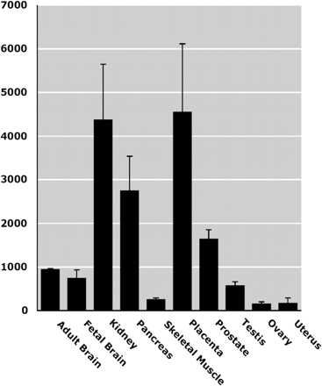
Fig. 3. Quantitative real-time PCR for estimation of ERRγ mRNA expression in human brains and reproductive organs. ...
Notes:
Fig. 3. Quantitative real-time PCR for estimation of ERRγ mRNA expression in human brains and reproductive organs. The gapdh mRNA gene was used as an internal control. The copy number per 1 × 105gapdh mRNA was estimated for ERRγ-whole mRNA in each tissue. The error bars indicate SEM.
Unless provided in the caption above, the following copyright applies to the content of this slide: © The Authors 2009. Published by Oxford University Press on behalf of the Japanese Biochemical Society. All rights reserved

Slide 3
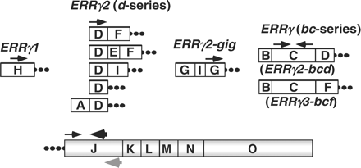
Fig. 2. Design strategy of forward sense and reverse antisense primers for real-time PCR quantification of ERRγ mRNA ...
Notes:
Fig. 2. Design strategy of forward sense and reverse antisense primers for real-time PCR quantification of ERRγ mRNA isoforms. Rightwards arrows indicate the forward sense primers, while leftwards arrows indicate the reverse antisense primers. Sense primers are specific to each mRNA isoform. For ERRγ2 containing exon D, ERRγ2-df, def, di, d, ad and bcd the same sense primer was set in exon D (Table 2). For ERRγ2-bcd isoforms, sense and antisense primers were set in the same exon, C. There are two different reverse antisense primers in exon J, besides the antisense primer in exon C for ERRγ2-bcd isoforms. The large black leftward arrow is a universal antisense primer for the quantification of all isoforms except for ERRγ2-bcd. The large grey leftward arrow is an ERRγ-specific antisense oligonucleotide for the reverse transcription to prepare cDNAs.
Unless provided in the caption above, the following copyright applies to the content of this slide: © The Authors 2009. Published by Oxford University Press on behalf of the Japanese Biochemical Society. All rights reserved

Slide 4
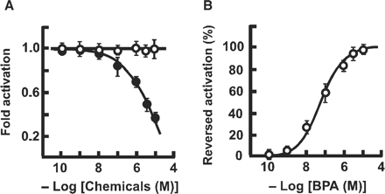
Fig. 7. The luciferase reporter gene assay of BPA and 4-hydroxytamoxifen (4-OHT) for type-1 ERRγ. (A) Deactivation of ...
Notes:
Fig. 7. The luciferase reporter gene assay of BPA and 4-hydroxytamoxifen (4-OHT) for type-1 ERRγ. (A) Deactivation of the fully activated human type-1 ERRγ isoform by the inverse agonist 4-hydroxytamoxifen (4-OHT) (filled circle) and sustainment by the inverse antagonist BPA (open circle). (B) Inverse antagonist activity of BPA (open circle) against the inverse agonist activity of 1.0 µM 4-OHT in ERRγ1. An amount of 1.0 µM 4-OHT exhibited ∼0.4-fold deactivation, and the inverse antagonist activities are shown by the percentage of relative activity to reverse this deactivation activity. The high basal constitutive activity of type-1 ERRγ isoform was evaluated with the luciferase reporter plasmid (pGL3/3 × ERRE), and the highest activity was estimated in a cell preparation of 1.0 × 105 HeLa cells/well.
Unless provided in the caption above, the following copyright applies to the content of this slide: © The Authors 2009. Published by Oxford University Press on behalf of the Japanese Biochemical Society. All rights reserved

Slide 5
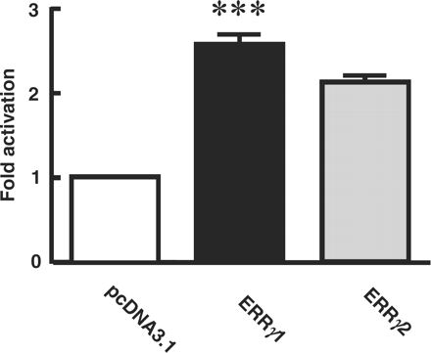
Fig. 6. Transcription activity of type-1 and type-2 ERRγ isoforms in the reporter gene assay. The type-1 ERRγ isoform ...
Notes:
Fig. 6. Transcription activity of type-1 and type-2 ERRγ isoforms in the reporter gene assay. The type-1 ERRγ isoform is 23-mer larger than the type-2 ordinary ERRγ isoform at the N-terminus. HeLa cells were transfected with the luciferase reporter gene (3 × ERRE) and the expression plasmid of the wild-type of either type-1 or type-2 ERRγ. After 24 h, luciferase activity was measured. Cells treated with 1% BSA/PBS were used as a vehicle control. Each assay was performed in duplicate and repeated at least three times. To normalize the transfection efficiency, the SEAP assay, in which a second plasmid that constitutively expresses an activity that can be clearly differentiated from SEAP, was co-transfected simultaneously. (***P < 0.0001: ANOVA)
Unless provided in the caption above, the following copyright applies to the content of this slide: © The Authors 2009. Published by Oxford University Press on behalf of the Japanese Biochemical Society. All rights reserved

Slide 6
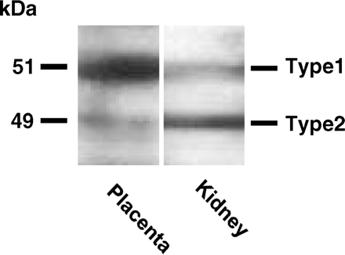
Fig. 5. Western blotting analyses of ERRγ protein isoform expression levels. An intense protein band of 49 kDa in ...
Notes:
Fig. 5. Western blotting analyses of ERRγ protein isoform expression levels. An intense protein band of 49 kDa in kidney lysate corresponds to the molecular weight of type-2 standard ERRγ. The accompanying faint band of 51 kDa corresponds to the molecular weight of type-1 ERRγ. A major strong band of 51 kDa in the placenta lysate corresponds also to this type-1 ERRγ. Other bands are supposed to be specific or non-specific protein bands derived from the first antibody.
Unless provided in the caption above, the following copyright applies to the content of this slide: © The Authors 2009. Published by Oxford University Press on behalf of the Japanese Biochemical Society. All rights reserved

Slide 7
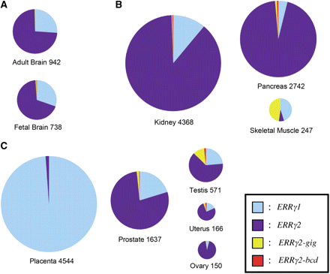
Fig. 4. Quantitative real-time PCR for estimation of ERRγ-whole mRNA expression and percentage of the constitutions ...
Notes:
Fig. 4. Quantitative real-time PCR for estimation of ERRγ-whole mRNA expression and percentage of the constitutions of ERRγ mRNA isoforms in human brains (A), standard tissues (kidney, pancreas and skeletal muscle) (B) and reproductive organs (C). The circled area shows the total expression amount of ERRγ-whole mRNA in each tissue. The area of each color region in the circle is proportional to the expression amount of the ERRγ mRNA isoforms. Blue, purple, yellow and red areas indicate ERRγ1, ERRγ2(d-series), ERRγ2-gig and ERRγ2-bcd mRNA isoforms, respectively. The expression rates of each ERRγ mRNA isoform were calculated against the sum of the copy numbers of ERRγ mRNA isoforms.
Unless provided in the caption above, the following copyright applies to the content of this slide: © The Authors 2009. Published by Oxford University Press on behalf of the Japanese Biochemical Society. All rights reserved

