Slide 1
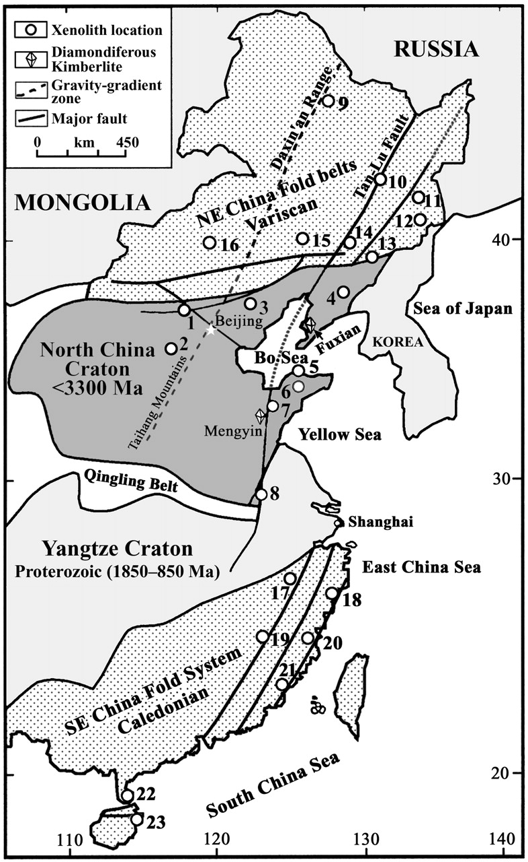
Fig. 1. Simplified tectonic map of eastern China [after Ma & Wu (1981)] with basalt-hosted xenolith localities shown ...
Notes:
Fig. 1. Simplified tectonic map of eastern China [after Ma & Wu (1981)] with basalt-hosted xenolith localities shown as numbers and kimberlite-hosted xenolith localities as diamonds. Basalt-hosted peridotite xenoliths were collected from on- and off-craton localities where basalts had entrained xenoliths erupted through Archaean (i.e. North China Craton) and post-Archaean crust (i.e. NE China fold belts; Yangtze craton and SE China fold system). On-craton localities: 1, Hannuoba; 2, Fansi; 3, Pingquan; 4, Kuandian; 5, Penglai; 6, Qixia; 7, Linqu; 8, Jiashan. Off-craton localities: 9, Wudalianchi; 10, Shangzhi; 11, Jingbohu; 12, Wangqing; 13, Huinan; 14, Yitong; 15, Abaga; 16, Shuangliao; 17, Xilong; 18, Ninghai; 19, Mingxi; 20, Minqing; 21, Longhai; 22, Xuwen; 23, Wenchang.
Unless provided in the caption above, the following copyright applies to the content of this slide: Oxford University Press

Slide 2
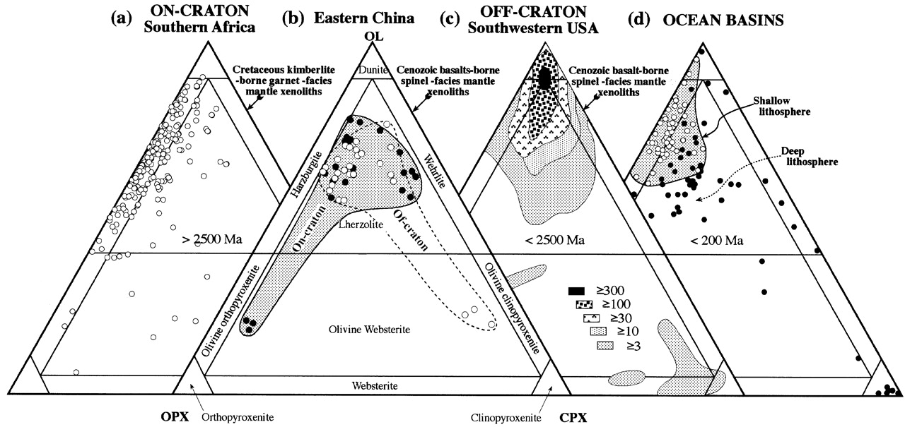
Fig. 2. Petrological classification of peridotites. On-craton: spinel- and garnet-facies peridotites from the ...
Notes:
Fig. 2. Petrological classification of peridotites. On-craton: spinel- and garnet-facies peridotites from the Kaapvaal craton, South Africa. (Note that the majority of the rocks from the Kaapvaal craton are harzburgites.) Data are compiled from Carswell & Dawson (1970), Mathias et al. (1970), Chen (1971), Cox et al. (1973), Maaloe & Aoki (1977), Boyd & Nixon (1978), Dawson (1980) and Walker et al. (1989). Eastern China: spinel-facies mantle xenoliths entrained in Cenozoic basalts from on-craton and off-craton localities. Spinel lherzolite and olivine websterite xenoliths are found at on- and off-craton localities, indicating no marked provinciality in modal mineralogy. Unless otherwise stated these symbols are used in the same way in all the following figures. Off-craton: basalt-borne spinel-facies mantle xenoliths in Cenozoic basalts from a tectonically active continental margin—Basin and Range, SW USA [Menzies et al. (1987) and references therein]. These xenoliths are dominated by lherzolite and dunite, and so they are significantly different from the Kaapvaal craton, which is dominated by harzburgites. Ocean basins: oceanic peridotites are divided into shallow lithosphere (i.e. abyssal, ophiolitic) and deep lithosphere (i.e. basalt-borne xenoliths, Hawaii and Tahiti). These data point to the possible existence of ‘layered oceanic lithosphere’ with a shallow depleted layer (harzburgite–dunite) and a deeper less depleted layer (lherzolite) [Green et al. (1979) and references therein; Dick & Fisher (1984); Menzies (1991)]. It should be noted that the ‘deep’ basalt-borne xenoliths from ocean basins (i.e. deep lithosphere) are similar to those from eastern China.
Unless provided in the caption above, the following copyright applies to the content of this slide: Oxford University Press

Slide 3
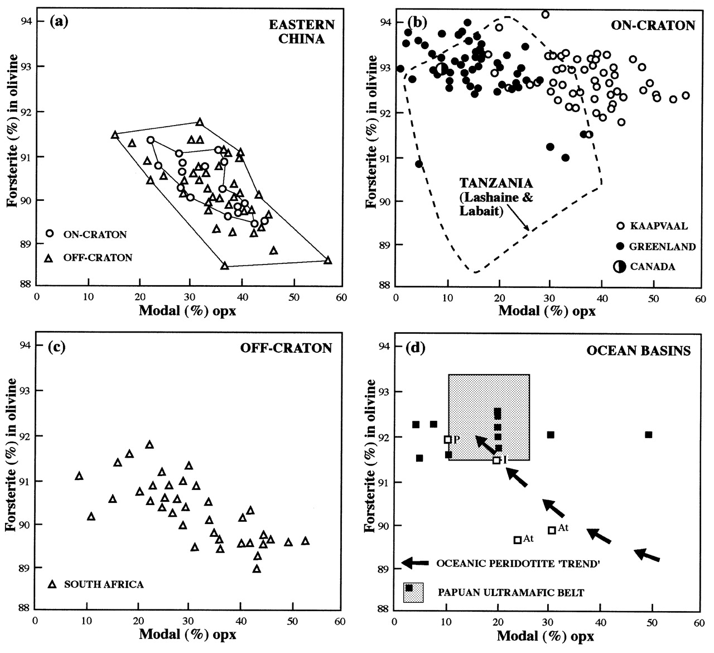
Fig. 3. Forsterite content vs modal abundance of orthopyroxene in mantle peridotites. (a) On- and off-craton spinel ...
Notes:
Fig. 3. Forsterite content vs modal abundance of orthopyroxene in mantle peridotites. (a) On- and off-craton spinel peridotitic xenoliths from eastern China plot as overlapping fields. (b) Garnet- and spinel-facies peridotites from cratons in Africa, Greenland and Canada (Boyd, 1989; Kelemen et al., 1998; Lee & Rudnick, 2000) display a greater range in olivine composition and modal abundance. Kaapvaal peridotites are orthopyroxene rich and contain magnesian olivines whereas those from Greenland and Canada are more orthopyroxene poor. The garnet and spinel peridotites from the Tanzanian craton have a greater spread in olivine compositional data and orthopyroxene mode than other cratons. (c) South African off-craton peridotites are different from on-craton peridotites (Boyd, 1989) but they overlap with on-craton peridotites from Tanzania (Lee & Rudnick, 2000) and Greenland (Kelemen et al., 1998). More importantly, off-craton peridotites from southern Africa are similar to on- and off-craton spinel peridotites from eastern China. (d) Spinel- and plagioclase-facies peridotites from the world’s ocean basins and ophiolites [i.e. abyssal peridotites, ophiolitic metamorphic peridotites and orogenic (non-ophiolitic) peridotites] have a compositional range that can be represented as an oceanic peridotite ‘trend’ (Boyd, 1989). ▪, arc-peridotites from the Papuan ultramafic belt [Kelemen et al., (1998) and references therein]. (Note the similarity between the eastern China dataset and oceanic peridotites from the Atlantic and Indian Oceans.) P, Pacific Ocean; I, Indian Ocean; At, Atlantic Ocean [after Menzies (1991) and references therein].
Unless provided in the caption above, the following copyright applies to the content of this slide: Oxford University Press

Slide 4
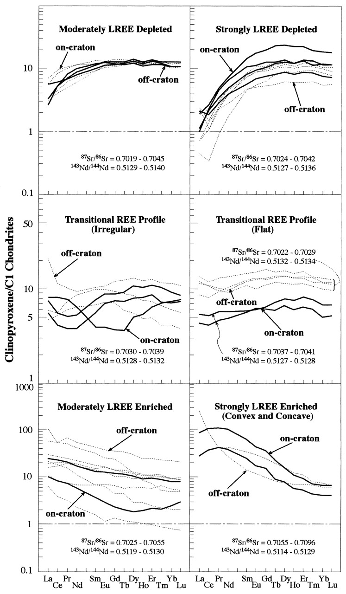
Fig. 4. Chondrite-normalized REE patterns of clinopyroxenes separated from the spinel-facies peridotites in on-craton ...
Notes:
Fig. 4. Chondrite-normalized REE patterns of clinopyroxenes separated from the spinel-facies peridotites in on-craton (continuous lines) and off-craton (dashed lines) localities, eastern China. It should be noted that there is a large variation in REE patterns from extremely depleted to strongly enriched in the LREE. Also, no systematic difference exists between on- and off-craton localities in eastern China, which contrasts with the REE characteristics of clinopyroxenes from on- and off-craton localities elsewhere in the world (e.g. McDonough & Frey, 1989). Chondrite values are from Anders & Grevesse (1989).
Unless provided in the caption above, the following copyright applies to the content of this slide: Oxford University Press

Slide 5
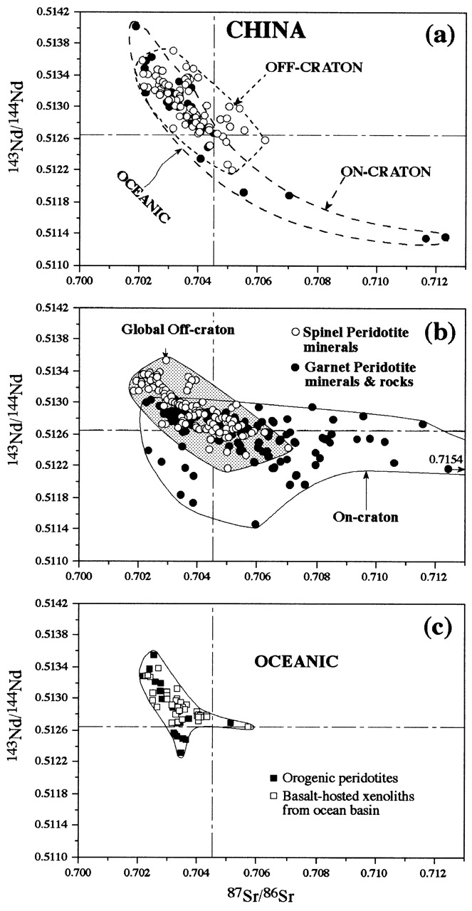
Fig. 5. Sr and Nd isotope variation in mantle peridotites and their constituent minerals. (a) The peridotite and ...
Notes:
Fig. 5. Sr and Nd isotope variation in mantle peridotites and their constituent minerals. (a) The peridotite and pyroxenite data reported in Table 4 primarily plot in the top left-hand quadrant (depleted source regions) with two pyroxenites from Fansi and Qixia plotting in the lower right-hand quadrant in a similar location to the pyroxenite and megacryst data of Tatsumoto et al. (1992) and W. M. Fan (unpublished data, 1999). These data are not necessarily evidence for enriched mantle because the petrogenesis of pyroxenites and megacrysts may involve crustal rocks and/or lower-crustal processes. Other data sources include Song & Frey (1989), Deng & MacDougall (1992), Qi et al. (1995) and X. Xu et al. (1998). (b) Peridotite xenoliths from other on- and off-craton locations around the world (Menzies & Murthy, 1980; Kramers et al., 1981, 1983; Richardson et al., 1985, 1993; Erlank et al., 1987; Walker et al., 1989; Hawkesworth et al., 1990; Pearson et al., 1995a). It should be noted that even more extreme on-craton mantle heterogeneity (i.e. high Sr and low Nd isotope ratios) was reported by Cohen et al. (1984; Tanzanian craton), Menzies & Halliday (1988; North Atlantic craton) and Carlson & Irving (1994; Wyoming craton). (c) Oceanic peridotites include orogenic and xenolithic peridotites [Menzies (1991) and references therein].
Unless provided in the caption above, the following copyright applies to the content of this slide: Oxford University Press

Slide 6
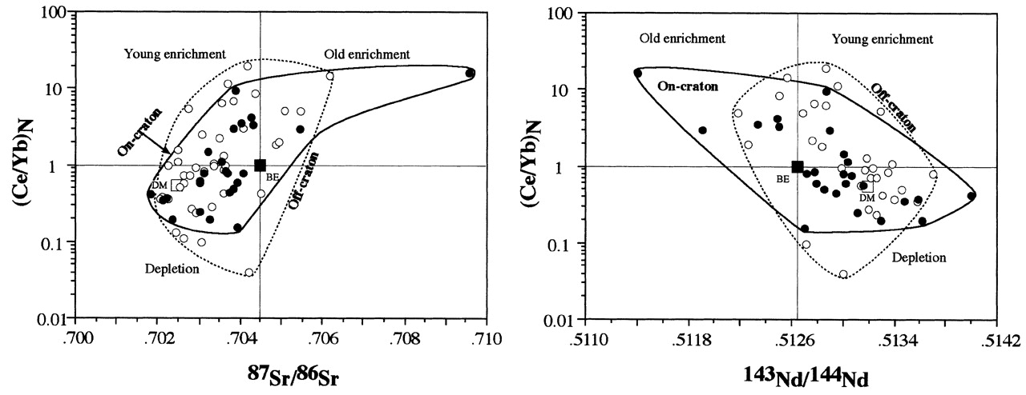
Fig. 6. (Ce/Yb)_{N} vs Sr and Nd isotope ratios in clinopyroxenes from on- and off-craton spinel-facies ...
Notes:
Fig. 6. (Ce/Yb)N vs Sr and Nd isotope ratios in clinopyroxenes from on- and off-craton spinel-facies mantle xenoliths. On- and off-craton data have the same elemental and isotopic characteristics with the exception of a few data points. Peridotite xenoliths from eastern China appear to have formed as a result of depletion processes. Data sources: Song & Frey (1989); Qi et al. (1995); Y.-G. Xu et al. (1998). BE and DM represent bulk earth and depleted MORB mantle, respectively.
Unless provided in the caption above, the following copyright applies to the content of this slide: Oxford University Press

