Slide 1
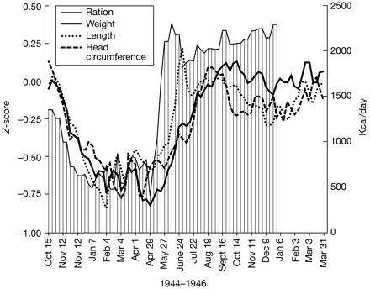
Figure 1 Weekly caloric rations and averages of z-scored linear measures of weight, length, and head circumference at ...
Notes:
Figure 1 Weekly caloric rations and averages of z-scored linear measures of weight, length, and head circumference at birth, for births in two institutions in the Western Netherlands, 1944–1946. Moving averages across individual births were used to smooth the plots. The reference population (births in 1943) has a mean Z-score of 0.
Unless provided in the caption above, the following copyright applies to the content of this slide: IJE vol.33 no.4 © International Epidemiological Association 2004; all rights reserved.

